Slide 1


COURSE SLIDES · WSQ
AWS Certified SysOps Administrator Associate Training
WSQ Course Code: TGS-2024051413
Conducted by Tertiary Infotech Academy Pte Ltd · UEN 201200696W
Version v6.0 · 23 August 2026
© 2026 Tertiary Infotech Academy Pte Ltd

Slide 2
ADMIN
COURSE ADMINISTRATION
Welcome & Course Orientation
Three days · 24 hours · 12 labs · 2 assessment hours
AWS Certified SysOps Administrator Associate Training · TGS-2024051413
© 2026 Tertiary Infotech Academy Pte Ltd
2

Slide 3
TRAQOM · SSG DIGITAL ATTENDANCE
Digital Attendance (Mandatory)
AM, PM and Assessment
Complete every required SSG digital attendance and wait for confirmation.
Trainer displays the QR
Scan only the current session's QR code using your mobile camera.
1
2
75% minimum
Attendance and assessment requirements determine course-completion eligibility.
Evidence
Notify the trainer immediately if a submission does not confirm.
3
4
AWS Certified SysOps Administrator Associate Training · TGS-2024051413
© 2026 Tertiary Infotech Academy Pte Ltd
3

Slide 4
YOUR TRAINER · GENERAL
About the Trainer
NAME
____________________________________________
?
TITLE / DESIGNATION
____________________________________________
QUALIFICATIONS
____________________________________________
Your Trainer
AWS AND CLOUD EXPERTISE
____________________________________________
General trainer profile template
INDUSTRY EXPERIENCE
____________________________________________
CONTACT
personal information is optional
AWS Certified SysOps Administrator Associate Training · TGS-2024051413
© 2026 Tertiary Infotech Academy Pte Ltd
4

Slide 5
YOUR TRAINER
About the Trainer
EXPERIENCE
More than 20 years across software engineering, AI, data analytics and cloud computing.
AA
QUALIFICATIONS
PhD (NUS), DACE, ACTA and GCWLP among professional credentials.
Dr. Alfred Ang
COURSE FOCUS
AWS observability, automation, resilience, security and evidence-led operations.
Founder & Chief Training Officer
Tertiary Infotech Academy Pte Ltd
TEACHING APPROACH
Connects architecture choices to measurable service outcomes and controlled change.
AWS Certified SysOps Administrator Associate Training · TGS-2024051413
© 2026 Tertiary Infotech Academy Pte Ltd
5

Slide 6
ICE-BREAKER
Let's Know Each Other
Introduce
Share your name, organisation and role.
1
Experience
Name one cloud service you have operated or supported.
2
Aim
Choose one outcome: stronger monitoring, recovery, automation, security or troubleshooting.
3
AWS Certified SysOps Administrator Associate Training · TGS-2024051413
© 2026 Tertiary Infotech Academy Pte Ltd
6

Slide 7
SAFE CLOUD LEARNING
Ground Rules
Participate
Ask, challenge and contribute evidence.
Respect
Critique the system or idea, not the person.
1
2
Protect access
Never share AWS passwords, access keys or account details.
Bound risk
Use learner-owned resources and the trainer-approved Region.
3
4
Be punctual
Return on time and complete attendance.
Clean up
Verify deletion of chargeable resources after every lab.
5
6
AWS Certified SysOps Administrator Associate Training · TGS-2024051413
© 2026 Tertiary Infotech Academy Pte Ltd
7

Slide 8

COURSE PORTAL
Login to LMS and Download Course Material
Log in at lms-tms.tertiaryinfotech.com with your registered email and the OTP sent to your inbox, then open this course to download the slides and Learner Guide.
AWS Certified SysOps Administrator Associate Training · TGS-2024051413
© 2026 Tertiary Infotech Academy Pte Ltd
8

Slide 9
VISUAL DOWNLOAD FLOW · LMS-TMS.TERTIARYINFOTECH.COM
Download Your Course Material
1
2
3
4
Open LMS-TMS
Sign in
Open this course
Download
Course portal
Registered email
AWS SysOps
Slides, LG, LP and Labs
PROCEDURE BOUNDARY
Detailed lab procedures are in the Learner Guide and the individual lab folders.
AWS Certified SysOps Administrator Associate Training · TGS-2024051413
© 2026 Tertiary Infotech Academy Pte Ltd
9

Slide 10
22 HOURS DELIVERY · 2 HOURS ASSESSMENT · 4 LABS/DAY
Lesson Plan — Three Days
1
Day 1
Foundations, observability, EC2 and fleet operations · Labs 01–04
2
Day 2
Reliability, continuity, deployment automation and security · Labs 05–08
3
Day 3
Networking, data operations, integrated troubleshooting and assessment · Labs 09–12
4
Assessment
WA-SAQ: 60 min · Case Study: 60 min
AWS Certified SysOps Administrator Associate Training · TGS-2024051413
© 2026 Tertiary Infotech Academy Pte Ltd
10

Slide 11
WHAT YOU WILL BE ABLE TO DO
Learning Outcomes
1
LO1
Maintain business continuity of AWS cloud operations to ensure stable service delivery.
2
LO2
Implement secure AWS cloud infrastructure setup such as data loading and performance monitoring.
3
LO3
Apply service quality standards to ensure security and compliance of AWS cloud operations.
4
LO4
Analyse and resolve processing issues to ensure continuity and disaster recovery in AWS cloud applications.
5
LO5
Troubleshoot networking performance issues at scale for optimal AWS infrastructure operation.
AWS Certified SysOps Administrator Associate Training · TGS-2024051413
© 2026 Tertiary Infotech Academy Pte Ltd
11

Slide 12
Cloud Computing Application · LOG-TEM-3007-1.1
Skills Framework Alignment — Knowledge
1
K1
Cloud computing infrastructure components and technologies
2
K2
Installation, configuration and troubleshooting of cloud computing infrastructures
3
K3
Installation, configuration and troubleshooting of software packages supporting cloud computing infrastructures
4
K4
Design, configuration, maintenance and troubleshooting of cloud computing applications
5
K5
Virtualisation technologies
AWS Certified SysOps Administrator Associate Training · TGS-2024051413
© 2026 Tertiary Infotech Academy Pte Ltd
12

Slide 13
Cloud Computing Application · LOG-TEM-3007-1.1
Skills Framework Alignment — Abilities
1
A1
Implement data loading, security, performance monitoring and tuning, capacity planning, backup and recovery
2
A2
Implement performance diagnostics and troubleshooting at scale in a live environment
3
A3
Maintain availability and performance of cloud computing operations and ensure secure services with no unplanned downtime
4
A4
Analyse processing issues and data anomalies and identify solutions
5
A5
Implement and release cloud computing operations changes
6
A6
Implement IT risk-management measures for business continuity and disaster recovery
7
A7
Implement service-quality standards
AWS Certified SysOps Administrator Associate Training · TGS-2024051413
© 2026 Tertiary Infotech Academy Pte Ltd
13

Slide 14
CURRENT CLOUDOPS BLUEPRINT · 10 TOPICS · 12 LABS
Course Outline
1
Topic 01 · Cloud Operations Foundations
Shared responsibility · regions and zones · operational excellence · SOA-C03 transition
2
Topic 02 · Monitoring, Logging and Incident Response
CloudWatch · CloudTrail · EventBridge · alarms · anomaly detection · remediation
3
Topic 03 · Compute, Virtualisation and Systems Management
EC2 lifecycle · AMIs · placement · Systems Manager · patching · Image Builder
4
Topic 04 · Reliability, Elasticity and High Availability
Elastic Load Balancing · Auto Scaling · health checks · containers · graceful degradation
5
Topic 05 · Backup, Restore and Business Continuity
RTO/RPO · AWS Backup · snapshots · replication · pilot light · warm standby
6
Topic 06 · Deployment, Provisioning and Automation
CloudFormation · StackSets · change sets · drift · Systems Manager Automation · Git and IaC
7
Topic 07 · Security, Identity and Compliance
IAM · Organizations · KMS · Config · Security Hub · GuardDuty · Inspector · Macie
8
Topic 08 · Networking, DNS and Content Delivery
VPC · routes · security groups · NACLs · endpoints · Route 53 · CloudFront
9
Topic 09 · Storage, Data and Database Operations
S3 · EBS · EFS · RDS · DynamoDB · lifecycle · performance · data protection
10
Topic 10 · Performance, Cost and Integrated Troubleshooting
Bottleneck analysis · Cost Explorer · Trusted Advisor · runbooks · game days · capstone
AWS Certified SysOps Administrator Associate Training · TGS-2024051413
© 2026 Tertiary Infotech Academy Pte Ltd
14

Slide 15
HANDS-ON CLOUD OPERATIONS
AWS Lab Environment
Learner account
Use only the account and Region authorised by the trainer.
AWS-native assets
Each folder includes editable YAML, JSON, CLI, shell or Python files.
1
2
Visual reference
Every lab includes an EXPECTED-ARCHITECTURE.jpg image.
Evidence
Retain outputs, decisions, verification and cleanup records.
3
4
Cost control
Use small resources, bounded tests and explicit cleanup.
Schedule
Exactly four labs are completed on each training day.
5
6
AWS Certified SysOps Administrator Associate Training · TGS-2024051413
© 2026 Tertiary Infotech Academy Pte Ltd
15

Slide 16
WA-SAQ + CASE STUDY
Assessment Briefing
Individual work
No discussion, recording or sharing of assessment scripts.
Open book
Use slides, Learner Guide and approved materials only.
1
2
Written Assessment
Five open-ended questions · K1–K5 · 60 minutes.
Case Study
Five connected tasks · A1–A7 · 60 minutes.
3
4
Submission
Complete and upload the candidate papers through LMS-TMS.
Outcome
Competent or Not Yet Competent; reassessment and appeal rights apply.
5
6
AWS Certified SysOps Administrator Associate Training · TGS-2024051413
© 2026 Tertiary Infotech Academy Pte Ltd
16

Slide 17
ON ASSESSMENT DAY
Assessment Flow
1
2
3
4
5
TRAQOM
Attendance
WA-SAQ
Case Study
Submit
Course feedback
Assessment QR
5 questions · 60 min
5 tasks · 60 min
LMS-TMS and sign-off
CONFIDENTIALITY
Candidate papers are learner-facing; answer keys remain trainer-only.
AWS Certified SysOps Administrator Associate Training · TGS-2024051413
© 2026 Tertiary Infotech Academy Pte Ltd
17

Slide 18
AWS CERTIFIED CLOUDOPS ENGINEER — ASSOCIATE
Current SOA-C03 Exam Domain Weighting
WHAT THE DATA SHOWS
Three domains carry equal 22% weight; the course integrates all five through observability, controlled change, recovery and troubleshooting.
AWS Certified SysOps Administrator Associate Training · TGS-2024051413
© 2026 Tertiary Infotech Academy Pte Ltd
18

Slide 19
CURRENT AWS AUTHORITY · HTTPS://EXAMS.TERTIARYINFOTECH.COM
Certification Readiness
Current exam
AWS Certified CloudOps Engineer — Associate (SOA-C03).
Exam format
65 questions · 130 minutes · scaled passing score 720.
1
2
Role transition
The WSQ title remains SysOps; exam-readiness content follows the current CloudOps guide.
Practice Exam
Open exams.tertiaryinfotech.com and select the matching AWS CloudOps / SysOps practice exam; never use exam dumps.
3
4
Readiness loop
Explain the service choice, apply the labs, interpret evidence and justify recovery.
Scope
Current guide version 1.1, published 1 June 2026.
5
6
AWS Certified SysOps Administrator Associate Training · TGS-2024051413
© 2026 Tertiary Infotech Academy Pte Ltd
19

Slide 20
VERSION v6.0 · 23 August 2026
Source and Version Authority
1
WSQ authority
Live Tertiary course page and Assessment Plan v5.0 — Course code, 24-hour duration, five LO, K1–K5, A1–A7 and WA+CS design.
2
Legacy content
Reference v3/v4 PowerPoints and Drive Activities dataset — Preserved useful EC2, SSM, CloudFormation, storage, monitoring, security and networking coverage; procedures moved out of the deck.
3
Certification authority
AWS Certified CloudOps Engineer - Associate SOA-C03 Exam Guide v1.1 — Current five-domain blueprint and scope, including containers, multi-account operations, automation and IaC.
4
Architecture guidance
AWS Well-Architected Framework and official AWS service documentation — Operational excellence, security, reliability, performance, cost and sustainability practices.
5
Assessment authority
Drive-held WA/CS v2 papers and Assessment Plan v5.0 — Instrument type, five-item counts, 60-minute timings and controlled K/A coverage.
AWS Certified SysOps Administrator Associate Training · TGS-2024051413
© 2026 Tertiary Infotech Academy Pte Ltd
20

Slide 21
SOURCE INTEGRATION · TRACEABLE LEGACY SLIDE NUMBERS
How the Original 927-Slide PPT Is Blended
Coverage authority
The original v4 deck supplies its broad EC2, SSM, scaling, CloudFormation, storage, database, monitoring, account, security, DNS and VPC coverage.
Modern visual treatment
Retained technical slides are rebuilt as layered cards, process visuals and diagram-plus-analysis layouts—not pasted as legacy bullet walls.
1
2
Current AWS authority
SOA-C03 and current AWS documentation govern terminology, operating practices and features; historical limits are explicitly treated as items to verify.
Procedure boundary
Console click paths, activities, quizzes and assessment pages are excluded. Detailed steps remain in the Learner Guide and the 12 lab folders.
3
4
AWS Certified SysOps Administrator Associate Training · TGS-2024051413
© 2026 Tertiary Infotech Academy Pte Ltd
21

Slide 22
01
TOPIC 01 · LO1 · LO2 · K1 · K5 · A1
Cloud Operations Foundations
Shared responsibility · regions and zones · operational excellence · SOA-C03 transition
AWS Certified SysOps Administrator Associate Training · TGS-2024051413
© 2026 Tertiary Infotech Academy Pte Ltd
22

Slide 23
BLUEPRINT · Foundation across all five SOA-C03 domains
Key Ideas — Cloud Operations Foundations
Operate for outcomes
Availability, security, performance and cost are managed as measurable service outcomes.
Know the responsibility boundary
AWS secures the cloud; customers secure configurations, identities, data and workloads in the cloud.
1
2
Design for failure domains
Regions, Availability Zones and edge locations create distinct resilience and latency choices.
Use evidence before change
Metrics, logs, configuration history and events establish the operational baseline.
3
4
AWS Certified SysOps Administrator Associate Training · TGS-2024051413
© 2026 Tertiary Infotech Academy Pte Ltd
23

Slide 24

IMAGEGEN VISUAL · TOPIC 01
Operate Across Accounts and Regions
READ THE SYSTEM
Read the scene as a governed operating model: isolated workload accounts, shared observability, policy, automation, regional resilience and human authority.
AWS Certified SysOps Administrator Associate Training · TGS-2024051413
© 2026 Tertiary Infotech Academy Pte Ltd
24

Slide 25
TOPIC 01 · K1 · K5 · A1
SysOps to CloudOps — What Changed
Area
Legacy SOA-C02 emphasis
Current SOA-C03 emphasis
Role name
SysOps Administrator
CloudOps Engineer
Workloads
EC2-heavy operations
Compute, containers, serverless and hybrid operations
Scope
Six broad domains
Five task-oriented domains
Automation
AWS-native operations
IaC, Git and third-party automation are explicit
WHEN IT MATTERS The WSQ course title and code remain unchanged; exam-readiness content follows the current SOA-C03 guide.
AWS Certified SysOps Administrator Associate Training · TGS-2024051413
© 2026 Tertiary Infotech Academy Pte Ltd
25

Slide 26
TOPIC 01 · K1 · K5 · A1
The Cloud Operations Control Loop
1
2
3
4
5
6
Observe
Assess
Decide
Change
Verify
Learn
Signals and context
Impact and risk
Runbook and authority
Small and reversible
Outcome and evidence
Prevent recurrence
PROFESSIONAL STANDARD
Every operational change must have a reason, owner, verification signal and rollback path.
AWS Certified SysOps Administrator Associate Training · TGS-2024051413
© 2026 Tertiary Infotech Academy Pte Ltd
26

Slide 27
TOPIC 01 · K1 · K5 · A1
AWS Global Infrastructure
Region
Geographic boundary for sovereignty, latency and disaster-recovery decisions.
Availability Zone
Independent failure domain connected with low-latency networking.
1
2
Edge
CloudFront and Route 53 move delivery and routing closer to users.
Local and hybrid
Outposts, Local Zones and connected environments extend the operating boundary.
3
4
AWS Certified SysOps Administrator Associate Training · TGS-2024051413
© 2026 Tertiary Infotech Academy Pte Ltd
27

Slide 28
TOPIC 01 · K1 · K5 · A1
Availability Improves with Independent Failure Domains
WHAT THE DATA SHOWS
More failure domains increase potential resilience only when dependencies, health checks and failover are also designed correctly.
AWS Certified SysOps Administrator Associate Training · TGS-2024051413
© 2026 Tertiary Infotech Academy Pte Ltd
28

Slide 29
TOPIC 01 · K1 · K5 · A1
Shared Responsibility by Layer
Layer
AWS responsibility
Customer responsibility
Facilities and hardware
Physical security, hosts and core network
Choose Regions and resilience strategy
Managed service
Service infrastructure and platform
Identity, configuration, data and use
EC2 workload
Underlying facilities and hypervisor
Guest OS, patches, application and traffic controls
Data
Durable service mechanisms
Classification, encryption, retention and access
AWS Certified SysOps Administrator Associate Training · TGS-2024051413
© 2026 Tertiary Infotech Academy Pte Ltd
29

Slide 30
TOPIC 01 · K1 · K5 · A1
Well-Architected Operational Questions
Prepare
Operate
Evolve
• What must be observable?
• What runbooks and permissions exist?
• What is normal?
• Who responds to deviation?
• What did evidence teach?
• Which control prevents recurrence?
AWS Certified SysOps Administrator Associate Training · TGS-2024051413
© 2026 Tertiary Infotech Academy Pte Ltd
30

Slide 31
Operations Mindset
The console is an interface—not the source of truth.
Treat configuration, telemetry, change history and verification evidence as the durable operational record.
AWS Certified SysOps Administrator Associate Training · TGS-2024051413
© 2026 Tertiary Infotech Academy Pte Ltd
31

Slide 32
TOPIC 01 · NATIVE EDITABLE TECHNICAL CHART
Operational Coverage by Control Layer
WHAT THE DATA SHOWS
Controls are only effective when ownership and evidence span every layer; the lowest-covered layer defines residual operational risk.
AWS Certified SysOps Administrator Associate Training · TGS-2024051413
© 2026 Tertiary Infotech Academy Pte Ltd
32

Slide 33
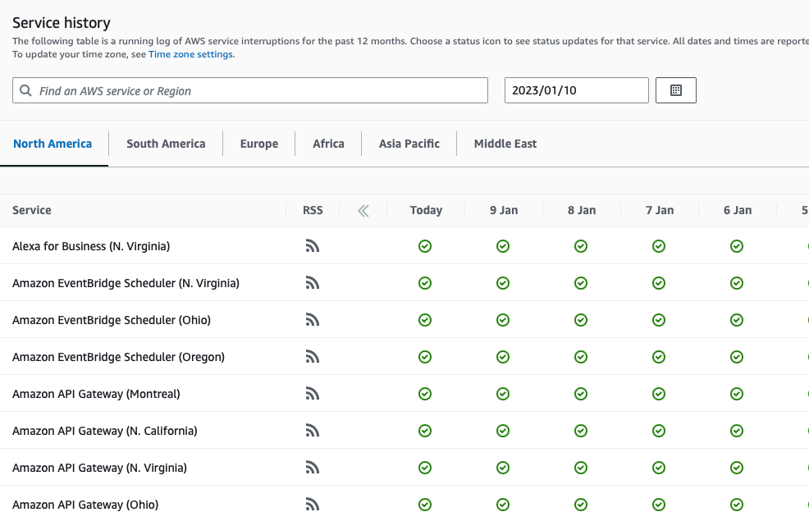
ORIGINAL PPT v4 · SOURCE SLIDE 623 · MODERNISED TECHNICAL DEEP DIVE
AWS Health Dashboard - Service History
1
Shows all regions, all services
Shows all regions, all services health
Operating model: keep the Organizations management account low-touch; delegate security, backup, Config and…
2
Failure mode
Failure mode: an SCP sets a maximum permission boundary but grants nothing; troubleshooting must still evaluate…
3
Evidence: organization trails…
Evidence: organization trails, Config aggregation, Health events, tag-policy compliance and cost-allocation…
CURRENT OPERATIONS LENS
Turn the architecture choice into an operating model: ownership boundary, account scope, guardrail, evidence and escalation. Validate service limits and regional availability against current AWS documentation.
AWS Certified SysOps Administrator Associate Training · TGS-2024051413
© 2026 Tertiary Infotech Academy Pte Ltd
33

Slide 34
ORIGINAL PPT v4 · SOURCE SLIDE 624 · MODERNISED TECHNICAL DEEP DIVE
AWS Health Dashboard - Your Account
1
Previously called AWS Personal…
2
AWS Account Health Dashboard…
3
While the Service Health Dashboard
4
services, Account Health…
Previously called AWS Personal Health Dashboard (PHD)
the performance and availability of the AWS services underlying your AWS resources.
AWS Account Health Dashboard provides alerts and remediation guidance when AWS is experiencing events that may impact you.
The dashboard displays relevant and timely information to help you
While the Service Health Dashboard displays the general status of AWS
manage events in progress and provides proactive notification to help you plan for scheduled activities.
services, Account Health Dashboard gives you a personalized view into.
Can aggregate data from an entire AWS Organization
CURRENT OPERATIONS LENS
Turn the architecture choice into an operating model: ownership boundary, account scope, guardrail, evidence and escalation. Validate service limits and regional availability against current AWS documentation.
AWS Certified SysOps Administrator Associate Training · TGS-2024051413
© 2026 Tertiary Infotech Academy Pte Ltd
34

Slide 35
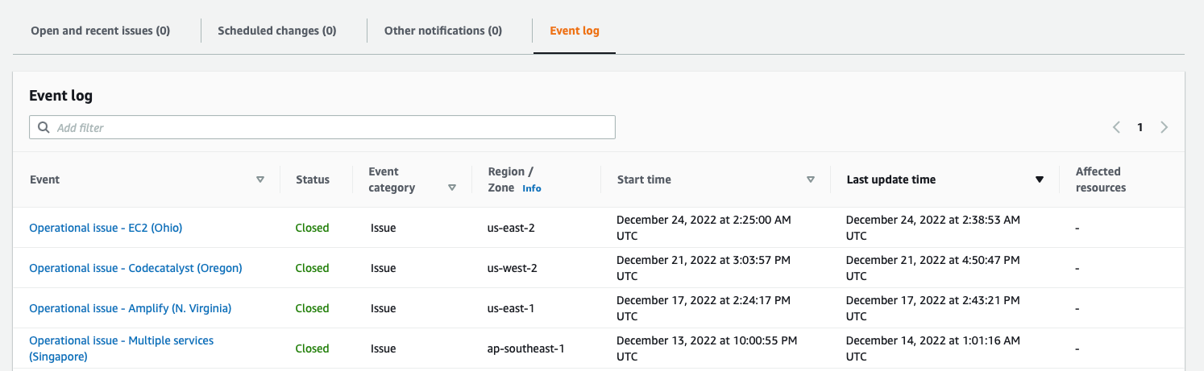
ORIGINAL PPT v4 · SOURCE SLIDE 625 · MODERNISED TECHNICAL DEEP DIVE
AWS Health Dashboard - Your Account
1
Global service
Global service
Operating model: keep the Organizations management account low-touch; delegate security, backup, Config and…
2
Failure mode
Failure mode: an SCP sets a maximum permission boundary but grants nothing; troubleshooting must still evaluate…
3
Evidence: organization trails…
Evidence: organization trails, Config aggregation, Health events, tag-policy compliance and cost-allocation…
CURRENT OPERATIONS LENS
Turn the architecture choice into an operating model: ownership boundary, account scope, guardrail, evidence and escalation. Validate service limits and regional availability against current AWS documentation.
AWS Certified SysOps Administrator Associate Training · TGS-2024051413
© 2026 Tertiary Infotech Academy Pte Ltd
35

Slide 36
ORIGINAL PPT v4 · SOURCE SLIDE 627 · MODERNISED TECHNICAL DEEP DIVE
Health Event Notifications
1
Use EventBridge to react to
2
Example: receive email…
3
This is possible for Account
4
Use cases
Use EventBridge to react to changes for AWS Health events in your AWS account
AWS Health Dashboard
Example: receive email notifications when EC2 instances in your AWS account are scheduled for updates
EventBridge
This is possible for Account events (resources that are affected in your account) and Public Events (Regional availability of a service)
Lambda SNS
Use cases: send notifications, capture event information, take corrective action...
Kinesis Data Streams
CURRENT OPERATIONS LENS
Turn the architecture choice into an operating model: ownership boundary, account scope, guardrail, evidence and escalation. Validate service limits and regional availability against current AWS documentation.
AWS Certified SysOps Administrator Associate Training · TGS-2024051413
© 2026 Tertiary Infotech Academy Pte Ltd
36

Slide 37
ORIGINAL PPT v4 · SOURCE SLIDE 628 · MODERNISED TECHNICAL DEEP DIVE
AWS Health Dashboard - Examples
1
AWS Health Dashboard
2
EventBridge
3
Exposed Access Keys
4
Delete Access Keys
AWS Health Dashboard
Remediating Exposed IAM Access Keys
Operating model: keep the Organizations management account low-touch; delegate security, backup, Config and observability administration to…
EventBridge
Instance Scheduled for Retirement
Failure mode: an SCP sets a maximum permission boundary but grants nothing; troubleshooting must still evaluate identity, resource, boundary and…
Exposed Access Keys
Restart Instance
Evidence: organization trails, Config aggregation, Health events, tag-policy compliance and cost-allocation coverage prove whether governance is…
Delete Access Keys
Restarting Instances That are Scheduled for Retirement
CURRENT OPERATIONS LENS
Turn the architecture choice into an operating model: ownership boundary, account scope, guardrail, evidence and escalation. Validate service limits and regional availability against current AWS documentation.
AWS Certified SysOps Administrator Associate Training · TGS-2024051413
© 2026 Tertiary Infotech Academy Pte Ltd
37

Slide 38
ORIGINAL PPT v4 · SOURCE SLIDE 629 · MODERNISED TECHNICAL DEEP DIVE
AWS Organizations
1
Global service
2
Allows to manage multiple AWS
3
The main account is the
4
Other accounts are member accounts
Global service
Member accounts can only be part of one organization
API is available to automate AWS account creation
Allows to manage multiple AWS accounts
Consolidated Billing across all accounts - single payment method
The main account is the management account
Pricing benefits from aggregated usage (volume discount for EC2, S3…)
Other accounts are member accounts
Shared reserved instances and Savings Plans discounts across accounts
CURRENT OPERATIONS LENS
Turn the architecture choice into an operating model: ownership boundary, account scope, guardrail, evidence and escalation. Validate service limits and regional availability against current AWS documentation.
AWS Certified SysOps Administrator Associate Training · TGS-2024051413
© 2026 Tertiary Infotech Academy Pte Ltd
38

Slide 39
ORIGINAL PPT v4 · SOURCE SLIDE 630 · MODERNISED TECHNICAL DEEP DIVE
AWS Organizations
1
Root Organizational Unit (OU)
2
Management Account
3
Member Accounts
4
OU (Finance)
Root Organizational Unit (OU)
Operating model: keep the Organizations management account low-touch; delegate security, backup, Config and observability administration to…
Management Account
Failure mode: an SCP sets a maximum permission boundary but grants nothing; troubleshooting must still evaluate identity, resource, boundary and…
Member Accounts
Evidence: organization trails, Config aggregation, Health events, tag-policy compliance and cost-allocation coverage prove whether governance is…
OU (Finance)
Decision point: define which controls are preventive, detective or responsive and which team owns exceptions, expiry and escalation.
CURRENT OPERATIONS LENS
Turn the architecture choice into an operating model: ownership boundary, account scope, guardrail, evidence and escalation. Validate service limits and regional availability against current AWS documentation.
AWS Certified SysOps Administrator Associate Training · TGS-2024051413
© 2026 Tertiary Infotech Academy Pte Ltd
39

Slide 40
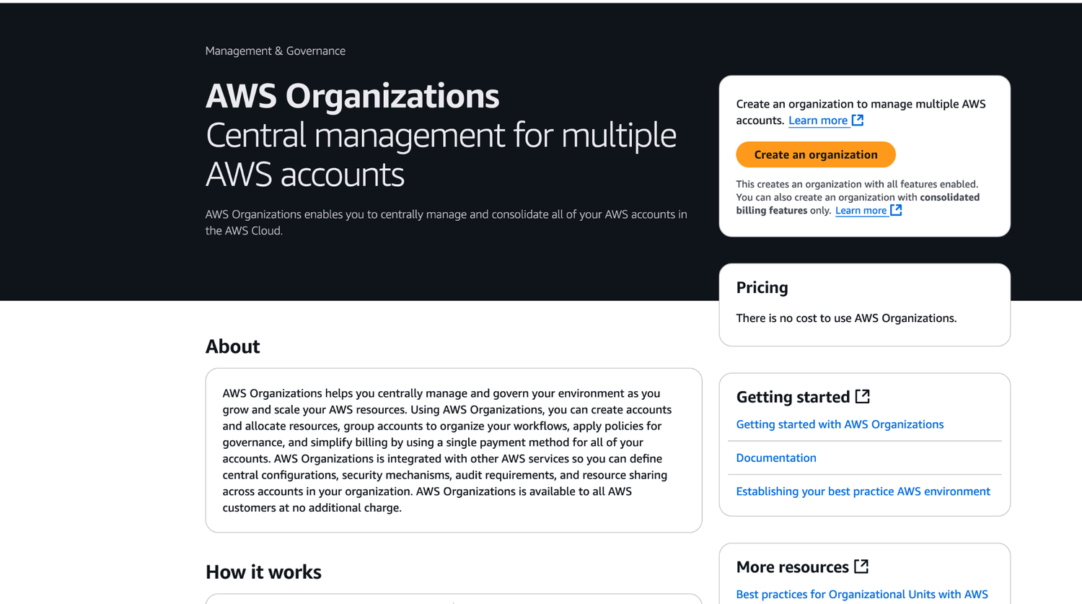
ORIGINAL PPT v4 · SOURCE SLIDE 631 · MODERNISED TECHNICAL DEEP DIVE
AWS Organizations
1
Operating model
Operating model: keep the Organizations management account low-touch; delegate security, backup, Config and…
2
Failure mode
Failure mode: an SCP sets a maximum permission boundary but grants nothing; troubleshooting must still evaluate…
3
Evidence: organization trails…
Evidence: organization trails, Config aggregation, Health events, tag-policy compliance and cost-allocation…
CURRENT OPERATIONS LENS
Turn the architecture choice into an operating model: ownership boundary, account scope, guardrail, evidence and escalation. Validate service limits and regional availability against current AWS documentation.
AWS Certified SysOps Administrator Associate Training · TGS-2024051413
© 2026 Tertiary Infotech Academy Pte Ltd
40

Slide 41
ORIGINAL PPT v4 · SOURCE SLIDE 632 · MODERNISED TECHNICAL DEEP DIVE
Organizational Units (OU) - Examples
1
Business Unit Environmental…
2
Management Account
3
Finance OU
4
Sales Account 1
Business Unit Environmental Lifecycle
Sales Account 2
Finance Account 2
Management Account
Retail Account 1
Prod Account 1
Operating model: keep the Organizations management account low-touch; delegate security, backup, Config and observability administration to…
Finance OU
Retail Account 2
Prod Account 2
Failure mode: an SCP sets a maximum permission boundary but grants nothing; troubleshooting must still evaluate identity, resource, boundary and…
Sales Account 1
Finance Account 1
Dev Account 1
Evidence: organization trails, Config aggregation, Health events, tag-policy compliance and cost-allocation coverage prove whether governance is…
CURRENT OPERATIONS LENS
Turn the architecture choice into an operating model: ownership boundary, account scope, guardrail, evidence and escalation. Validate service limits and regional availability against current AWS documentation.
AWS Certified SysOps Administrator Associate Training · TGS-2024051413
© 2026 Tertiary Infotech Academy Pte Ltd
41

Slide 42
ORIGINAL PPT v4 · SOURCE SLIDE 633 · MODERNISED TECHNICAL DEEP DIVE
AWS Organizations
1
Advantages
2
Multi Account vs One Account
3
Use tagging standards for billing
4
Enable CloudTrail on all accounts,
Advantages
Send CloudWatch Logs to central logging account
They do not apply to the management account (full admin power)
Multi Account vs One Account Multi VPC
Establish Cross Account Roles for Admin purposes
Must have an explicit allow from the root through each OU in the direct path to the target account (does not allow anything by default – like IAM)
Use tagging standards for billing purposes
Security: Service Control Policies (SCP)
Enable CloudTrail on all accounts, send logs to central S3 account
IAM policies applied to OU or Accounts to restrict Users and Roles
CURRENT OPERATIONS LENS
Turn the architecture choice into an operating model: ownership boundary, account scope, guardrail, evidence and escalation. Validate service limits and regional availability against current AWS documentation.
AWS Certified SysOps Administrator Associate Training · TGS-2024051413
© 2026 Tertiary Infotech Academy Pte Ltd
42

Slide 43
ORIGINAL PPT v4 · SOURCE SLIDE 634 · MODERNISED TECHNICAL DEEP DIVE
SCP Hierarchy
1
Management Account
2
OU (Sandbox)
3
FullAWSAccess
4
Can do anything (no SCP
Management Account
Can do anything
Can access EC2
Operating model: keep the Organizations management account low-touch; delegate security, backup, Config and observability administration to…
OU (Sandbox)
EXCEPT S3 (explicit Deny from Sandbox OU)
Prod OU & Account E & F
FullAWSAccess
EXCEPT EC2 (explicit Deny)
OU (Workloads)
Failure mode: an SCP sets a maximum permission boundary but grants nothing; troubleshooting must still evaluate identity, resource, boundary and…
Can do anything (no SCP apply)
Account B & C
Deny Athena FullAWSAccess
CURRENT OPERATIONS LENS
Turn the architecture choice into an operating model: ownership boundary, account scope, guardrail, evidence and escalation. Validate service limits and regional availability against current AWS documentation.
AWS Certified SysOps Administrator Associate Training · TGS-2024051413
© 2026 Tertiary Infotech Academy Pte Ltd
43

Slide 44
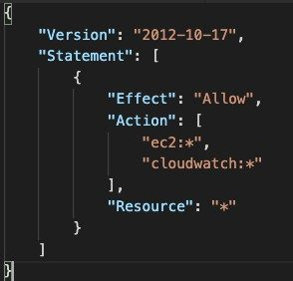
ORIGINAL PPT v4 · SOURCE SLIDE 636 · MODERNISED TECHNICAL DEEP DIVE
SCP Examples
1
Blocklist and Allowlist strategies
Blocklist and Allowlist strategies
Operating model: keep the Organizations management account low-touch; delegate security, backup, Config and…
2
Failure mode
Failure mode: an SCP sets a maximum permission boundary but grants nothing; troubleshooting must still evaluate…
3
Evidence: organization trails…
Evidence: organization trails, Config aggregation, Health events, tag-policy compliance and cost-allocation…
CURRENT OPERATIONS LENS
Turn the architecture choice into an operating model: ownership boundary, account scope, guardrail, evidence and escalation. Validate service limits and regional availability against current AWS documentation.
AWS Certified SysOps Administrator Associate Training · TGS-2024051413
© 2026 Tertiary Infotech Academy Pte Ltd
44

Slide 45
ORIGINAL PPT v4 · SOURCE SLIDE 637 · MODERNISED TECHNICAL DEEP DIVE
AWS Organizations - Reserved Instances
1
For billing purposes, the…
2
This means that all accounts
3
The payer account (management…
4
Reserved Instance (RI) discount…
For billing purposes, the consolidated billing feature of AWS Organizations treats all the accounts in the organization as one account.
This means that RIs and Savings Plans discounts aren't shared between any accounts that have sharing turned off.
This means that all accounts in the organization can receive the hourly cost benefit of Reserved Instances that are purchased by any other account.
To share an RI or Savings Plans discount with an account, both accounts must have sharing turned on.
The payer account (management account) of an organization can turn off
Reserved Instance (RI) discount and Savings Plans discount sharing for any accounts in that organization, including the payer account
CURRENT OPERATIONS LENS
Turn the architecture choice into an operating model: ownership boundary, account scope, guardrail, evidence and escalation. Validate service limits and regional availability against current AWS documentation.
AWS Certified SysOps Administrator Associate Training · TGS-2024051413
© 2026 Tertiary Infotech Academy Pte Ltd
45

Slide 46
ORIGINAL PPT v4 · SOURCE SLIDE 638 · MODERNISED TECHNICAL DEEP DIVE
AWS Organizations - IAM Policies
1
Use AWS
2
AWS Organization (o-exampleorgid)
3
Management Account (111111111111)
4
Member Account (123456789012)
Use AWS:PrincipalOrgID condition key in your resource-based policies to restrict access to IAM principals from accounts in an AWS Organization
IAM User (stephane)
Use the aws:PrincipalOrgID condition
AWS Organization (o-exampleorgid)
Member Account (222222222222)
Operating model: keep the Organizations management account low-touch; delegate security, backup, Config and observability administration to…
Management Account (111111111111)
IAM User (Olivia)
Failure mode: an SCP sets a maximum permission boundary but grants nothing; troubleshooting must still evaluate identity, resource, boundary and…
Member Account (123456789012)
(financial-data-2021)
Evidence: organization trails, Config aggregation, Health events, tag-policy compliance and cost-allocation coverage prove whether governance is…
CURRENT OPERATIONS LENS
Turn the architecture choice into an operating model: ownership boundary, account scope, guardrail, evidence and escalation. Validate service limits and regional availability against current AWS documentation.
AWS Certified SysOps Administrator Associate Training · TGS-2024051413
© 2026 Tertiary Infotech Academy Pte Ltd
46

Slide 47
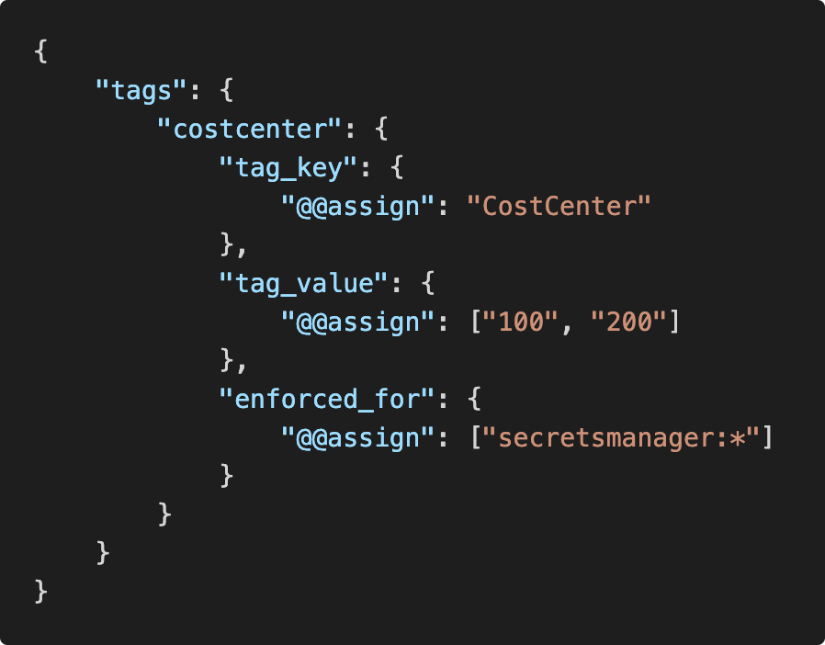
ORIGINAL PPT v4 · SOURCE SLIDE 639 · MODERNISED TECHNICAL DEEP DIVE
AWS Organizations - Tag Policies
1
Helps you standardize tags across
Helps you standardize tags across resources in an AWS Organization
2
Operating model
Operating model: keep the Organizations management account low-touch; delegate security, backup, Config and…
3
Failure mode
Failure mode: an SCP sets a maximum permission boundary but grants nothing; troubleshooting must still evaluate…
CURRENT OPERATIONS LENS
Turn the architecture choice into an operating model: ownership boundary, account scope, guardrail, evidence and escalation. Validate service limits and regional availability against current AWS documentation.
AWS Certified SysOps Administrator Associate Training · TGS-2024051413
© 2026 Tertiary Infotech Academy Pte Ltd
47

Slide 48
ORIGINAL PPT v4 · SOURCE SLIDE 640 · MODERNISED TECHNICAL DEEP DIVE
AWS Control Tower
1
Easy way to set up
2
Automate the set up of
3
Automate ongoing policy…
4
Detect policy violations and…
Easy way to set up and govern a secure and compliant mutli-account AWS environment based on best practices
Monitor compliance through an interactive dashboard
Automate the set up of your environment in a few clicks
AWS Control Tower runs on top of AWS Organizations
Automate ongoing policy management using guardrails
It automatically sets up AWS Organizations to organize accounts and implement SCPs (Service Control Policies)
Detect policy violations and remediate them
Operating model: keep the Organizations management account low-touch; delegate security, backup, Config and observability administration to…
CURRENT OPERATIONS LENS
Turn the architecture choice into an operating model: ownership boundary, account scope, guardrail, evidence and escalation. Validate service limits and regional availability against current AWS documentation.
AWS Certified SysOps Administrator Associate Training · TGS-2024051413
© 2026 Tertiary Infotech Academy Pte Ltd
48

Slide 49
ORIGINAL PPT v4 · SOURCE SLIDE 641 · MODERNISED TECHNICAL DEEP DIVE
AWS Service Catalog
1
Users that are new to
2
Some users just want a
3
authorized products pre-defined…
4
Includes: virtual machines…
Users that are new to AWS have too many options, and may create stacks that are not compliant / in line with the rest of the organization
Enter AWS Service Catalog!
Some users just want a quick self-service portal to launch a set of
authorized products pre-defined by admins
Operating model: keep the Organizations management account low-touch; delegate security, backup, Config and observability administration to…
Includes: virtual machines, databases, storage options, etc…
Failure mode: an SCP sets a maximum permission boundary but grants nothing; troubleshooting must still evaluate identity, resource, boundary and…
CURRENT OPERATIONS LENS
Turn the architecture choice into an operating model: ownership boundary, account scope, guardrail, evidence and escalation. Validate service limits and regional availability against current AWS documentation.
AWS Certified SysOps Administrator Associate Training · TGS-2024051413
© 2026 Tertiary Infotech Academy Pte Ltd
49

Slide 50
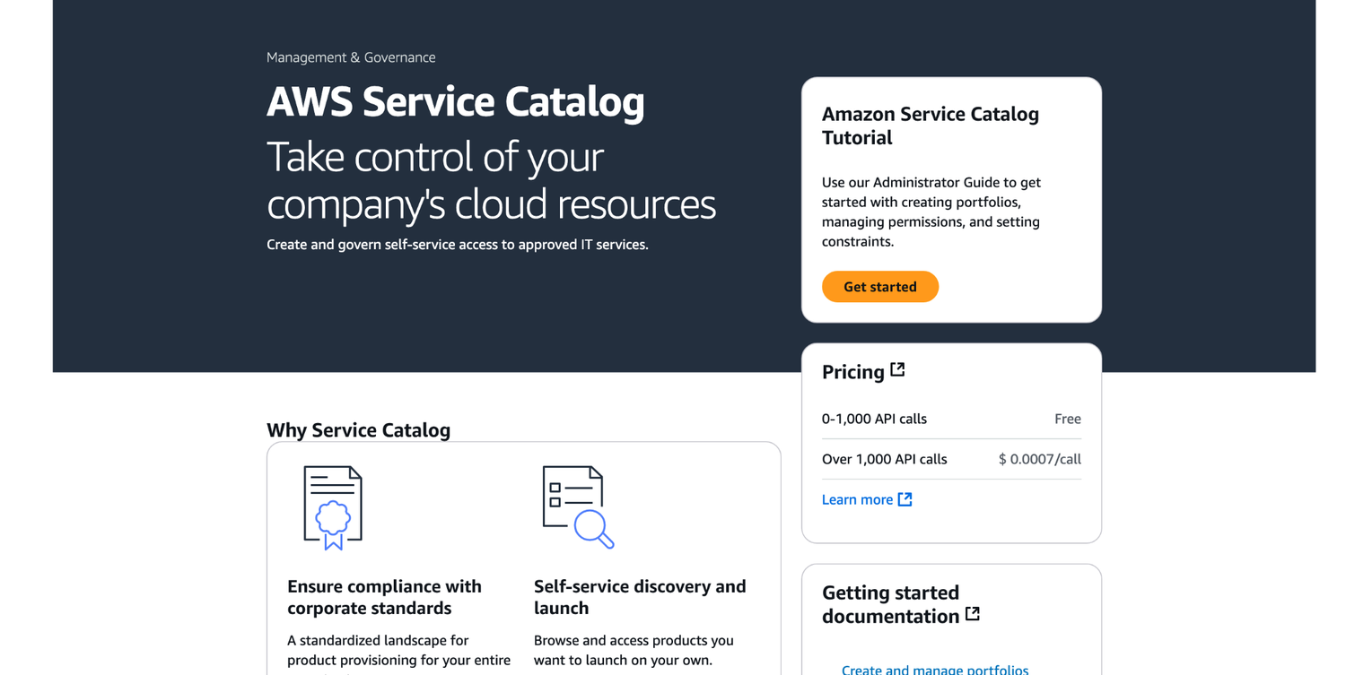
ORIGINAL PPT v4 · SOURCE SLIDE 642 · MODERNISED TECHNICAL DEEP DIVE
AWS Service Catalog
1
Operating model
Operating model: keep the Organizations management account low-touch; delegate security, backup, Config and…
2
Failure mode
Failure mode: an SCP sets a maximum permission boundary but grants nothing; troubleshooting must still evaluate…
3
Evidence: organization trails…
Evidence: organization trails, Config aggregation, Health events, tag-policy compliance and cost-allocation…
CURRENT OPERATIONS LENS
Turn the architecture choice into an operating model: ownership boundary, account scope, guardrail, evidence and escalation. Validate service limits and regional availability against current AWS documentation.
AWS Certified SysOps Administrator Associate Training · TGS-2024051413
© 2026 Tertiary Infotech Academy Pte Ltd
50

Slide 51
ORIGINAL PPT v4 · SOURCE SLIDE 643 · MODERNISED TECHNICAL DEEP DIVE
Service Catalog diagram
1
Product Portfolio
2
CloudFormation Templates
3
Collection of Products
4
ADMIN TASKS
Product Portfolio
IAM Permissions to Access Portfolios
Provisioned Products
Operating model: keep the Organizations management account low-touch; delegate security, backup, Config and observability administration to…
CloudFormation Templates
Product List
Ready to use Properly Configured Properly Tagged
Collection of Products
USER TASKS
Failure mode: an SCP sets a maximum permission boundary but grants nothing; troubleshooting must still evaluate identity, resource, boundary and…
ADMIN TASKS
Authorized by IAM
Evidence: organization trails, Config aggregation, Health events, tag-policy compliance and cost-allocation coverage prove whether governance is…
CURRENT OPERATIONS LENS
Turn the architecture choice into an operating model: ownership boundary, account scope, guardrail, evidence and escalation. Validate service limits and regional availability against current AWS documentation.
AWS Certified SysOps Administrator Associate Training · TGS-2024051413
© 2026 Tertiary Infotech Academy Pte Ltd
51

Slide 52
ORIGINAL PPT v4 · SOURCE SLIDE 644 · MODERNISED TECHNICAL DEEP DIVE
AWS Service Catalog - Sharing Catalogs
1
Share portfolios with individual…
2
Sharing options
3
Share a reference of the
4
Deploy a copy of the
Share portfolios with individual AWS accounts or AWS Organizations
Ability to add products from the
share (in-sync)
Sharing options
imported portfolio to the local portfolio
(re-deploy updates)
Share a reference of the portfolio, then import the shared portfolio in the recipient account (stays in-sync with the original portfolio)
Portfolio A (port-xxxxxxxxxx)
import portfolio & launch products
Deploy a copy of the portfolio into the recipient account (must re-deploy any updates)
Product 1 Product 2 Product 3
Portfolio A - Copy (port-yyyyyyyyyy)
CURRENT OPERATIONS LENS
Turn the architecture choice into an operating model: ownership boundary, account scope, guardrail, evidence and escalation. Validate service limits and regional availability against current AWS documentation.
AWS Certified SysOps Administrator Associate Training · TGS-2024051413
© 2026 Tertiary Infotech Academy Pte Ltd
52

Slide 53
ORIGINAL PPT v4 · SOURCE SLIDE 645 · MODERNISED TECHNICAL DEEP DIVE
AWS Service Catalog - TagOptions Library
1
Easily manage tags on provisioned
2
Key-value pair managed in AWS
3
Used to create an AWS
4
Can be associated with Portfolios
Easily manage tags on provisioned products
Use cases: proper resources tagging, defined allowed tags, …
Key-value pair managed in AWS Service Catalog
Can be shared with other AWS accounts and AWS Organizations
Used to create an AWS Tag
Portfolio A (port-xxxxxxxxxx)
Operating model: keep the Organizations management account low-touch; delegate security, backup, Config and observability administration to…
Can be associated with Portfolios and Products
Product 1 Product 2 Product 3
CURRENT OPERATIONS LENS
Turn the architecture choice into an operating model: ownership boundary, account scope, guardrail, evidence and escalation. Validate service limits and regional availability against current AWS documentation.
AWS Certified SysOps Administrator Associate Training · TGS-2024051413
© 2026 Tertiary Infotech Academy Pte Ltd
53

Slide 54
ORIGINAL PPT v4 · SOURCE SLIDE 647 · MODERNISED TECHNICAL DEEP DIVE
AWS Billing Alarms
1
Billing data metric is stored
2
Billing data are for overall
3
It’s for actual cost, project
4
Let’s create a billing alarm
Billing data metric is stored in CloudWatch us-east-1
Operating model: keep the Organizations management account low-touch; delegate security, backup, Config and observability administration to…
Billing data are for overall worldwide
Failure mode: an SCP sets a maximum permission boundary but grants nothing; troubleshooting must still evaluate identity, resource, boundary and…
It’s for actual cost, project costs
Evidence: organization trails, Config aggregation, Health events, tag-policy compliance and cost-allocation coverage prove whether governance is…
Let’s create a billing alarm together!
Decision point: define which controls are preventive, detective or responsive and which team owns exceptions, expiry and escalation.
CURRENT OPERATIONS LENS
Turn the architecture choice into an operating model: ownership boundary, account scope, guardrail, evidence and escalation. Validate service limits and regional availability against current AWS documentation.
AWS Certified SysOps Administrator Associate Training · TGS-2024051413
© 2026 Tertiary Infotech Academy Pte Ltd
54

Slide 55
ORIGINAL PPT v4 · SOURCE SLIDE 648 · MODERNISED TECHNICAL DEEP DIVE
Cost Explorer
1
Visualize, understand, and manage…
2
Create custom reports that analyze
3
Analyze your data at a high level
4
Or Monthly, hourly, resource level
Visualize, understand, and manage your AWS costs and usage over time
Choose an optimal Savings Plan(to lower prices on your bill)
Create custom reports that analyze cost and usage data.
Forecast usage up to 12 months based on previous usage
Analyze your data at a high level: total costs and usage across all accounts
Or Monthly, hourly, resource level granularity
Operating model: keep the Organizations management account low-touch; delegate security, backup, Config and observability administration to…
CURRENT OPERATIONS LENS
Turn the architecture choice into an operating model: ownership boundary, account scope, guardrail, evidence and escalation. Validate service limits and regional availability against current AWS documentation.
AWS Certified SysOps Administrator Associate Training · TGS-2024051413
© 2026 Tertiary Infotech Academy Pte Ltd
55

Slide 56
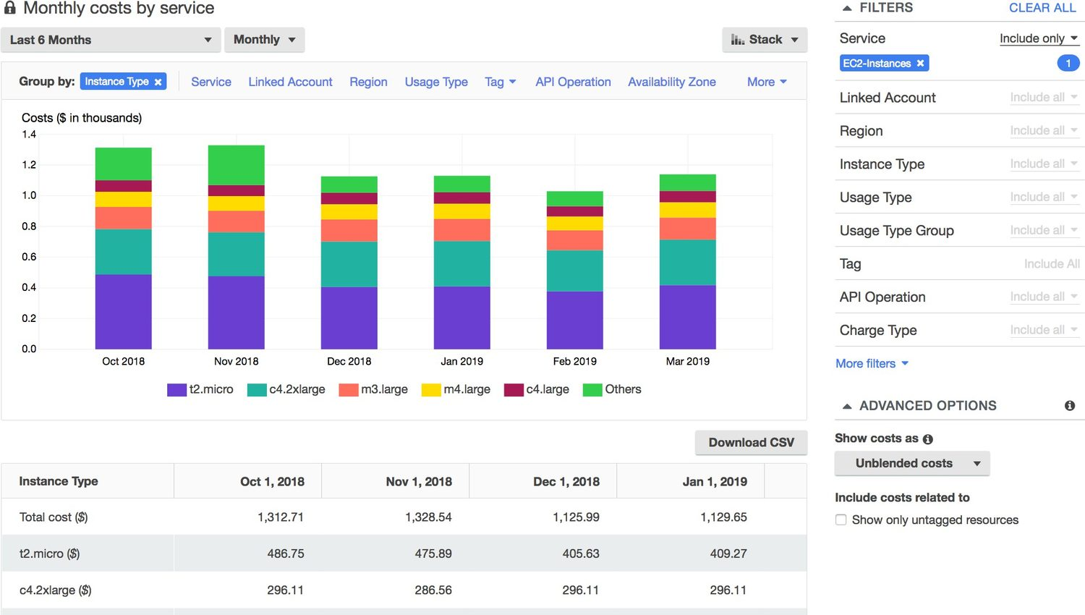
ORIGINAL PPT v4 · SOURCE SLIDE 649 · MODERNISED TECHNICAL DEEP DIVE
Cost Explorer - Monthly Cost by AWS Service
1
Operating model
Operating model: keep the Organizations management account low-touch; delegate security, backup, Config and…
2
Failure mode
Failure mode: an SCP sets a maximum permission boundary but grants nothing; troubleshooting must still evaluate…
3
Evidence: organization trails…
Evidence: organization trails, Config aggregation, Health events, tag-policy compliance and cost-allocation…
CURRENT OPERATIONS LENS
Turn the architecture choice into an operating model: ownership boundary, account scope, guardrail, evidence and escalation. Validate service limits and regional availability against current AWS documentation.
AWS Certified SysOps Administrator Associate Training · TGS-2024051413
© 2026 Tertiary Infotech Academy Pte Ltd
56

Slide 57
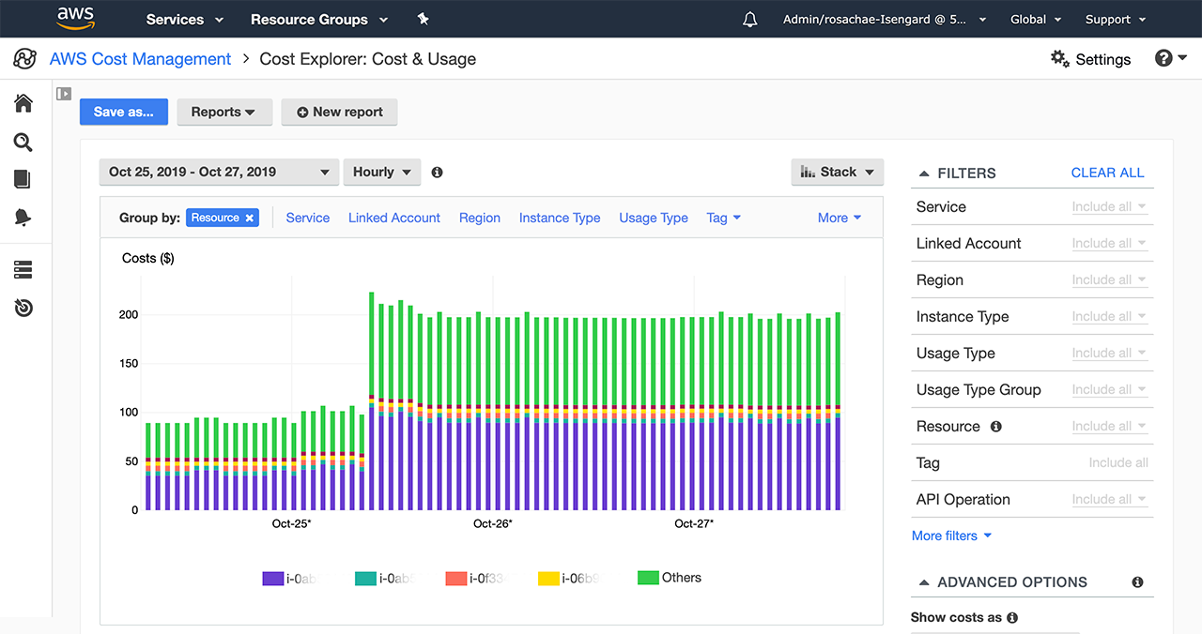
ORIGINAL PPT v4 · SOURCE SLIDE 650 · MODERNISED TECHNICAL DEEP DIVE
Cost Explorer - Hourly & Resource Level
1
Operating model
Operating model: keep the Organizations management account low-touch; delegate security, backup, Config and…
2
Failure mode
Failure mode: an SCP sets a maximum permission boundary but grants nothing; troubleshooting must still evaluate…
3
Evidence: organization trails…
Evidence: organization trails, Config aggregation, Health events, tag-policy compliance and cost-allocation…
CURRENT OPERATIONS LENS
Turn the architecture choice into an operating model: ownership boundary, account scope, guardrail, evidence and escalation. Validate service limits and regional availability against current AWS documentation.
AWS Certified SysOps Administrator Associate Training · TGS-2024051413
© 2026 Tertiary Infotech Academy Pte Ltd
57

Slide 58
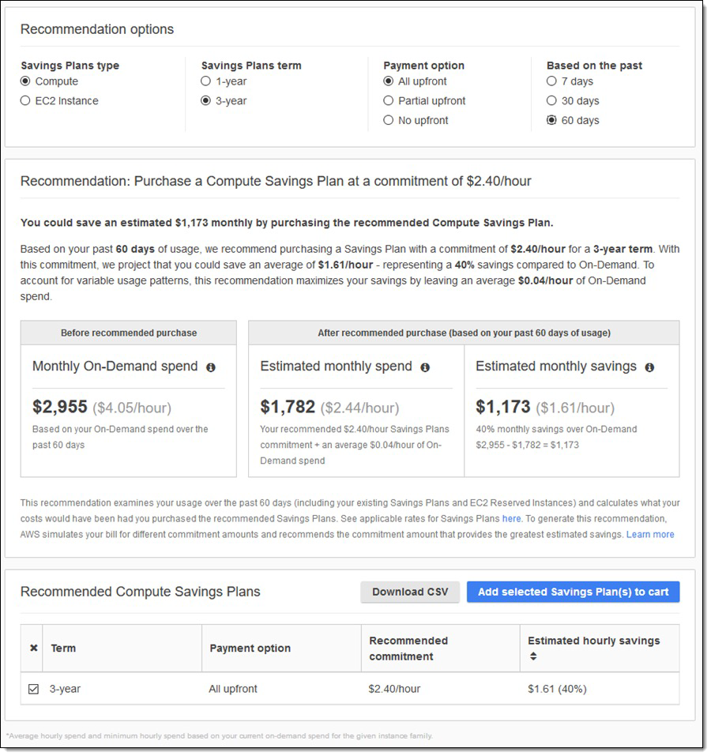
ORIGINAL PPT v4 · SOURCE SLIDE 651 · MODERNISED TECHNICAL DEEP DIVE
Cost Explorer - Savings Plan Alternative to Reserved Instances
1
Operating model
Operating model: keep the Organizations management account low-touch; delegate security, backup, Config and…
2
Failure mode
Failure mode: an SCP sets a maximum permission boundary but grants nothing; troubleshooting must still evaluate…
3
Evidence: organization trails…
Evidence: organization trails, Config aggregation, Health events, tag-policy compliance and cost-allocation…
CURRENT OPERATIONS LENS
Turn the architecture choice into an operating model: ownership boundary, account scope, guardrail, evidence and escalation. Validate service limits and regional availability against current AWS documentation.
AWS Certified SysOps Administrator Associate Training · TGS-2024051413
© 2026 Tertiary Infotech Academy Pte Ltd
58

Slide 59
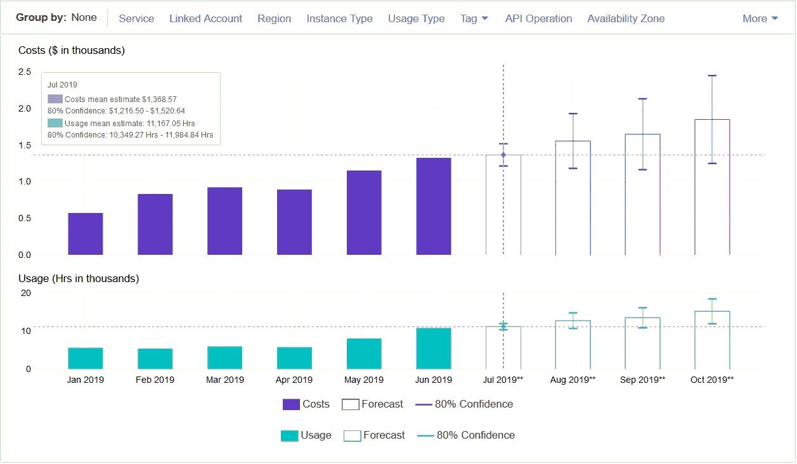
ORIGINAL PPT v4 · SOURCE SLIDE 652 · MODERNISED TECHNICAL DEEP DIVE
Cost Explorer - Forecast Usage
1
Operating model
Operating model: keep the Organizations management account low-touch; delegate security, backup, Config and…
2
Failure mode
Failure mode: an SCP sets a maximum permission boundary but grants nothing; troubleshooting must still evaluate…
3
Evidence: organization trails…
Evidence: organization trails, Config aggregation, Health events, tag-policy compliance and cost-allocation…
CURRENT OPERATIONS LENS
Turn the architecture choice into an operating model: ownership boundary, account scope, guardrail, evidence and escalation. Validate service limits and regional availability against current AWS documentation.
AWS Certified SysOps Administrator Associate Training · TGS-2024051413
© 2026 Tertiary Infotech Academy Pte Ltd
59

Slide 60
ORIGINAL PPT v4 · SOURCE SLIDE 653 · MODERNISED TECHNICAL DEEP DIVE
AWS Budgets
1
Create budget and send alarms
2
4 types of budgets
3
For Reserved Instances (RI)
4
Track utilization
Create budget and send alarms when costs exceeds the budget
Supports EC2, ElastiCache, RDS, Redshift
2 budgets are free, then $0.02/day/budget
4 types of budgets: Usage, Cost, Reservation, Savings Plans
Up to 5 SNS notifications per budget
For Reserved Instances (RI)
Can filter by: Service, Linked Account,Tag, Purchase Option, Instance Type, Region, Availability Zone, API Operation, etc…
Track utilization
Same options as AWS Cost Explorer!
Operating model: keep the Organizations management account low-touch; delegate security, backup, Config and observability administration to…
CURRENT OPERATIONS LENS
Turn the architecture choice into an operating model: ownership boundary, account scope, guardrail, evidence and escalation. Validate service limits and regional availability against current AWS documentation.
AWS Certified SysOps Administrator Associate Training · TGS-2024051413
© 2026 Tertiary Infotech Academy Pte Ltd
60

Slide 61
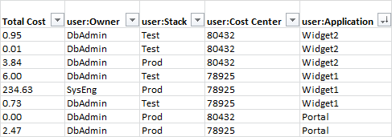
ORIGINAL PPT v4 · SOURCE SLIDE 654 · MODERNISED TECHNICAL DEEP DIVE
Cost Allocation Tags
1
Use cost allocation tags to
Use cost allocation tags to track your AWS costs on a detailed level
2
Operating model
Operating model: keep the Organizations management account low-touch; delegate security, backup, Config and…
3
Failure mode
Failure mode: an SCP sets a maximum permission boundary but grants nothing; troubleshooting must still evaluate…
CURRENT OPERATIONS LENS
Turn the architecture choice into an operating model: ownership boundary, account scope, guardrail, evidence and escalation. Validate service limits and regional availability against current AWS documentation.
AWS Certified SysOps Administrator Associate Training · TGS-2024051413
© 2026 Tertiary Infotech Academy Pte Ltd
61

Slide 62
ORIGINAL PPT v4 · SOURCE SLIDE 655 · MODERNISED TECHNICAL DEEP DIVE
Cost and Usage Reports
1
Dive deeper into your AWS
2
The AWS Cost & Usage
3
Includes additional metadata…
4
The AWS Cost & Usage
Dive deeper into your AWS costs and usage
service category used by an account
Can be integrated with Athena, Redshift or QuickSight
The AWS Cost & Usage Report contains the most comprehensive set of AWS cost and usage data available
in hourly or daily line items
AWS Cost & Usage Report
Includes additional metadata about AWS services, pricing, and reservations (e.g. Amazon EC2 Reserved Instances (RIs))
any tags that you have activated for cost allocation purposes
The AWS Cost & Usage Report lists AWS usage for each
Can be configured for daily exports to S3
CURRENT OPERATIONS LENS
Turn the architecture choice into an operating model: ownership boundary, account scope, guardrail, evidence and escalation. Validate service limits and regional availability against current AWS documentation.
AWS Certified SysOps Administrator Associate Training · TGS-2024051413
© 2026 Tertiary Infotech Academy Pte Ltd
62

Slide 63
TOPIC 01 · LEGACY COVERAGE INTEGRATION
Original PPT Coverage Retained — Topic 01
Modernised slides
30 technical slides extracted from the original v4 PowerPoint and rebuilt in the current visual system.
Traceability
Every blended slide names its original v4 source slide number in the kicker.
1
2
Current validation
Terminology is normalised; service limits and Region availability remain explicit current-documentation checks.
Procedure boundary
Click-by-click sequences, activities and quizzes are kept out of the deck and remain in the Learner Guide or lab package.
3
4
AWS Certified SysOps Administrator Associate Training · TGS-2024051413
© 2026 Tertiary Infotech Academy Pte Ltd
63

Slide 64
TOPIC 01 · RETRIEVAL PRACTICE
Recap — Cloud Operations Foundations
Explain
Availability, security, performance and cost are managed as measurable service outcomes.
Distinguish
AWS secures the cloud; customers secure configurations, identities, data and workloads in the cloud.
1
2
Apply
Use the control loop and responsibility boundary to frame an operational decision.
Evidence
Identify the configuration, telemetry, change and verification record required.
3
4
AWS Certified SysOps Administrator Associate Training · TGS-2024051413
© 2026 Tertiary Infotech Academy Pte Ltd
64

Slide 65
02
TOPIC 02 · LO2 · LO4 · K1 · K3 · K4 · A1 · A4
Monitoring, Logging and Incident Response
CloudWatch · CloudTrail · EventBridge · alarms · anomaly detection · remediation
AWS Certified SysOps Administrator Associate Training · TGS-2024051413
© 2026 Tertiary Infotech Academy Pte Ltd
65

Slide 66
BLUEPRINT · SOA-C03 Domain 1 · 22%
Key Ideas — Monitoring, Logging and Incident Response
Metrics show behaviour
Dimensions, periods and statistics turn raw measurements into service signals.
Logs explain events
Structured records provide detail for search, correlation, retention and audit.
1
2
Traces connect dependencies
A request path exposes latency and failure across distributed components.
Incidents require controlled response
Detection, triage, containment, recovery and learning form one evidence chain.
3
4
AWS Certified SysOps Administrator Associate Training · TGS-2024051413
© 2026 Tertiary Infotech Academy Pte Ltd
66

Slide 67

IMAGEGEN VISUAL · TOPIC 02
Observe, Decide, Remediate
READ THE SYSTEM
Read the scene as an operational control loop: signal, context, safe action, verification and escalation.
AWS Certified SysOps Administrator Associate Training · TGS-2024051413
© 2026 Tertiary Infotech Academy Pte Ltd
67

Slide 68
TOPIC 02 · K1 · K3 · K4 · A1 · A4
Telemetry Pipeline
1
2
3
4
5
6
Instrument
Collect
Store
Analyse
Alert
Remediate
Metrics, logs and traces
Agents and service…
Retention and protection
Queries and correlation
Actionable threshold
Human or automation
DESIGN TEST
A signal is useful only when it identifies impact, owner and next safe action.
AWS Certified SysOps Administrator Associate Training · TGS-2024051413
© 2026 Tertiary Infotech Academy Pte Ltd
68

Slide 69
TOPIC 02 · K1 · K3 · K4 · A1 · A4
CloudWatch, CloudTrail and Config
Service
Primary question
Typical evidence
CloudWatch
How is the workload behaving?
Metrics, logs, alarms and dashboards
CloudTrail
Who called which AWS API, when and from where?
Management and data events
AWS Config
What configuration existed and was it compliant?
Configuration history and rule evaluation
AWS Certified SysOps Administrator Associate Training · TGS-2024051413
© 2026 Tertiary Infotech Academy Pte Ltd
69

Slide 70
TOPIC 02 · K1 · K3 · K4 · A1 · A4
Composite Signals Reduce Alert Noise
WHAT THE DATA SHOWS
Filtering transient and context-free signals can preserve actionable detection while reducing noise.
AWS Certified SysOps Administrator Associate Training · TGS-2024051413
© 2026 Tertiary Infotech Academy Pte Ltd
70

Slide 71
TOPIC 02 · K1 · K3 · K4 · A1 · A4
Alarm Design
Statistic
Average can hide peaks; percentiles expose tail latency.
Period
Short periods detect quickly but may amplify noise.
1
2
Missing data
Choose breaching, not breaching, ignore or missing deliberately.
Action
Notify, scale or remediate only with tested permissions and rollback.
3
4
AWS Certified SysOps Administrator Associate Training · TGS-2024051413
© 2026 Tertiary Infotech Academy Pte Ltd
71

Slide 72
TOPIC 02 · K1 · K3 · K4 · A1 · A4
Incident Lifecycle
1
2
3
4
5
6
Detect
Triage
Contain
Recover
Verify
Review
Signal and timestamp
Scope and severity
Limit blast radius
Restore service
Health and data integrity
Actions and owners
A4 CONNECTION
Separate observed evidence, hypothesis, decision and result throughout the incident record.
AWS Certified SysOps Administrator Associate Training · TGS-2024051413
© 2026 Tertiary Infotech Academy Pte Ltd
72

Slide 73
TOPIC 02 · K1 · K3 · K4 · A1 · A4
Threshold vs Anomaly Detection
Choice
Strength
Use when
Static threshold
Transparent and predictable
A meaningful limit is known
Anomaly detection
Adapts to time-varying baseline
Seasonality makes one limit noisy
Composite alarm
Combines symptom and impact
One signal alone is insufficient
Metric math
Derives rates and ratios
Raw counts need context
AWS Certified SysOps Administrator Associate Training · TGS-2024051413
© 2026 Tertiary Infotech Academy Pte Ltd
73

Slide 74
TOPIC 02 · K1 · K3 · K4 · A1 · A4
Automation Guardrails
Trigger
Authority
Verification
• Use sustained evidence
• Prevent recursive events
• Least-privilege execution role
• Separate approval for high-risk action
• Check intended state
• Escalate when remediation fails
AWS Certified SysOps Administrator Associate Training · TGS-2024051413
© 2026 Tertiary Infotech Academy Pte Ltd
74

Slide 75
TOPIC 02 · NATIVE EDITABLE TECHNICAL CHART
SLO Error-Budget Burn by Time Window
WHAT THE DATA SHOWS
Fast windows detect acute impact; slow windows protect the long-term objective. Multi-window alarms reduce both late detection and transient noise.
AWS Certified SysOps Administrator Associate Training · TGS-2024051413
© 2026 Tertiary Infotech Academy Pte Ltd
75

Slide 76
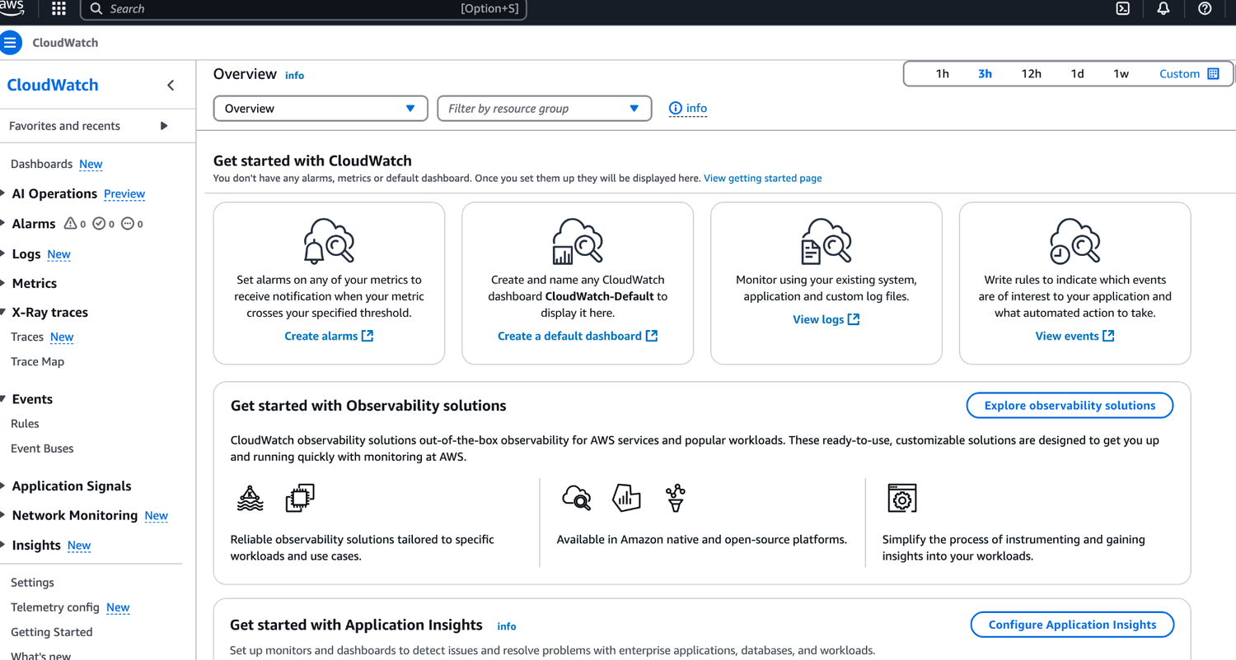
ORIGINAL PPT v4 · SOURCE SLIDE 572 · MODERNISED TECHNICAL DEEP DIVE
AWS CloudWatch
1
Mechanism: metrics expose…
Mechanism: metrics expose behaviour, logs provide event detail, traces connect dependencies and configuration…
2
Failure mode
Failure mode: average statistics, broad dimensions or short retention can hide tail latency, tenant impact and the…
3
Evidence: alarm state history…
Evidence: alarm state history, Logs Insights queries, CloudTrail event identity, trace correlation and SLO burn…
CURRENT OPERATIONS LENS
Connect every signal to service impact, an accountable owner, a safe response and a verification condition. Validate service limits and regional availability against current AWS documentation.
AWS Certified SysOps Administrator Associate Training · TGS-2024051413
© 2026 Tertiary Infotech Academy Pte Ltd
76

Slide 77
ORIGINAL PPT v4 · SOURCE SLIDE 574 · MODERNISED TECHNICAL DEEP DIVE
AWS CloudWatch Metrics
1
CloudWatch provides metrics for…
2
Metric is a variable to
3
Metrics belong to namespaces
4
Dimension is an attribute of
CloudWatch provides metrics for every services in AWS
Up to 30 dimensions per metric
Metric is a variable to monitor (CPUUtilization, NetworkIn…)
Metrics have timestamps
Metrics belong to namespaces
Can create CloudWatch dashboards of metrics
Dimension is an attribute of a metric (instance id, environment, etc…).
CURRENT OPERATIONS LENS
Connect every signal to service impact, an accountable owner, a safe response and a verification condition. Validate service limits and regional availability against current AWS documentation.
AWS Certified SysOps Administrator Associate Training · TGS-2024051413
© 2026 Tertiary Infotech Academy Pte Ltd
77

Slide 78
ORIGINAL PPT v4 · SOURCE SLIDE 575 · MODERNISED TECHNICAL DEEP DIVE
EC2 Detailed monitoring
1
EC2 instance metrics have metrics
2
With detailed monitoring (for a
3
Use detailed monitoring if you
4
The AWS Free Tier allows
EC2 instance metrics have metrics “every 5 minutes”
Note: EC2 Memory usage is by default not pushed (must be pushed from inside the instance as a custom metric)
With detailed monitoring (for a cost), you get data “every 1 minute”
Use detailed monitoring if you want to scale faster for your ASG!
The AWS Free Tier allows us to have 10 detailed monitoring metrics
CURRENT OPERATIONS LENS
Connect every signal to service impact, an accountable owner, a safe response and a verification condition. Validate service limits and regional availability against current AWS documentation.
AWS Certified SysOps Administrator Associate Training · TGS-2024051413
© 2026 Tertiary Infotech Academy Pte Ltd
78

Slide 79
ORIGINAL PPT v4 · SOURCE SLIDE 576 · MODERNISED TECHNICAL DEEP DIVE
CloudWatch Custom Metrics
1
Possibility to define and send
2
Example: memory (RAM) usage, disk
3
Use API call PutMetricData
4
Ability to use dimensions…
Possibility to define and send your own custom metrics to CloudWatch
Instance.id
High Resolution: 1/5/10/30 second(s) - Higher cost
Example: memory (RAM) usage, disk space, number of logged in users …
Environment.name
Important: Accepts metric data points two weeks in the past and two hours in the future (make sure to configure your EC2 instance time correctly)
Use API call PutMetricData
Metric resolution (StorageResolution API parameter - two possible value)
Ability to use dimensions (attributes) to segment metrics
Standard: 1 minute (60 seconds)
CURRENT OPERATIONS LENS
Connect every signal to service impact, an accountable owner, a safe response and a verification condition. Validate service limits and regional availability against current AWS documentation.
AWS Certified SysOps Administrator Associate Training · TGS-2024051413
© 2026 Tertiary Infotech Academy Pte Ltd
79

Slide 80
ORIGINAL PPT v4 · SOURCE SLIDE 577 · MODERNISED TECHNICAL DEEP DIVE
CloudWatch Dashboards
1
Great way to setup custom
2
Dashboards are global
3
Dashboards can include graphs from
4
You can change the time
Great way to setup custom dashboards for quick access to key metrics and alarms
You can setup automatic refresh (10s, 1m, 2m, 5m, 15m)
Dashboards are global
Dashboards can be shared with people who don’t have an AWS account (public, email address, 3rd party SSO provider through Amazon Cognito)
Dashboards can include graphs from different AWS accounts and regions
3 dashboards (up to 50 metrics) for free
You can change the time zone & time range of the dashboards
$3/dashboard/month afterwards
CURRENT OPERATIONS LENS
Connect every signal to service impact, an accountable owner, a safe response and a verification condition. Validate service limits and regional availability against current AWS documentation.
AWS Certified SysOps Administrator Associate Training · TGS-2024051413
© 2026 Tertiary Infotech Academy Pte Ltd
80

Slide 81
ORIGINAL PPT v4 · SOURCE SLIDE 579 · MODERNISED TECHNICAL DEEP DIVE
CloudWatch Logs
1
Logs group
2
Log stream
3
Can define log expiration policies
4
CloudWatch Logs can send logs
Logs group: arbitrary name, usually representing an application
Amazon S3 (exports)
OpenSearch
Log stream: instances within application / log files / containers
Kinesis Data Streams
Logs are encrypted by default
Can define log expiration policies (never expire, 1 day to 10 years…)
Kinesis Data Firehose
Can setup KMS-based encryption with your own keys
CloudWatch Logs can send logs to
AWS Lambda
Mechanism: metrics expose behaviour, logs provide event detail, traces connect dependencies and configuration history explains what changed.
CURRENT OPERATIONS LENS
Connect every signal to service impact, an accountable owner, a safe response and a verification condition. Validate service limits and regional availability against current AWS documentation.
AWS Certified SysOps Administrator Associate Training · TGS-2024051413
© 2026 Tertiary Infotech Academy Pte Ltd
81

Slide 82
ORIGINAL PPT v4 · SOURCE SLIDE 580 · MODERNISED TECHNICAL DEEP DIVE
CloudWatch Logs - Sources
1
SDK, CloudWatch Logs Agent…
2
Elastic Beanstalk
3
ECS: collection from containers
4
AWS Lambda
SDK, CloudWatch Logs Agent, CloudWatch Unified Agent
VPC Flow Logs:VPC specific logs
Elastic Beanstalk: collection of logs from application
API Gateway
Mechanism: metrics expose behaviour, logs provide event detail, traces connect dependencies and configuration history explains what changed.
ECS: collection from containers
CloudTrail based on filter
Failure mode: average statistics, broad dimensions or short retention can hide tail latency, tenant impact and the evidence needed for a…
AWS Lambda: collection from function logs
Route53: Log DNS queries
CURRENT OPERATIONS LENS
Connect every signal to service impact, an accountable owner, a safe response and a verification condition. Validate service limits and regional availability against current AWS documentation.
AWS Certified SysOps Administrator Associate Training · TGS-2024051413
© 2026 Tertiary Infotech Academy Pte Ltd
82

Slide 83
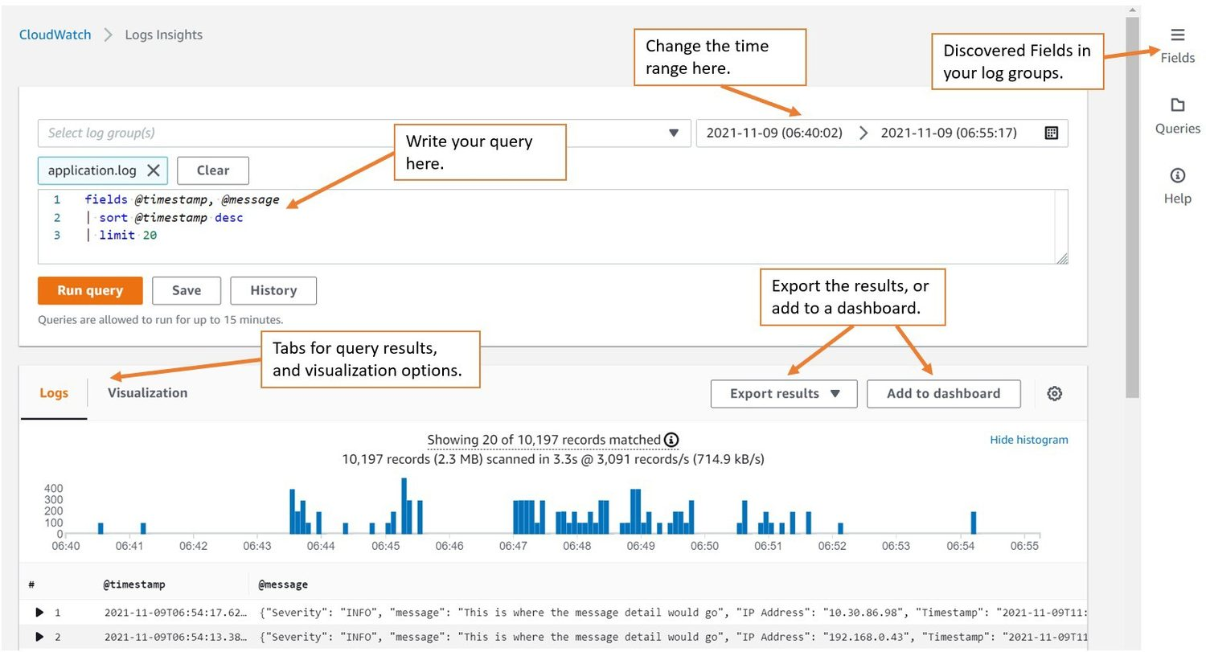
ORIGINAL PPT v4 · SOURCE SLIDE 581 · MODERNISED TECHNICAL DEEP DIVE
CloudWatch Logs Insights
1
Mechanism: metrics expose…
Mechanism: metrics expose behaviour, logs provide event detail, traces connect dependencies and configuration…
2
Failure mode
Failure mode: average statistics, broad dimensions or short retention can hide tail latency, tenant impact and the…
3
Evidence: alarm state history…
Evidence: alarm state history, Logs Insights queries, CloudTrail event identity, trace correlation and SLO burn…
CURRENT OPERATIONS LENS
Connect every signal to service impact, an accountable owner, a safe response and a verification condition. Validate service limits and regional availability against current AWS documentation.
AWS Certified SysOps Administrator Associate Training · TGS-2024051413
© 2026 Tertiary Infotech Academy Pte Ltd
83

Slide 84
ORIGINAL PPT v4 · SOURCE SLIDE 582 · MODERNISED TECHNICAL DEEP DIVE
CloudWatch Logs Insights
1
Search and analyze log data
2
Example: find a specific IP
3
Provides a purpose-built query…
4
Automatically discovers fields…
Search and analyze log data stored in CloudWatch Logs
Fetch desired event fields, filter based on conditions, calculate aggregate statistics, sort events, limit number of events…
Example: find a specific IP inside a log, count occurrences of “ERROR” in your logs…
Can save queries and add them to CloudWatch Dashboards
Provides a purpose-built query language
Can query multiple Log Groups in different AWS accounts
Automatically discovers fields from AWS services and JSON log events
It’s a query engine, not a real-time engine
CURRENT OPERATIONS LENS
Connect every signal to service impact, an accountable owner, a safe response and a verification condition. Validate service limits and regional availability against current AWS documentation.
AWS Certified SysOps Administrator Associate Training · TGS-2024051413
© 2026 Tertiary Infotech Academy Pte Ltd
84

Slide 85
ORIGINAL PPT v4 · SOURCE SLIDE 583 · MODERNISED TECHNICAL DEEP DIVE
CloudWatch Logs - S3 Export
1
Log data can take up
2
The API call is CreateExportTaskNo…
3
CloudWatch Logs
4
Failure mode
Log data can take up to 12 hours to become available for export
The API call is CreateExportTaskNot near-real time or real-time… use Logs Subscriptions instead
CloudWatch Logs
Mechanism: metrics expose behaviour, logs provide event detail, traces connect dependencies and configuration history explains what changed.
Failure mode: average statistics, broad dimensions or short retention can hide tail latency, tenant impact and the evidence needed for a…
CURRENT OPERATIONS LENS
Connect every signal to service impact, an accountable owner, a safe response and a verification condition. Validate service limits and regional availability against current AWS documentation.
AWS Certified SysOps Administrator Associate Training · TGS-2024051413
© 2026 Tertiary Infotech Academy Pte Ltd
85

Slide 86
ORIGINAL PPT v4 · SOURCE SLIDE 585 · MODERNISED TECHNICAL DEEP DIVE
CloudWatch Logs Subscriptions
1
Get a real-time log events
2
Send to Kinesis Data Streams,
3
Subscription filter
4
CloudWatch Logs
Get a real-time log events from CloudWatch Logs for processing and analysis
Subscription Filter
near real-time
Send to Kinesis Data Streams, Kinesis Data Firehose, or Lambda
Kinesis Data Firehose
EC2 Lambda
Subscription filter - filter which logs are events delivered to your destination
Kinesis Data Streams
CloudWatch Logs
OpenSearch Service
Mechanism: metrics expose behaviour, logs provide event detail, traces connect dependencies and configuration history explains what changed.
CURRENT OPERATIONS LENS
Connect every signal to service impact, an accountable owner, a safe response and a verification condition. Validate service limits and regional availability against current AWS documentation.
AWS Certified SysOps Administrator Associate Training · TGS-2024051413
© 2026 Tertiary Infotech Academy Pte Ltd
86

Slide 87
ORIGINAL PPT v4 · SOURCE SLIDE 586 · MODERNISED TECHNICAL DEEP DIVE
CloudWatch Logs Aggregation Multi-Account & Multi Region
1
Kinesis Data Streams
2
Kinesis Data Firehose
3
Near Real Time
4
ACCOUNT A REGION 1
Kinesis Data Streams
CloudWatch Logs Subscription Filter
Mechanism: metrics expose behaviour, logs provide event detail, traces connect dependencies and configuration history explains what changed.
Kinesis Data Firehose
ACCOUNT B REGION 2
Failure mode: average statistics, broad dimensions or short retention can hide tail latency, tenant impact and the evidence needed for a…
Near Real Time
ACCOUNT B REGION 3
Evidence: alarm state history, Logs Insights queries, CloudTrail event identity, trace correlation and SLO burn rate should tell one consistent story.
ACCOUNT A REGION 1
Decision point: alert only when a signal identifies impact, urgency, owner and a safe next action; everything else belongs in a dashboard or…
CURRENT OPERATIONS LENS
Connect every signal to service impact, an accountable owner, a safe response and a verification condition. Validate service limits and regional availability against current AWS documentation.
AWS Certified SysOps Administrator Associate Training · TGS-2024051413
© 2026 Tertiary Infotech Academy Pte Ltd
87

Slide 88
ORIGINAL PPT v4 · SOURCE SLIDE 587 · MODERNISED TECHNICAL DEEP DIVE
CloudWatch Logs Subscriptions
1
Cross-Account Subscription
2
Account - Sender
3
(111111111111)
4
CloudWatch Logs
Cross-Account Subscription - send log events to resources in a different AWS account (KDS, KDF)
Subscription
(RecipientStream)
Account - Sender
Account - Recipient
Subscription Destination
Mechanism: metrics expose behaviour, logs provide event detail, traces connect dependencies and configuration history explains what changed.
(111111111111)
(999999999999)
Destination Access Policy
Failure mode: average statistics, broad dimensions or short retention can hide tail latency, tenant impact and the evidence needed for a…
CloudWatch Logs
Kinesis Data Streams
IAM Role (Cross-Account)
Evidence: alarm state history, Logs Insights queries, CloudTrail event identity, trace correlation and SLO burn rate should tell one consistent story.
CURRENT OPERATIONS LENS
Connect every signal to service impact, an accountable owner, a safe response and a verification condition. Validate service limits and regional availability against current AWS documentation.
AWS Certified SysOps Administrator Associate Training · TGS-2024051413
© 2026 Tertiary Infotech Academy Pte Ltd
88

Slide 89
ORIGINAL PPT v4 · SOURCE SLIDE 588 · MODERNISED TECHNICAL DEEP DIVE
CloudWatch Alarms
1
Alarms are used to trigger
2
Various options (sampling, %, max,
3
Alarm States
4
INSUFFICIENT_DATA
Alarms are used to trigger notifications for any metric
Length of time in seconds to evaluate the metric
Various options (sampling, %, max, min, etc…)
High resolution custom metrics: 10 sec, 30 sec or multiples of 60 sec
Alarm States
Mechanism: metrics expose behaviour, logs provide event detail, traces connect dependencies and configuration history explains what changed.
INSUFFICIENT_DATA
Failure mode: average statistics, broad dimensions or short retention can hide tail latency, tenant impact and the evidence needed for a…
CURRENT OPERATIONS LENS
Connect every signal to service impact, an accountable owner, a safe response and a verification condition. Validate service limits and regional availability against current AWS documentation.
AWS Certified SysOps Administrator Associate Training · TGS-2024051413
© 2026 Tertiary Infotech Academy Pte Ltd
89

Slide 90
ORIGINAL PPT v4 · SOURCE SLIDE 589 · MODERNISED TECHNICAL DEEP DIVE
CloudWatch Alarm Targets
1
Stop,Terminate, Reboot, or…
2
Trigger Auto Scaling Action
3
Send notification to SNS (from
4
Amazon EC2
Stop,Terminate, Reboot, or Recover an EC2 Instance
EC2 Auto Scaling
Trigger Auto Scaling Action
Amazon SNS
Mechanism: metrics expose behaviour, logs provide event detail, traces connect dependencies and configuration history explains what changed.
Send notification to SNS (from which you can do pretty much anything)
Amazon EC2
Failure mode: average statistics, broad dimensions or short retention can hide tail latency, tenant impact and the evidence needed for a…
CURRENT OPERATIONS LENS
Connect every signal to service impact, an accountable owner, a safe response and a verification condition. Validate service limits and regional availability against current AWS documentation.
AWS Certified SysOps Administrator Associate Training · TGS-2024051413
© 2026 Tertiary Infotech Academy Pte Ltd
90

Slide 91
ORIGINAL PPT v4 · SOURCE SLIDE 590 · MODERNISED TECHNICAL DEEP DIVE
CloudWatch Alarms - Composite Alarms
1
CloudWatch Alarms are on a
2
Composite Alarms are monitoring…
3
AND and OR conditions
4
Helpful to reduce “alarm noise”
CloudWatch Alarms are on a single metric
EC2 Instance
Composite Alarm
Composite Alarms are monitoring the states of multiple other alarms
monitor CPU
CW Alarm - A
AND and OR conditions
monitor IOPS
CW Alarm - B
Helpful to reduce “alarm noise” by creating complex composite alarms
Amazon SNS
CURRENT OPERATIONS LENS
Connect every signal to service impact, an accountable owner, a safe response and a verification condition. Validate service limits and regional availability against current AWS documentation.
AWS Certified SysOps Administrator Associate Training · TGS-2024051413
© 2026 Tertiary Infotech Academy Pte Ltd
91

Slide 92
ORIGINAL PPT v4 · SOURCE SLIDE 592 · MODERNISED TECHNICAL DEEP DIVE
EC2 Instance Recovery
1
CloudWatch Alarm
2
StatusCheckFailed_System
3
Status Check
4
Instance status = check the
CloudWatch Alarm
System status = check the underlying hardware
Mechanism: metrics expose behaviour, logs provide event detail, traces connect dependencies and configuration history explains what changed.
StatusCheckFailed_System
Attached EBS status = check attached EBS volumes
Failure mode: average statistics, broad dimensions or short retention can hide tail latency, tenant impact and the evidence needed for a…
Status Check
EC2 Instance
Evidence: alarm state history, Logs Insights queries, CloudTrail event identity, trace correlation and SLO burn rate should tell one consistent story.
Instance status = check the EC2 VM
Recovery: same Private, Public, Elastic IP, metadata, placement group
CURRENT OPERATIONS LENS
Connect every signal to service impact, an accountable owner, a safe response and a verification condition. Validate service limits and regional availability against current AWS documentation.
AWS Certified SysOps Administrator Associate Training · TGS-2024051413
© 2026 Tertiary Infotech Academy Pte Ltd
92

Slide 93
ORIGINAL PPT v4 · SOURCE SLIDE 593 · MODERNISED TECHNICAL DEEP DIVE
CloudWatch Alarm: good to know
1
Alarms can be created based
2
Amazon SNS
3
To test alarms and notifications,
4
aws cloudwatch set-alarm-state…
Alarms can be created based on CloudWatch Logs Metrics Filters
CloudWatch
Amazon SNS
Metric Filter
Mechanism: metrics expose behaviour, logs provide event detail, traces connect dependencies and configuration history explains what changed.
To test alarms and notifications, set the alarm state to Alarm using CLI
aws cloudwatch set-alarm-state --alarm-name "myalarm" --state-value ALARM --state-reason "testing purposes"
CURRENT OPERATIONS LENS
Connect every signal to service impact, an accountable owner, a safe response and a verification condition. Validate service limits and regional availability against current AWS documentation.
AWS Certified SysOps Administrator Associate Training · TGS-2024051413
© 2026 Tertiary Infotech Academy Pte Ltd
93

Slide 94
ORIGINAL PPT v4 · SOURCE SLIDE 594 · MODERNISED TECHNICAL DEEP DIVE
CloudWatch Synthetics Canary
1
Configurable script that monitor…
2
Reproduce what your customers do
3
Checks the availability and…
4
endpoints and can store load
Configurable script that monitor your APIs, URLs, Websites, …
Integration with CloudWatch Alarms
CloudWatch Alarm
Reproduce what your customers do programmatically to find issues before customers are impacted
Scripts written in Node.js or Python
Lambda Function
Checks the availability and latency of your
Programmatic access to a headless Google Chrome browser
update DNS record
endpoints and can store load time data and screenshots of the UI
Can run once or on a regular schedule
CURRENT OPERATIONS LENS
Connect every signal to service impact, an accountable owner, a safe response and a verification condition. Validate service limits and regional availability against current AWS documentation.
AWS Certified SysOps Administrator Associate Training · TGS-2024051413
© 2026 Tertiary Infotech Academy Pte Ltd
94

Slide 95
ORIGINAL PPT v4 · SOURCE SLIDE 595 · MODERNISED TECHNICAL DEEP DIVE
CloudWatch Synthetics Canary Blueprints
1
Heartbeat monitor
2
API canary
3
Broken link checker
4
Visual monitoring
Heartbeat monitor - load URL, store screenshot and an HTTP archive file
Canary recorder - used with CloudWatch Synthetics Recorder (record your actions on a website and automatically generates a script for that)
API canary - test basic read and write functions of REST APIs
GUI flow builder - verifies that actions can be taken on your webpage (e.g., test a webpage with a login form)
Broken link checker - check all links inside the URL that you are testing
Visual monitoring - compare a screenshot taken during a canary run with a baseline screenshot
CURRENT OPERATIONS LENS
Connect every signal to service impact, an accountable owner, a safe response and a verification condition. Validate service limits and regional availability against current AWS documentation.
AWS Certified SysOps Administrator Associate Training · TGS-2024051413
© 2026 Tertiary Infotech Academy Pte Ltd
95

Slide 96
ORIGINAL PPT v4 · SOURCE SLIDE 596 · MODERNISED TECHNICAL DEEP DIVE
Amazon EventBridge (formerly Amazon EventBridge)
1
Schedule: Cron jobs (scheduled…
2
Event Pattern
3
Trigger Lambda functions, send…
4
IAM Root User Sign in
Schedule: Cron jobs (scheduled scripts)
SNS Topic with Email Notification
Event Pattern: Event rules to react to a service doing something
Schedule Every hour
Trigger Lambda functions, send SQS/SNS messages…
Trigger script on Lambda function
IAM Root User Sign in Event
Mechanism: metrics expose behaviour, logs provide event detail, traces connect dependencies and configuration history explains what changed.
CURRENT OPERATIONS LENS
Connect every signal to service impact, an accountable owner, a safe response and a verification condition. Validate service limits and regional availability against current AWS documentation.
AWS Certified SysOps Administrator Associate Training · TGS-2024051413
© 2026 Tertiary Infotech Academy Pte Ltd
96

Slide 97
ORIGINAL PPT v4 · SOURCE SLIDE 597 · MODERNISED TECHNICAL DEEP DIVE
Amazon EventBridge Rules
1
Example Source
2
EC2 Instance
3
(ex: Start Instance)
4
(ex: failed build)
Example Source
(ex: upload object)
(any API call)
Mechanism: metrics expose behaviour, logs provide event detail, traces connect dependencies and configuration history explains what changed.
EC2 Instance
Trusted Advisor
Schedule or Cron
Failure mode: average statistics, broad dimensions or short retention can hide tail latency, tenant impact and the evidence needed for a…
(ex: Start Instance)
(ex: new Finding)
(ex: every 4 hours)
(ex: failed build)
CloudTrail
Amazon EventBridge
Evidence: alarm state history, Logs Insights queries, CloudTrail event identity, trace correlation and SLO burn rate should tell one consistent story.
CURRENT OPERATIONS LENS
Connect every signal to service impact, an accountable owner, a safe response and a verification condition. Validate service limits and regional availability against current AWS documentation.
AWS Certified SysOps Administrator Associate Training · TGS-2024051413
© 2026 Tertiary Infotech Academy Pte Ltd
97

Slide 98
ORIGINAL PPT v4 · SOURCE SLIDE 598 · MODERNISED TECHNICAL DEEP DIVE
Amazon EventBridge
1
Event buses can be accessed
2
You can archive events…
3
Ability to replay archived events
4
AWS Services
Event buses can be accessed by other AWS accounts using Resource-based Policies
Default Event Bus
You can archive events (all/filter) sent to an event bus (indefinitely or set period)
Partner Event Bus
Ability to replay archived events
Custom Event Bus
Mechanism: metrics expose behaviour, logs provide event detail, traces connect dependencies and configuration history explains what changed.
AWS Services
Custom Apps
Failure mode: average statistics, broad dimensions or short retention can hide tail latency, tenant impact and the evidence needed for a…
CURRENT OPERATIONS LENS
Connect every signal to service impact, an accountable owner, a safe response and a verification condition. Validate service limits and regional availability against current AWS documentation.
AWS Certified SysOps Administrator Associate Training · TGS-2024051413
© 2026 Tertiary Infotech Academy Pte Ltd
98

Slide 99
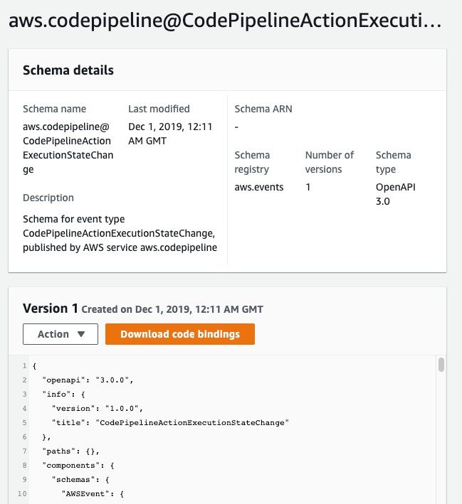
ORIGINAL PPT v4 · SOURCE SLIDE 600 · MODERNISED TECHNICAL DEEP DIVE
Amazon EventBridge - Schema Registry
1
EventBridge can analyze the events
EventBridge can analyze the events in your bus and infer the schema
2
Mechanism: metrics expose…
Mechanism: metrics expose behaviour, logs provide event detail, traces connect dependencies and configuration…
3
Failure mode
Failure mode: average statistics, broad dimensions or short retention can hide tail latency, tenant impact and the…
CURRENT OPERATIONS LENS
Connect every signal to service impact, an accountable owner, a safe response and a verification condition. Validate service limits and regional availability against current AWS documentation.
AWS Certified SysOps Administrator Associate Training · TGS-2024051413
© 2026 Tertiary Infotech Academy Pte Ltd
99

Slide 100
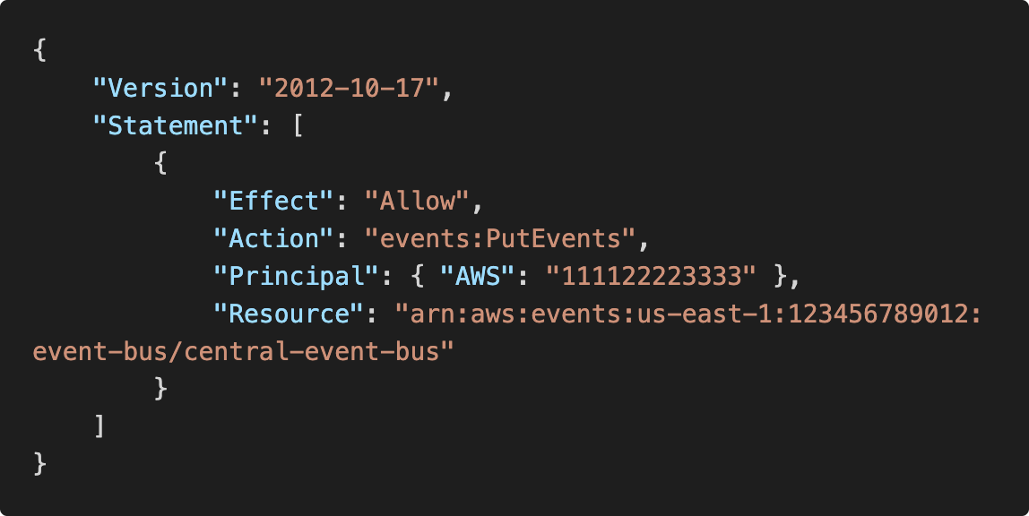
ORIGINAL PPT v4 · SOURCE SLIDE 601 · MODERNISED TECHNICAL DEEP DIVE
Amazon EventBridge - Resource-based Policy
1
Manage permissions for a specific
Manage permissions for a specific Event Bus
Mechanism: metrics expose behaviour, logs provide event detail, traces connect dependencies and configuration…
2
Failure mode
Failure mode: average statistics, broad dimensions or short retention can hide tail latency, tenant impact and the…
3
Evidence: alarm state history…
Evidence: alarm state history, Logs Insights queries, CloudTrail event identity, trace correlation and SLO burn…
CURRENT OPERATIONS LENS
Connect every signal to service impact, an accountable owner, a safe response and a verification condition. Validate service limits and regional availability against current AWS documentation.
AWS Certified SysOps Administrator Associate Training · TGS-2024051413
© 2026 Tertiary Infotech Academy Pte Ltd
100

Slide 101
ORIGINAL PPT v4 · SOURCE SLIDE 602 · MODERNISED TECHNICAL DEEP DIVE
Service Quotas CloudWatch Alarms
1
AWS Service Quotas
2
Notify you when you’re close
3
Create CloudWatch Alarms on the
4
Example: Lambda concurrent…
AWS Service Quotas
Helps you know if you need to request a quota increase or shutdown resources before limit is reached
Notify you when you’re close to a service quota value threshold
AWS Lambda Quota
Create CloudWatch Alarms on the Service Quotas console
Mechanism: metrics expose behaviour, logs provide event detail, traces connect dependencies and configuration history explains what changed.
Example: Lambda concurrent executions
Failure mode: average statistics, broad dimensions or short retention can hide tail latency, tenant impact and the evidence needed for a…
CURRENT OPERATIONS LENS
Connect every signal to service impact, an accountable owner, a safe response and a verification condition. Validate service limits and regional availability against current AWS documentation.
AWS Certified SysOps Administrator Associate Training · TGS-2024051413
© 2026 Tertiary Infotech Academy Pte Ltd
101

Slide 102
ORIGINAL PPT v4 · SOURCE SLIDE 603 · MODERNISED TECHNICAL DEEP DIVE
Alternative:Trusted Advisor + CW Alarms
1
Limited number of Service Limits
2
Trusted Advisor publishes its…
3
You can create CloudWatch Alarms
4
AWS Trusted Advisor
Limited number of Service Limits checks in Trusted Advisor (~50)
CloudWatch
Trusted Advisor publishes its check results to CloudWatch
Service Limits
You can create CloudWatch Alarms on service quota usage (Service Limits)
Lambda Concurrent Executions: 1000
AWS Trusted Advisor
Mechanism: metrics expose behaviour, logs provide event detail, traces connect dependencies and configuration history explains what changed.
CURRENT OPERATIONS LENS
Connect every signal to service impact, an accountable owner, a safe response and a verification condition. Validate service limits and regional availability against current AWS documentation.
AWS Certified SysOps Administrator Associate Training · TGS-2024051413
© 2026 Tertiary Infotech Academy Pte Ltd
102

Slide 103
ORIGINAL PPT v4 · SOURCE SLIDE 604 · MODERNISED TECHNICAL DEEP DIVE
AWS CloudTrail
1
Provides governance, compliance…
2
CloudTrail is enabled by default!
3
Get a history of events
4
AWS Services
Provides governance, compliance and audit for your AWS Account
Can put logs from CloudTrail into CloudWatch Logs or S3
CloudTrail is enabled by default!
A trail can be applied to All Regions (default) or a single Region
Get a history of events / API calls made within your AWS Account by
If a resource is deleted in AWS, investigate CloudTrail first!
AWS Services
Mechanism: metrics expose behaviour, logs provide event detail, traces connect dependencies and configuration history explains what changed.
CURRENT OPERATIONS LENS
Connect every signal to service impact, an accountable owner, a safe response and a verification condition. Validate service limits and regional availability against current AWS documentation.
AWS Certified SysOps Administrator Associate Training · TGS-2024051413
© 2026 Tertiary Infotech Academy Pte Ltd
103

Slide 104
ORIGINAL PPT v4 · SOURCE SLIDE 605 · MODERNISED TECHNICAL DEEP DIVE
CloudTrail Diagram
1
CloudTrail Console
2
Inspect & Audit
3
CloudWatch Logs
4
IAM Users & IAM Roles
CloudTrail Console
Mechanism: metrics expose behaviour, logs provide event detail, traces connect dependencies and configuration history explains what changed.
Inspect & Audit
Failure mode: average statistics, broad dimensions or short retention can hide tail latency, tenant impact and the evidence needed for a…
CloudWatch Logs
Evidence: alarm state history, Logs Insights queries, CloudTrail event identity, trace correlation and SLO burn rate should tell one consistent story.
IAM Users & IAM Roles
Decision point: alert only when a signal identifies impact, urgency, owner and a safe next action; everything else belongs in a dashboard or…
CURRENT OPERATIONS LENS
Connect every signal to service impact, an accountable owner, a safe response and a verification condition. Validate service limits and regional availability against current AWS documentation.
AWS Certified SysOps Administrator Associate Training · TGS-2024051413
© 2026 Tertiary Infotech Academy Pte Ltd
104

Slide 105
ORIGINAL PPT v4 · SOURCE SLIDE 606 · MODERNISED TECHNICAL DEEP DIVE
CloudTrail Events
1
Management Events
2
Operations that are performed on
3
Configuring security (IAM…
4
Configuring rules for routing data
Management Events
Setting up logging (AWS CloudTrail CreateTrail)
By default, data events are not logged (because high volume operations)
Operations that are performed on resources in your AWS account
By default, trails are configured to log management events.
Amazon S3 object-level activity (ex: GetObject, DeleteObject, PutObject): can separate Read and Write Events
Configuring security (IAM AttachRolePolicy)
Can separate Read Events (that don’t modify resources) from Write Events (that may modify resources)
AWS Lambda function execution activity (the Invoke API)
Configuring rules for routing data (Amazon EC2 CreateSubnet)
Data Events
CloudTrail Insights Events
CURRENT OPERATIONS LENS
Connect every signal to service impact, an accountable owner, a safe response and a verification condition. Validate service limits and regional availability against current AWS documentation.
AWS Certified SysOps Administrator Associate Training · TGS-2024051413
© 2026 Tertiary Infotech Academy Pte Ltd
105

Slide 106
ORIGINAL PPT v4 · SOURCE SLIDE 607 · MODERNISED TECHNICAL DEEP DIVE
CloudTrail Insights
1
Enable CloudTrail Insights to…
2
inaccurate resource provisioning
3
hitting service limits
4
Bursts of AWS IAM actions
Enable CloudTrail Insights to detect unusual activity in your account
Gaps in periodic maintenance activity
Event is sent to Amazon S3
inaccurate resource provisioning
CloudTrail Insights analyzes normal management events to create a baseline
An EventBridge event is generated (for automation needs)
hitting service limits
And then continuously analyzes write events to detect unusual patterns
Management Events
Bursts of AWS IAM actions
Anomalies appear in the CloudTrail console
Continuous analysis
CURRENT OPERATIONS LENS
Connect every signal to service impact, an accountable owner, a safe response and a verification condition. Validate service limits and regional availability against current AWS documentation.
AWS Certified SysOps Administrator Associate Training · TGS-2024051413
© 2026 Tertiary Infotech Academy Pte Ltd
106

Slide 107
ORIGINAL PPT v4 · SOURCE SLIDE 608 · MODERNISED TECHNICAL DEEP DIVE
CloudTrail Events Retention
1
Events are stored for 90
2
To keep events beyond this
3
CloudTrail
4
S3 Bucket Long-term retention
Events are stored for 90 days in CloudTrail
Data Events
To keep events beyond this period, log them to S3 and use Athena
Management Events
CloudTrail
Insights Events
Mechanism: metrics expose behaviour, logs provide event detail, traces connect dependencies and configuration history explains what changed.
S3 Bucket Long-term retention
90 days retention
Failure mode: average statistics, broad dimensions or short retention can hide tail latency, tenant impact and the evidence needed for a…
CURRENT OPERATIONS LENS
Connect every signal to service impact, an accountable owner, a safe response and a verification condition. Validate service limits and regional availability against current AWS documentation.
AWS Certified SysOps Administrator Associate Training · TGS-2024051413
© 2026 Tertiary Infotech Academy Pte Ltd
107

Slide 108
ORIGINAL PPT v4 · SOURCE SLIDE 609 · MODERNISED TECHNICAL DEEP DIVE
Amazon EventBridge - Intercept API Calls
1
CloudTrail
2
(any API call)
3
Amazon EventBridge
4
Log API call
CloudTrail
DeleteTable API Call
Mechanism: metrics expose behaviour, logs provide event detail, traces connect dependencies and configuration history explains what changed.
(any API call)
Failure mode: average statistics, broad dimensions or short retention can hide tail latency, tenant impact and the evidence needed for a…
Amazon EventBridge
Evidence: alarm state history, Logs Insights queries, CloudTrail event identity, trace correlation and SLO burn rate should tell one consistent story.
Log API call
Decision point: alert only when a signal identifies impact, urgency, owner and a safe next action; everything else belongs in a dashboard or…
CURRENT OPERATIONS LENS
Connect every signal to service impact, an accountable owner, a safe response and a verification condition. Validate service limits and regional availability against current AWS documentation.
AWS Certified SysOps Administrator Associate Training · TGS-2024051413
© 2026 Tertiary Infotech Academy Pte Ltd
108

Slide 109
ORIGINAL PPT v4 · SOURCE SLIDE 610 · MODERNISED TECHNICAL DEEP DIVE
Amazon EventBridge + CloudTrail
1
CloudTrail
2
EventBridge
3
AssumeRole
4
API Call logs
CloudTrail
AuthorizeSecurityGroupIngress
Mechanism: metrics expose behaviour, logs provide event detail, traces connect dependencies and configuration history explains what changed.
EventBridge
Security Group
Failure mode: average statistics, broad dimensions or short retention can hide tail latency, tenant impact and the evidence needed for a…
AssumeRole
edit SG Inbound Rules
Evidence: alarm state history, Logs Insights queries, CloudTrail event identity, trace correlation and SLO burn rate should tell one consistent story.
API Call logs
Decision point: alert only when a signal identifies impact, urgency, owner and a safe next action; everything else belongs in a dashboard or…
CURRENT OPERATIONS LENS
Connect every signal to service impact, an accountable owner, a safe response and a verification condition. Validate service limits and regional availability against current AWS documentation.
AWS Certified SysOps Administrator Associate Training · TGS-2024051413
© 2026 Tertiary Infotech Academy Pte Ltd
109

Slide 110
ORIGINAL PPT v4 · SOURCE SLIDE 611 · MODERNISED TECHNICAL DEEP DIVE
CloudTrail - Log File Integrity Validation
1
Digest files
2
References the log files for
3
Stored in the same S3
4
Helps you determine whether a
Digest files
Hashing using SHA-256, Digital Signing using SHA- 256 with RSA
contains a hash of each log file
References the log files for the last hour and contains a hash of each
Protect the S3 bucket using bucket policy, versioning, MFA Delete protection, encryption, object lock
Digest File
Stored in the same S3 bucket as log files (different folder)
Protect CloudTrail using IAM
Amazon EC2
Helps you determine whether a log file was modified/deleted after CloudTrail delivered it
Log Files (1 hour)
start instance
CURRENT OPERATIONS LENS
Connect every signal to service impact, an accountable owner, a safe response and a verification condition. Validate service limits and regional availability against current AWS documentation.
AWS Certified SysOps Administrator Associate Training · TGS-2024051413
© 2026 Tertiary Infotech Academy Pte Ltd
110

Slide 111
TOPIC 02 · LEGACY COVERAGE INTEGRATION
Original PPT Coverage Retained — Topic 02
Modernised slides
35 technical slides extracted from the original v4 PowerPoint and rebuilt in the current visual system.
Traceability
Every blended slide names its original v4 source slide number in the kicker.
1
2
Current validation
Terminology is normalised; service limits and Region availability remain explicit current-documentation checks.
Procedure boundary
Click-by-click sequences, activities and quizzes are kept out of the deck and remain in the Learner Guide or lab package.
3
4
AWS Certified SysOps Administrator Associate Training · TGS-2024051413
© 2026 Tertiary Infotech Academy Pte Ltd
111

Slide 112
TOPIC 02 · CONCEPT-LED LAB BRIEF
Build an Observability and Incident Detection Baseline
LAB 01
Apply K1, K3, K4, A1 and A4 by creating a dashboard, alarm, CloudTrail evidence query and EventBridge detection rule for one tagged workload.
Create measurable service signals, route one actionable event and record an evidence-led incident hypothesis.
YOU'LL BUILD
TOOLCHAIN
DONE WHEN
A CloudWatch dashboard, alarm definition, EventBridge pattern, evidence log and validation screenshots.
CloudWatch · CloudTrail · EventBridge · SNS · AWS CLI · CloudShell
The dashboard and alarm reference the assigned workload; CloudTrail evidence names the actor and event; the EventBridge pattern is valid; the incident record distinguishes observation from hypothesis; validation emits LAB 01 PASS.
AWS Certified SysOps Administrator Associate Training · TGS-2024051413
© 2026 Tertiary Infotech Academy Pte Ltd
112

Slide 113
LAB 01 · CONCEPTUAL WORKFLOW
Lab 01 Evidence Model
1
2
3
4
5
Instrument
Collect
Alarm
Notify
Verify
Metrics and logs
Agent and service
Actionable signal
Owner and context
Evidence and cleanup
PROCEDURE BOUNDARY
Detailed commands and numbered steps are in the Learner Guide and lab folder—not on these slides.
AWS Certified SysOps Administrator Associate Training · TGS-2024051413
© 2026 Tertiary Infotech Academy Pte Ltd
113

Slide 114
LAB 01 · ACCEPTANCE EVIDENCE
Build an Observability and Incident Detection Baseline
✅ Expected result
The dashboard and alarm reference the assigned workload; CloudTrail evidence names the actor and event; the EventBridge pattern is valid; the incident record distinguishes observation from hypothesis; validation emits LAB 01 PASS.
IF IT DOESN'T WORK
Input mismatch
Validation stop
Evidence differs
Reconcile identifiers, required fields and units with the supplied data dictionary.
Inspect the named rule and source row; preserve the check rather than bypassing it.
Check the denominator, time window and assumptions before rerunning from clean inputs.
AWS Certified SysOps Administrator Associate Training · TGS-2024051413
© 2026 Tertiary Infotech Academy Pte Ltd
114

Slide 115
TOPIC 02 · CONCEPT-LED LAB BRIEF
Automate Event-Driven Incident Triage
LAB 02
Apply K3, K4, A1 and A4 by routing a controlled AWS event through EventBridge, invoking a least-privilege remediation function and preserving an auditable triage record.
Build an event pattern and Lambda triage function that records evidence and recommends a bounded next action.
YOU'LL BUILD
TOOLCHAIN
DONE WHEN
An EventBridge rule, Lambda triage function, test event, CloudWatch Logs evidence and incident decision record.
EventBridge · Lambda · CloudTrail · CloudWatch Logs · IAM
The test and real events reach the Lambda target, logs contain the event ID and actor context, no automatic network modification occurs, the decision record names authority and verification, and validation emits LAB 02 PASS.
AWS Certified SysOps Administrator Associate Training · TGS-2024051413
© 2026 Tertiary Infotech Academy Pte Ltd
115

Slide 116
LAB 02 · CONCEPTUAL WORKFLOW
Lab 02 Evidence Model
1
2
3
4
5
Event
Route
Triage
Remediate
Audit
Matched condition
EventBridge target
Context enrichment
Bounded action
Result and exception
PROCEDURE BOUNDARY
Detailed commands and numbered steps are in the Learner Guide and lab folder—not on these slides.
AWS Certified SysOps Administrator Associate Training · TGS-2024051413
© 2026 Tertiary Infotech Academy Pte Ltd
116

Slide 117
LAB 02 · ACCEPTANCE EVIDENCE
Automate Event-Driven Incident Triage
✅ Expected result
The test and real events reach the Lambda target, logs contain the event ID and actor context, no automatic network modification occurs, the decision record names authority and verification, and validation emits LAB 02 PASS.
IF IT DOESN'T WORK
Input mismatch
Validation stop
Evidence differs
Reconcile identifiers, required fields and units with the supplied data dictionary.
Inspect the named rule and source row; preserve the check rather than bypassing it.
Check the denominator, time window and assumptions before rerunning from clean inputs.
AWS Certified SysOps Administrator Associate Training · TGS-2024051413
© 2026 Tertiary Infotech Academy Pte Ltd
117

Slide 118
TOPIC 02 · RETRIEVAL PRACTICE
Recap — Monitoring, Logging and Incident Response
Explain
Dimensions, periods and statistics turn raw measurements into service signals.
Distinguish
Structured records provide detail for search, correlation, retention and audit.
1
2
Apply
K1, K3, K4, A1 and A4 by creating a dashboard, alarm, CloudTrail evidence query and EventBridge detection rule for one tagged workload.
Evidence
The dashboard and alarm reference the assigned workload; CloudTrail evidence names the actor and event; the EventBridge pattern is valid; the incident record…
3
4
AWS Certified SysOps Administrator Associate Training · TGS-2024051413
© 2026 Tertiary Infotech Academy Pte Ltd
118

Slide 119
03
TOPIC 03 · LO1 · LO2 · K3 · K5 · A3 · A5
Compute, Virtualisation and Systems Management
EC2 lifecycle · AMIs · placement · Systems Manager · patching · Image Builder
AWS Certified SysOps Administrator Associate Training · TGS-2024051413
© 2026 Tertiary Infotech Academy Pte Ltd
119

Slide 120
BLUEPRINT · SOA-C03 Domains 1 and 3
Key Ideas — Compute, Virtualisation and Systems Management
Treat instances as managed nodes
Inventory, patch, access and automate consistently across a fleet.
Images are controlled supply-chain inputs
Build, scan, test and version AMIs instead of hand-configuring servers.
1
2
Placement affects failure and performance
Spread, partition and cluster strategies solve different operational needs.
Lifecycle actions need coordination
Launch, stop, terminate and scale transitions require hooks and evidence.
3
4
AWS Certified SysOps Administrator Associate Training · TGS-2024051413
© 2026 Tertiary Infotech Academy Pte Ltd
120

Slide 121
TOPIC 03 · K3 · K5 · A3 · A5
EC2 Purchase and Capacity Models
Model
Operational value
Risk / constraint
On-Demand
Flexible baseline and unpredictable workloads
Higher unit cost
Savings Plans
Commitment discount across eligible usage
Forecast and commitment risk
Reserved capacity
Capacity assurance in an AZ
Scope and utilisation management
Spot
Large discount for interruptible work
Two-minute interruption and capacity variability
AWS Certified SysOps Administrator Associate Training · TGS-2024051413
© 2026 Tertiary Infotech Academy Pte Ltd
121

Slide 122
TOPIC 03 · K3 · K5 · A3 · A5
Golden Image Pipeline
1
2
3
4
5
6
Source
Build
Scan
Test
Distribute
Retire
Hardened base image
Versioned components
Vulnerability and policy
Boot and workload checks
Accounts and Regions
Deprecate old images
A5 CONTROL
An image release is an operational change with evidence, version and rollback.
AWS Certified SysOps Administrator Associate Training · TGS-2024051413
© 2026 Tertiary Infotech Academy Pte Ltd
122

Slide 123
TOPIC 03 · K3 · K5 · A3 · A5
Patch Compliance by Fleet Segment
WHAT THE DATA SHOWS
Patch compliance cannot exceed managed-node visibility; onboard and inventory the fleet before enforcing targets.
AWS Certified SysOps Administrator Associate Training · TGS-2024051413
© 2026 Tertiary Infotech Academy Pte Ltd
123

Slide 124
TOPIC 03 · K3 · K5 · A3 · A5
Systems Manager Capabilities
Session Manager
Auditable shell access without inbound SSH or bastion exposure.
Run Command
Execute controlled commands across tagged targets.
1
2
Patch Manager
Baseline, maintenance window, compliance and remediation.
Automation
Runbooks coordinate multi-step operational changes.
3
4
AWS Certified SysOps Administrator Associate Training · TGS-2024051413
© 2026 Tertiary Infotech Academy Pte Ltd
124

Slide 125
TOPIC 03 · K3 · K5 · A3 · A5
Placement Strategies
Strategy
Optimises
Failure characteristic
Cluster
Low-latency high-throughput east-west traffic
Single-AZ concentration
Spread
Small number of critical instances
Distinct underlying hardware
Partition
Large distributed workloads
Partition-aware failure isolation
AWS Certified SysOps Administrator Associate Training · TGS-2024051413
© 2026 Tertiary Infotech Academy Pte Ltd
125

Slide 126
TOPIC 03 · K3 · K5 · A3 · A5
Safe Fleet Change
1
2
3
4
5
6
Select
Canary
Execute
Observe
Expand
Rollback
Tags and inventory
One representative node
Controlled concurrency
Health and errors
Waves by risk
Known-good state
OPERATIONS RULE
Scale the change only after the canary evidence meets the acceptance threshold.
AWS Certified SysOps Administrator Associate Training · TGS-2024051413
© 2026 Tertiary Infotech Academy Pte Ltd
126

Slide 127
Fleet Principle
If a server cannot be identified, accessed, patched and replaced consistently, it is not operationally managed.
Use tags, roles, inventory, image pipelines and Systems Manager to turn instances into a governed fleet.
AWS Certified SysOps Administrator Associate Training · TGS-2024051413
© 2026 Tertiary Infotech Academy Pte Ltd
127

Slide 128
TOPIC 03 · NATIVE EDITABLE TECHNICAL CHART
Fleet Management Coverage
WHAT THE DATA SHOWS
The control chain weakens at verification: successful execution is not the same as confirmed service health.
AWS Certified SysOps Administrator Associate Training · TGS-2024051413
© 2026 Tertiary Infotech Academy Pte Ltd
128

Slide 129
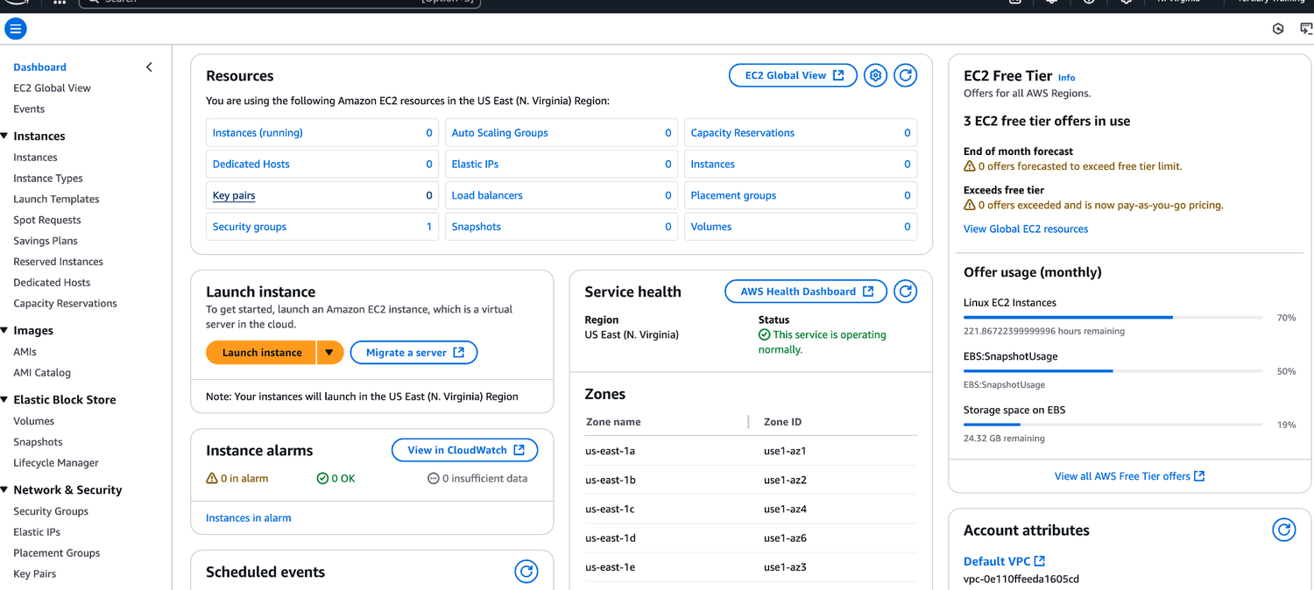
ORIGINAL PPT v4 · SOURCE SLIDE 022 · MODERNISED TECHNICAL DEEP DIVE
EC2 Interface
1
Mechanism: launch templates…
Mechanism: launch templates, AMIs, instance metadata, IAM roles and Systems Manager define the repeatable state…
2
Failure mode
Failure mode: configuration drift, unmanaged nodes, stale AMIs and unbounded Run Command concurrency turn a…
3
Evidence: inventory coverage…
Evidence: inventory coverage, patch compliance, command output, instance status checks, application health and…
CURRENT OPERATIONS LENS
Manage compute as a governed fleet: immutable inputs, tagged targets, bounded concurrency, health evidence and replacement. Validate service limits and regional availability against current AWS documentation.
AWS Certified SysOps Administrator Associate Training · TGS-2024051413
© 2026 Tertiary Infotech Academy Pte Ltd
129

Slide 130
ORIGINAL PPT v4 · SOURCE SLIDE 025 · MODERNISED TECHNICAL DEEP DIVE
Enhanced Networking
1
EC2 Enhanced Networking (SR-IOV)
2
Higher bandwidth, higher PPS…
3
Option 1
4
Option 2
EC2 Enhanced Networking (SR-IOV)
Works for newer generation EC2 Instances
Leverages Message Passing Interface (MPI) standard
Higher bandwidth, higher PPS (packet per second), lower latency
Elastic Fabric Adapter (EFA)
Bypasses the underlying Linux OS to provide low-latency reliable transport
Option 1: Elastic Network Adapter (ENA) up to 100 Gbps
Improved ENA for HPC, only works for Linux
Option 2: Intel 82599 VF up to 10 Gbps – LEGACY
Great for inter-node communications, tightly coupled workloads.
CURRENT OPERATIONS LENS
Manage compute as a governed fleet: immutable inputs, tagged targets, bounded concurrency, health evidence and replacement. Validate service limits and regional availability against current AWS documentation.
AWS Certified SysOps Administrator Associate Training · TGS-2024051413
© 2026 Tertiary Infotech Academy Pte Ltd
130

Slide 131
ORIGINAL PPT v4 · SOURCE SLIDE 026 · MODERNISED TECHNICAL DEEP DIVE
Placement Groups
1
Sometimes you want control over
2
That strategy can be defined
3
When you create a placement
4
Cluster—clusters instances into a…
Sometimes you want control over the EC2 Instance placement strategy
Spread—spreads instances across underlying hardware (max 7 instances per group per AZ) – critical applications
That strategy can be defined using placement groups
Partition—spreads instances across many different partitions (which rely on different sets of racks) within an AZ. Scales to 100s of EC2 instances…
When you create a placement group, you specify one of the following strategies for the group
Cluster—clusters instances into a low-latency group in a single Availability Zone
CURRENT OPERATIONS LENS
Manage compute as a governed fleet: immutable inputs, tagged targets, bounded concurrency, health evidence and replacement. Validate service limits and regional availability against current AWS documentation.
AWS Certified SysOps Administrator Associate Training · TGS-2024051413
© 2026 Tertiary Infotech Academy Pte Ltd
131

Slide 132
ORIGINAL PPT v4 · SOURCE SLIDE 027 · MODERNISED TECHNICAL DEEP DIVE
Same AZ
1
Placement Groups Cluster
2
Placement group Cluster
3
Low latency
4
10 Gbps network
Placement Groups Cluster
Pros: Great network (10 Gbps bandwidth between instances with Enhanced Networking enabled - recommended)
Placement group Cluster
Cons: If the AZ fails, all instances fails at the same time
Low latency
Big Data job that needs to complete fast
10 Gbps network
Application that needs extremely low latency and high network throughput
CURRENT OPERATIONS LENS
Manage compute as a governed fleet: immutable inputs, tagged targets, bounded concurrency, health evidence and replacement. Validate service limits and regional availability against current AWS documentation.
AWS Certified SysOps Administrator Associate Training · TGS-2024051413
© 2026 Tertiary Infotech Academy Pte Ltd
132

Slide 133
ORIGINAL PPT v4 · SOURCE SLIDE 029 · MODERNISED TECHNICAL DEEP DIVE
Placements Groups Partition
1
us-east-1a
2
Partition 1
3
Partition 2
4
Partition 3
us-east-1a
us-east-1b
The instances in a partition do not
Mechanism: launch templates, AMIs, instance metadata, IAM roles and Systems Manager define the repeatable state and management channel for a fleet.
Partition 1
Up to 7 partitions per AZ
share racks with the instances in the other partitions
Partition 2
Can span across multiple AZs in the same region
A partition failure can affect many EC2 but won’t affect other partitions
Partition 3
Up to 100s of EC2 instances
EC2 instances get access to the partition information as metadata
CURRENT OPERATIONS LENS
Manage compute as a governed fleet: immutable inputs, tagged targets, bounded concurrency, health evidence and replacement. Validate service limits and regional availability against current AWS documentation.
AWS Certified SysOps Administrator Associate Training · TGS-2024051413
© 2026 Tertiary Infotech Academy Pte Ltd
133

Slide 134
ORIGINAL PPT v4 · SOURCE SLIDE 032 · MODERNISED TECHNICAL DEEP DIVE
Shutdown Behaviour: How should the instance react when shutdown is done using the OS?
1
Stop (default)
2
This is not applicable when
3
CLI Attribute
4
InstanceInitiatedShutdownBehavior
Stop (default)
Shutdown Behavior
$ shutdown
Mechanism: launch templates, AMIs, instance metadata, IAM roles and Systems Manager define the repeatable state and management channel for a fleet.
This is not applicable when shutting down from AWS console.
EC2 Instance (running)
CLI Attribute
OS shutdown
Failure mode: configuration drift, unmanaged nodes, stale AMIs and unbounded Run Command concurrency turn a routine change into fleet-wide impact.
InstanceInitiatedShutdownBehavior
EC2 Instance (stopped)
Evidence: inventory coverage, patch compliance, command output, instance status checks, application health and replacement success must be correlated.
CURRENT OPERATIONS LENS
Manage compute as a governed fleet: immutable inputs, tagged targets, bounded concurrency, health evidence and replacement. Validate service limits and regional availability against current AWS documentation.
AWS Certified SysOps Administrator Associate Training · TGS-2024051413
© 2026 Tertiary Infotech Academy Pte Ltd
134

Slide 135
ORIGINAL PPT v4 · SOURCE SLIDE 033 · MODERNISED TECHNICAL DEEP DIVE
Termination Protection
1
Enable termination protection
2
To protect against accidental…
3
We have an instance where
4
We shutdown the instance from
Enable termination protection
Mechanism: launch templates, AMIs, instance metadata, IAM roles and Systems Manager define the repeatable state and management channel for a fleet.
To protect against accidental termination in AWS Console or CLI
We have an instance where shutdown behavior = terminate and enable terminate protection is ticked
We shutdown the instance from the OS, what will happen? The instance will still be terminated!
CURRENT OPERATIONS LENS
Manage compute as a governed fleet: immutable inputs, tagged targets, bounded concurrency, health evidence and replacement. Validate service limits and regional availability against current AWS documentation.
AWS Certified SysOps Administrator Associate Training · TGS-2024051413
© 2026 Tertiary Infotech Academy Pte Ltd
135

Slide 136
ORIGINAL PPT v4 · SOURCE SLIDE 035 · MODERNISED TECHNICAL DEEP DIVE
EC2 Launch Troubleshooting
1
# InstanceLimitExceeded if you get
2
On-Demand instance limits are set
3
Example: If you run on-demand
4
Resolution: Either launch the…
# InstanceLimitExceeded if you get this error, it means that you have reached your limit of max number of vCPUs per region
NOTE: vCPU-based limits only apply to running On-Demand instances and Spot instances
On-Demand instance limits are set on a per-region basis
Mechanism: launch templates, AMIs, instance metadata, IAM roles and Systems Manager define the repeatable state and management channel for a fleet.
Example: If you run on-demand (A, C, D, H, I, M, R,T, Z) instance types you’ll have 64 vCPUs (default)
Resolution: Either launch the instance in a different region or request AWS to increase your limit of the region
CURRENT OPERATIONS LENS
Manage compute as a governed fleet: immutable inputs, tagged targets, bounded concurrency, health evidence and replacement. Validate service limits and regional availability against current AWS documentation.
AWS Certified SysOps Administrator Associate Training · TGS-2024051413
© 2026 Tertiary Infotech Academy Pte Ltd
136

Slide 137
ORIGINAL PPT v4 · SOURCE SLIDE 036 · MODERNISED TECHNICAL DEEP DIVE
EC2 Launch Troubleshooting
1
# InsufficientInstanceCapacity
2
Resolution
3
Wait for few mins before
4
If requesting more than 1
# InsufficientInstanceCapacity: if you get this error, it means AWS does not have that enough On-Demand capacity in the particular AZ where the…
If urgent, submit a request for a different instance type now, which can be resized later.
Resolution
Also, can request the EC2 instance in a different AZ
Wait for few mins before requesting again.
Mechanism: launch templates, AMIs, instance metadata, IAM roles and Systems Manager define the repeatable state and management channel for a fleet.
If requesting more than 1 requests, break down the requests. If you need 5 instances, rather than a single request of 5, request one by one.
CURRENT OPERATIONS LENS
Manage compute as a governed fleet: immutable inputs, tagged targets, bounded concurrency, health evidence and replacement. Validate service limits and regional availability against current AWS documentation.
AWS Certified SysOps Administrator Associate Training · TGS-2024051413
© 2026 Tertiary Infotech Academy Pte Ltd
137

Slide 138
ORIGINAL PPT v4 · SOURCE SLIDE 037 · MODERNISED TECHNICAL DEEP DIVE
EC2 Launch Troubleshooting
1
# Instance Terminates Immediately…
2
You've reached your EBS volume
3
An EBS snapshot is corrupt.
4
The root EBS volume is
# Instance Terminates Immediately (goes from pending to terminated)
The instance store-backed AMI that you used to launch the instance is missing a required part (an image.part.xx file).
You've reached your EBS volume limit.
To find the exact reason, check out the EC2 console of AWS - instances - Description tab, note the reason next to the State transition reason label.
An EBS snapshot is corrupt.
Mechanism: launch templates, AMIs, instance metadata, IAM roles and Systems Manager define the repeatable state and management channel for a fleet.
The root EBS volume is encrypted and you do not have permissions to access the KMS key for decryption.
CURRENT OPERATIONS LENS
Manage compute as a governed fleet: immutable inputs, tagged targets, bounded concurrency, health evidence and replacement. Validate service limits and regional availability against current AWS documentation.
AWS Certified SysOps Administrator Associate Training · TGS-2024051413
© 2026 Tertiary Infotech Academy Pte Ltd
138

Slide 139
ORIGINAL PPT v4 · SOURCE SLIDE 038 · MODERNISED TECHNICAL DEEP DIVE
EC2 SSH troubleshooting
1
Make sure the private key
2
Make sure the username for
3
else you will get "Host
4
Possible reasons for "Connection…
Make sure the private key (pem file) on your linux machine has 400 permissions, else you will get "Unprotected private key file" error
SG is not configured correctly
CPU load of the instance is high
Make sure the username for the OS is given correctly when logging via SSH,
NACL is not configured correctly
else you will get "Host key not found, "Permission denied", or "Connection closed by [instance] port 22" error
Check the route table for the subnet (routes traffic destined outside VPC to IGW)
Possible reasons for "Connection timed out" to EC2 instance via SSH
Instance doesn’t have a public IPv4
CURRENT OPERATIONS LENS
Manage compute as a governed fleet: immutable inputs, tagged targets, bounded concurrency, health evidence and replacement. Validate service limits and regional availability against current AWS documentation.
AWS Certified SysOps Administrator Associate Training · TGS-2024051413
© 2026 Tertiary Infotech Academy Pte Ltd
139

Slide 140
ORIGINAL PPT v4 · SOURCE SLIDE 039 · MODERNISED TECHNICAL DEEP DIVE
SSH vs. EC2 Instance Connect
1
Connect using SSH Connect using
2
Inbound Rules
3
(IPv4: 1.2.3.4)
4
(IPv4: 5.6.7.8)
Connect using SSH Connect using EC2 Instance Connect
"ip_prefix": "18.206.107.24/29", "region": "us-east-1",
push one-time SSH public key (valid for 60 secs)
Inbound Rules
"service": "EC2_INSTANCE_CONNECT",
EC2 Console,
Mechanism: launch templates, AMIs, instance metadata, IAM roles and Systems Manager define the repeatable state and management channel for a fleet.
(IPv4: 1.2.3.4)
"network_border_group": "us-east-1"
EC2 Instance Connect CLI
Failure mode: configuration drift, unmanaged nodes, stale AMIs and unbounded Run Command concurrency turn a routine change into fleet-wide impact.
(IPv4: 5.6.7.8)
EC2 Instance Connect API
Allows AWS IP Range
CURRENT OPERATIONS LENS
Manage compute as a governed fleet: immutable inputs, tagged targets, bounded concurrency, health evidence and replacement. Validate service limits and regional availability against current AWS documentation.
AWS Certified SysOps Administrator Associate Training · TGS-2024051413
© 2026 Tertiary Infotech Academy Pte Ltd
140

Slide 141
ORIGINAL PPT v4 · SOURCE SLIDE 040 · MODERNISED TECHNICAL DEEP DIVE
EC2 Instances Purchasing Options
1
On-Demand Instances
2
Reserved (1 & 3 years)
3
Reversed Instances
4
Convertible Reserved Instances
On-Demand Instances - short workload, predictable pricing, pay by second
Savings Plans (1 & 3 years) - commitment to an amount of usage, long workload
Capacity reservations - reserve capacity in a specific AZ for any duration
Reserved (1 & 3 years)
Spot Instances - short workloads, cheap, can lose instances (less reliable)
Reversed Instances - long workloads
Dedicated Hosts - book an entire physical server, control instance placement
Convertible Reserved Instances - long workloads with flexible instances
Dedicated Instances - no other customers will share your hardware
CURRENT OPERATIONS LENS
Manage compute as a governed fleet: immutable inputs, tagged targets, bounded concurrency, health evidence and replacement. Validate service limits and regional availability against current AWS documentation.
AWS Certified SysOps Administrator Associate Training · TGS-2024051413
© 2026 Tertiary Infotech Academy Pte Ltd
141

Slide 142
ORIGINAL PPT v4 · SOURCE SLIDE 041 · MODERNISED TECHNICAL DEEP DIVE
EC2 On Demand
1
Pay for what you use
2
Linux or Windows
3
All other operating systems
4
Has the highest cost but
Pay for what you use
No long-term commitment
Mechanism: launch templates, AMIs, instance metadata, IAM roles and Systems Manager define the repeatable state and management channel for a fleet.
Linux or Windows - billing per second, after the first minute
Recommended for short term and un-interrupted workloads, where you can't predict how the application will behave
All other operating systems - billing per hour
Failure mode: configuration drift, unmanaged nodes, stale AMIs and unbounded Run Command concurrency turn a routine change into fleet-wide impact.
Has the highest cost but no upfront payment
Evidence: inventory coverage, patch compliance, command output, instance status checks, application health and replacement success must be correlated.
CURRENT OPERATIONS LENS
Manage compute as a governed fleet: immutable inputs, tagged targets, bounded concurrency, health evidence and replacement. Validate service limits and regional availability against current AWS documentation.
AWS Certified SysOps Administrator Associate Training · TGS-2024051413
© 2026 Tertiary Infotech Academy Pte Ltd
142

Slide 143
ORIGINAL PPT v4 · SOURCE SLIDE 042 · MODERNISED TECHNICAL DEEP DIVE
Up to 72% discount compared to On-demand
1
You reserve a specific instance
2
Reservation Period
3
Payment options
4
Reserved Instance's Scope
You reserve a specific instance attributes (Instance Type, Region, Tenancy, OS)
Recommended for steady-state usage applications (think database)
Up to 66% discount
Reservation Period - 1 year (+discount) or 3 years (+++discount)
You can buy and sell in the Reserved Instance Marketplace
EC2 Reserved Instances
Payment options - No Upfront (+), Partial Upfront (++), All Upfront (+++)
Convertible Reserved Instance
Note: the % discounts are different from the video as AWS change them over time – the exact numbers are not needed for the exam. This is just for…
Reserved Instance's Scope - Regional or Zonal (reserve capacity in an AZ)
Can change the EC2 instance type, instance family, OS, scope and tenancy
CURRENT OPERATIONS LENS
Manage compute as a governed fleet: immutable inputs, tagged targets, bounded concurrency, health evidence and replacement. Validate service limits and regional availability against current AWS documentation.
AWS Certified SysOps Administrator Associate Training · TGS-2024051413
© 2026 Tertiary Infotech Academy Pte Ltd
143

Slide 144
ORIGINAL PPT v4 · SOURCE SLIDE 043 · MODERNISED TECHNICAL DEEP DIVE
EC2 Savings Plans
1
Get a discount based on
2
Commit to a certain type
3
Usage beyond EC2 Savings Plans
4
Locked to a specific instance
Get a discount based on long-term usage (up to 72% - same as RIs)
Flexible across
Commit to a certain type of usage ($10/hour for 1 or 3 years)
Instance Size (e.g., m5.xlarge, m5.2xlarge)
Usage beyond EC2 Savings Plans is billed at the On-Demand price
OS (e.g., Linux, Windows)
Locked to a specific instance family & AWS region (e.g., M5 in us-east-1)
Tenancy (Host, Dedicated, Default)
CURRENT OPERATIONS LENS
Manage compute as a governed fleet: immutable inputs, tagged targets, bounded concurrency, health evidence and replacement. Validate service limits and regional availability against current AWS documentation.
AWS Certified SysOps Administrator Associate Training · TGS-2024051413
© 2026 Tertiary Infotech Academy Pte Ltd
144

Slide 145
ORIGINAL PPT v4 · SOURCE SLIDE 044 · MODERNISED TECHNICAL DEEP DIVE
EC2 Spot Instances
1
Can get a discount of
2
Instances that you can “lose”
3
The MOST cost-efficient instances…
4
Useful for workloads that are
Can get a discount of up to 90% compared to On-demand
Batch jobs
Workloads with a flexible start and end time
Instances that you can “lose” at any point of time if your max price is less than the current spot price
Data analysis
Not suitable for critical jobs or databases
The MOST cost-efficient instances in AWS
Image processing
Mechanism: launch templates, AMIs, instance metadata, IAM roles and Systems Manager define the repeatable state and management channel for a fleet.
Useful for workloads that are resilient to failure
Any distributed workloads
CURRENT OPERATIONS LENS
Manage compute as a governed fleet: immutable inputs, tagged targets, bounded concurrency, health evidence and replacement. Validate service limits and regional availability against current AWS documentation.
AWS Certified SysOps Administrator Associate Training · TGS-2024051413
© 2026 Tertiary Infotech Academy Pte Ltd
145

Slide 146
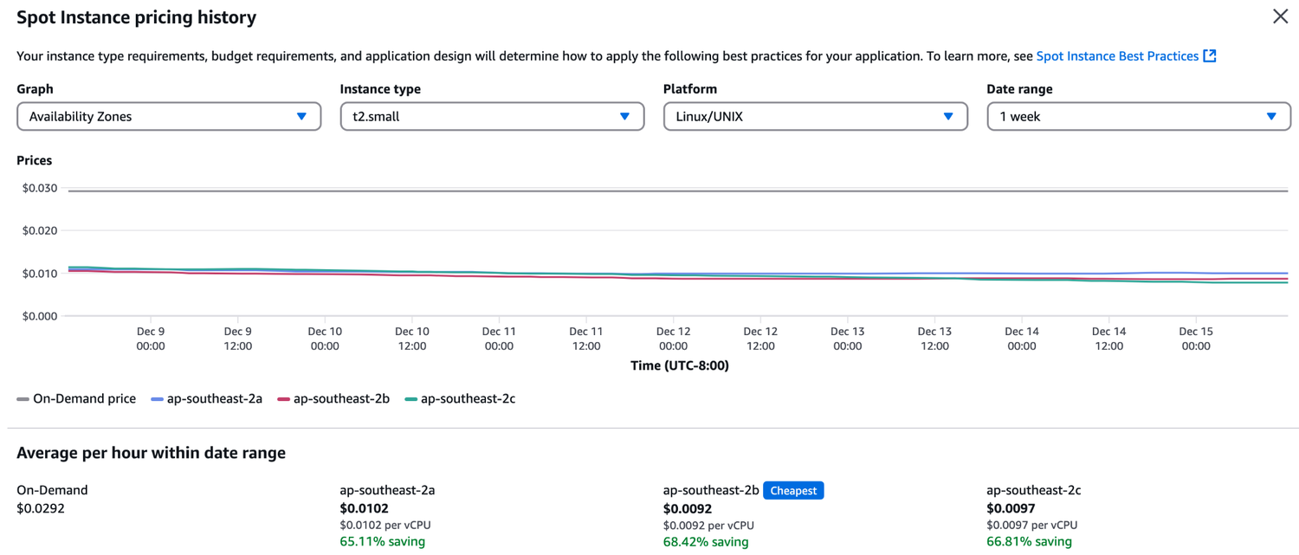
ORIGINAL PPT v4 · SOURCE SLIDE 045 · MODERNISED TECHNICAL DEEP DIVE
EC2 Spot Instance Pricing History
1
Mechanism: launch templates…
Mechanism: launch templates, AMIs, instance metadata, IAM roles and Systems Manager define the repeatable state…
2
Failure mode
Failure mode: configuration drift, unmanaged nodes, stale AMIs and unbounded Run Command concurrency turn a…
3
Evidence: inventory coverage…
Evidence: inventory coverage, patch compliance, command output, instance status checks, application health and…
CURRENT OPERATIONS LENS
Manage compute as a governed fleet: immutable inputs, tagged targets, bounded concurrency, health evidence and replacement. Validate service limits and regional availability against current AWS documentation.
AWS Certified SysOps Administrator Associate Training · TGS-2024051413
© 2026 Tertiary Infotech Academy Pte Ltd
146

Slide 147
ORIGINAL PPT v4 · SOURCE SLIDE 047 · MODERNISED TECHNICAL DEEP DIVE
EC2 Dedicated Hosts
1
A physical server with EC2
2
Allows you address compliance…
3
Purchasing Options
4
On-demand - pay per second
A physical server with EC2 instance capacity fully dedicated to your use
Reserved - 1 or 3 years (No Upfront, Partial Upfront, All Upfront) The most expensive option
Allows you address compliance requirements and use your existing server - bound software licenses (per-socket, per-core, pe—VM software licenses)
Useful for software that have complicated licensing model (BYOL – Bring Your Own License)
Purchasing Options
Or for companies that have strong regulatory or compliance needs
On-demand - pay per second for active Dedicated Host
Mechanism: launch templates, AMIs, instance metadata, IAM roles and Systems Manager define the repeatable state and management channel for a fleet.
CURRENT OPERATIONS LENS
Manage compute as a governed fleet: immutable inputs, tagged targets, bounded concurrency, health evidence and replacement. Validate service limits and regional availability against current AWS documentation.
AWS Certified SysOps Administrator Associate Training · TGS-2024051413
© 2026 Tertiary Infotech Academy Pte Ltd
147

Slide 148
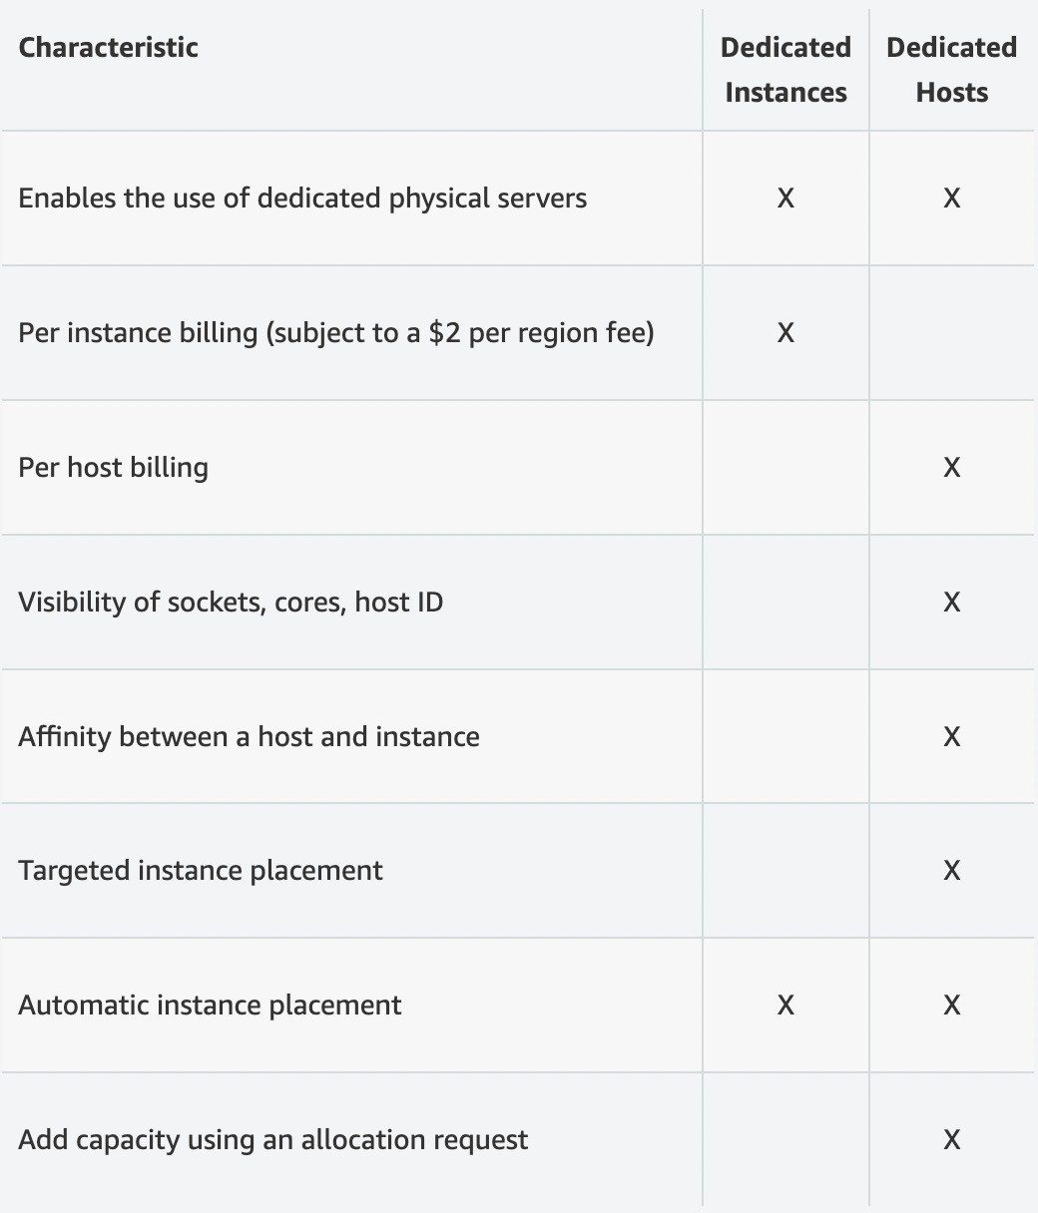
ORIGINAL PPT v4 · SOURCE SLIDE 048 · MODERNISED TECHNICAL DEEP DIVE
EC2 Dedicated Instances
1
Instances run on hardware that’s
Instances run on hardware that’s dedicated to you
Mechanism: launch templates, AMIs, instance metadata, IAM roles and Systems Manager define the repeatable state…
2
Failure mode
Failure mode: configuration drift, unmanaged nodes, stale AMIs and unbounded Run Command concurrency turn a…
3
Evidence: inventory coverage…
Evidence: inventory coverage, patch compliance, command output, instance status checks, application health and…
CURRENT OPERATIONS LENS
Manage compute as a governed fleet: immutable inputs, tagged targets, bounded concurrency, health evidence and replacement. Validate service limits and regional availability against current AWS documentation.
AWS Certified SysOps Administrator Associate Training · TGS-2024051413
© 2026 Tertiary Infotech Academy Pte Ltd
148

Slide 149
ORIGINAL PPT v4 · SOURCE SLIDE 049 · MODERNISED TECHNICAL DEEP DIVE
EC2 Capacity Reservations
1
Reserve on-Demand instances…
2
You always have access to
3
No time commitment (create/cancel…
4
You’re charged at On-Demand rate
Reserve on-Demand instances capacity in a specific AZ for any duration
Suitable for short-term, uninterrupted workloads that needs to be in a specific AZ
You always have access to EC2 capacity when you need it
No time commitment (create/cancel anytime), no billing discounts Combine with Regional Reserved Instances and Savings Plans to benefit from billing…
You’re charged at On-Demand rate whether you run instances or not
CURRENT OPERATIONS LENS
Manage compute as a governed fleet: immutable inputs, tagged targets, bounded concurrency, health evidence and replacement. Validate service limits and regional availability against current AWS documentation.
AWS Certified SysOps Administrator Associate Training · TGS-2024051413
© 2026 Tertiary Infotech Academy Pte Ltd
149

Slide 150

ORIGINAL PPT v4 · SOURCE SLIDE 050 · MODERNISED TECHNICAL DEEP DIVE
Which purchasing option is right for me?
1
On demand
On demand: coming and staying in resort whenever we like, we pay the full price
2
Mechanism: launch templates…
Mechanism: launch templates, AMIs, instance metadata, IAM roles and Systems Manager define the repeatable state…
3
Failure mode
Failure mode: configuration drift, unmanaged nodes, stale AMIs and unbounded Run Command concurrency turn a…
CURRENT OPERATIONS LENS
Manage compute as a governed fleet: immutable inputs, tagged targets, bounded concurrency, health evidence and replacement. Validate service limits and regional availability against current AWS documentation.
AWS Certified SysOps Administrator Associate Training · TGS-2024051413
© 2026 Tertiary Infotech Academy Pte Ltd
150

Slide 151
ORIGINAL PPT v4 · SOURCE SLIDE 051 · MODERNISED TECHNICAL DEEP DIVE
EC2 Purchase Options — Cost Model Comparison
1
On-Demand: no term commitment…
2
Savings Plans
3
Reserved Instances
4
Spot Instances
On-Demand: no term commitment; suitable for short-lived, irregular or uncertain demand.
Savings Plans: commit to consistent compute spend in exchange for discounted eligible usage.
Reserved Instances: apply a term-based discount and, for zonal reservations, optional capacity assurance.
Spot Instances: use spare capacity at deep discount with interruption-aware, fault-tolerant workloads.
CURRENT OPERATIONS LENS
Manage compute as a governed fleet: immutable inputs, tagged targets, bounded concurrency, health evidence and replacement. Validate service limits and regional availability against current AWS documentation.
AWS Certified SysOps Administrator Associate Training · TGS-2024051413
© 2026 Tertiary Infotech Academy Pte Ltd
151

Slide 152
ORIGINAL PPT v4 · SOURCE SLIDE 052 · MODERNISED TECHNICAL DEEP DIVE
AWS charges for IPv4 addresses
1
IPv4 created in your account
2
$0.005 per hour of Public
3
For new accounts in AWS,
4
For all other services there
IPv4 created in your account
Starting February 1st 2024, there’s a charge for all Public
One Public IPv4
$0.005 per hour of Public IPv4 (~ $3.6 per month)
EC2 Instance
per AZ, no Free Tier
For new accounts in AWS, you have a free tier for the EC2 service: 750 hours of Public IPv4 per month for the first 12 months
Free until 750 hours/month of usage
RDS Database
For all other services there is no free tier
Load Balancer
One Public IPv4 No Free Tier
CURRENT OPERATIONS LENS
Manage compute as a governed fleet: immutable inputs, tagged targets, bounded concurrency, health evidence and replacement. Validate service limits and regional availability against current AWS documentation.
AWS Certified SysOps Administrator Associate Training · TGS-2024051413
© 2026 Tertiary Infotech Academy Pte Ltd
152

Slide 153
ORIGINAL PPT v4 · SOURCE SLIDE 053 · MODERNISED TECHNICAL DEEP DIVE
Public IPv4 Addressing — Cost and Operational Controls
1
Billing scope
2
Visibility: use AWS Public IP
3
Control: release unused…
4
IPv6 decision
Billing scope: public IPv4 addresses are chargeable whether attached to a running resource or retained while idle.
Visibility: use AWS Public IP Insights and cost-allocation evidence to identify address ownership, attachment and utilisation.
Control: release unused addresses, minimise public exposure and prefer private connectivity, load balancing or managed endpoints where appropriate.
IPv6 decision: validate client reachability, dual-stack routing, security rules, DNS records and application support before migration.
CURRENT OPERATIONS LENS
Manage compute as a governed fleet: immutable inputs, tagged targets, bounded concurrency, health evidence and replacement. Validate service limits and regional availability against current AWS documentation.
AWS Certified SysOps Administrator Associate Training · TGS-2024051413
© 2026 Tertiary Infotech Academy Pte Ltd
153

Slide 154
ORIGINAL PPT v4 · SOURCE SLIDE 054 · MODERNISED TECHNICAL DEEP DIVE
EC2 Spot Instance Requests
1
Can get a discount of
2
Define max spot price and
3
The hourly spot price varies
4
If the current spot price
Can get a discount of up to 90% compared to On-demand
Other strategy: Spot Block
Not great for critical jobs or databases
Define max spot price and get the instance while current spot price < max
“block” spot instance during a specified time frame (1 to 6 hours) without interruptions
The hourly spot price varies based on offer and capacity
In rare situations, the instance may be reclaimed
If the current spot price > your max price you can choose to stop or terminate your instance with a 2 minutes grace period.
Used for batch jobs, data analysis, or workloads that are resilient to failures.
CURRENT OPERATIONS LENS
Manage compute as a governed fleet: immutable inputs, tagged targets, bounded concurrency, health evidence and replacement. Validate service limits and regional availability against current AWS documentation.
AWS Certified SysOps Administrator Associate Training · TGS-2024051413
© 2026 Tertiary Infotech Academy Pte Ltd
154

Slide 155
ORIGINAL PPT v4 · SOURCE SLIDE 055 · MODERNISED TECHNICAL DEEP DIVE
EC2 Spot Instances Pricing
1
User-defined max price
2
Failure mode
3
Evidence: inventory coverage…
4
Decision point
User-defined max price
Mechanism: launch templates, AMIs, instance metadata, IAM roles and Systems Manager define the repeatable state and management channel for a fleet.
Failure mode: configuration drift, unmanaged nodes, stale AMIs and unbounded Run Command concurrency turn a routine change into fleet-wide impact.
Evidence: inventory coverage, patch compliance, command output, instance status checks, application health and replacement success must be correlated.
Decision point: prefer canary and wave deployment with explicit stop thresholds; replace inconsistent instances rather than repairing them…
CURRENT OPERATIONS LENS
Manage compute as a governed fleet: immutable inputs, tagged targets, bounded concurrency, health evidence and replacement. Validate service limits and regional availability against current AWS documentation.
AWS Certified SysOps Administrator Associate Training · TGS-2024051413
© 2026 Tertiary Infotech Academy Pte Ltd
155

Slide 156
ORIGINAL PPT v4 · SOURCE SLIDE 057 · MODERNISED TECHNICAL DEEP DIVE
Spot Fleets
1
Spot Fleets = set of
2
The Spot Fleet will try
3
Define possible launch pools
4
Can have multiple launch pools,
Spot Fleets = set of Spot Instances + (optional) On-Demand Instances
Spot Fleet stops launching instances when reaching capacity or max cost
capacityOptimized: pool with the optimal capacity for the number of instances
The Spot Fleet will try to meet the target capacity with price constraints
Strategies to allocate Spot Instances
priceCapacityOptimized (recommended): pools with highe
Define possible launch pools: instance type (m5.large), OS, Availability Zone
lowestPrice: rom the pool with the lowest price (cost optimization, short workload)
st capacity available, then select the pool with the lowest price (best choice for most workloads)
Can have multiple launch pools, so that the fleet can choose
diversified: distributed across all pools (great for availability, long workloads)
Spot Fleets allow us to automatically request Spot Instances with the lowest price
CURRENT OPERATIONS LENS
Manage compute as a governed fleet: immutable inputs, tagged targets, bounded concurrency, health evidence and replacement. Validate service limits and regional availability against current AWS documentation.
AWS Certified SysOps Administrator Associate Training · TGS-2024051413
© 2026 Tertiary Infotech Academy Pte Ltd
156

Slide 157
ORIGINAL PPT v4 · SOURCE SLIDE 058 · MODERNISED TECHNICAL DEEP DIVE
Burstable Instances (T2/T3)
1
AWS has the concept of
2
Burst means that overall, the
3
When the machine needs to
4
If the machine bursts, it
AWS has the concept of burstable instances (T2/T3 machines)
If all the credits are gone, the CPU becomes BAD
Burst means that overall, the instance has OK CPU performance.
If the machine stops bursting, credits are accumulated over time
When the machine needs to process something unexpected (a spike in load for example), it can burst, and CPU can be VERY good.
If the machine bursts, it utilizes “burst credits”
Mechanism: launch templates, AMIs, instance metadata, IAM roles and Systems Manager define the repeatable state and management channel for a fleet.
CURRENT OPERATIONS LENS
Manage compute as a governed fleet: immutable inputs, tagged targets, bounded concurrency, health evidence and replacement. Validate service limits and regional availability against current AWS documentation.
AWS Certified SysOps Administrator Associate Training · TGS-2024051413
© 2026 Tertiary Infotech Academy Pte Ltd
157

Slide 158
ORIGINAL PPT v4 · SOURCE SLIDE 059 · MODERNISED TECHNICAL DEEP DIVE
Burstable Instances (T2/T3)
1
Burstable instances can be amazing
2
If your instance consistently runs
3
Credit usage
4
Credit balance
Burstable instances can be amazing to handle unexpected traffic and getting the insurance that it will be handled correctly
If your instance consistently runs low on credit, you need to move to a different kind of non-burstable instance
Credit usage
Mechanism: launch templates, AMIs, instance metadata, IAM roles and Systems Manager define the repeatable state and management channel for a fleet.
Credit balance
Failure mode: configuration drift, unmanaged nodes, stale AMIs and unbounded Run Command concurrency turn a routine change into fleet-wide impact.
CURRENT OPERATIONS LENS
Manage compute as a governed fleet: immutable inputs, tagged targets, bounded concurrency, health evidence and replacement. Validate service limits and regional availability against current AWS documentation.
AWS Certified SysOps Administrator Associate Training · TGS-2024051413
© 2026 Tertiary Infotech Academy Pte Ltd
158

Slide 159
ORIGINAL PPT v4 · SOURCE SLIDE 061 · MODERNISED TECHNICAL DEEP DIVE
What happens when credit ar exhausted?
1
Experiment: run a CPU stress
2
After the credits are exhausted,
3
100% CPU Utilization
4
Credit Usage
Experiment: run a CPU stress command (to peak at 100%)
Credit exhaustion
After the credits are exhausted, the measured CPU utilization drops
Lowered CPU Utilization
100% CPU Utilization
Mechanism: launch templates, AMIs, instance metadata, IAM roles and Systems Manager define the repeatable state and management channel for a fleet.
Credit Usage
Failure mode: configuration drift, unmanaged nodes, stale AMIs and unbounded Run Command concurrency turn a routine change into fleet-wide impact.
CURRENT OPERATIONS LENS
Manage compute as a governed fleet: immutable inputs, tagged targets, bounded concurrency, health evidence and replacement. Validate service limits and regional availability against current AWS documentation.
AWS Certified SysOps Administrator Associate Training · TGS-2024051413
© 2026 Tertiary Infotech Academy Pte Ltd
159

Slide 160
ORIGINAL PPT v4 · SOURCE SLIDE 062 · MODERNISED TECHNICAL DEEP DIVE
T2/T3 Unlimited
1
It is possible to have
2
You pay extra money if
3
If average CPU usage over
4
Be careful, costs could go
It is possible to have an “unlimited burst credit balance”
You pay extra money if you go over your credit balance, but you don’t lose in performance
If average CPU usage over a 24-hour period exceeds the baseline, the instance is billed for additional usage per vCPU/hour
Be careful, costs could go high if you’re not monitoring the CPU health of your instances
CURRENT OPERATIONS LENS
Manage compute as a governed fleet: immutable inputs, tagged targets, bounded concurrency, health evidence and replacement. Validate service limits and regional availability against current AWS documentation.
AWS Certified SysOps Administrator Associate Training · TGS-2024051413
© 2026 Tertiary Infotech Academy Pte Ltd
160

Slide 161
ORIGINAL PPT v4 · SOURCE SLIDE 063 · MODERNISED TECHNICAL DEEP DIVE
Public subnet
1
Elastic IPs
2
When you stop and then
3
If you need to have
4
An Elastic IP is a
Elastic IPs
You can attach it to one instance at a time
EC2 Instance
When you stop and then start an EC2 instance, it changes its public IP
You can remap it across instances\
(IPv4: 1.2.3.4)
If you need to have a fixed public IP, you need an Elastic IP
You don’t pay for the Elastic IP if it’s attached to a server
An Elastic IP is a public IPv4 you own as long as you don’t delete it
You pay for the Elastic IP if it’s not attached to a server
CURRENT OPERATIONS LENS
Manage compute as a governed fleet: immutable inputs, tagged targets, bounded concurrency, health evidence and replacement. Validate service limits and regional availability against current AWS documentation.
AWS Certified SysOps Administrator Associate Training · TGS-2024051413
© 2026 Tertiary Infotech Academy Pte Ltd
161

Slide 162
ORIGINAL PPT v4 · SOURCE SLIDE 064 · MODERNISED TECHNICAL DEEP DIVE
Elastic IPs
1
With an Elastic IP address,
2
You can only have 5
3
How you can avoid using
4
Always think if other alternatives
With an Elastic IP address, you can mask the failure of an instance or software by rapidly remapping the address to another instance in your account.
You could use a random public IP and register a DNS name to it
You can only have 5 Elastic IP in your account (you can ask AWS to increase that).
Or use a Load Balancer with a static hostname
How you can avoid using Elastic IP
Mechanism: launch templates, AMIs, instance metadata, IAM roles and Systems Manager define the repeatable state and management channel for a fleet.
Always think if other alternatives are available to you
Failure mode: configuration drift, unmanaged nodes, stale AMIs and unbounded Run Command concurrency turn a routine change into fleet-wide impact.
CURRENT OPERATIONS LENS
Manage compute as a governed fleet: immutable inputs, tagged targets, bounded concurrency, health evidence and replacement. Validate service limits and regional availability against current AWS documentation.
AWS Certified SysOps Administrator Associate Training · TGS-2024051413
© 2026 Tertiary Infotech Academy Pte Ltd
162

Slide 163
ORIGINAL PPT v4 · SOURCE SLIDE 066 · MODERNISED TECHNICAL DEEP DIVE
CloudWatch Metrics for EC2
1
AWS Provided metrics (AWS pushes
2
Basic Monitoring (default)
3
Detailed Monitoring (paid)
4
Includes CPU, Network, Disk and
AWS Provided metrics (AWS pushes them)
Custom metric (yours to push)
Make sure the IAM permissions on the EC2 instance role are correct !
Basic Monitoring (default): metrics are collected at a 5 minute internal
Basic Resolution: 1 minute resolution
Detailed Monitoring (paid): metrics are collected at a 1 minute interval
High Resolution: all the way to 1 second resolution
Includes CPU, Network, Disk and Status Check Metrics
Include RAM, application level metrics
CURRENT OPERATIONS LENS
Manage compute as a governed fleet: immutable inputs, tagged targets, bounded concurrency, health evidence and replacement. Validate service limits and regional availability against current AWS documentation.
AWS Certified SysOps Administrator Associate Training · TGS-2024051413
© 2026 Tertiary Infotech Academy Pte Ltd
163

Slide 164
ORIGINAL PPT v4 · SOURCE SLIDE 067 · MODERNISED TECHNICAL DEEP DIVE
EC2 included metrics
1
CPU: CPU Utilization + Credit
2
Network: Network In / Out
3
Status Check
4
Instance status = check the
CPU: CPU Utilization + Credit Usage / Balance
System status = check the underlying hardware
Network: Network In / Out
Attached EBS status = check attached EBS volumes
Status Check
Disk: Read / Write for Ops / Bytes (only for instance store)
Instance status = check the EC2 VM
RAM is NOT included in the AWS EC2 metrics
CURRENT OPERATIONS LENS
Manage compute as a governed fleet: immutable inputs, tagged targets, bounded concurrency, health evidence and replacement. Validate service limits and regional availability against current AWS documentation.
AWS Certified SysOps Administrator Associate Training · TGS-2024051413
© 2026 Tertiary Infotech Academy Pte Ltd
164

Slide 165
ORIGINAL PPT v4 · SOURCE SLIDE 070 · MODERNISED TECHNICAL DEEP DIVE
Unified CloudWatch Agent
1
For virtual servers (EC2…
2
Collect additional system-level…
3
Collect logs to send to
4
No logs from inside your
For virtual servers (EC2 instances, on-premises servers, …)
Centralized configuration using SSM Parameter Store
CloudWatch
Collect additional system-level metrics such as RAM, processes, used disk space, etc.
Make sure IAM permissions are correct
Server with Unified CW Agent
Collect logs to send to CloudWatch Logs
Default namespace for metrics collected by the Unified CloudWatch agent is CWAgent (can be configured/changed)
EC2 Instance with Unified CW Agent
No logs from inside your EC2 instance will be sent to CloudWatch Logs without using an agent
Corporate Data Center
push metrics
CURRENT OPERATIONS LENS
Manage compute as a governed fleet: immutable inputs, tagged targets, bounded concurrency, health evidence and replacement. Validate service limits and regional availability against current AWS documentation.
AWS Certified SysOps Administrator Associate Training · TGS-2024051413
© 2026 Tertiary Infotech Academy Pte Ltd
165

Slide 166
ORIGINAL PPT v4 · SOURCE SLIDE 071 · MODERNISED TECHNICAL DEEP DIVE
Unified CloudWatch Agent – procstat Plugin
1
Collect metrics and monitor system
2
Supports both Linux and Windows
3
Example: amount of time the
4
Select which processes to monitor
Collect metrics and monitor system utilization of individual processes
pid_file: name of process identification number (PID) files they create
Supports both Linux and Windows servers
exe: process name that match string you specify (RegEx)
Example: amount of time the process uses CPU, amount of memory the process uses, …
pattern: command lines used to start the processes (RegEx)
Select which processes to monitor by
Metrics collected by procstat plugin begins with "procstat" prefix (e.g., procstat_cpu_time, procstat_cpu_usage, …)
CURRENT OPERATIONS LENS
Manage compute as a governed fleet: immutable inputs, tagged targets, bounded concurrency, health evidence and replacement. Validate service limits and regional availability against current AWS documentation.
AWS Certified SysOps Administrator Associate Training · TGS-2024051413
© 2026 Tertiary Infotech Academy Pte Ltd
166

Slide 167
ORIGINAL PPT v4 · SOURCE SLIDE 072 · MODERNISED TECHNICAL DEEP DIVE
Status Checks
1
Automated checks to identify…
2
System status Checks
3
Monitors problems with AWS systems
4
Check Personal Health Dashboard…
Automated checks to identify hardware and software issues
Resolution: stop and start the instance (instance migrated to a new host)
Attached EBS Status Checks
System status Checks
Instance Status Checks
Monitors EBS volumes attached to your instance (reachable & complete I/O Operations)
Monitors problems with AWS systems (software/hardware issues on the physical host, loss of system power, …)
Monitors software/network configuration of your instance (invalid network configuration, exhausted memory, …)
Resolution: reboot the instance or replace affected EBS volumes
Check Personal Health Dashboard for any scheduled critical maintenance by AWS to your instance’s host
Resolution: reboot the instance or change instance configuration
Stop & Start
CURRENT OPERATIONS LENS
Manage compute as a governed fleet: immutable inputs, tagged targets, bounded concurrency, health evidence and replacement. Validate service limits and regional availability against current AWS documentation.
AWS Certified SysOps Administrator Associate Training · TGS-2024051413
© 2026 Tertiary Infotech Academy Pte Ltd
167

Slide 168
ORIGINAL PPT v4 · SOURCE SLIDE 073 · MODERNISED TECHNICAL DEEP DIVE
Status Checks - CW Metrics & Recovery
1
CloudWatch Metrics (1 minute…
2
StatusCheckFailed_System
3
StatusCheckFailed_Instance
4
StatusCheckFailed_AttachedEBS
CloudWatch Metrics (1 minute interval)
StatusCheckFailed (for any)
Option 2: Auto Scaling Group
StatusCheckFailed_System
Option 1: CloudWatch Alarm
Set min/max/desired 1 to recover an instance but won't keep the same private and elastic IP
StatusCheckFailed_Instance
Recover EC2 instance with the same private/public IP, EIP, metadata, and Placement Group
EC2 Instance
StatusCheckFailed_AttachedEBS
Send notifications using SNS
CloudWatch
Mechanism: launch templates, AMIs, instance metadata, IAM roles and Systems Manager define the repeatable state and management channel for a fleet.
CURRENT OPERATIONS LENS
Manage compute as a governed fleet: immutable inputs, tagged targets, bounded concurrency, health evidence and replacement. Validate service limits and regional availability against current AWS documentation.
AWS Certified SysOps Administrator Associate Training · TGS-2024051413
© 2026 Tertiary Infotech Academy Pte Ltd
168

Slide 169
ORIGINAL PPT v4 · SOURCE SLIDE 074 · MODERNISED TECHNICAL DEEP DIVE
EC2 Hibernate
1
We know we can stop,
2
Stop - the data on
3
Terminate - any EBS volumes
4
On start, the following happens
We know we can stop, terminate instances
First start: the OS boots & the EC2 User Data script is run
Stop - the data on disk (EBS) is kept intact in the next start
Following starts: the OS boots up
Terminate - any EBS volumes (root) also set-up to be destroyed is lost
Then your application starts, caches get warmed up, and that can take time!
On start, the following happens
Mechanism: launch templates, AMIs, instance metadata, IAM roles and Systems Manager define the repeatable state and management channel for a fleet.
CURRENT OPERATIONS LENS
Manage compute as a governed fleet: immutable inputs, tagged targets, bounded concurrency, health evidence and replacement. Validate service limits and regional availability against current AWS documentation.
AWS Certified SysOps Administrator Associate Training · TGS-2024051413
© 2026 Tertiary Infotech Academy Pte Ltd
169

Slide 170
ORIGINAL PPT v4 · SOURCE SLIDE 075 · MODERNISED TECHNICAL DEEP DIVE
EC2 Hibernate
1
Introducing EC2 Hibernate
2
The in-memory (RAM) state is
3
The instance boot is much
4
Under the hood
Introducing EC2 Hibernate
The root EBS volume must be encrypted
EC2 Instance
The in-memory (RAM) state is preserved
Long-running processing
(Encrypted)
Mechanism: launch templates, AMIs, instance metadata, IAM roles and Systems Manager define the repeatable state and management channel for a fleet.
The instance boot is much faster! (the OS is not stopped / restarted)
Saving the RAM state
Hibernation
Under the hood: the RAM state is written to a file in the root EBS volume
Services that take time to initialize
CURRENT OPERATIONS LENS
Manage compute as a governed fleet: immutable inputs, tagged targets, bounded concurrency, health evidence and replacement. Validate service limits and regional availability against current AWS documentation.
AWS Certified SysOps Administrator Associate Training · TGS-2024051413
© 2026 Tertiary Infotech Academy Pte Ltd
170

Slide 171
ORIGINAL PPT v4 · SOURCE SLIDE 076 · MODERNISED TECHNICAL DEEP DIVE
EC2 Hibernate – Good to know
1
Supported Instance Families
2
instance RAM Size
3
Instance Size
4
AMI - Amazon Linux 2,
Supported Instance Families - C3, C4, C5, I3, M3, M4, R3, R4,T2,T3, …
Root Volume - must be EBS, encrypted, not instance store, and large.
instance RAM Size - must be less than 150 GB.
Available for On-Demand, Reserved and Spot Instances.
Instance Size - not supposed for bare metal instances.
An instance can NOT be hibernated for more than 60 days.
AMI - Amazon Linux 2, Linux AMI, Ubuntu, RHEL, CentOS & Windows…
CURRENT OPERATIONS LENS
Manage compute as a governed fleet: immutable inputs, tagged targets, bounded concurrency, health evidence and replacement. Validate service limits and regional availability against current AWS documentation.
AWS Certified SysOps Administrator Associate Training · TGS-2024051413
© 2026 Tertiary Infotech Academy Pte Ltd
171

Slide 172
ORIGINAL PPT v4 · SOURCE SLIDE 078 · MODERNISED TECHNICAL DEEP DIVE
AMI Overview
1
AMI = Amazon Machine Image
2
AMI is a customization of
3
You add your own software,
4
Faster boot / configuration time
AMI = Amazon Machine Image
AMI are built for a specific region (and can be copied across regions)
An AWS Marketplace AMI: an AMI someone else made (and potentially sells)
AMI is a customization of an EC2 instance
You can launch EC2 instances from
You add your own software, configuration, operating system, monitoring…
A Public AMI: AWS provided
Faster boot / configuration time because all your software is pre-packaged
Your own AMI: you make and maintain them yourself
CURRENT OPERATIONS LENS
Manage compute as a governed fleet: immutable inputs, tagged targets, bounded concurrency, health evidence and replacement. Validate service limits and regional availability against current AWS documentation.
AWS Certified SysOps Administrator Associate Training · TGS-2024051413
© 2026 Tertiary Infotech Academy Pte Ltd
172

Slide 173
ORIGINAL PPT v4 · SOURCE SLIDE 080 · MODERNISED TECHNICAL DEEP DIVE
AMI Process (from an EC2 instance)
1
Start an EC2 instance and
2
Stop the instance (for data
3
Build an AMI
4
Launch instances from other AMIs
Start an EC2 instance and customize it
US-EAST-1A
Launch from AMI
Stop the instance (for data integrity)
US-EAST-1B
Mechanism: launch templates, AMIs, instance metadata, IAM roles and Systems Manager define the repeatable state and management channel for a fleet.
Build an AMI – this will also create EBS snapshots
Custom AMI
Launch instances from other AMIs
Create AMI
Failure mode: configuration drift, unmanaged nodes, stale AMIs and unbounded Run Command concurrency turn a routine change into fleet-wide impact.
CURRENT OPERATIONS LENS
Manage compute as a governed fleet: immutable inputs, tagged targets, bounded concurrency, health evidence and replacement. Validate service limits and regional availability against current AWS documentation.
AWS Certified SysOps Administrator Associate Training · TGS-2024051413
© 2026 Tertiary Infotech Academy Pte Ltd
173

Slide 174
ORIGINAL PPT v4 · SOURCE SLIDE 081 · MODERNISED TECHNICAL DEEP DIVE
AMI No-Reboot Option
1
Enables you to create an
2
By default, it’s not selected
3
With No-Reboot Disabled (default)
4
EC2 Instance (running)
Enables you to create an AMI without shutting down your instance
Attached EBS Volume
create image
By default, it’s not selected (AWS will shut down the instance before creating an AMI to maintain the file system integrity)
EBS Snapshot
With No-Reboot Enabled
With No-Reboot Disabled (default)
EC2 Instance (stopped)
EC2 Instance
Mechanism: launch templates, AMIs, instance metadata, IAM roles and Systems Manager define the repeatable state and management channel for a fleet.
EC2 Instance (running)
EBS Volume
Note: OS Buffers are not flushed to disk before the snapshot is created
CURRENT OPERATIONS LENS
Manage compute as a governed fleet: immutable inputs, tagged targets, bounded concurrency, health evidence and replacement. Validate service limits and regional availability against current AWS documentation.
AWS Certified SysOps Administrator Associate Training · TGS-2024051413
© 2026 Tertiary Infotech Academy Pte Ltd
174

Slide 175
ORIGINAL PPT v4 · SOURCE SLIDE 082 · MODERNISED TECHNICAL DEEP DIVE
AWS Backup Plans to create AMI
1
AWS Backup doesn't reboot the
2
This won't help you to
3
To maintain integrity you need
4
+ Lambda + CreateImage API
AWS Backup doesn't reboot the instances while taking EBS snapshots (no-reboot behavior)
Create AMI
Amazon EC2
This won't help you to create an AMI that guarantees file system integrity since you need to reboot the instance
Amazon EC2 (rebooting)
AWS Amazon
To maintain integrity you need to provide the reboot parameter while taking images (EventBridge
EventBridge Rule (schedule)
+ Lambda + CreateImage API with reboot)
Lambda Function
Mechanism: launch templates, AMIs, instance metadata, IAM roles and Systems Manager define the repeatable state and management channel for a fleet.
CURRENT OPERATIONS LENS
Manage compute as a governed fleet: immutable inputs, tagged targets, bounded concurrency, health evidence and replacement. Validate service limits and regional availability against current AWS documentation.
AWS Certified SysOps Administrator Associate Training · TGS-2024051413
© 2026 Tertiary Infotech Academy Pte Ltd
175

Slide 176
ORIGINAL PPT v4 · SOURCE SLIDE 083 · MODERNISED TECHNICAL DEEP DIVE
EC2 Instance Migration between AZ
1
us-east-1a
2
us-east-1b
3
EC2 Instance
4
EBS Volume
us-east-1a
create image launch/restore
Mechanism: launch templates, AMIs, instance metadata, IAM roles and Systems Manager define the repeatable state and management channel for a fleet.
us-east-1b
Failure mode: configuration drift, unmanaged nodes, stale AMIs and unbounded Run Command concurrency turn a routine change into fleet-wide impact.
EC2 Instance
Evidence: inventory coverage, patch compliance, command output, instance status checks, application health and replacement success must be correlated.
EBS Volume
Decision point: prefer canary and wave deployment with explicit stop thresholds; replace inconsistent instances rather than repairing them…
CURRENT OPERATIONS LENS
Manage compute as a governed fleet: immutable inputs, tagged targets, bounded concurrency, health evidence and replacement. Validate service limits and regional availability against current AWS documentation.
AWS Certified SysOps Administrator Associate Training · TGS-2024051413
© 2026 Tertiary Infotech Academy Pte Ltd
176

Slide 177
ORIGINAL PPT v4 · SOURCE SLIDE 084 · MODERNISED TECHNICAL DEEP DIVE
Cross-Account AMI Sharing
1
You can share an AMI
2
Sharing an AMI does not
3
You can only share AMIs
4
If you share an AMI
You can share an AMI with another AWS account
Source AMI
Sharing an AMI does not affect the ownership of the AMI
Share with Account B
You can only share AMIs that have unencrypted volumes and volumes that are encrypted with a customer managed key
EC2 Instance
If you share an AMI with encrypted volumes, you must also share any customer managed keys used to encrypt them.
(AMI: Source AMI)
CURRENT OPERATIONS LENS
Manage compute as a governed fleet: immutable inputs, tagged targets, bounded concurrency, health evidence and replacement. Validate service limits and regional availability against current AWS documentation.
AWS Certified SysOps Administrator Associate Training · TGS-2024051413
© 2026 Tertiary Infotech Academy Pte Ltd
177

Slide 178
ORIGINAL PPT v4 · SOURCE SLIDE 085 · MODERNISED TECHNICAL DEEP DIVE
AMI Sharing with KMS Encryption
1
Custom AMI
2
(encrypted)
3
IAM Permissions
4
kms:DescribeKey kms:CreateGrant…
Custom AMI
EC2 Instance
Mechanism: launch templates, AMIs, instance metadata, IAM roles and Systems Manager define the repeatable state and management channel for a fleet.
(encrypted)
(AMI: Custom AMI)
Failure mode: configuration drift, unmanaged nodes, stale AMIs and unbounded Run Command concurrency turn a routine change into fleet-wide impact.
IAM Permissions
Evidence: inventory coverage, patch compliance, command output, instance status checks, application health and replacement success must be correlated.
kms:DescribeKey kms:CreateGrant kms:Decrypt kms:GenerateDataKey kms:ReEncrypt
Decision point: prefer canary and wave deployment with explicit stop thresholds; replace inconsistent instances rather than repairing them…
CURRENT OPERATIONS LENS
Manage compute as a governed fleet: immutable inputs, tagged targets, bounded concurrency, health evidence and replacement. Validate service limits and regional availability against current AWS documentation.
AWS Certified SysOps Administrator Associate Training · TGS-2024051413
© 2026 Tertiary Infotech Academy Pte Ltd
178

Slide 179
ORIGINAL PPT v4 · SOURCE SLIDE 086 · MODERNISED TECHNICAL DEEP DIVE
Cross-Account AMI Copy
1
If you copy an AMI
2
The owner of the source
3
If the shared AMI has
4
Can encrypt the AMI with
If you copy an AMI that has been shared with your account, you are the owner of the target AMI in your account
Source AMI
copy image
The owner of the source AMI must grant you read permissions for the storage that backs the AMI (EBS Snapshot)
EBS Snapshot
If the shared AMI has encrypted snapshots, the owner must share the key or keys with you as well
Copy of Source AMI
Can encrypt the AMI with your own CMK while copying
IAM Permissions (read snapshot)
CURRENT OPERATIONS LENS
Manage compute as a governed fleet: immutable inputs, tagged targets, bounded concurrency, health evidence and replacement. Validate service limits and regional availability against current AWS documentation.
AWS Certified SysOps Administrator Associate Training · TGS-2024051413
© 2026 Tertiary Infotech Academy Pte Ltd
179

Slide 180
ORIGINAL PPT v4 · SOURCE SLIDE 087 · MODERNISED TECHNICAL DEEP DIVE
AMI Copy with KMS Encryption
1
Custom AMI
2
(encrypted)
3
IAM Permissions
4
kms:DescribeKey kms:CreateGrant…
Custom AMI
Decrypt: CMK – A Encrypt: CMK – B
us-east-1 us-east-1
(encrypted)
Cross-Region / Cross-Account Encrypted AMI Copy
Mechanism: launch templates, AMIs, instance metadata, IAM roles and Systems Manager define the repeatable state and management channel for a fleet.
IAM Permissions
Source Target
Failure mode: configuration drift, unmanaged nodes, stale AMIs and unbounded Run Command concurrency turn a routine change into fleet-wide impact.
kms:DescribeKey kms:CreateGrant kms:Decrypt
Account A Account B
Evidence: inventory coverage, patch compliance, command output, instance status checks, application health and replacement success must be correlated.
CURRENT OPERATIONS LENS
Manage compute as a governed fleet: immutable inputs, tagged targets, bounded concurrency, health evidence and replacement. Validate service limits and regional availability against current AWS documentation.
AWS Certified SysOps Administrator Associate Training · TGS-2024051413
© 2026 Tertiary Infotech Academy Pte Ltd
180

Slide 181
ORIGINAL PPT v4 · SOURCE SLIDE 088 · MODERNISED TECHNICAL DEEP DIVE
EC2 Image Builder
1
Used to automate the creation
2
=> Automate the creation…
3
Can be run on a
4
Free service (only pay for
Used to automate the creation of Virtual Machines or container images
Builder EC2 Instance
(is the AMI working, secure?)
=> Automate the creation, maintain, validate and test EC2 AMIs
Build Components applied (customize software on instance)
AMI is distributed
Can be run on a schedule (weekly, whenever packages are updated, etc…)
Test EC2 Instance
(can be multiple regions)
Free service (only pay for the underlying resources)
Test suite is run
CURRENT OPERATIONS LENS
Manage compute as a governed fleet: immutable inputs, tagged targets, bounded concurrency, health evidence and replacement. Validate service limits and regional availability against current AWS documentation.
AWS Certified SysOps Administrator Associate Training · TGS-2024051413
© 2026 Tertiary Infotech Academy Pte Ltd
181

Slide 182
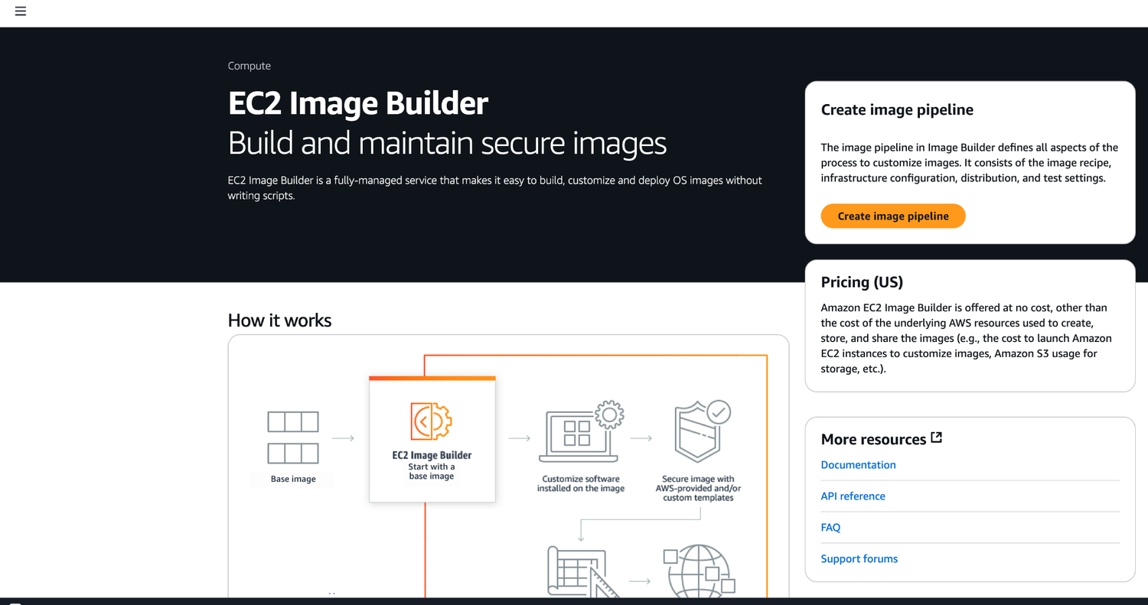
ORIGINAL PPT v4 · SOURCE SLIDE 089 · MODERNISED TECHNICAL DEEP DIVE
Image Builder
1
Mechanism: launch templates…
Mechanism: launch templates, AMIs, instance metadata, IAM roles and Systems Manager define the repeatable state…
2
Failure mode
Failure mode: configuration drift, unmanaged nodes, stale AMIs and unbounded Run Command concurrency turn a…
3
Evidence: inventory coverage…
Evidence: inventory coverage, patch compliance, command output, instance status checks, application health and…
CURRENT OPERATIONS LENS
Manage compute as a governed fleet: immutable inputs, tagged targets, bounded concurrency, health evidence and replacement. Validate service limits and regional availability against current AWS documentation.
AWS Certified SysOps Administrator Associate Training · TGS-2024051413
© 2026 Tertiary Infotech Academy Pte Ltd
182

Slide 183
ORIGINAL PPT v4 · SOURCE SLIDE 091 · MODERNISED TECHNICAL DEEP DIVE
AMI in Production
1
You can force users to
2
Combine with AWS Config to
3
(not approved)
4
(approved)
You can force users to only launch EC2 instances from pre-approved AMIs (AMIs tagged with specific tags) using IAM policies
IAM Permissions
AWS Config
Combine with AWS Config to find non- compliant EC2 instance (instances launched with non-approved AMIs)
… "Condition": {
NON_COMPLIANT
(not approved)
"StringEquals": {
EC2 Instance
Mechanism: launch templates, AMIs, instance metadata, IAM roles and Systems Manager define the repeatable state and management channel for a fleet.
(approved)
"ec2:ResourceTag/Environment": "Prod"
Failure mode: configuration drift, unmanaged nodes, stale AMIs and unbounded Run Command concurrency turn a routine change into fleet-wide impact.
CURRENT OPERATIONS LENS
Manage compute as a governed fleet: immutable inputs, tagged targets, bounded concurrency, health evidence and replacement. Validate service limits and regional availability against current AWS documentation.
AWS Certified SysOps Administrator Associate Training · TGS-2024051413
© 2026 Tertiary Infotech Academy Pte Ltd
183

Slide 184
TOPIC 03 · LEGACY COVERAGE INTEGRATION
Original PPT Coverage Retained — Topic 03
Modernised slides
55 technical slides extracted from the original v4 PowerPoint and rebuilt in the current visual system.
Traceability
Every blended slide names its original v4 source slide number in the kicker.
1
2
Current validation
Terminology is normalised; service limits and Region availability remain explicit current-documentation checks.
Procedure boundary
Click-by-click sequences, activities and quizzes are kept out of the deck and remain in the Learner Guide or lab package.
3
4
AWS Certified SysOps Administrator Associate Training · TGS-2024051413
© 2026 Tertiary Infotech Academy Pte Ltd
184

Slide 185
TOPIC 03 · CONCEPT-LED LAB BRIEF
Operate an EC2 Fleet with Systems Manager
LAB 03
Apply K3, K5, A3 and A5 by onboarding a managed node, using Session Manager and Run Command, assessing patch compliance and executing a controlled Automation runbook.
Build a least-privilege managed-node baseline and produce patch, command and change evidence without exposing inbound administration ports.
YOU'LL BUILD
TOOLCHAIN
DONE WHEN
An EC2 managed node, SSM document, patch-compliance report, automation execution record and rollback evidence.
EC2 · IAM · Systems Manager · Session Manager · Run Command · Patch Manager · Automation
The instance is managed without public SSH, the custom document validates, command and compliance evidence are present, the change record includes verification and rollback, and validation emits LAB 03 PASS.
AWS Certified SysOps Administrator Associate Training · TGS-2024051413
© 2026 Tertiary Infotech Academy Pte Ltd
185

Slide 186
LAB 03 · CONCEPTUAL WORKFLOW
Lab 03 Evidence Model
1
2
3
4
5
Inventory
Canary
Execute
Assess
Rollback
Managed nodes
One target
Controlled command
Patch compliance
Change record
PROCEDURE BOUNDARY
Detailed commands and numbered steps are in the Learner Guide and lab folder—not on these slides.
AWS Certified SysOps Administrator Associate Training · TGS-2024051413
© 2026 Tertiary Infotech Academy Pte Ltd
186

Slide 187
LAB 03 · ACCEPTANCE EVIDENCE
Operate an EC2 Fleet with Systems Manager
✅ Expected result
The instance is managed without public SSH, the custom document validates, command and compliance evidence are present, the change record includes verification and rollback, and validation emits LAB 03 PASS.
IF IT DOESN'T WORK
Input mismatch
Validation stop
Evidence differs
Reconcile identifiers, required fields and units with the supplied data dictionary.
Inspect the named rule and source row; preserve the check rather than bypassing it.
Check the denominator, time window and assumptions before rerunning from clean inputs.
AWS Certified SysOps Administrator Associate Training · TGS-2024051413
© 2026 Tertiary Infotech Academy Pte Ltd
187

Slide 188
TOPIC 03 · RETRIEVAL PRACTICE
Recap — Compute, Virtualisation and Systems Management
Explain
Inventory, patch, access and automate consistently across a fleet.
Distinguish
Build, scan, test and version AMIs instead of hand-configuring servers.
1
2
Apply
K3, K5, A3 and A5 by onboarding a managed node, using Session Manager and Run Command, assessing patch compliance and executing a controlled…
Evidence
The instance is managed without public SSH, the custom document validates, command and compliance evidence are present, the change record includes verification and…
3
4
AWS Certified SysOps Administrator Associate Training · TGS-2024051413
© 2026 Tertiary Infotech Academy Pte Ltd
188

Slide 189
04
TOPIC 04 · LO1 · K4 · K5 · A3 · A5
Reliability, Elasticity and High Availability
Elastic Load Balancing · Auto Scaling · health checks · containers · graceful degradation
AWS Certified SysOps Administrator Associate Training · TGS-2024051413
© 2026 Tertiary Infotech Academy Pte Ltd
189

Slide 190
BLUEPRINT · SOA-C03 Domain 2 · 22%
Key Ideas — Reliability, Elasticity and High Availability
High availability is an end-to-end property
Compute redundancy fails if identity, data or network dependencies remain single points.
Elasticity follows demand
Auto Scaling changes capacity using a measurable signal and bounded policy.
1
2
Health checks drive routing
A check must represent the user's ability to receive a correct response.
Resilience requires recovery
Design degradation, retry, failover and rollback before an incident.
3
4
AWS Certified SysOps Administrator Associate Training · TGS-2024051413
© 2026 Tertiary Infotech Academy Pte Ltd
190

Slide 191
TOPIC 04 · K4 · K5 · A3 · A5
Load Balancer Selection
Type
Layer and strength
Typical workload
ALB
Layer 7 HTTP routing, host/path rules
Web, APIs and containers
NLB
Layer 4 performance and static IP
TCP/UDP/TLS and extreme scale
GWLB
Transparent appliance insertion
Firewalls and inspection fleets
AWS Certified SysOps Administrator Associate Training · TGS-2024051413
© 2026 Tertiary Infotech Academy Pte Ltd
191

Slide 192
TOPIC 04 · K4 · K5 · A3 · A5
Request Path and Health
1
2
3
4
5
6
DNS
Load balancer
Target group
Application
Telemetry
Scaling
Resolve healthy endpoint
Select target
Health and port
Dependency-aware response
Latency and errors
Capacity response
TROUBLESHOOTING
Follow the request path in order; do not jump directly to the instance.
AWS Certified SysOps Administrator Associate Training · TGS-2024051413
© 2026 Tertiary Infotech Academy Pte Ltd
192

Slide 193
TOPIC 04 · K4 · K5 · A3 · A5
Scaling Policy Behaviour
WHAT THE DATA SHOWS
Target tracking follows demand with delay; warm-up and cooldown prevent unstable oscillation.
AWS Certified SysOps Administrator Associate Training · TGS-2024051413
© 2026 Tertiary Infotech Academy Pte Ltd
193

Slide 194
TOPIC 04 · K4 · K5 · A3 · A5
Auto Scaling Controls
Desired capacity
The current fleet target between minimum and maximum bounds.
Target tracking
Adjusts capacity to hold a metric near a chosen target.
1
2
Step scaling
Uses breach magnitude to change capacity by defined steps.
Lifecycle hook
Pauses launch or termination for controlled work.
3
4
AWS Certified SysOps Administrator Associate Training · TGS-2024051413
© 2026 Tertiary Infotech Academy Pte Ltd
194

Slide 195
TOPIC 04 · K4 · K5 · A3 · A5
Failure Handling
Pattern
Response
Caution
Retry with backoff
Recover from transient dependency failure
Bound attempts and add jitter
Circuit breaker
Stop calling an unhealthy dependency
Define recovery probe
Bulkhead
Isolate resource pools
Capacity must reflect priority
Graceful degradation
Preserve critical function
Communicate reduced service
AWS Certified SysOps Administrator Associate Training · TGS-2024051413
© 2026 Tertiary Infotech Academy Pte Ltd
195

Slide 196
TOPIC 04 · K4 · K5 · A3 · A5
Container Operations in SOA-C03
ECS / EKS
Images
Observability
• Service desired count
• Task or pod health and placement
• Versioned and scanned
• Immutable deployment input
• Container Insights
• Logs, metrics and traces by workload
AWS Certified SysOps Administrator Associate Training · TGS-2024051413
© 2026 Tertiary Infotech Academy Pte Ltd
196

Slide 197
Availability Test
Redundancy is not resilience until failover is exercised.
Measure detection, decision, traffic shift, recovery, data integrity and return to steady state.
AWS Certified SysOps Administrator Associate Training · TGS-2024051413
© 2026 Tertiary Infotech Academy Pte Ltd
197

Slide 198
TOPIC 04 · NATIVE EDITABLE TECHNICAL CHART
Scaling Response with Warm-Up
WHAT THE DATA SHOWS
Warm-up prevents premature scaling decisions, but it also delays usable capacity; validate boot time and health-check behaviour together.
AWS Certified SysOps Administrator Associate Training · TGS-2024051413
© 2026 Tertiary Infotech Academy Pte Ltd
198

Slide 199
ORIGINAL PPT v4 · SOURCE SLIDE 134 · MODERNISED TECHNICAL DEEP DIVE
Scalability & High Availability
1
Scalability means that an…
2
There are two kinds of
3
Vertical Scalability
4
Horizontal Scalability (=…
Scalability means that an application / system can handle greater loads by adapting.
Scalability is linked but different to High Availability
There are two kinds of scalability
Let’s deep dive into the distinction, using a call center as an example
Vertical Scalability
Mechanism: DNS, load-balancer health, target-group health, Auto Scaling policy and application dependency checks cooperate to keep capacity available.
Horizontal Scalability (= elasticity)
Failure mode: shallow health checks, incorrect warm-up or coupled dependencies can report healthy capacity while users experience failure.
CURRENT OPERATIONS LENS
Evaluate the complete request path, capacity response, health model, failure domain and recovery behaviour—not one component in isolation. Validate service limits and regional availability against current AWS documentation.
AWS Certified SysOps Administrator Associate Training · TGS-2024051413
© 2026 Tertiary Infotech Academy Pte Ltd
199

Slide 200
ORIGINAL PPT v4 · SOURCE SLIDE 135 · MODERNISED TECHNICAL DEEP DIVE
Vertical Scalability
1
Vertically scalability means…
2
For example, your application runs
3
Scaling that application…
4
Vertical scalability is very…
Vertically scalability means increasing the size of the instance
RDS, ElastiCache are services that can scale vertically.
For example, your application runs on a t2.micro
There’s usually a limit to how much you can vertically scale (hardware limit)
Scaling that application vertically means running it on a t2.large
junior operator
Vertical scalability is very common for non distributed systems, such as a database.
senior operator
CURRENT OPERATIONS LENS
Evaluate the complete request path, capacity response, health model, failure domain and recovery behaviour—not one component in isolation. Validate service limits and regional availability against current AWS documentation.
AWS Certified SysOps Administrator Associate Training · TGS-2024051413
© 2026 Tertiary Infotech Academy Pte Ltd
200

Slide 201
ORIGINAL PPT v4 · SOURCE SLIDE 136 · MODERNISED TECHNICAL DEEP DIVE
Horizontal Scalability
1
Horizontal Scalability means…
2
Horizontal scaling implies…
3
This is very common for
4
It’s easy to horizontally scale
Horizontal Scalability means increasing the number of instances / systems for your application
Horizontal scaling implies distributed systems.
Mechanism: DNS, load-balancer health, target-group health, Auto Scaling policy and application dependency checks cooperate to keep capacity available.
This is very common for web applications / modern applications
It’s easy to horizontally scale thanks the cloud offerings such as Amazon EC2
CURRENT OPERATIONS LENS
Evaluate the complete request path, capacity response, health model, failure domain and recovery behaviour—not one component in isolation. Validate service limits and regional availability against current AWS documentation.
AWS Certified SysOps Administrator Associate Training · TGS-2024051413
© 2026 Tertiary Infotech Academy Pte Ltd
201

Slide 202
ORIGINAL PPT v4 · SOURCE SLIDE 137 · MODERNISED TECHNICAL DEEP DIVE
second building in San Francisco
1
first building in New York
2
High Availability
3
High Availability usually goes…
4
High availability means running…
first building in New York
application / system in at least 2 data centers (== Availability Zones)
High Availability
The goal of high availability is to survive a data center loss
High Availability usually goes hand in hand with horizontal scaling
The high availability can be passive (for RDS Multi AZ for example)
High availability means running your
The high availability can be active (for horizontal scaling)
CURRENT OPERATIONS LENS
Evaluate the complete request path, capacity response, health model, failure domain and recovery behaviour—not one component in isolation. Validate service limits and regional availability against current AWS documentation.
AWS Certified SysOps Administrator Associate Training · TGS-2024051413
© 2026 Tertiary Infotech Academy Pte Ltd
202

Slide 203
ORIGINAL PPT v4 · SOURCE SLIDE 138 · MODERNISED TECHNICAL DEEP DIVE
High Availability & Scalability For EC2
1
Vertical Scaling
2
From: t2.nano
3
To: u-12tb1.metal
4
Horizontal Scaling
Vertical Scaling: Increase instance size (= scale up / down)
Auto Scaling Group
Load Balancer multi-AZ
From: t2.nano - 0.5G of RAM, 1 vCPU
Load Balancer
To: u-12tb1.metal – 12.3 TB of RAM, 448 vCPUs
High Availability: Run instances for the same application across multi-AZ
Horizontal Scaling: Increase number of instances (= scale out / in)
Auto Scaling Group multi-AZ
CURRENT OPERATIONS LENS
Evaluate the complete request path, capacity response, health model, failure domain and recovery behaviour—not one component in isolation. Validate service limits and regional availability against current AWS documentation.
AWS Certified SysOps Administrator Associate Training · TGS-2024051413
© 2026 Tertiary Infotech Academy Pte Ltd
203

Slide 204
ORIGINAL PPT v4 · SOURCE SLIDE 139 · MODERNISED TECHNICAL DEEP DIVE
What is load balancing?
1
Elastic Load Balancer
2
EC2 Instance
3
Load Balances are servers that
4
Evidence: request count, target…
Elastic Load Balancer
Mechanism: DNS, load-balancer health, target-group health, Auto Scaling policy and application dependency checks cooperate to keep capacity available.
EC2 Instance
Failure mode: shallow health checks, incorrect warm-up or coupled dependencies can report healthy capacity while users experience failure.
Load Balances are servers that forward traffic to multiple servers (e.g., EC2 instances) downstream
Evidence: request count, target response time, HTTP error rate, scaling activities, lifecycle-hook events and recovery time expose the complete…
CURRENT OPERATIONS LENS
Evaluate the complete request path, capacity response, health model, failure domain and recovery behaviour—not one component in isolation. Validate service limits and regional availability against current AWS documentation.
AWS Certified SysOps Administrator Associate Training · TGS-2024051413
© 2026 Tertiary Infotech Academy Pte Ltd
204

Slide 205
ORIGINAL PPT v4 · SOURCE SLIDE 140 · MODERNISED TECHNICAL DEEP DIVE
Why use a load balancer?
1
Spread load across multiple…
2
Expose a single point of
3
Seamlessly handle failures of…
4
Do regular health checks to
Spread load across multiple downstream instances
Provide SSL termination (HTTPS) for your websites
Expose a single point of access (DNS) to your application
Enforce stickiness with cookies
Seamlessly handle failures of downstream instances
High availability across zones
Do regular health checks to your instances
Separate public traffic from private traffic
CURRENT OPERATIONS LENS
Evaluate the complete request path, capacity response, health model, failure domain and recovery behaviour—not one component in isolation. Validate service limits and regional availability against current AWS documentation.
AWS Certified SysOps Administrator Associate Training · TGS-2024051413
© 2026 Tertiary Infotech Academy Pte Ltd
205

Slide 206
ORIGINAL PPT v4 · SOURCE SLIDE 141 · MODERNISED TECHNICAL DEEP DIVE
Why use an Elastic Load Balancer?
1
An Elastic Load Balancer is
2
AWS guarantees that it will
3
AWS takes care of upgrades,
4
AWS provides only a few
An Elastic Load Balancer is a managed load balancer
It costs less to setup your own load balancer but it will be a lot more effort on your end
Route 53, AWS WAF, AWS Global Accelerator
AWS guarantees that it will be working
It is integrated with many AWS offerings / services
AWS takes care of upgrades, maintenance, high availability
EC2, EC2 Auto Scaling Groups, Amazon ECS
AWS provides only a few configuration knobs
AWS Certificate Manager (ACM), CloudWatch
CURRENT OPERATIONS LENS
Evaluate the complete request path, capacity response, health model, failure domain and recovery behaviour—not one component in isolation. Validate service limits and regional availability against current AWS documentation.
AWS Certified SysOps Administrator Associate Training · TGS-2024051413
© 2026 Tertiary Infotech Academy Pte Ltd
206

Slide 207
ORIGINAL PPT v4 · SOURCE SLIDE 142 · MODERNISED TECHNICAL DEEP DIVE
Health Checks
1
Health Checks are crucial for
2
They enable the load balancer
3
The health check is done
4
If the response is not
Health Checks are crucial for Load Balancers
Elastic Load Balancer
They enable the load balancer to know if instances it forwards traffic to are available to reply to requests
EC2 Instance
The health check is done on a port and a route (/health is common)
Protocol: HTTP Port: 4567 Endpoint: /health
If the response is not 200 (OK), then the instance is unhealthy
CURRENT OPERATIONS LENS
Evaluate the complete request path, capacity response, health model, failure domain and recovery behaviour—not one component in isolation. Validate service limits and regional availability against current AWS documentation.
AWS Certified SysOps Administrator Associate Training · TGS-2024051413
© 2026 Tertiary Infotech Academy Pte Ltd
207

Slide 208
ORIGINAL PPT v4 · SOURCE SLIDE 143 · MODERNISED TECHNICAL DEEP DIVE
Types of load balancer on AWS
1
AWS has 4 kinds of
2
Classic Load Balancers (v1
3
HTTP, HTTPS,TCP, SSL (secure TCP)
4
Application Load Balancer v2
AWS has 4 kinds of managed Load Balancers
HTTP, HTTPS, WebSocket
Operates at layer 3 (Network layer) - IP Protocol
Classic Load Balancers (v1 - old generation) - 2009 - CLB
Network Load Balancer (v2 - new generation) - 2017 - NLB
Overall, it is recommended to use the newer generation load balancers as they provide more features
HTTP, HTTPS,TCP, SSL (secure TCP)
TCP, TLS (secure TCP), UDP
Some load balancers can be setup as internal (private) or external (public) ELB
Application Load Balancer v2 - new generation) - 2016 - ALB
Gateway Load Balancer - 2020 - GWLB
CURRENT OPERATIONS LENS
Evaluate the complete request path, capacity response, health model, failure domain and recovery behaviour—not one component in isolation. Validate service limits and regional availability against current AWS documentation.
AWS Certified SysOps Administrator Associate Training · TGS-2024051413
© 2026 Tertiary Infotech Academy Pte Ltd
208

Slide 209
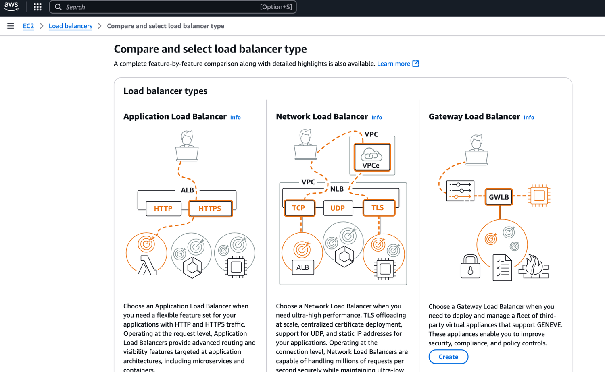
ORIGINAL PPT v4 · SOURCE SLIDE 144 · MODERNISED TECHNICAL DEEP DIVE
Types of load balancer on AWS
1
Mechanism: DNS, load-balancer…
Mechanism: DNS, load-balancer health, target-group health, Auto Scaling policy and application dependency checks…
2
Failure mode
Failure mode: shallow health checks, incorrect warm-up or coupled dependencies can report healthy capacity while…
3
Evidence: request count, target…
Evidence: request count, target response time, HTTP error rate, scaling activities, lifecycle-hook events and…
CURRENT OPERATIONS LENS
Evaluate the complete request path, capacity response, health model, failure domain and recovery behaviour—not one component in isolation. Validate service limits and regional availability against current AWS documentation.
AWS Certified SysOps Administrator Associate Training · TGS-2024051413
© 2026 Tertiary Infotech Academy Pte Ltd
209

Slide 210
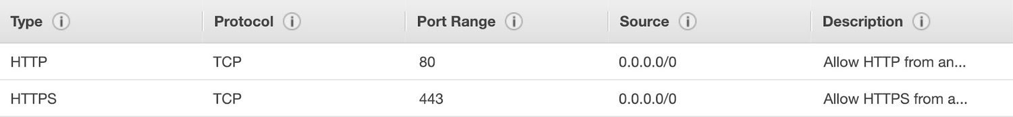
ORIGINAL PPT v4 · SOURCE SLIDE 145 · MODERNISED TECHNICAL DEEP DIVE
Users
1
HTTPS / HTTP
HTTPS / HTTP
Mechanism: DNS, load-balancer health, target-group health, Auto Scaling policy and application dependency checks…
2
Failure mode
Failure mode: shallow health checks, incorrect warm-up or coupled dependencies can report healthy capacity while…
3
Evidence: request count, target…
Evidence: request count, target response time, HTTP error rate, scaling activities, lifecycle-hook events and…
CURRENT OPERATIONS LENS
Evaluate the complete request path, capacity response, health model, failure domain and recovery behaviour—not one component in isolation. Validate service limits and regional availability against current AWS documentation.
AWS Certified SysOps Administrator Associate Training · TGS-2024051413
© 2026 Tertiary Infotech Academy Pte Ltd
210

Slide 211
ORIGINAL PPT v4 · SOURCE SLIDE 146 · MODERNISED TECHNICAL DEEP DIVE
Classic Load Balancers (v1)
1
Supports TCP (Layer 4), HTTP
2
Health checks are TCP or
3
Fixed hostname XXX.region.elb.amaz…
4
Decision point
Supports TCP (Layer 4), HTTP & HTTPS (Layer 7)
Mechanism: DNS, load-balancer health, target-group health, Auto Scaling policy and application dependency checks cooperate to keep capacity available.
Health checks are TCP or HTTP based
Failure mode: shallow health checks, incorrect warm-up or coupled dependencies can report healthy capacity while users experience failure.
Fixed hostname XXX.region.elb.amazonaws.com
Evidence: request count, target response time, HTTP error rate, scaling activities, lifecycle-hook events and recovery time expose the complete…
Decision point: distinguish capacity shortage, unhealthy deployment and downstream dependency failure before changing scaling thresholds.
CURRENT OPERATIONS LENS
Evaluate the complete request path, capacity response, health model, failure domain and recovery behaviour—not one component in isolation. Validate service limits and regional availability against current AWS documentation.
AWS Certified SysOps Administrator Associate Training · TGS-2024051413
© 2026 Tertiary Infotech Academy Pte Ltd
211

Slide 212
ORIGINAL PPT v4 · SOURCE SLIDE 147 · MODERNISED TECHNICAL DEEP DIVE
Application Load Balancer (v2)
1
Application load balancers is…
2
Load balancing to multiple HTTP
3
Load balancing to multiple…
4
Support for HTTP/2 and WebSocket
Application load balancers is Layer 7 (HTTP)
Support redirects (from HTTP to HTTPS for example)
Load balancing to multiple HTTP applications across machines (target groups)
Load balancing to multiple applications on the same machine (ex: containers)
Support for HTTP/2 and WebSocket
Mechanism: DNS, load-balancer health, target-group health, Auto Scaling policy and application dependency checks cooperate to keep capacity available.
CURRENT OPERATIONS LENS
Evaluate the complete request path, capacity response, health model, failure domain and recovery behaviour—not one component in isolation. Validate service limits and regional availability against current AWS documentation.
AWS Certified SysOps Administrator Associate Training · TGS-2024051413
© 2026 Tertiary Infotech Academy Pte Ltd
212

Slide 213
ORIGINAL PPT v4 · SOURCE SLIDE 148 · MODERNISED TECHNICAL DEEP DIVE
Application Load Balancer (v2)
1
Routing tables to different target
2
Routing based on path in
3
Routing based on hostname in
4
Routing based on Query String,
Routing tables to different target groups
ALB are a great fit for micro services & container-based application (example: Docker & Amazon ECS)
Routing based on path in URL (example.com/users & example.com/posts)
Has a port mapping feature to redirect to a dynamic port in ECS
Routing based on hostname in URL ( & other.example.com)
In comparison, we’d need multiple Classic Load Balancer per application
Routing based on Query String, Headers (example.com/users? id=123=false)
Mechanism: DNS, load-balancer health, target-group health, Auto Scaling policy and application dependency checks cooperate to keep capacity available.
CURRENT OPERATIONS LENS
Evaluate the complete request path, capacity response, health model, failure domain and recovery behaviour—not one component in isolation. Validate service limits and regional availability against current AWS documentation.
AWS Certified SysOps Administrator Associate Training · TGS-2024051413
© 2026 Tertiary Infotech Academy Pte Ltd
213

Slide 214
ORIGINAL PPT v4 · SOURCE SLIDE 149 · MODERNISED TECHNICAL DEEP DIVE
Target Group for Users application
1
Application Load Balancer (v2)…
2
External Application Load…
3
Route /user
4
Target Group for Search…
Application Load Balancer (v2) HTTP Based Traffic
Route /search
Mechanism: DNS, load-balancer health, target-group health, Auto Scaling policy and application dependency checks cooperate to keep capacity available.
External Application Load Balancer (v2)
Health Check
Failure mode: shallow health checks, incorrect warm-up or coupled dependencies can report healthy capacity while users experience failure.
Route /user
Evidence: request count, target response time, HTTP error rate, scaling activities, lifecycle-hook events and recovery time expose the complete…
Target Group for Search application
Decision point: distinguish capacity shortage, unhealthy deployment and downstream dependency failure before changing scaling thresholds.
CURRENT OPERATIONS LENS
Evaluate the complete request path, capacity response, health model, failure domain and recovery behaviour—not one component in isolation. Validate service limits and regional availability against current AWS documentation.
AWS Certified SysOps Administrator Associate Training · TGS-2024051413
© 2026 Tertiary Infotech Academy Pte Ltd
214

Slide 215
ORIGINAL PPT v4 · SOURCE SLIDE 150 · MODERNISED TECHNICAL DEEP DIVE
Application Load Balancer (v2) Target Groups
1
EC2 instances (can be managed
2
ECS tasks (managed by ECS itself)
3
Lambda functions
4
IP Addresses
EC2 instances (can be managed by an Auto Scaling Group) - HTTP
ALB can route to multiple target groups
ECS tasks (managed by ECS itself) - HTTP
Health checks are at the target group level
Lambda functions - HTTP request is translated into a JSON event
IP Addresses - must be private IPs
Mechanism: DNS, load-balancer health, target-group health, Auto Scaling policy and application dependency checks cooperate to keep capacity available.
CURRENT OPERATIONS LENS
Evaluate the complete request path, capacity response, health model, failure domain and recovery behaviour—not one component in isolation. Validate service limits and regional availability against current AWS documentation.
AWS Certified SysOps Administrator Associate Training · TGS-2024051413
© 2026 Tertiary Infotech Academy Pte Ltd
215

Slide 216
ORIGINAL PPT v4 · SOURCE SLIDE 151 · MODERNISED TECHNICAL DEEP DIVE
Target Group 1
1
AWS – EC2 based
2
Application Load Balancer (v2)…
3
External Application Load…
4
?Platform=Mobile
AWS – EC2 based
Target Group 2
Mechanism: DNS, load-balancer health, target-group health, Auto Scaling policy and application dependency checks cooperate to keep capacity available.
Application Load Balancer (v2) Query Strings/Parameters Routing
On-premises – Private IP routing
External Application Load Balancer (v2)
?Platform=Desktop
Failure mode: shallow health checks, incorrect warm-up or coupled dependencies can report healthy capacity while users experience failure.
?Platform=Mobile
Evidence: request count, target response time, HTTP error rate, scaling activities, lifecycle-hook events and recovery time expose the complete…
CURRENT OPERATIONS LENS
Evaluate the complete request path, capacity response, health model, failure domain and recovery behaviour—not one component in isolation. Validate service limits and regional availability against current AWS documentation.
AWS Certified SysOps Administrator Associate Training · TGS-2024051413
© 2026 Tertiary Infotech Academy Pte Ltd
216

Slide 217
ORIGINAL PPT v4 · SOURCE SLIDE 152 · MODERNISED TECHNICAL DEEP DIVE
Application Load Balancer (v2) Good to Know
1
Fixed hostname (XXX.region.elb.ama…
2
The application servers don’t see
3
The true IP of the
4
We can also get Port
Fixed hostname (XXX.region.elb.amazonaws.com)
Client IP 12.34.56.78
Mechanism: DNS, load-balancer health, target-group health, Auto Scaling policy and application dependency checks cooperate to keep capacity available.
The application servers don’t see the IP of the client directly
Load Balancer IP (Private IP)
The true IP of the client is inserted in the header X-Forwarded-For
Connection termination
We can also get Port (X-Forwarded-Port) and proto (X-Forwarded-Proto)
Failure mode: shallow health checks, incorrect warm-up or coupled dependencies can report healthy capacity while users experience failure.
CURRENT OPERATIONS LENS
Evaluate the complete request path, capacity response, health model, failure domain and recovery behaviour—not one component in isolation. Validate service limits and regional availability against current AWS documentation.
AWS Certified SysOps Administrator Associate Training · TGS-2024051413
© 2026 Tertiary Infotech Academy Pte Ltd
217

Slide 218
ORIGINAL PPT v4 · SOURCE SLIDE 154 · MODERNISED TECHNICAL DEEP DIVE
Network Load Balancer (v2)
1
Network load balancers (Layer 4)
2
Forward TCP & UDP traffic
3
Handle millions of request per
4
Ultra-low latency
Network load balancers (Layer 4) allow to
NLB has one static IP per AZ and supports assigning Elastic IP
Forward TCP & UDP traffic to your instances
(helpful for whitelisting specific IP)
Handle millions of request per seconds
NLB are used for extreme performance,TCP or UDP traffic
Ultra-low latency
Not included in the AWS free tier
Mechanism: DNS, load-balancer health, target-group health, Auto Scaling policy and application dependency checks cooperate to keep capacity available.
CURRENT OPERATIONS LENS
Evaluate the complete request path, capacity response, health model, failure domain and recovery behaviour—not one component in isolation. Validate service limits and regional availability against current AWS documentation.
AWS Certified SysOps Administrator Associate Training · TGS-2024051413
© 2026 Tertiary Infotech Academy Pte Ltd
218

Slide 219
ORIGINAL PPT v4 · SOURCE SLIDE 155 · MODERNISED TECHNICAL DEEP DIVE
Network Load Balancer (v2) TCP (Layer 4) Based Traffic
1
Target Group for Users application
2
External Network Load Balancer…
3
TCP + Rules
4
Target Group for Search…
Target Group for Users application
Health Check
Mechanism: DNS, load-balancer health, target-group health, Auto Scaling policy and application dependency checks cooperate to keep capacity available.
External Network Load Balancer (v2)
Failure mode: shallow health checks, incorrect warm-up or coupled dependencies can report healthy capacity while users experience failure.
TCP + Rules
Evidence: request count, target response time, HTTP error rate, scaling activities, lifecycle-hook events and recovery time expose the complete…
Target Group for Search application
Decision point: distinguish capacity shortage, unhealthy deployment and downstream dependency failure before changing scaling thresholds.
CURRENT OPERATIONS LENS
Evaluate the complete request path, capacity response, health model, failure domain and recovery behaviour—not one component in isolation. Validate service limits and regional availability against current AWS documentation.
AWS Certified SysOps Administrator Associate Training · TGS-2024051413
© 2026 Tertiary Infotech Academy Pte Ltd
219

Slide 220
ORIGINAL PPT v4 · SOURCE SLIDE 156 · MODERNISED TECHNICAL DEEP DIVE
Network Load Balancer - Target Groups
1
EC2 Instances
2
IP Addresses
3
Application Load Balancer
4
Health Checks support the TCP,
EC2 Instances
i-1234567890abcdef0 i-1234567890abcdef0
192.168.1.118
Mechanism: DNS, load-balancer health, target-group health, Auto Scaling policy and application dependency checks cooperate to keep capacity available.
IP Addresses - must be private IPs
Target Group
Failure mode: shallow health checks, incorrect warm-up or coupled dependencies can report healthy capacity while users experience failure.
Application Load Balancer
Load Balancer
Evidence: request count, target response time, HTTP error rate, scaling activities, lifecycle-hook events and recovery time expose the complete…
Health Checks support the TCP, HTTP, HTTPS Protocols
(IP Addresses)
CURRENT OPERATIONS LENS
Evaluate the complete request path, capacity response, health model, failure domain and recovery behaviour—not one component in isolation. Validate service limits and regional availability against current AWS documentation.
AWS Certified SysOps Administrator Associate Training · TGS-2024051413
© 2026 Tertiary Infotech Academy Pte Ltd
220

Slide 221
ORIGINAL PPT v4 · SOURCE SLIDE 158 · MODERNISED TECHNICAL DEEP DIVE
Gateway Load Balancer
1
Deploy, scale, and manage a
2
Example: Firewalls, Intrusion…
3
Prevention Systems, Deep Packet…
4
Operates at Layer 3 (Network…
Deploy, scale, and manage a fleet of 3rd party network virtual appliances in AWS
Combines the following functions
Application
Example: Firewalls, Intrusion Detection and
Transparent Network Gateway - single entry/exit for all traffic
(destination)
Prevention Systems, Deep Packet Inspection Systems, payload manipulation, …
Load Balancer - distributes traffic to your virtual appliances
Target Group
Operates at Layer 3 (Network Layer) – IP Packets
Uses the GENEVE protocol on port 60
3rd Party Security Virtual Appliances
CURRENT OPERATIONS LENS
Evaluate the complete request path, capacity response, health model, failure domain and recovery behaviour—not one component in isolation. Validate service limits and regional availability against current AWS documentation.
AWS Certified SysOps Administrator Associate Training · TGS-2024051413
© 2026 Tertiary Infotech Academy Pte Ltd
221

Slide 222
ORIGINAL PPT v4 · SOURCE SLIDE 159 · MODERNISED TECHNICAL DEEP DIVE
Gateway Load Balancer - Target Groups
1
EC2 Instances
2
IP Addresses
3
i-1234567890abcdef0…
4
Target Group
EC2 Instances
Gateway Load Balancer
Mechanism: DNS, load-balancer health, target-group health, Auto Scaling policy and application dependency checks cooperate to keep capacity available.
IP Addresses - must be private IPs
(IP Addresses)
Failure mode: shallow health checks, incorrect warm-up or coupled dependencies can report healthy capacity while users experience failure.
i-1234567890abcdef0 i-1234567890abcdef0
192.168.1.118
Evidence: request count, target response time, HTTP error rate, scaling activities, lifecycle-hook events and recovery time expose the complete…
Target Group
Decision point: distinguish capacity shortage, unhealthy deployment and downstream dependency failure before changing scaling thresholds.
CURRENT OPERATIONS LENS
Evaluate the complete request path, capacity response, health model, failure domain and recovery behaviour—not one component in isolation. Validate service limits and regional availability against current AWS documentation.
AWS Certified SysOps Administrator Associate Training · TGS-2024051413
© 2026 Tertiary Infotech Academy Pte Ltd
222

Slide 223
ORIGINAL PPT v4 · SOURCE SLIDE 160 · MODERNISED TECHNICAL DEEP DIVE
Sticky Sessions (Session Affinity)
1
It is possible to implement
2
same client is always redirected
3
This works for Classic Load
4
Application Load Balancer, and…
It is possible to implement stickiness so that the
For both CLB & ALB, the “cookie” used for stickiness has an expiration date you control
same client is always redirected to the same instance behind a load balancer
Use case: make sure the user doesn’t lose his session data
This works for Classic Load Balancer
Enabling stickiness may bring imbalance to the load over the backend EC2 instances
Application Load Balancer, and Network Load Balancer
EC2 Instance
Mechanism: DNS, load-balancer health, target-group health, Auto Scaling policy and application dependency checks cooperate to keep capacity available.
CURRENT OPERATIONS LENS
Evaluate the complete request path, capacity response, health model, failure domain and recovery behaviour—not one component in isolation. Validate service limits and regional availability against current AWS documentation.
AWS Certified SysOps Administrator Associate Training · TGS-2024051413
© 2026 Tertiary Infotech Academy Pte Ltd
223

Slide 224
ORIGINAL PPT v4 · SOURCE SLIDE 161 · MODERNISED TECHNICAL DEEP DIVE
Sticky Sessions – Cookie Names
1
Application based cookies
2
Custom cookie
3
Generated by the target
4
Can include any custom attributes
Application based cookies
Cookie name must be specified individually for each target group
Cookie name is AWSALBAPP
Custom cookie
Don’t use AWSALB, AWSALBAPP or AWSALBTG reserved for use by the ELB)
Duration based cookies
Generated by the target
Application cookie
Cookie generated by the load balancer
Can include any custom attributes required by the application
Generated by the load balancer
Cookie name is AWSALB for ALB, AWSELB for CLB
CURRENT OPERATIONS LENS
Evaluate the complete request path, capacity response, health model, failure domain and recovery behaviour—not one component in isolation. Validate service limits and regional availability against current AWS documentation.
AWS Certified SysOps Administrator Associate Training · TGS-2024051413
© 2026 Tertiary Infotech Academy Pte Ltd
224

Slide 225
ORIGINAL PPT v4 · SOURCE SLIDE 163 · MODERNISED TECHNICAL DEEP DIVE
Cross-Zone Load Balancing
1
Availability Zone 1
2
Availability Zone 2
3
With Cross Zone Load Balancing
4
each load balancer instance…
Availability Zone 1
Without Cross Zone Load Balancing
Mechanism: DNS, load-balancer health, target-group health, Auto Scaling policy and application dependency checks cooperate to keep capacity available.
Availability Zone 2
Requests are distributed in the instances of the node of the Elastic Load Balancer
With Cross Zone Load Balancing
Failure mode: shallow health checks, incorrect warm-up or coupled dependencies can report healthy capacity while users experience failure.
each load balancer instance distributes evenly across all registered instances in all AZ
CURRENT OPERATIONS LENS
Evaluate the complete request path, capacity response, health model, failure domain and recovery behaviour—not one component in isolation. Validate service limits and regional availability against current AWS documentation.
AWS Certified SysOps Administrator Associate Training · TGS-2024051413
© 2026 Tertiary Infotech Academy Pte Ltd
225

Slide 226
ORIGINAL PPT v4 · SOURCE SLIDE 164 · MODERNISED TECHNICAL DEEP DIVE
Cross-Zone Load Balancing
1
Application Load Balancer
2
Enabled by default (can be
3
No charges for inter AZ
4
Network Load Balancer $ Gateway
Application Load Balancer
Disabled by default
Mechanism: DNS, load-balancer health, target-group health, Auto Scaling policy and application dependency checks cooperate to keep capacity available.
Enabled by default (can be disabled at the Target Group level)
You pay charges ($) for inter AZ data if enabled
No charges for inter AZ data
Classic Load Balancer
Failure mode: shallow health checks, incorrect warm-up or coupled dependencies can report healthy capacity while users experience failure.
Network Load Balancer $ Gateway Load Balancer
No charges for inter AZ data if enabled
CURRENT OPERATIONS LENS
Evaluate the complete request path, capacity response, health model, failure domain and recovery behaviour—not one component in isolation. Validate service limits and regional availability against current AWS documentation.
AWS Certified SysOps Administrator Associate Training · TGS-2024051413
© 2026 Tertiary Infotech Academy Pte Ltd
226

Slide 227
ORIGINAL PPT v4 · SOURCE SLIDE 166 · MODERNISED TECHNICAL DEEP DIVE
SSL/TLS - Basics
1
An SSL Certificate allows traffic
2
SSL refers to Secure Sockets
3
TLS refers to Transport Layer
4
Nowadays, TLS certificates are…
An SSL Certificate allows traffic between your clients and your load balancer to be encrypted in transit (in-flight encryption)
Public SSL certificates are issued by Certificate Authorities (CA)
SSL refers to Secure Sockets Layer, used to encrypt connections
Comodo, Symantec, GoDaddy, GlobalSign, Digicert, Letsencrypt, etc…
TLS refers to Transport Layer Security, which is a newer version
SSL certificates have an expiration date (you set) and must be renewed
Nowadays, TLS certificates are mainly used, but people still refer as SSL
CURRENT OPERATIONS LENS
Evaluate the complete request path, capacity response, health model, failure domain and recovery behaviour—not one component in isolation. Validate service limits and regional availability against current AWS documentation.
AWS Certified SysOps Administrator Associate Training · TGS-2024051413
© 2026 Tertiary Infotech Academy Pte Ltd
227

Slide 228
ORIGINAL PPT v4 · SOURCE SLIDE 167 · MODERNISED TECHNICAL DEEP DIVE
The load balancer uses an X.509 certificate (SSL/TLS server certificate)
1
You can manage certificates using
2
You can create upload your
3
HTTPS listener
4
You must specify a default
You can manage certificates using ACM (AWS Certificate Manager)
You can add an optional list of certs to support multiple domains
Over private VPC
You can create upload your own certificates alternatively
Cilents can use SNI (Server Name Indication) to specify the hostname they reach
Load Balancer - SSL Certificates
HTTPS listener
Ability to specify a security policy to support older versions of SSL / TLS (legacy clients)
LOAD BALANCER
You must specify a default certificate
HTTPS (encrypted) Over www
CURRENT OPERATIONS LENS
Evaluate the complete request path, capacity response, health model, failure domain and recovery behaviour—not one component in isolation. Validate service limits and regional availability against current AWS documentation.
AWS Certified SysOps Administrator Associate Training · TGS-2024051413
© 2026 Tertiary Infotech Academy Pte Ltd
228

Slide 229
ORIGINAL PPT v4 · SOURCE SLIDE 168 · MODERNISED TECHNICAL DEEP DIVE
SSL - Server Name Indication (SNI)
1
SNI solves the problem of
2
It’s a “newer” protocol, and
3
to indicate the hostname of
4
The server will then find
SNI solves the problem of loading multiple SSL certificates onto multiple web servers (to serve multiple websites)
Only works for ALB & NLB (newer generation), CloudFront
I would like www.mycorp.com
It’s a “newer” protocol, and requires the client
Does not work for CLB (older gen)
Target group for www.mycorp.com
to indicate the hostname of the target server in the initial SSL handshake
SSL Cert: Domain1.example.com
Target group for Domain1.example.com
The server will then find the correct certificate, or return the default one
SSL Cert: www.mycorp.com
Use the correct SSL cert
CURRENT OPERATIONS LENS
Evaluate the complete request path, capacity response, health model, failure domain and recovery behaviour—not one component in isolation. Validate service limits and regional availability against current AWS documentation.
AWS Certified SysOps Administrator Associate Training · TGS-2024051413
© 2026 Tertiary Infotech Academy Pte Ltd
229

Slide 230
ORIGINAL PPT v4 · SOURCE SLIDE 169 · MODERNISED TECHNICAL DEEP DIVE
Elastic Load Balancers - SSL Certificates
1
Classic Load Balancer (v1)
2
Support only one SSL certificate
3
Must use multiple CLB for
4
Application Load Balancer (v2)
Classic Load Balancer (v1)
Supports multiple listeners with multiple SSL certificates
Support only one SSL certificate
Uses Server Name Indication (SNI) to make it work
Must use multiple CLB for multiple hostname with multiple SSL certificates
Network Load Balancer (v2)
Application Load Balancer (v2)
Mechanism: DNS, load-balancer health, target-group health, Auto Scaling policy and application dependency checks cooperate to keep capacity available.
CURRENT OPERATIONS LENS
Evaluate the complete request path, capacity response, health model, failure domain and recovery behaviour—not one component in isolation. Validate service limits and regional availability against current AWS documentation.
AWS Certified SysOps Administrator Associate Training · TGS-2024051413
© 2026 Tertiary Infotech Academy Pte Ltd
230

Slide 231
ORIGINAL PPT v4 · SOURCE SLIDE 171 · MODERNISED TECHNICAL DEEP DIVE
Connection Draining
1
Feature naming
2
Connection Draining
3
Deregistration Delay
4
Time to complete “in-flight…
Feature naming
Stops sending new requests to the EC2 instance which is de-registering
waiting for existing
Connection Draining – for CLB
Between 1 to 3600 seconds (default: 300 seconds)
connections to complete
Deregistration Delay – for ALB & NLB
Can be disabled (set value to 0)
new connections
Time to complete “in-flight requests” while the instance is de-registering or unhealthy
Set to a low value if your requests are short
established to all other instances
CURRENT OPERATIONS LENS
Evaluate the complete request path, capacity response, health model, failure domain and recovery behaviour—not one component in isolation. Validate service limits and regional availability against current AWS documentation.
AWS Certified SysOps Administrator Associate Training · TGS-2024051413
© 2026 Tertiary Infotech Academy Pte Ltd
231

Slide 232
ORIGINAL PPT v4 · SOURCE SLIDE 172 · MODERNISED TECHNICAL DEEP DIVE
ELB Health Checks
1
Target Health Status
2
Initial: registering the target
3
Unused: target is not registered
4
Draining: de-registering the…
Target Health Status
unavailable: health checks disabled
Health Check
Mechanism: DNS, load-balancer health, target-group health, Auto Scaling policy and application dependency checks cooperate to keep capacity available.
Initial: registering the target
If a group contains only unhealthy targets, ELB routes requests across its unhealthy targets
Description
Unused: target is not registered
Target Group
HealthCheckProtocol
Failure mode: shallow health checks, incorrect warm-up or coupled dependencies can report healthy capacity while users experience failure.
Draining: de-registering the target
Application Load Balancer
Protocol used to perform health checks
CURRENT OPERATIONS LENS
Evaluate the complete request path, capacity response, health model, failure domain and recovery behaviour—not one component in isolation. Validate service limits and regional availability against current AWS documentation.
AWS Certified SysOps Administrator Associate Training · TGS-2024051413
© 2026 Tertiary Infotech Academy Pte Ltd
232

Slide 233
ORIGINAL PPT v4 · SOURCE SLIDE 173 · MODERNISED TECHNICAL DEEP DIVE
Load Balancer Error codes
1
Successful request
2
Unsuccessful at client side
3
Error 400
4
Error 401
Successful request : Code 200.
Error 403 : Forbidden
An error 500 / Internal server error would mean some error on the ELB itself.
Unsuccessful at client side : 4XX code.
Error 460 : Client closed connection.
Error 502 : Bad Gateway
Error 400 : Bad Request
Error 463 : X-Forwarded For header with >30 IP (Similar to malformed request).
An error 503/ Service Unavailable
Error 401 : Unauthorized
Unsuccessful at server side : 5xx code.
Error 504 / Gateway timeout : probably an issue within the server.
CURRENT OPERATIONS LENS
Evaluate the complete request path, capacity response, health model, failure domain and recovery behaviour—not one component in isolation. Validate service limits and regional availability against current AWS documentation.
AWS Certified SysOps Administrator Associate Training · TGS-2024051413
© 2026 Tertiary Infotech Academy Pte Ltd
233

Slide 234
ORIGINAL PPT v4 · SOURCE SLIDE 175 · MODERNISED TECHNICAL DEEP DIVE
Load Balancers Monitoring
1
All Load Balancer metrics are
2
BackendConnectionErrors
3
HealthyHostCount / UnHealthyHostCo…
4
HTTPCode_Backend_2XX: Successful…
All Load Balancer metrics are directly pushed to CloudWatch metrics
HTTPCode_Backend_3XX, redirected request
RequestCount
BackendConnectionErrors
HTTPCode_ELB_4XX: Client error codes
ReuqestCountPerTarget
Mechanism: DNS, load-balancer health, target-group health, Auto Scaling policy and application dependency checks cooperate to keep capacity available.
HealthyHostCount / UnHealthyHostCount
HTTPCode_ELB_5XX
SurgeQueueLength: the total
Failure mode: shallow health checks, incorrect warm-up or coupled dependencies can report healthy capacity while users experience failure.
HTTPCode_Backend_2XX: Successful request.
Server error codes generated by the load balancer.
number of requests (HTTP listener) or connections (TCP
CURRENT OPERATIONS LENS
Evaluate the complete request path, capacity response, health model, failure domain and recovery behaviour—not one component in isolation. Validate service limits and regional availability against current AWS documentation.
AWS Certified SysOps Administrator Associate Training · TGS-2024051413
© 2026 Tertiary Infotech Academy Pte Ltd
234

Slide 235
ORIGINAL PPT v4 · SOURCE SLIDE 176 · MODERNISED TECHNICAL DEEP DIVE
Load Balancer troubleshooting using metrics
1
HTTP 400
2
HTTP 503
3
every Availability Zone that your
4
HTTP 504
HTTP 400: BAD_REQUEST=> The client sent a malformed request that does not meet HTTP specifications.
instances are enabled and make sure that the keep-alive timeout is greater than the idle timeout settings of load balancer.
HTTP 503: Service Unavailable => Ensure that you have healthy instances in
Set alarms & look at the documentation for troubleshooting: message.html
every Availability Zone that your load balancer is configured to respond in. Look for HealthyHostCount in CloudWatch
HTTP 504: Gateway Timeout => Check if keep-alive settings on your EC2
CURRENT OPERATIONS LENS
Evaluate the complete request path, capacity response, health model, failure domain and recovery behaviour—not one component in isolation. Validate service limits and regional availability against current AWS documentation.
AWS Certified SysOps Administrator Associate Training · TGS-2024051413
© 2026 Tertiary Infotech Academy Pte Ltd
235

Slide 236
ORIGINAL PPT v4 · SOURCE SLIDE 177 · MODERNISED TECHNICAL DEEP DIVE
Load Balancers Access Logs
1
Access logs from Load Balancers
2
Client IP address
3
Request paths
4
Server response
Access logs from Load Balancers can be stored in S3 and contain
Only pay for the S3 storage
Client IP address
Helpful for compliance reason
Mechanism: DNS, load-balancer health, target-group health, Auto Scaling policy and application dependency checks cooperate to keep capacity available.
Request paths
Helpful for keeping access data even after ELB or EC2 instances are terminated
Server response
Access Logs are already encrypted
Failure mode: shallow health checks, incorrect warm-up or coupled dependencies can report healthy capacity while users experience failure.
CURRENT OPERATIONS LENS
Evaluate the complete request path, capacity response, health model, failure domain and recovery behaviour—not one component in isolation. Validate service limits and regional availability against current AWS documentation.
AWS Certified SysOps Administrator Associate Training · TGS-2024051413
© 2026 Tertiary Infotech Academy Pte Ltd
236

Slide 237
ORIGINAL PPT v4 · SOURCE SLIDE 178 · MODERNISED TECHNICAL DEEP DIVE
Application Load Balancer Request Tracing
1
Request tracing
2
‘X-Amzn-Trace-Id’
3
X-Amzn-Trace-Id: Root=1-67891233-a…
4
This is useful in logs
Request tracing – Each HTTP request has an added custom header
Application Load Balancer is not (yet) integrated with X-Ray
‘X-Amzn-Trace-Id’
Mechanism: DNS, load-balancer health, target-group health, Auto Scaling policy and application dependency checks cooperate to keep capacity available.
X-Amzn-Trace-Id: Root=1-67891233-abcdef012345678912345678
Failure mode: shallow health checks, incorrect warm-up or coupled dependencies can report healthy capacity while users experience failure.
This is useful in logs / distributed tracing platform to track a single request
CURRENT OPERATIONS LENS
Evaluate the complete request path, capacity response, health model, failure domain and recovery behaviour—not one component in isolation. Validate service limits and regional availability against current AWS documentation.
AWS Certified SysOps Administrator Associate Training · TGS-2024051413
© 2026 Tertiary Infotech Academy Pte Ltd
237

Slide 238
ORIGINAL PPT v4 · SOURCE SLIDE 179 · MODERNISED TECHNICAL DEEP DIVE
Target Groups Settings
1
Deregistration_delay.timeout_secon…
2
slow_start.duration_seconds: (see…
3
load_balancing.algorithm.type: ow…
4
Stickiness.enabled
Deregistration_delay.timeout_seconds time the load balancer waits before deregistering a target
Stickiness.type: application-based or duration-based cookie
slow_start.duration_seconds: (see next slide)
Stickiness.app_cookie.cookie_name: name of the application cookie
load_balancing.algorithm.type: ow the load balancer selects targets when routing requests (Round Robin, Least Outstanding Requests)
Stickiness.app_cookie.duration_seconds: application-based cookie expiration period
Stickiness.enabled
Stickiness.lb_cookie.duration_seconds: duration-based cookie expiration period
Mechanism: DNS, load-balancer health, target-group health, Auto Scaling policy and application dependency checks cooperate to keep capacity available.
CURRENT OPERATIONS LENS
Evaluate the complete request path, capacity response, health model, failure domain and recovery behaviour—not one component in isolation. Validate service limits and regional availability against current AWS documentation.
AWS Certified SysOps Administrator Associate Training · TGS-2024051413
© 2026 Tertiary Infotech Academy Pte Ltd
238

Slide 239
ORIGINAL PPT v4 · SOURCE SLIDE 180 · MODERNISED TECHNICAL DEEP DIVE
Slow Start Mode
1
By default, a target receives
2
slow start mode gives healthy
3
The load balancer linearly…
4
A target exits Slow Start
By default, a target receives its full share of requests once it’s registered with the target group
The duration period elapses
without Slow Start mode
slow start mode gives healthy targets time to warm-up before the load balancer sends them a full share of requests
The target becomes unhealthy
with Slow Start mode
The load balancer linearly increases the number of requests that it sends to the target
To disable, set slow start duration value to 0
EC2 Instance EC2 Instance
A target exits Slow Start Mode when
Slow Start duration
Target Group
CURRENT OPERATIONS LENS
Evaluate the complete request path, capacity response, health model, failure domain and recovery behaviour—not one component in isolation. Validate service limits and regional availability against current AWS documentation.
AWS Certified SysOps Administrator Associate Training · TGS-2024051413
© 2026 Tertiary Infotech Academy Pte Ltd
239

Slide 240
ORIGINAL PPT v4 · SOURCE SLIDE 181 · MODERNISED TECHNICAL DEEP DIVE
Request Routing Algorithms - Least Outstanding Requests
1
The next instance to receive
2
Works with Application Load…
3
EC2 Instance
4
Registered Instances
The next instance to receive the request is the instance that has the lowest number of pending/unfinished requests
(HTTP/HTTPS Listener)
Works with Application Load Balancer and Classic Load Balancer (HTTP/HTTPS)
EC2 Instance
Mechanism: DNS, load-balancer health, target-group health, Auto Scaling policy and application dependency checks cooperate to keep capacity available.
Registered Instances
Failure mode: shallow health checks, incorrect warm-up or coupled dependencies can report healthy capacity while users experience failure.
CURRENT OPERATIONS LENS
Evaluate the complete request path, capacity response, health model, failure domain and recovery behaviour—not one component in isolation. Validate service limits and regional availability against current AWS documentation.
AWS Certified SysOps Administrator Associate Training · TGS-2024051413
© 2026 Tertiary Infotech Academy Pte Ltd
240

Slide 241
ORIGINAL PPT v4 · SOURCE SLIDE 182 · MODERNISED TECHNICAL DEEP DIVE
Request Routing Algorithms - Round Robin
1
Equally choose the targets from
2
Works with Application Load…
3
CLB (TCP Listener)
4
EC2 Instance
Equally choose the targets from the target group
Target Group (ALB) / Registered Instances (CLB)
Works with Application Load Balancer and Classic Load Balancer (TCP)
CLB (TCP Listener)
Mechanism: DNS, load-balancer health, target-group health, Auto Scaling policy and application dependency checks cooperate to keep capacity available.
EC2 Instance
Failure mode: shallow health checks, incorrect warm-up or coupled dependencies can report healthy capacity while users experience failure.
CURRENT OPERATIONS LENS
Evaluate the complete request path, capacity response, health model, failure domain and recovery behaviour—not one component in isolation. Validate service limits and regional availability against current AWS documentation.
AWS Certified SysOps Administrator Associate Training · TGS-2024051413
© 2026 Tertiary Infotech Academy Pte Ltd
241

Slide 242
ORIGINAL PPT v4 · SOURCE SLIDE 183 · MODERNISED TECHNICAL DEEP DIVE
Request Routing Algorithms - Flow Hash
1
Selects a target based on
2
Each TCP/UDP connection is routed
3
Works with Network Load Balancer
4
Network Load Balancer
Selects a target based on the protocol, source/destination IP address, source/destination port, and TCP sequence number
Flow Hash Algorithm
Target Group
Each TCP/UDP connection is routed to a single target for the life of the connection
Source & destination IP Source & destination Port TCP sequence no.
Works with Network Load Balancer
Hash 8743b…
Mechanism: DNS, load-balancer health, target-group health, Auto Scaling policy and application dependency checks cooperate to keep capacity available.
Network Load Balancer
EC2 Instance
Failure mode: shallow health checks, incorrect warm-up or coupled dependencies can report healthy capacity while users experience failure.
CURRENT OPERATIONS LENS
Evaluate the complete request path, capacity response, health model, failure domain and recovery behaviour—not one component in isolation. Validate service limits and regional availability against current AWS documentation.
AWS Certified SysOps Administrator Associate Training · TGS-2024051413
© 2026 Tertiary Infotech Academy Pte Ltd
242

Slide 243
ORIGINAL PPT v4 · SOURCE SLIDE 184 · MODERNISED TECHNICAL DEEP DIVE
ALB - Listener Rules
1
Processed in order (with Default
2
Supported Actions (forward…
3
Rule Conditions
4
host-header
Processed in order (with Default Rule)
http-request-method
Application Load Balancer
Supported Actions (forward, redirect, fixed-response)
path-pattern
Rule (Default)
Mechanism: DNS, load-balancer health, target-group health, Auto Scaling policy and application dependency checks cooperate to keep capacity available.
Rule Conditions
http-header
Target Group 2
Failure mode: shallow health checks, incorrect warm-up or coupled dependencies can report healthy capacity while users experience failure.
host-header
query-string
Target Group 3
Evidence: request count, target response time, HTTP error rate, scaling activities, lifecycle-hook events and recovery time expose the complete…
CURRENT OPERATIONS LENS
Evaluate the complete request path, capacity response, health model, failure domain and recovery behaviour—not one component in isolation. Validate service limits and regional availability against current AWS documentation.
AWS Certified SysOps Administrator Associate Training · TGS-2024051413
© 2026 Tertiary Infotech Academy Pte Ltd
243

Slide 244
TOPIC 04 · LEGACY COVERAGE INTEGRATION
Original PPT Coverage Retained — Topic 04
Modernised slides
45 technical slides extracted from the original v4 PowerPoint and rebuilt in the current visual system.
Traceability
Every blended slide names its original v4 source slide number in the kicker.
1
2
Current validation
Terminology is normalised; service limits and Region availability remain explicit current-documentation checks.
Procedure boundary
Click-by-click sequences, activities and quizzes are kept out of the deck and remain in the Learner Guide or lab package.
3
4
AWS Certified SysOps Administrator Associate Training · TGS-2024051413
© 2026 Tertiary Infotech Academy Pte Ltd
244

Slide 245
TOPIC 04 · CONCEPT-LED LAB BRIEF
Deploy and Test a Multi-AZ Highly Available Service
LAB 04
Apply K4, K5, A3 and A5 by deploying an ALB and Auto Scaling service across two Availability Zones, testing health-based recovery and recording a controlled change.
Deploy a small Multi-AZ web tier, verify health and scaling signals, then run a bounded failure exercise.
YOU'LL BUILD
TOOLCHAIN
DONE WHEN
A two-AZ VPC web tier, ALB, target group, launch template, Auto Scaling group, failover evidence and cleanup record.
VPC · EC2 · ALB · Auto Scaling · CloudWatch · CloudFormation
The service spans two Availability Zones, returns a healthy response during one-instance replacement, recovers desired capacity, records measured recovery time, and validation emits LAB 04 PASS.
AWS Certified SysOps Administrator Associate Training · TGS-2024051413
© 2026 Tertiary Infotech Academy Pte Ltd
245

Slide 246
LAB 04 · CONCEPTUAL WORKFLOW
Lab 04 Evidence Model
1
2
3
4
5
Deploy
Observe
Disrupt
Recover
Measure
Two-AZ service
Health baseline
One canary
Replace capacity
Recovery time
PROCEDURE BOUNDARY
Detailed commands and numbered steps are in the Learner Guide and lab folder—not on these slides.
AWS Certified SysOps Administrator Associate Training · TGS-2024051413
© 2026 Tertiary Infotech Academy Pte Ltd
246

Slide 247
LAB 04 · ACCEPTANCE EVIDENCE
Deploy and Test a Multi-AZ Highly Available Service
✅ Expected result
The service spans two Availability Zones, returns a healthy response during one-instance replacement, recovers desired capacity, records measured recovery time, and validation emits LAB 04 PASS.
IF IT DOESN'T WORK
Input mismatch
Validation stop
Evidence differs
Reconcile identifiers, required fields and units with the supplied data dictionary.
Inspect the named rule and source row; preserve the check rather than bypassing it.
Check the denominator, time window and assumptions before rerunning from clean inputs.
AWS Certified SysOps Administrator Associate Training · TGS-2024051413
© 2026 Tertiary Infotech Academy Pte Ltd
247

Slide 248
TOPIC 04 · RETRIEVAL PRACTICE
Recap — Reliability, Elasticity and High Availability
Explain
Compute redundancy fails if identity, data or network dependencies remain single points.
Distinguish
Auto Scaling changes capacity using a measurable signal and bounded policy.
1
2
Apply
K4, K5, A3 and A5 by deploying an ALB and Auto Scaling service across two Availability Zones, testing health-based recovery and recording a…
Evidence
The service spans two Availability Zones, returns a healthy response during one-instance replacement, recovers desired capacity, records measured recovery time, and…
3
4
AWS Certified SysOps Administrator Associate Training · TGS-2024051413
© 2026 Tertiary Infotech Academy Pte Ltd
248

Slide 249
05
TOPIC 05 · LO1 · LO4 · K4 · A1 · A4 · A6
Backup, Restore and Business Continuity
RTO/RPO · AWS Backup · snapshots · replication · pilot light · warm standby
AWS Certified SysOps Administrator Associate Training · TGS-2024051413
© 2026 Tertiary Infotech Academy Pte Ltd
249

Slide 250
BLUEPRINT · SOA-C03 Domain 2 · 22%
Key Ideas — Backup, Restore and Business Continuity
Backup is not recovery
A protected copy has value only when restore time and data integrity are proven.
RTO and RPO drive design
Recovery time and acceptable data loss determine technology and cost.
1
2
Cross-account protection limits blast radius
Separate vault ownership and controls protect against compromised workloads.
Continuity is a rehearsed capability
People, runbooks, dependencies and evidence matter as much as replication.
3
4
AWS Certified SysOps Administrator Associate Training · TGS-2024051413
© 2026 Tertiary Infotech Academy Pte Ltd
250

Slide 251
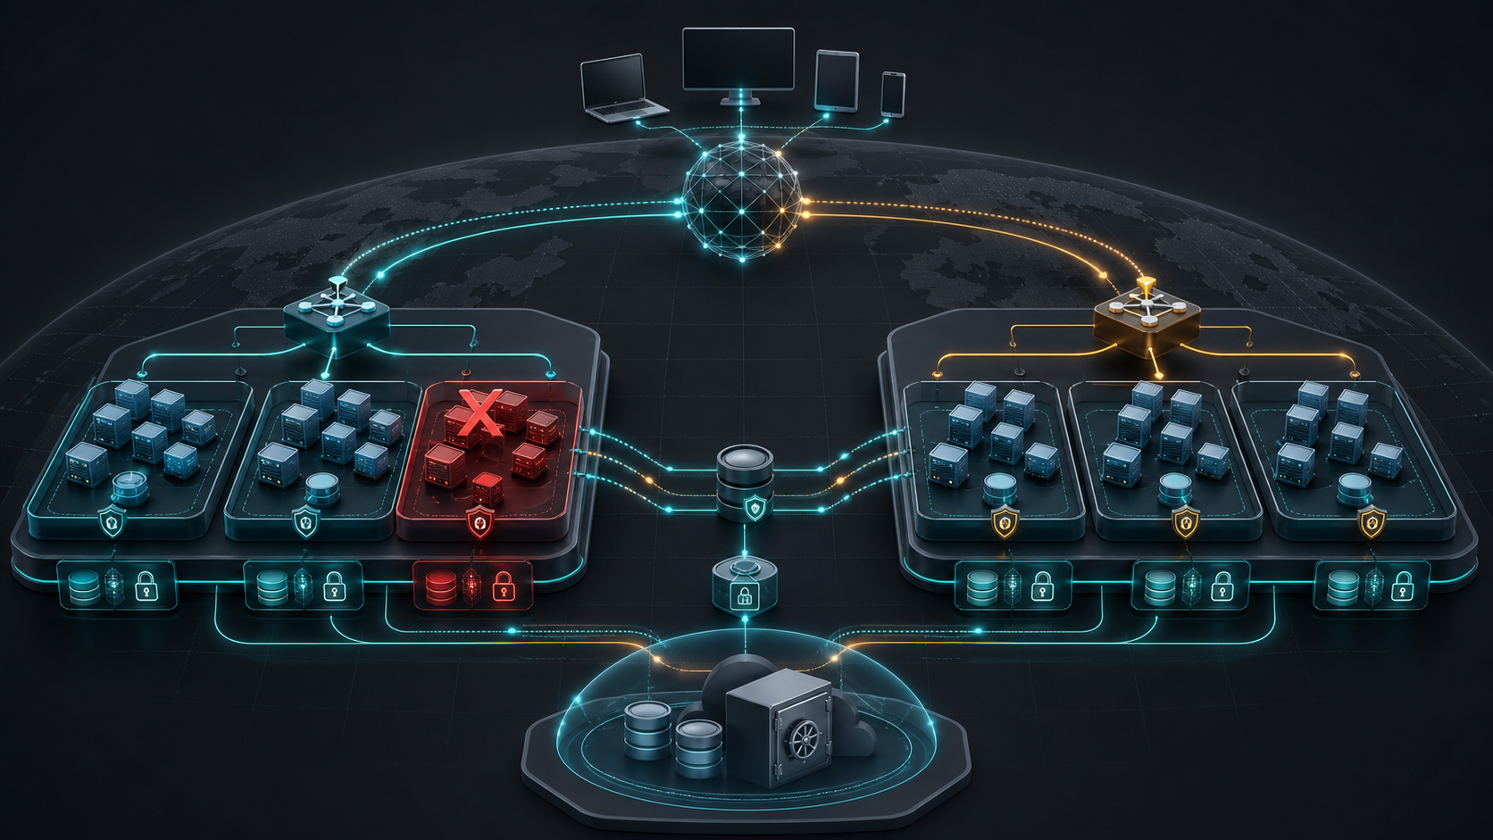
IMAGEGEN VISUAL · TOPIC 05
Resilience Is a Tested Capability
READ THE SYSTEM
Identify independent failure domains, recovery paths and the evidence needed to prove continuity.
AWS Certified SysOps Administrator Associate Training · TGS-2024051413
© 2026 Tertiary Infotech Academy Pte Ltd
251

Slide 252

IMAGEGEN VISUAL · TOPIC 05
Air-Gapped Recovery Is an Operating Capability
READ THE SYSTEM
Separate production compromise from protected recovery points and an isolated restore environment; verify access, retention, restore time and application integrity.
AWS Certified SysOps Administrator Associate Training · TGS-2024051413
© 2026 Tertiary Infotech Academy Pte Ltd
252

Slide 253
TOPIC 05 · K4 · A1 · A4 · A6
RTO and RPO
Objective
Question
Design influence
RTO
How quickly must service return?
Automation, standby capacity and failover
RPO
How much recent data may be lost?
Backup frequency and replication
Retention
How far back must recovery reach?
Lifecycle, vault and compliance
Integrity
How do we know restored data is correct?
Checksums and application validation
AWS Certified SysOps Administrator Associate Training · TGS-2024051413
© 2026 Tertiary Infotech Academy Pte Ltd
253

Slide 254
TOPIC 05 · K4 · A1 · A4 · A6
Continuity Patterns Trade Cost for Recovery
WHAT THE DATA SHOWS
Choose the least costly pattern that demonstrably meets business RTO, RPO and compliance requirements.
AWS Certified SysOps Administrator Associate Training · TGS-2024051413
© 2026 Tertiary Infotech Academy Pte Ltd
254

Slide 255
TOPIC 05 · K4 · A1 · A4 · A6
Recovery Assurance Loop
1
2
3
4
5
6
Classify
Protect
Monitor
Restore
Validate
Improve
Workload and data
Plan and vault
Job and copy status
Isolated target
Application and data
Gap and owner
A6 EVIDENCE
A completed backup job is an input; a tested restore with measured recovery is evidence.
AWS Certified SysOps Administrator Associate Training · TGS-2024051413
© 2026 Tertiary Infotech Academy Pte Ltd
255

Slide 256
TOPIC 05 · K4 · A1 · A4 · A6
AWS Backup Controls
Plan
Schedules, windows, lifecycle and copy actions.
Vault
Access policy, encryption and logical separation.
1
2
Vault Lock
Retention controls designed to resist early deletion.
Audit Manager
Evidence against backup policy and compliance frameworks.
3
4
AWS Certified SysOps Administrator Associate Training · TGS-2024051413
© 2026 Tertiary Infotech Academy Pte Ltd
256

Slide 257
TOPIC 05 · K4 · A1 · A4 · A6
Replication Choices
Mechanism
Strength
Operational concern
EBS snapshot copy
Point-in-time regional protection
Restore and launch workflow
S3 replication
Object-level asynchronous copy
Existing objects and delete markers
RDS cross-Region replica
Lower RPO read copy
Promotion and endpoint change
DynamoDB global table
Multi-Region active data
Conflict and application behaviour
AWS Certified SysOps Administrator Associate Training · TGS-2024051413
© 2026 Tertiary Infotech Academy Pte Ltd
257

Slide 258
TOPIC 05 · K4 · A1 · A4 · A6
Continuity Runbook
Decision
Execution
Evidence
• Declared trigger and authority
• Communication path
• Dependency order
• Automated and manual steps
• Timestamps and validation
• Actual RTO/RPO and gaps
AWS Certified SysOps Administrator Associate Training · TGS-2024051413
© 2026 Tertiary Infotech Academy Pte Ltd
258

Slide 259
Recovery Principle
A restore you have not tested is only a hypothesis.
Schedule recovery exercises, isolate tests from production, measure actual results and close every gap with an owner.
AWS Certified SysOps Administrator Associate Training · TGS-2024051413
© 2026 Tertiary Infotech Academy Pte Ltd
259

Slide 260
TOPIC 05 · NATIVE EDITABLE TECHNICAL CHART
Recovery Objectives versus Test Results
WHAT THE DATA SHOWS
A passed backup can still miss the service objective: the RDS test exceeds RTO and requires a corrective action with an owner.
AWS Certified SysOps Administrator Associate Training · TGS-2024051413
© 2026 Tertiary Infotech Academy Pte Ltd
260

Slide 261
ORIGINAL PPT v4 · SOURCE SLIDE 660 · MODERNISED TECHNICAL DEEP DIVE
AWS DataSync
1
Move large amount of data
2
On-premises / other cloud to
3
AWS to AWS (different storage…
4
Can synchronize to
Move large amount of data to and from
Amazon S3 (any storage classes – including Glacier)
File permissions and metadata are preserved (NFS POSIX, SMB…)
On-premises / other cloud to AWS (NFS, SMB, HDFS, S3 API…) - needs agent
Amazon EFS
One agent task can use 10 Gbps, can setup a bandwidth limit
AWS to AWS (different storage services) – no agent needed
Amazon FSx (Windows, Lustre, NetApp, OpenZFS...)
Can synchronize to
Replication tasks can be scheduled hourly, daily, weekly
CURRENT OPERATIONS LENS
Distinguish backup completion from recovery assurance; measure restore time, data integrity, dependency order and actual RPO. Validate service limits and regional availability against current AWS documentation.
AWS Certified SysOps Administrator Associate Training · TGS-2024051413
© 2026 Tertiary Infotech Academy Pte Ltd
261

Slide 262
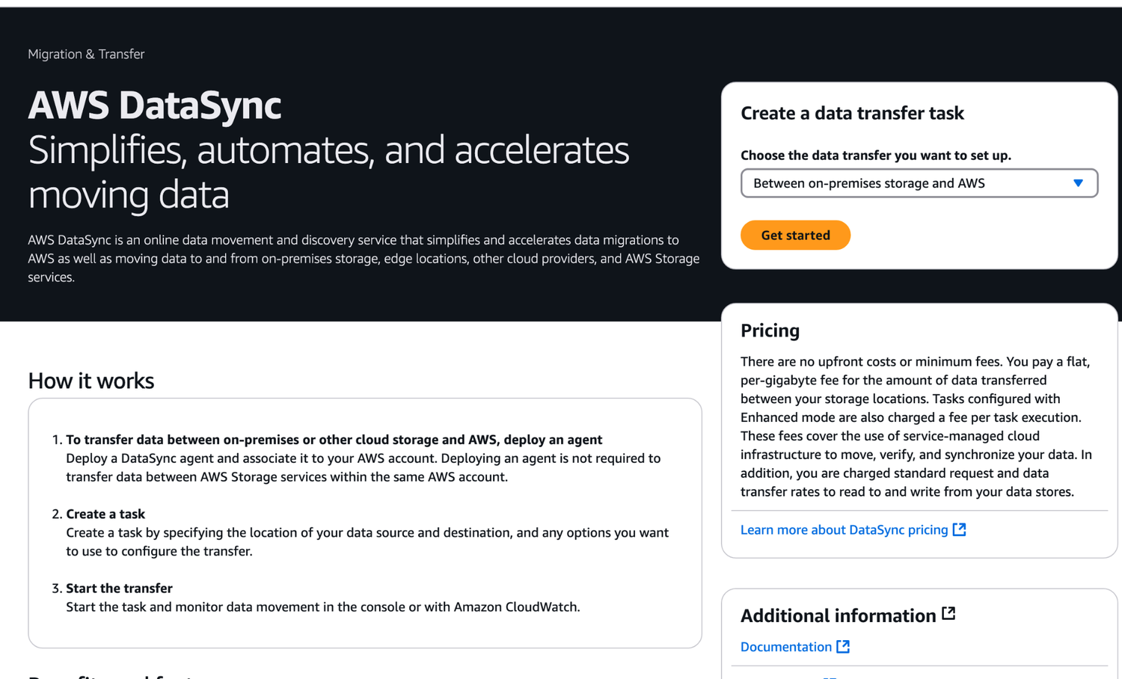
ORIGINAL PPT v4 · SOURCE SLIDE 661 · MODERNISED TECHNICAL DEEP DIVE
AWS DataSync
1
Mechanism: backup plans, vault…
Mechanism: backup plans, vault policies, Vault Lock, cross-account copies and restore-testing plans separate…
2
Failure mode
Failure mode: an immutable recovery point can still be unusable when keys, IAM roles, network dependencies…
3
Evidence: job completion…
Evidence: job completion, recovery-point age, restore duration, validation workflow, data checksum and actual…
CURRENT OPERATIONS LENS
Distinguish backup completion from recovery assurance; measure restore time, data integrity, dependency order and actual RPO. Validate service limits and regional availability against current AWS documentation.
AWS Certified SysOps Administrator Associate Training · TGS-2024051413
© 2026 Tertiary Infotech Academy Pte Ltd
262

Slide 263
ORIGINAL PPT v4 · SOURCE SLIDE 662 · MODERNISED TECHNICAL DEEP DIVE
AWS DataSync
1
NFS / SMB to AWS
2
On-Premises
3
NFS or SMB
4
AWS DataSync Agent
NFS / SMB to AWS (S3, EFS, FSx…)
AWS Storage Resources
S3 One Zone-IA
On-Premises
S3 Standard
S3 Glacier
Mechanism: backup plans, vault policies, Vault Lock, cross-account copies and restore-testing plans separate protection from operational recovery.
NFS or SMB
S3 Intelligent- Tiering
S3 Glacier Deep Archive
AWS DataSync Agent
S3 Standard-IA
Amazon FSx
Failure mode: an immutable recovery point can still be unusable when keys, IAM roles, network dependencies, metadata or application validation are…
CURRENT OPERATIONS LENS
Distinguish backup completion from recovery assurance; measure restore time, data integrity, dependency order and actual RPO. Validate service limits and regional availability against current AWS documentation.
AWS Certified SysOps Administrator Associate Training · TGS-2024051413
© 2026 Tertiary Infotech Academy Pte Ltd
263

Slide 264
ORIGINAL PPT v4 · SOURCE SLIDE 663 · MODERNISED TECHNICAL DEEP DIVE
AWS DataSync
1
Transfer between AWS storage…
2
copy data and metadata between
3
Amazon EFS
4
Amazon FSx
Transfer between AWS storage services
Mechanism: backup plans, vault policies, Vault Lock, cross-account copies and restore-testing plans separate protection from operational recovery.
copy data and metadata between AWS Storage Services
Failure mode: an immutable recovery point can still be unusable when keys, IAM roles, network dependencies, metadata or application validation are…
Amazon EFS
Evidence: job completion, recovery-point age, restore duration, validation workflow, data checksum and actual RTO/RPO prove recoverability.
Amazon FSx
Decision point: choose backup/restore, pilot light, warm standby or active/active from measured business objectives—not from service familiarity.
CURRENT OPERATIONS LENS
Distinguish backup completion from recovery assurance; measure restore time, data integrity, dependency order and actual RPO. Validate service limits and regional availability against current AWS documentation.
AWS Certified SysOps Administrator Associate Training · TGS-2024051413
© 2026 Tertiary Infotech Academy Pte Ltd
264

Slide 265
ORIGINAL PPT v4 · SOURCE SLIDE 665 · MODERNISED TECHNICAL DEEP DIVE
AWS Backup
1
Fully managed service
2
Centrally manage and automate…
3
No need to create custom
4
Supported services
Fully managed service
Amazon EC2 / Amazon EBS
AWS Storage Gateway (Volume Gateway)
Centrally manage and automate backups across AWS services
Amazon RDS (all DBs engines) / Amazon Aurora / Amazon DynamoDB
Supports cross-region backups
No need to create custom scripts and manual processes
Amazon DocumentDB / Amazon Neptune
Supports cross-account backups
Supported services
Amazon EFS / Amazon FSx (Lustre & Windows File Server)
CURRENT OPERATIONS LENS
Distinguish backup completion from recovery assurance; measure restore time, data integrity, dependency order and actual RPO. Validate service limits and regional availability against current AWS documentation.
AWS Certified SysOps Administrator Associate Training · TGS-2024051413
© 2026 Tertiary Infotech Academy Pte Ltd
265

Slide 266
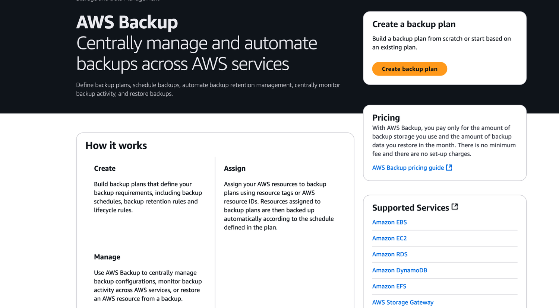
ORIGINAL PPT v4 · SOURCE SLIDE 666 · MODERNISED TECHNICAL DEEP DIVE
AWS Backup
1
Mechanism: backup plans, vault…
Mechanism: backup plans, vault policies, Vault Lock, cross-account copies and restore-testing plans separate…
2
Failure mode
Failure mode: an immutable recovery point can still be unusable when keys, IAM roles, network dependencies…
3
Evidence: job completion…
Evidence: job completion, recovery-point age, restore duration, validation workflow, data checksum and actual…
CURRENT OPERATIONS LENS
Distinguish backup completion from recovery assurance; measure restore time, data integrity, dependency order and actual RPO. Validate service limits and regional availability against current AWS documentation.
AWS Certified SysOps Administrator Associate Training · TGS-2024051413
© 2026 Tertiary Infotech Academy Pte Ltd
266

Slide 267
ORIGINAL PPT v4 · SOURCE SLIDE 667 · MODERNISED TECHNICAL DEEP DIVE
AWS Backup
1
Supports PITR for supported…
2
On-Demand and Scheduled backups
3
Tag-based backup policies
4
You create backup policies known
Supports PITR for supported services
Backup frequency (every 12 hours, daily, weekly, monthly, cron expression)
On-Demand and Scheduled backups
Backup window
Mechanism: backup plans, vault policies, Vault Lock, cross-account copies and restore-testing plans separate protection from operational recovery.
Tag-based backup policies
Transition to Cold Storage (Never, Days, Weeks, Months,Years)
You create backup policies known as Backup Plans
Retention Period (Always, Days, Weeks, Months,Years)
CURRENT OPERATIONS LENS
Distinguish backup completion from recovery assurance; measure restore time, data integrity, dependency order and actual RPO. Validate service limits and regional availability against current AWS documentation.
AWS Certified SysOps Administrator Associate Training · TGS-2024051413
© 2026 Tertiary Infotech Academy Pte Ltd
267

Slide 268
ORIGINAL PPT v4 · SOURCE SLIDE 668 · MODERNISED TECHNICAL DEEP DIVE
AWS Backup
1
Create Backup Plan
2
(frequency, retention policy)
3
Assign AWS Resources
4
Storage Gateway
Create Backup Plan
Automatically backed up to
Mechanism: backup plans, vault policies, Vault Lock, cross-account copies and restore-testing plans separate protection from operational recovery.
(frequency, retention policy)
DynamoDB DocumentDB
Failure mode: an immutable recovery point can still be unusable when keys, IAM roles, network dependencies, metadata or application validation are…
Assign AWS Resources
Evidence: job completion, recovery-point age, restore duration, validation workflow, data checksum and actual RTO/RPO prove recoverability.
Storage Gateway
Decision point: choose backup/restore, pilot light, warm standby or active/active from measured business objectives—not from service familiarity.
CURRENT OPERATIONS LENS
Distinguish backup completion from recovery assurance; measure restore time, data integrity, dependency order and actual RPO. Validate service limits and regional availability against current AWS documentation.
AWS Certified SysOps Administrator Associate Training · TGS-2024051413
© 2026 Tertiary Infotech Academy Pte Ltd
268

Slide 269
ORIGINAL PPT v4 · SOURCE SLIDE 669 · MODERNISED TECHNICAL DEEP DIVE
AWS Backup Vault Lock
1
Enforce a WORM (Write Once
2
Additional layer of defense to
3
Inadvertent or malicious delete…
4
Updates that shorten or alter
Enforce a WORM (Write Once Read Many) state for all the backups that you store in your AWS Backup Vault
Even the root user cannot delete backups when enabled
Additional layer of defense to protect your backups against
Backup Vault Lock Policy
Inadvertent or malicious delete operations
Backups can’t be deleted
Mechanism: backup plans, vault policies, Vault Lock, cross-account copies and restore-testing plans separate protection from operational recovery.
Updates that shorten or alter retention periods
Failure mode: an immutable recovery point can still be unusable when keys, IAM roles, network dependencies, metadata or application validation are…
CURRENT OPERATIONS LENS
Distinguish backup completion from recovery assurance; measure restore time, data integrity, dependency order and actual RPO. Validate service limits and regional availability against current AWS documentation.
AWS Certified SysOps Administrator Associate Training · TGS-2024051413
© 2026 Tertiary Infotech Academy Pte Ltd
269

Slide 270
ORIGINAL PPT v4 · SOURCE SLIDE 328 · MODERNISED TECHNICAL DEEP DIVE
What’s an EBS Volume?
1
An EBS (Elastic Block Store)
2
It allows your instances to
3
They can only be mounted
4
They are bound to a
An EBS (Elastic Block Store) Volume is a network drive you can attach to your instances while they run
Analogy:Think of them as a “network USB stick”
It allows your instances to persist data, even after their termination
Free tier: 30 GB of free EBS storage of type General Purpose (SSD) or Magnetic per month
They can only be mounted to one instance at a time (at the CCP level)
They are bound to a specific availability zone
Mechanism: backup plans, vault policies, Vault Lock, cross-account copies and restore-testing plans separate protection from operational recovery.
CURRENT OPERATIONS LENS
Distinguish backup completion from recovery assurance; measure restore time, data integrity, dependency order and actual RPO. Validate service limits and regional availability against current AWS documentation.
AWS Certified SysOps Administrator Associate Training · TGS-2024051413
© 2026 Tertiary Infotech Academy Pte Ltd
270

Slide 271
ORIGINAL PPT v4 · SOURCE SLIDE 330 · MODERNISED TECHNICAL DEEP DIVE
EBS Volume
1
It’s a network drive (i.e.
2
It uses the network to
3
It can be detached from
4
It’s locked to an Availability
It’s a network drive (i.e. not a physical drive)
An EBS Volume in us-east-1a cannot be attached to us-east-1b
You can increase the capacity of the drive over time
It uses the network to communicate the instance, which means there might be a bit of latency
To move a volume across, you first need to snapshot it
It can be detached from an EC2 instance and attached to another one quickly
Have a provisioned capacity (size in GBs, and IOPS)
It’s locked to an Availability Zone (AZ)
You get billed for all the provisioned capacity
CURRENT OPERATIONS LENS
Distinguish backup completion from recovery assurance; measure restore time, data integrity, dependency order and actual RPO. Validate service limits and regional availability against current AWS documentation.
AWS Certified SysOps Administrator Associate Training · TGS-2024051413
© 2026 Tertiary Infotech Academy Pte Ltd
271

Slide 272
ORIGINAL PPT v4 · SOURCE SLIDE 332 · MODERNISED TECHNICAL DEEP DIVE
EC2 Instance Store
1
EBS volumes are network drives
2
If you need a high-performance
3
Better I/O performance
4
EC2 Instance Store lose their
EBS volumes are network drives with good but “limited” performance
Good for buffer / cache / scratch data / temporary content
If you need a high-performance hardware disk, use EC2 Instance store
Risk of data loss if hardware fails
Better I/O performance
Backups and Replication are your responsibility
Mechanism: backup plans, vault policies, Vault Lock, cross-account copies and restore-testing plans separate protection from operational recovery.
EC2 Instance Store lose their storage if they’re stopped (ephemeral)
CURRENT OPERATIONS LENS
Distinguish backup completion from recovery assurance; measure restore time, data integrity, dependency order and actual RPO. Validate service limits and regional availability against current AWS documentation.
AWS Certified SysOps Administrator Associate Training · TGS-2024051413
© 2026 Tertiary Infotech Academy Pte Ltd
272

Slide 273
ORIGINAL PPT v4 · SOURCE SLIDE 335 · MODERNISED TECHNICAL DEEP DIVE
EBS Volume Types
1
EBS Volumes come in 6
2
gp2 / gp3 (SSD)
3
io1 / io2 Block Express (SSD)
4
st1 (HDD)
EBS Volumes come in 6 types
sc1 (HDD): Lowest cost HDD volume designed for less frequently accessed workloads
gp2 / gp3 (SSD): General purpose SSD volume that balances price and performance for a wide variety of workloads
EBS Volumes are characterized in Size | Throughput | IOPS (I/O Ops Per Sec)
io1 / io2 Block Express (SSD): Highest-performance SSD volume for mission-critical low-latency or high-throughput workloads
When in doubt always consult the AWS documentation – it’s good!
st1 (HDD): Low cost HDD volume designed for frequently accessed, throughput- intensive workloads
Only gp2/gp3 and io1/io2 Block Express can be used as boot volumes
CURRENT OPERATIONS LENS
Distinguish backup completion from recovery assurance; measure restore time, data integrity, dependency order and actual RPO. Validate service limits and regional availability against current AWS documentation.
AWS Certified SysOps Administrator Associate Training · TGS-2024051413
© 2026 Tertiary Infotech Academy Pte Ltd
273

Slide 274
ORIGINAL PPT v4 · SOURCE SLIDE 337 · MODERNISED TECHNICAL DEEP DIVE
EBS Volume Types Use cases Provisioned IOPS (PIOPS) SSD
1
Critical business applications…
2
Or applications that need more
3
Great for databases workloads…
4
io1 (4 GiB
Critical business applications with sustained IOPS performance
Max PIOPS: 64,000 for Nitro EC2 instances & 32,000 for other
Max PIOPS: 256,000 with an IOPS:GiB ratio of 1,000:1
Or applications that need more than 16,000 IOPS
Can increase PIOPS independently from storage size
Supports EBS Multi-attach
Great for databases workloads (sensitive to storage perf and consistency)
io2 Block Express (4 GiB – 64 TiB)
io1 (4 GiB - 16 TiB)
Sub-millisecond latency
Mechanism: backup plans, vault policies, Vault Lock, cross-account copies and restore-testing plans separate protection from operational recovery.
CURRENT OPERATIONS LENS
Distinguish backup completion from recovery assurance; measure restore time, data integrity, dependency order and actual RPO. Validate service limits and regional availability against current AWS documentation.
AWS Certified SysOps Administrator Associate Training · TGS-2024051413
© 2026 Tertiary Infotech Academy Pte Ltd
274

Slide 275
ORIGINAL PPT v4 · SOURCE SLIDE 338 · MODERNISED TECHNICAL DEEP DIVE
EBS Volume Types Use cases
1
Hard Disk Drives (HDD)
2
Cannot be a boot volume
3
125 GiB to 16 TiB
4
Throughput Optimized HDD (st1)
Hard Disk Drives (HDD)
Big Data, Data Warehouses, Log Processing
Scenarios where lowest cost is important
Cannot be a boot volume
Max through put500 MiB/s – max IOPS 500
Max throughput 250 MiB/s – max IOPS 250
125 GiB to 16 TiB
Cold HDD (sc1)
Mechanism: backup plans, vault policies, Vault Lock, cross-account copies and restore-testing plans separate protection from operational recovery.
Throughput Optimized HDD (st1)
For data that is infrequently accessed
CURRENT OPERATIONS LENS
Distinguish backup completion from recovery assurance; measure restore time, data integrity, dependency order and actual RPO. Validate service limits and regional availability against current AWS documentation.
AWS Certified SysOps Administrator Associate Training · TGS-2024051413
© 2026 Tertiary Infotech Academy Pte Ltd
275

Slide 276
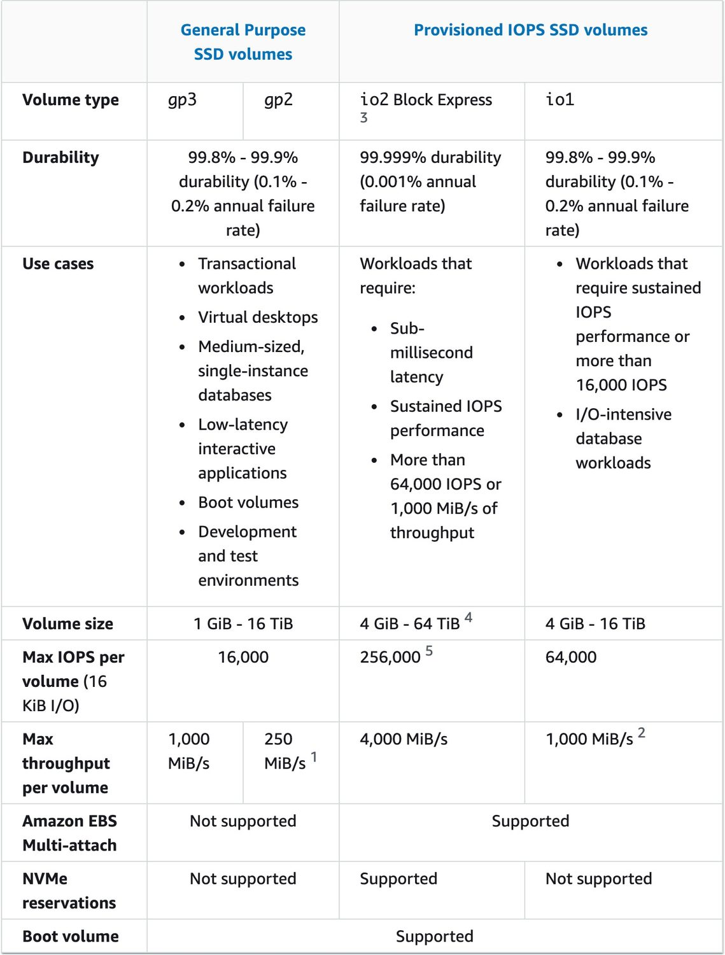
ORIGINAL PPT v4 · SOURCE SLIDE 339 · MODERNISED TECHNICAL DEEP DIVE
EBS - Volume Types Summary
1
Mechanism: backup plans, vault…
Mechanism: backup plans, vault policies, Vault Lock, cross-account copies and restore-testing plans separate…
2
Failure mode
Failure mode: an immutable recovery point can still be unusable when keys, IAM roles, network dependencies…
3
Evidence: job completion…
Evidence: job completion, recovery-point age, restore duration, validation workflow, data checksum and actual…
CURRENT OPERATIONS LENS
Distinguish backup completion from recovery assurance; measure restore time, data integrity, dependency order and actual RPO. Validate service limits and regional availability against current AWS documentation.
AWS Certified SysOps Administrator Associate Training · TGS-2024051413
© 2026 Tertiary Infotech Academy Pte Ltd
276

Slide 277
ORIGINAL PPT v4 · SOURCE SLIDE 340 · MODERNISED TECHNICAL DEEP DIVE
EBS Multi-Attach - io1/io2 family
1
Attach the same EBS volume
2
Each instance has full read
3
Achieve higher application…
4
Applications must manage…
Attach the same EBS volume to multiple EC2 instances in the same AZ
Up to 16 EC2 Instances at a time
Each instance has full read & write permissions to the high-performance volume
Must use a file system that’s cluster-aware (not XFS, EXT4, etc…)
Achieve higher application availability in clustered Linux applications (ex:Teradata)
Availability Zone 1
Applications must manage concurrent write operations
io2 volume with Multi-Attach
CURRENT OPERATIONS LENS
Distinguish backup completion from recovery assurance; measure restore time, data integrity, dependency order and actual RPO. Validate service limits and regional availability against current AWS documentation.
AWS Certified SysOps Administrator Associate Training · TGS-2024051413
© 2026 Tertiary Infotech Academy Pte Ltd
277

Slide 278
ORIGINAL PPT v4 · SOURCE SLIDE 341 · MODERNISED TECHNICAL DEEP DIVE
EBS Volume Resizing
1
You can only increase the
2
Size (any volume type)
3
IOPS (only in IO1)
4
After resizing an EBS volume,
You can only increase the EBS volumes
After increasing the size, it’s possible for the volume to be in a long time in the “optimisation” phase.The volume is still usable
repartition
Size (any volume type)
You can’t decrease the size of your EBS volume (create another smaller volume then migrate data)
IOPS (only in IO1)
EBS Volume
Mechanism: backup plans, vault policies, Vault Lock, cross-account copies and restore-testing plans separate protection from operational recovery.
After resizing an EBS volume, you need to repartition your drive
Optimizing
CURRENT OPERATIONS LENS
Distinguish backup completion from recovery assurance; measure restore time, data integrity, dependency order and actual RPO. Validate service limits and regional availability against current AWS documentation.
AWS Certified SysOps Administrator Associate Training · TGS-2024051413
© 2026 Tertiary Infotech Academy Pte Ltd
278

Slide 279
ORIGINAL PPT v4 · SOURCE SLIDE 343 · MODERNISED TECHNICAL DEEP DIVE
EBS Snapshots
1
Make a backup (snapshot) of
2
Not necessary to detach volume
3
Can copy snapshots across AZ
4
US-EAST-1A
Make a backup (snapshot) of your EBS volume at a point in time
US-EAST-1B
Not necessary to detach volume to do snapshot, but recommended
EBS Snapshot
Can copy snapshots across AZ or Region
Mechanism: backup plans, vault policies, Vault Lock, cross-account copies and restore-testing plans separate protection from operational recovery.
US-EAST-1A
Failure mode: an immutable recovery point can still be unusable when keys, IAM roles, network dependencies, metadata or application validation are…
CURRENT OPERATIONS LENS
Distinguish backup completion from recovery assurance; measure restore time, data integrity, dependency order and actual RPO. Validate service limits and regional availability against current AWS documentation.
AWS Certified SysOps Administrator Associate Training · TGS-2024051413
© 2026 Tertiary Infotech Academy Pte Ltd
279

Slide 280
ORIGINAL PPT v4 · SOURCE SLIDE 344 · MODERNISED TECHNICAL DEEP DIVE
Amazon Data Lifecycle Manager
1
Automate the creation, retention…
2
Schedule backups, cross-account…
3
Uses resource tags to identify
4
Can’t be used to manage
Automate the creation, retention, and deletion of EBS snapshots and EBS-backed AMIs
Can’t be used to manage instance-store backed AMIs
Schedule backups, cross-account snapshot copies, delete outdated backups, …
EBS Volume
Uses resource tags to identify the resources (EC2 instances, EBS volumes)
EBS Volumes
Can’t be used to manage snapshots/AMIs created outside DLM
EC2 Instance
CURRENT OPERATIONS LENS
Distinguish backup completion from recovery assurance; measure restore time, data integrity, dependency order and actual RPO. Validate service limits and regional availability against current AWS documentation.
AWS Certified SysOps Administrator Associate Training · TGS-2024051413
© 2026 Tertiary Infotech Academy Pte Ltd
280

Slide 281
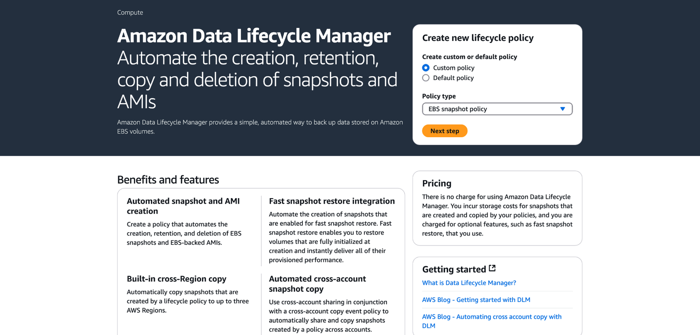
ORIGINAL PPT v4 · SOURCE SLIDE 345 · MODERNISED TECHNICAL DEEP DIVE
Amazon Data Lifecycle Manager
1
Mechanism: backup plans, vault…
Mechanism: backup plans, vault policies, Vault Lock, cross-account copies and restore-testing plans separate…
2
Failure mode
Failure mode: an immutable recovery point can still be unusable when keys, IAM roles, network dependencies…
3
Evidence: job completion…
Evidence: job completion, recovery-point age, restore duration, validation workflow, data checksum and actual…
CURRENT OPERATIONS LENS
Distinguish backup completion from recovery assurance; measure restore time, data integrity, dependency order and actual RPO. Validate service limits and regional availability against current AWS documentation.
AWS Certified SysOps Administrator Associate Training · TGS-2024051413
© 2026 Tertiary Infotech Academy Pte Ltd
281

Slide 282
ORIGINAL PPT v4 · SOURCE SLIDE 346 · MODERNISED TECHNICAL DEEP DIVE
EBS Snapshots - Fast Snapshot Restore (FSR)
1
EBS Snapshots stored in S3
2
By default, there’s a latency
3
Solution: force the…
4
volume (using the dd or
EBS Snapshots stored in S3
FSR helps you to create a volume from a snapshot that is fully initialized at creation (no I/O latency)
(FSR enabled)
By default, there’s a latency of I/O operations the first time each block is accessed (block must be pulled from S3)
Enabled for a snapshot in a particular AZ (billed per minute – very expensive $$$)
EBS Volume
Solution: force the initialization of the entire
Can be enabled on snapshots created by Data Lifecycle Manager
storage blocks
volume (using the dd or fio command), or you can enable FSR
EBS Snapshot
CURRENT OPERATIONS LENS
Distinguish backup completion from recovery assurance; measure restore time, data integrity, dependency order and actual RPO. Validate service limits and regional availability against current AWS documentation.
AWS Certified SysOps Administrator Associate Training · TGS-2024051413
© 2026 Tertiary Infotech Academy Pte Ltd
282

Slide 283
ORIGINAL PPT v4 · SOURCE SLIDE 347 · MODERNISED TECHNICAL DEEP DIVE
EBS Snapshots Features
1
EBS Snapshot Archive
2
Move a Snapshot to an
3
Takes within 24 to 72
4
Recycle Bin for EBS Snapshots
EBS Snapshot Archive
Setup rules to retain deleted snapshots so you can recover them after an accidental deletion
Move a Snapshot to an ”archive tier” that is 75% cheaper
Specify retention (from 1 day to 1 year)
Takes within 24 to 72 hours for restoring the archive
EBS Snapshot
Recycle Bin for EBS Snapshots
Recycle Bin
Mechanism: backup plans, vault policies, Vault Lock, cross-account copies and restore-testing plans separate protection from operational recovery.
CURRENT OPERATIONS LENS
Distinguish backup completion from recovery assurance; measure restore time, data integrity, dependency order and actual RPO. Validate service limits and regional availability against current AWS documentation.
AWS Certified SysOps Administrator Associate Training · TGS-2024051413
© 2026 Tertiary Infotech Academy Pte Ltd
283

Slide 284
ORIGINAL PPT v4 · SOURCE SLIDE 349 · MODERNISED TECHNICAL DEEP DIVE
EBS Migration
1
EBS Volumes are only locked
2
To migrate it to a
3
Snapshot the volume
4
(optional) Copy the volume to
EBS Volumes are only locked to a specific AZ
Create a volume from the snapshot in the AZ of your choice
To migrate it to a different AZ (or region)
Let’s practice!
Snapshot the volume
Mechanism: backup plans, vault policies, Vault Lock, cross-account copies and restore-testing plans separate protection from operational recovery.
(optional) Copy the volume to a different region
Failure mode: an immutable recovery point can still be unusable when keys, IAM roles, network dependencies, metadata or application validation are…
CURRENT OPERATIONS LENS
Distinguish backup completion from recovery assurance; measure restore time, data integrity, dependency order and actual RPO. Validate service limits and regional availability against current AWS documentation.
AWS Certified SysOps Administrator Associate Training · TGS-2024051413
© 2026 Tertiary Infotech Academy Pte Ltd
284

Slide 285
ORIGINAL PPT v4 · SOURCE SLIDE 350 · MODERNISED TECHNICAL DEEP DIVE
EBS Encryption
1
When you create an encrypted
2
Data at rest is encrypted
3
All the data in flight
4
All snapshots are encrypted
When you create an encrypted EBS volume, you get the following
All volumes created from the snapshot
Copying an unencrypted snapshot allows encryption
Data at rest is encrypted inside the volume
Encryption and decryption are handled transparently (you have nothing to do)
Snapshots of encrypted volumes are encrypted
All the data in flight moving between the instance and the volume is encrypted
Encryption has a minimal impact on latency
All snapshots are encrypted
EBS Encryption leverages keys from KMS (AES-256)
CURRENT OPERATIONS LENS
Distinguish backup completion from recovery assurance; measure restore time, data integrity, dependency order and actual RPO. Validate service limits and regional availability against current AWS documentation.
AWS Certified SysOps Administrator Associate Training · TGS-2024051413
© 2026 Tertiary Infotech Academy Pte Ltd
285

Slide 286
ORIGINAL PPT v4 · SOURCE SLIDE 353 · MODERNISED TECHNICAL DEEP DIVE
Amazon EFS - Elastic File System
1
Managed NFS (network file system)
2
EFS works with EC2 instances
3
Highly available, scalable…
4
us-east-1a
Managed NFS (network file system) that can be mounted on many EC2
EC2 Instances
EFS FileSystem
EFS works with EC2 instances in multi-AZ
us-east-1b
Mechanism: backup plans, vault policies, Vault Lock, cross-account copies and restore-testing plans separate protection from operational recovery.
Highly available, scalable, expensive (3x gp2), pay per use
us-east-1c
us-east-1a
Security Group
Failure mode: an immutable recovery point can still be unusable when keys, IAM roles, network dependencies, metadata or application validation are…
CURRENT OPERATIONS LENS
Distinguish backup completion from recovery assurance; measure restore time, data integrity, dependency order and actual RPO. Validate service limits and regional availability against current AWS documentation.
AWS Certified SysOps Administrator Associate Training · TGS-2024051413
© 2026 Tertiary Infotech Academy Pte Ltd
286

Slide 287
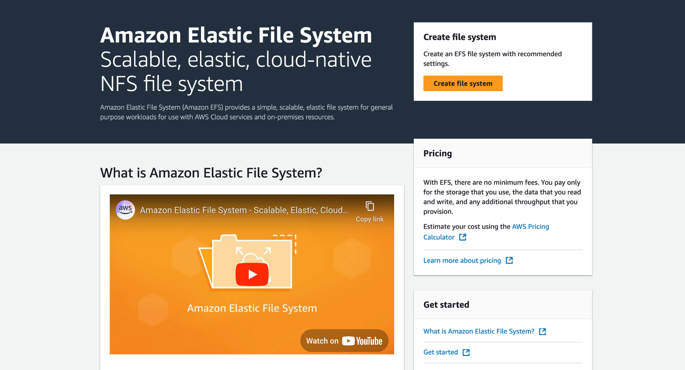
ORIGINAL PPT v4 · SOURCE SLIDE 354 · MODERNISED TECHNICAL DEEP DIVE
Amazon EFS - Elastic File System
1
Mechanism: backup plans, vault…
Mechanism: backup plans, vault policies, Vault Lock, cross-account copies and restore-testing plans separate…
2
Failure mode
Failure mode: an immutable recovery point can still be unusable when keys, IAM roles, network dependencies…
3
Evidence: job completion…
Evidence: job completion, recovery-point age, restore duration, validation workflow, data checksum and actual…
CURRENT OPERATIONS LENS
Distinguish backup completion from recovery assurance; measure restore time, data integrity, dependency order and actual RPO. Validate service limits and regional availability against current AWS documentation.
AWS Certified SysOps Administrator Associate Training · TGS-2024051413
© 2026 Tertiary Infotech Academy Pte Ltd
287

Slide 288
ORIGINAL PPT v4 · SOURCE SLIDE 355 · MODERNISED TECHNICAL DEEP DIVE
Amazon EFS - Elastic File System
1
Use cases
2
Uses NFSv4.1 protocol
3
Uses security group to control
4
Compatible with Linux based AMI
Use cases: content management, web serving, data sharing, Wordpress
Encryption at rest using KMS
Uses NFSv4.1 protocol
POSIX file system (~Linux) that has a standard file API
Uses security group to control access to EFS
File system scales automatically, pay-per-use, no capacity planning!
Compatible with Linux based AMI (not windows)
Mechanism: backup plans, vault policies, Vault Lock, cross-account copies and restore-testing plans separate protection from operational recovery.
CURRENT OPERATIONS LENS
Distinguish backup completion from recovery assurance; measure restore time, data integrity, dependency order and actual RPO. Validate service limits and regional availability against current AWS documentation.
AWS Certified SysOps Administrator Associate Training · TGS-2024051413
© 2026 Tertiary Infotech Academy Pte Ltd
288

Slide 289
ORIGINAL PPT v4 · SOURCE SLIDE 357 · MODERNISED TECHNICAL DEEP DIVE
EFS - Performance & Storage Classes
1
1000s of concurrent NFS clients,
2
Grow to Petabyte-scale network…
3
Performance Mode (set at EFS
4
General Purpose (default)
1000s of concurrent NFS clients, 10 GB+ /s throughput
Max I/O - higher latecy, throughput, highly parallel (big data, media processing)
Elastic - automatically scales throughput up or down based on your workloads
Grow to Petabyte-scale network file system, automatically
Throughput Mode
Up to 3GiB/s for reads and 1GiB/s for writes
Performance Mode (set at EFS creation time)
Bursting - 1TB = 50MiB/s + burst of up to 100MiB/s
Used for unpredictable workloads
General Purpose (default) - latency-sensitive use cases (web server, CMS, etc…)
Provisioned - set your throughput regardless of storage size, ex: 1 GiB/s for 1 TB storage
CURRENT OPERATIONS LENS
Distinguish backup completion from recovery assurance; measure restore time, data integrity, dependency order and actual RPO. Validate service limits and regional availability against current AWS documentation.
AWS Certified SysOps Administrator Associate Training · TGS-2024051413
© 2026 Tertiary Infotech Academy Pte Ltd
289

Slide 290
ORIGINAL PPT v4 · SOURCE SLIDE 358 · MODERNISED TECHNICAL DEEP DIVE
EFS - Storage Classes
1
Storage Tiers (lifecycle…
2
Standard: for frequently accessed…
3
Infrequent access (EFS-IA)
4
Archive: rarely accessed data (few
Storage Tiers (lifecycle management feature move file after N days)
Implement Lifecycle policies to move files between storage tiers
Over 90% in cost savings
Standard: for frequently accessed files
Availability and durability
Amazon EFS File System
Infrequent access (EFS-IA): cost to retrieve files, lower price to store.
Standard: Multi-AZ, great for prod
Lifecycle Policy
Archive: rarely accessed data (few times each year), 50% cheaper
One Zone: One AZ, great for dev, backup enabled by default, compatible with IA (EFS One Zone-IA)
no access for 60 days
CURRENT OPERATIONS LENS
Distinguish backup completion from recovery assurance; measure restore time, data integrity, dependency order and actual RPO. Validate service limits and regional availability against current AWS documentation.
AWS Certified SysOps Administrator Associate Training · TGS-2024051413
© 2026 Tertiary Infotech Academy Pte Ltd
290

Slide 291
TOPIC 05 · LEGACY COVERAGE INTEGRATION
Original PPT Coverage Retained — Topic 05
Modernised slides
30 technical slides extracted from the original v4 PowerPoint and rebuilt in the current visual system.
Traceability
Every blended slide names its original v4 source slide number in the kicker.
1
2
Current validation
Terminology is normalised; service limits and Region availability remain explicit current-documentation checks.
Procedure boundary
Click-by-click sequences, activities and quizzes are kept out of the deck and remain in the Learner Guide or lab package.
3
4
AWS Certified SysOps Administrator Associate Training · TGS-2024051413
© 2026 Tertiary Infotech Academy Pte Ltd
291

Slide 292
TOPIC 05 · CONCEPT-LED LAB BRIEF
Prove Backup and Restore Readiness
LAB 06
Apply K4, A1, A4 and A6 by protecting an S3/EBS-style workload, restoring into isolation and measuring actual recovery evidence.
Create a backup plan and vault configuration, run a protected copy, restore into isolation and validate integrity and recovery time.
YOU'LL BUILD
TOOLCHAIN
DONE WHEN
A backup plan, selection, restore checklist, recovery evidence and measured RTO/RPO report.
AWS Backup · S3 · EBS · KMS · CloudWatch Events
A completed recovery point is restored to an isolated target, integrity is checked, actual recovery is compared with RTO/RPO, gaps have owners, and validation emits LAB 06 PASS.
AWS Certified SysOps Administrator Associate Training · TGS-2024051413
© 2026 Tertiary Infotech Academy Pte Ltd
292

Slide 293
LAB 06 · CONCEPTUAL WORKFLOW
Lab 06 Evidence Model
1
2
3
4
5
Classify
Protect
Restore
Validate
Improve
RTO and RPO
Plan and vault
Isolated target
Data integrity
Gap and owner
PROCEDURE BOUNDARY
Detailed commands and numbered steps are in the Learner Guide and lab folder—not on these slides.
AWS Certified SysOps Administrator Associate Training · TGS-2024051413
© 2026 Tertiary Infotech Academy Pte Ltd
293

Slide 294
LAB 06 · ACCEPTANCE EVIDENCE
Prove Backup and Restore Readiness
✅ Expected result
A completed recovery point is restored to an isolated target, integrity is checked, actual recovery is compared with RTO/RPO, gaps have owners, and validation emits LAB 06 PASS.
IF IT DOESN'T WORK
Input mismatch
Validation stop
Evidence differs
Reconcile identifiers, required fields and units with the supplied data dictionary.
Inspect the named rule and source row; preserve the check rather than bypassing it.
Check the denominator, time window and assumptions before rerunning from clean inputs.
AWS Certified SysOps Administrator Associate Training · TGS-2024051413
© 2026 Tertiary Infotech Academy Pte Ltd
294

Slide 295
TOPIC 05 · RETRIEVAL PRACTICE
Recap — Backup, Restore and Business Continuity
Explain
A protected copy has value only when restore time and data integrity are proven.
Distinguish
Recovery time and acceptable data loss determine technology and cost.
1
2
Apply
K4, A1, A4 and A6 by protecting an S3/EBS-style workload, restoring into isolation and measuring actual recovery evidence.
Evidence
A completed recovery point is restored to an isolated target, integrity is checked, actual recovery is compared with RTO/RPO, gaps have owners, and validation emits…
3
4
AWS Certified SysOps Administrator Associate Training · TGS-2024051413
© 2026 Tertiary Infotech Academy Pte Ltd
295

Slide 296
06
TOPIC 06 · LO2 · LO4 · K3 · K4 · A4 · A5
Deployment, Provisioning and Automation
CloudFormation · StackSets · change sets · drift · Systems Manager Automation · Git and IaC
AWS Certified SysOps Administrator Associate Training · TGS-2024051413
© 2026 Tertiary Infotech Academy Pte Ltd
296

Slide 297
BLUEPRINT · SOA-C03 Domain 3 · 22%
Key Ideas — Deployment, Provisioning and Automation
Infrastructure is versioned
Templates and policies create a reviewable desired state.
Preview before execution
Change sets reveal creates, replacements and deletions before the stack changes.
1
2
Drift is a control signal
Difference between desired and actual state requires investigation, not blind overwrite.
Automation must be idempotent
Repeated execution should converge safely to the intended state.
3
4
AWS Certified SysOps Administrator Associate Training · TGS-2024051413
© 2026 Tertiary Infotech Academy Pte Ltd
297

Slide 298
TOPIC 06 · K3 · K4 · A4 · A5
Infrastructure Change Path
1
2
3
4
5
6
Branch
Validate
Plan
Approve
Apply
Verify
Versioned proposal
Syntax and policy
Change set
Risk and authority
Bounded deployment
State, service and…
A5 CONNECTION
The template, plan, approval, execution and verification form one auditable release record.
AWS Certified SysOps Administrator Associate Training · TGS-2024051413
© 2026 Tertiary Infotech Academy Pte Ltd
298

Slide 299
TOPIC 06 · K3 · K4 · A4 · A5
CloudFormation Update Controls
Control
Purpose
Operational use
Change set
Preview resource actions
Review replacements and deletions
Stack policy
Protect critical resources
Restrict updates during normal change
Rollback
Return after failed update
Preserve events for diagnosis
Termination protection
Prevent accidental stack deletion
Use on persistent environments
AWS Certified SysOps Administrator Associate Training · TGS-2024051413
© 2026 Tertiary Infotech Academy Pte Ltd
299

Slide 300
TOPIC 06 · K3 · K4 · A4 · A5
Automation Reduces Configuration Variance
WHAT THE DATA SHOWS
Automation improves consistency; policy and version control make the change explainable and governable.
AWS Certified SysOps Administrator Associate Training · TGS-2024051413
© 2026 Tertiary Infotech Academy Pte Ltd
300

Slide 301
TOPIC 06 · K3 · K4 · A4 · A5
Template Engineering
Parameters
Expose safe environment-specific values without duplicating templates.
Mappings and conditions
Represent controlled variation, not arbitrary complexity.
1
2
Outputs and exports
Publish stable integration values with dependency awareness.
Deletion and update policies
Protect or snapshot stateful resources during change.
3
4
AWS Certified SysOps Administrator Associate Training · TGS-2024051413
© 2026 Tertiary Infotech Academy Pte Ltd
301

Slide 302
TOPIC 06 · K3 · K4 · A4 · A5
StackSets Deployment Models
Model
Best fit
Trade-off
Self-managed
Explicit administration and target roles
More role setup and control
Service-managed
AWS Organizations integration
Requires trusted access and OU planning
Automatic deployment
New accounts inherit baseline
Test policy and Region scope carefully
AWS Certified SysOps Administrator Associate Training · TGS-2024051413
© 2026 Tertiary Infotech Academy Pte Ltd
302

Slide 303
TOPIC 06 · K3 · K4 · A4 · A5
Automation Runbook Design
Inputs
Control
Output
• Validated parameters
• No embedded secrets
• Retries and timeouts
• Approval for destructive steps
• Structured evidence
• Explicit success and rollback
AWS Certified SysOps Administrator Associate Training · TGS-2024051413
© 2026 Tertiary Infotech Academy Pte Ltd
303

Slide 304
IaC Discipline
Do not fix drift by hiding it.
Identify who changed what and why, decide whether actual or desired state is correct, then reconcile through the controlled source.
AWS Certified SysOps Administrator Associate Training · TGS-2024051413
© 2026 Tertiary Infotech Academy Pte Ltd
304

Slide 305
TOPIC 06 · NATIVE EDITABLE TECHNICAL CHART
Change Assurance Funnel
WHAT THE DATA SHOWS
Each gate removes a different failure class; skipping drift reconciliation leaves successful deployments operationally inconsistent.
AWS Certified SysOps Administrator Associate Training · TGS-2024051413
© 2026 Tertiary Infotech Academy Pte Ltd
305

Slide 306
ORIGINAL PPT v4 · SOURCE SLIDE 210 · MODERNISED TECHNICAL DEEP DIVE
Elastic Beanstalk - Overview
1
Elastic Beanstalk is a developer
2
It uses all the component’s
3
Managed service
4
Automatically handles capacity…
Elastic Beanstalk is a developer centric view of deploying an application on AWS
Just the application code is the responsibility of the developer
It uses all the component’s we’ve seen before: EC2, ASG, ELB, RDS, …
We still have full control over the configuration
Managed service
Beanstalk is free but you pay for the underlying instances
Automatically handles capacity provisioning, load balancing, scaling, application health monitoring, instance configuration, …
CURRENT OPERATIONS LENS
Treat infrastructure automation as controlled change: validate, preview, approve, deploy, observe, reconcile drift and retain rollback evidence. Validate service limits and regional availability against current AWS documentation.
AWS Certified SysOps Administrator Associate Training · TGS-2024051413
© 2026 Tertiary Infotech Academy Pte Ltd
306

Slide 307
ORIGINAL PPT v4 · SOURCE SLIDE 211 · MODERNISED TECHNICAL DEEP DIVE
Multi AZ
1
Availability zone 1
2
Auto Scaling group
3
Availability zone 2
4
Availability zone 3
Availability zone 1
ElastiCache
PUBLIC SUBNET
Mechanism: templates define desired state; change sets expose impact; policies and hooks gate risk; stack events and drift detection expose outcome.
Auto Scaling group
Store / retrieve
PRIVATE SUBNET
Failure mode: unmanaged console changes, implicit defaults, replacement-sensitive resources and missing rollback signals create difficult recovery…
Availability zone 2
session data
Amazon RDS Read / write data
Availability zone 3
+ Cached data
DATA SUBNET
Evidence: validation result, reviewed change set, policy decision, stack events, health alarms, drift detail and reconciled source must all be…
CURRENT OPERATIONS LENS
Treat infrastructure automation as controlled change: validate, preview, approve, deploy, observe, reconcile drift and retain rollback evidence. Validate service limits and regional availability against current AWS documentation.
AWS Certified SysOps Administrator Associate Training · TGS-2024051413
© 2026 Tertiary Infotech Academy Pte Ltd
307

Slide 308
ORIGINAL PPT v4 · SOURCE SLIDE 212 · MODERNISED TECHNICAL DEEP DIVE
Developer problems on AWS
1
Managing infrastructure
2
Deploying Code
3
Configuring all the databases…
4
Scaling concerns
Managing infrastructure
Most web apps have the same architecture (ALB + ASG)
Deploying Code
All the developers want is for their code to run!
Configuring all the databases, load balancers, etc
Possibly, consistently across different applications and environments
Scaling concerns
Mechanism: templates define desired state; change sets expose impact; policies and hooks gate risk; stack events and drift detection expose outcome.
CURRENT OPERATIONS LENS
Treat infrastructure automation as controlled change: validate, preview, approve, deploy, observe, reconcile drift and retain rollback evidence. Validate service limits and regional availability against current AWS documentation.
AWS Certified SysOps Administrator Associate Training · TGS-2024051413
© 2026 Tertiary Infotech Academy Pte Ltd
308

Slide 309
ORIGINAL PPT v4 · SOURCE SLIDE 213 · MODERNISED TECHNICAL DEEP DIVE
Elastic Beanstalk - Components
1
Application: collection of…
2
Application Version
3
Environment
4
Collection of AWS resources…
Application: collection of Elastic Beanstalk components (environments, versions, configurations, …)
Tiers: Web Server Environment Tier & Worker Environment Tier
Upload Version
Application Version: an iteration of your application code
You can create multiple environments (dev, test, prod, …)
Launch Environment
Environment
update version
Manage Environment
Mechanism: templates define desired state; change sets expose impact; policies and hooks gate risk; stack events and drift detection expose outcome.
Collection of AWS resources running an application version (only one application version at a time)
Create Application
deploy new version
CURRENT OPERATIONS LENS
Treat infrastructure automation as controlled change: validate, preview, approve, deploy, observe, reconcile drift and retain rollback evidence. Validate service limits and regional availability against current AWS documentation.
AWS Certified SysOps Administrator Associate Training · TGS-2024051413
© 2026 Tertiary Infotech Academy Pte Ltd
309

Slide 310
ORIGINAL PPT v4 · SOURCE SLIDE 214 · MODERNISED TECHNICAL DEEP DIVE
Elastic Beanstalk - Supported Platforms
1
Java with Tomcat
2
.NET Core on Linux
3
.NET on Windows Server
4
Packer Builder
Java with Tomcat
Single Container Docker
Mechanism: templates define desired state; change sets expose impact; policies and hooks gate risk; stack events and drift detection expose outcome.
.NET Core on Linux
Multi-container Docker
Failure mode: unmanaged console changes, implicit defaults, replacement-sensitive resources and missing rollback signals create difficult recovery…
.NET on Windows Server
Preconfigured Docker
Evidence: validation result, reviewed change set, policy decision, stack events, health alarms, drift detail and reconciled source must all be…
Packer Builder
Decision point: reconcile an emergency change by deciding whether the template or the live state is authoritative, then restore one controlled source…
CURRENT OPERATIONS LENS
Treat infrastructure automation as controlled change: validate, preview, approve, deploy, observe, reconcile drift and retain rollback evidence. Validate service limits and regional availability against current AWS documentation.
AWS Certified SysOps Administrator Associate Training · TGS-2024051413
© 2026 Tertiary Infotech Academy Pte Ltd
310

Slide 311
ORIGINAL PPT v4 · SOURCE SLIDE 215 · MODERNISED TECHNICAL DEEP DIVE
Web Server Tier vs Worker Tier
1
Web Environment
2
(myapp.us-east-1.elasticbeanstalk…
3
Auto Scaling group
4
Worker Environment
Web Environment
Availability Zone 1
EC2 Instance (Worker)
Mechanism: templates define desired state; change sets expose impact; policies and hooks gate risk; stack events and drift detection expose outcome.
(myapp.us-east-1.elasticbeanstalk.com)
Availability Zone 2
Scale based on the number of SQS messages
Auto Scaling group
SQS message
Can push messages to SQS queue from another Web Server Tier
Worker Environment
pull SQS message
Failure mode: unmanaged console changes, implicit defaults, replacement-sensitive resources and missing rollback signals create difficult recovery…
CURRENT OPERATIONS LENS
Treat infrastructure automation as controlled change: validate, preview, approve, deploy, observe, reconcile drift and retain rollback evidence. Validate service limits and regional availability against current AWS documentation.
AWS Certified SysOps Administrator Associate Training · TGS-2024051413
© 2026 Tertiary Infotech Academy Pte Ltd
311

Slide 312
ORIGINAL PPT v4 · SOURCE SLIDE 216 · MODERNISED TECHNICAL DEEP DIVE
Elastic Beanstalk Deployment Modes
1
Single Instance Great for dev
2
High Availability with Load…
3
Availability Zone 1
4
Auto Scaling Group
Single Instance Great for dev
Availability Zone 2
Elastic IP
High Availability with Load Balancer Great for prod
RDS Master
Availability Zone 1
RDS Standby
Mechanism: templates define desired state; change sets expose impact; policies and hooks gate risk; stack events and drift detection expose outcome.
Auto Scaling Group
EC2 Instance
Failure mode: unmanaged console changes, implicit defaults, replacement-sensitive resources and missing rollback signals create difficult recovery…
CURRENT OPERATIONS LENS
Treat infrastructure automation as controlled change: validate, preview, approve, deploy, observe, reconcile drift and retain rollback evidence. Validate service limits and regional availability against current AWS documentation.
AWS Certified SysOps Administrator Associate Training · TGS-2024051413
© 2026 Tertiary Infotech Academy Pte Ltd
312

Slide 313
ORIGINAL PPT v4 · SOURCE SLIDE 219 · MODERNISED TECHNICAL DEEP DIVE
AWS CloudFormation
1
CloudFormation is a declarative…
2
For example, within a…
3
I want a security group
4
I want two EC2 instances
CloudFormation is a declarative way of outlining your AWS Infrastructure, for any resources (most of them are supported)
I want two Elastic IPs for these EC2 instances
For example, within a CloudFormation template, you say
I want an S3 bucket
I want a security group
I want a load balancer (ELB) in front of these EC2 instances
I want two EC2 instances using this security group
Then CloudFormation creates those for you, in the right order, with the exact configuration that you specify
CURRENT OPERATIONS LENS
Treat infrastructure automation as controlled change: validate, preview, approve, deploy, observe, reconcile drift and retain rollback evidence. Validate service limits and regional availability against current AWS documentation.
AWS Certified SysOps Administrator Associate Training · TGS-2024051413
© 2026 Tertiary Infotech Academy Pte Ltd
313

Slide 314
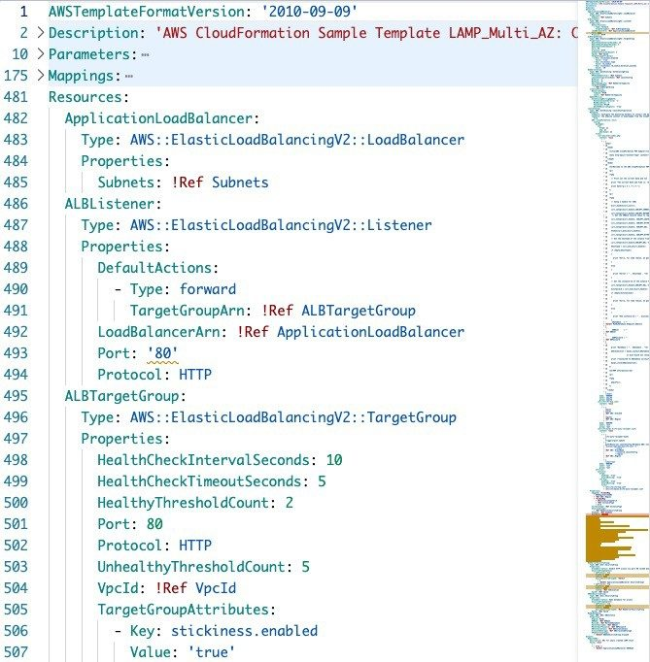
ORIGINAL PPT v4 · SOURCE SLIDE 221 · MODERNISED TECHNICAL DEEP DIVE
CloudFormation - Template Example
1
Application Composer
Application Composer
Mechanism: templates define desired state; change sets expose impact; policies and hooks gate risk; stack events…
2
Failure mode
Failure mode: unmanaged console changes, implicit defaults, replacement-sensitive resources and missing rollback…
3
Evidence: validation result…
Evidence: validation result, reviewed change set, policy decision, stack events, health alarms, drift detail and…
CURRENT OPERATIONS LENS
Treat infrastructure automation as controlled change: validate, preview, approve, deploy, observe, reconcile drift and retain rollback evidence. Validate service limits and regional availability against current AWS documentation.
AWS Certified SysOps Administrator Associate Training · TGS-2024051413
© 2026 Tertiary Infotech Academy Pte Ltd
314

Slide 315
ORIGINAL PPT v4 · SOURCE SLIDE 222 · MODERNISED TECHNICAL DEEP DIVE
Benefits of AWS CloudFormation (1/2)
1
Infrastructure as code
2
No resources are manually created,
3
The code can be version
4
Changes to the infrastructure are
Infrastructure as code
Each resources within the stack is tagged with an identifier so you can easily see how much a stack costs you
No resources are manually created, which is excellent for control
You can estimate the costs of your resources using the CloudFormation template
The code can be version controlled for example using Git
Savings strategy: In Dev, you could automation deletion of templates at 5 PM and recreated at 8 AM, safely
Changes to the infrastructure are reviewed through code
Mechanism: templates define desired state; change sets expose impact; policies and hooks gate risk; stack events and drift detection expose outcome.
CURRENT OPERATIONS LENS
Treat infrastructure automation as controlled change: validate, preview, approve, deploy, observe, reconcile drift and retain rollback evidence. Validate service limits and regional availability against current AWS documentation.
AWS Certified SysOps Administrator Associate Training · TGS-2024051413
© 2026 Tertiary Infotech Academy Pte Ltd
315

Slide 316
ORIGINAL PPT v4 · SOURCE SLIDE 223 · MODERNISED TECHNICAL DEEP DIVE
Benefits of AWS CloudFormation (2/2)
1
Productivity
2
Ability to destroy and re-create
3
Automated generation of Diagram…
4
Declarative programming (no need…
Productivity
Separation of concern: create many stacks for many apps and many layers. Eg.
Don't re-invent the wheel
Ability to destroy and re-create an infrastructure on the cloud on the fly
VPC stacks
Leverage existing templates on the web!
Automated generation of Diagram for your templates!
Network stacks
Leverage the documentation
Declarative programming (no need to figure out ordering and orchestration)
App stacks
CURRENT OPERATIONS LENS
Treat infrastructure automation as controlled change: validate, preview, approve, deploy, observe, reconcile drift and retain rollback evidence. Validate service limits and regional availability against current AWS documentation.
AWS Certified SysOps Administrator Associate Training · TGS-2024051413
© 2026 Tertiary Infotech Academy Pte Ltd
316

Slide 317
ORIGINAL PPT v4 · SOURCE SLIDE 224 · MODERNISED TECHNICAL DEEP DIVE
How CloudFormation Works
1
Templates must be uploaded in
2
To update a template, we
3
Stacks are identified by a
4
Deleting a stack deletes every
Templates must be uploaded in S3 and then referenced in CloudFormation
AWS CloudFormation
To update a template, we can’t edit previous ones. We have to re- upload a new version of the template to AWS
AWS Resources
Stacks are identified by a name
Mechanism: templates define desired state; change sets expose impact; policies and hooks gate risk; stack events and drift detection expose outcome.
Deleting a stack deletes every single artifact that was created by CloudFormation.
CURRENT OPERATIONS LENS
Treat infrastructure automation as controlled change: validate, preview, approve, deploy, observe, reconcile drift and retain rollback evidence. Validate service limits and regional availability against current AWS documentation.
AWS Certified SysOps Administrator Associate Training · TGS-2024051413
© 2026 Tertiary Infotech Academy Pte Ltd
317

Slide 318
ORIGINAL PPT v4 · SOURCE SLIDE 225 · MODERNISED TECHNICAL DEEP DIVE
Deploying CloudFormation Templates
1
Manual way
2
Editing templates in Application…
3
Using the console to input
4
We’ll mostly do this way
Manual way
Automated way
CloudFormation Console
Mechanism: templates define desired state; change sets expose impact; policies and hooks gate risk; stack events and drift detection expose outcome.
Editing templates in Application Composer or code editor
Editing templates in a YAML file
Application Composer / Code Editor
Using the console to input parameters, etc…
Using the AWS CLI (Command Line Interface) to deploy the templates, or using a Continuous Delivery (CD) tool
create-stack
We’ll mostly do this way in the course for learning purposes
Recommended way when you fully want to automate your flow
CloudFormation
CURRENT OPERATIONS LENS
Treat infrastructure automation as controlled change: validate, preview, approve, deploy, observe, reconcile drift and retain rollback evidence. Validate service limits and regional availability against current AWS documentation.
AWS Certified SysOps Administrator Associate Training · TGS-2024051413
© 2026 Tertiary Infotech Academy Pte Ltd
318

Slide 319
ORIGINAL PPT v4 · SOURCE SLIDE 226 · MODERNISED TECHNICAL DEEP DIVE
CloudFormation - Building Blocks
1
Template's Components
2
AWSTemplateFormatVersion…
3
Description - comments about the
4
Resources (MANDATORY)
Template's Components
Parameters - the dynamic inputs for your template
Template's Helpers
AWSTemplateFormatVersion - identifies the capabilities of the template “2010-09-09”
Mappings - the static variables for your template
Description - comments about the template
Outputs - references to what has been created
Resources (MANDATORY) - your AWS resources declared in the template
Conditionals - list of conditions to perform resource creation
CURRENT OPERATIONS LENS
Treat infrastructure automation as controlled change: validate, preview, approve, deploy, observe, reconcile drift and retain rollback evidence. Validate service limits and regional availability against current AWS documentation.
AWS Certified SysOps Administrator Associate Training · TGS-2024051413
© 2026 Tertiary Infotech Academy Pte Ltd
319

Slide 320
ORIGINAL PPT v4 · SOURCE SLIDE 227 · MODERNISED TECHNICAL DEEP DIVE
Introductory Example
1
We’re going to create a
2
And we’re going to add
3
For now, forget about the
4
We’ll look at the structure
We’re going to create a simple EC2 instance
We’ll see how in no-time, we are able to get started with CloudFormation!
And we’re going to add security group to it
Web Server
For now, forget about the code syntax
WebServerSecurityGroup
Mechanism: templates define desired state; change sets expose impact; policies and hooks gate risk; stack events and drift detection expose outcome.
We’ll look at the structure of the files later
Failure mode: unmanaged console changes, implicit defaults, replacement-sensitive resources and missing rollback signals create difficult recovery…
CURRENT OPERATIONS LENS
Treat infrastructure automation as controlled change: validate, preview, approve, deploy, observe, reconcile drift and retain rollback evidence. Validate service limits and regional availability against current AWS documentation.
AWS Certified SysOps Administrator Associate Training · TGS-2024051413
© 2026 Tertiary Infotech Academy Pte Ltd
320

Slide 321
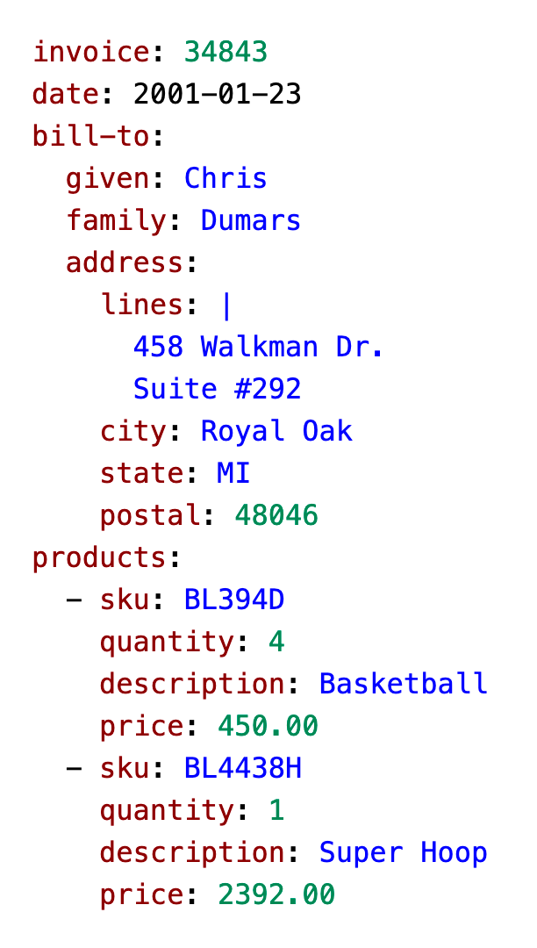
ORIGINAL PPT v4 · SOURCE SLIDE 229 · MODERNISED TECHNICAL DEEP DIVE
YAML Crash Course
1
YAML and JSON are the
YAML and JSON are the languages you can use for CloudFormation
2
Mechanism: templates define…
Mechanism: templates define desired state; change sets expose impact; policies and hooks gate risk; stack events…
3
Failure mode
Failure mode: unmanaged console changes, implicit defaults, replacement-sensitive resources and missing rollback…
CURRENT OPERATIONS LENS
Treat infrastructure automation as controlled change: validate, preview, approve, deploy, observe, reconcile drift and retain rollback evidence. Validate service limits and regional availability against current AWS documentation.
AWS Certified SysOps Administrator Associate Training · TGS-2024051413
© 2026 Tertiary Infotech Academy Pte Ltd
321

Slide 322
ORIGINAL PPT v4 · SOURCE SLIDE 230 · MODERNISED TECHNICAL DEEP DIVE
CloudFormation - Resources
1
Resources are the core of
2
They represent the different AWS
3
Resources are declared and can
4
AWS figures out creation, updates
Resources are the core of your CloudFormation template (MANDATORY)
There are over 700 types of resources (!)
They represent the different AWS Components that will be created and configured
Resource types identifiers are of the form
Resources are declared and can reference each other
service-provider::service-name::data-type-name
Mechanism: templates define desired state; change sets expose impact; policies and hooks gate risk; stack events and drift detection expose outcome.
AWS figures out creation, updates and deletes of resources for us
CURRENT OPERATIONS LENS
Treat infrastructure automation as controlled change: validate, preview, approve, deploy, observe, reconcile drift and retain rollback evidence. Validate service limits and regional availability against current AWS documentation.
AWS Certified SysOps Administrator Associate Training · TGS-2024051413
© 2026 Tertiary Infotech Academy Pte Ltd
322

Slide 323
ORIGINAL PPT v4 · SOURCE SLIDE 231 · MODERNISED TECHNICAL DEEP DIVE
How do I find Resources documentation?
1
I can’t teach you all
2
All the resources can be
3
Then, we just read the
4
Example here (for an EC2
I can’t teach you all the 700+ resources, but I can teach you how to learn how to use them
All the resources can be found here
Mechanism: templates define desired state; change sets expose impact; policies and hooks gate risk; stack events and drift detection expose outcome.
Then, we just read the docs ©
Failure mode: unmanaged console changes, implicit defaults, replacement-sensitive resources and missing rollback signals create difficult recovery…
Example here (for an EC2 instance)
Evidence: validation result, reviewed change set, policy decision, stack events, health alarms, drift detail and reconciled source must all be…
CURRENT OPERATIONS LENS
Treat infrastructure automation as controlled change: validate, preview, approve, deploy, observe, reconcile drift and retain rollback evidence. Validate service limits and regional availability against current AWS documentation.
AWS Certified SysOps Administrator Associate Training · TGS-2024051413
© 2026 Tertiary Infotech Academy Pte Ltd
323

Slide 324
ORIGINAL PPT v4 · SOURCE SLIDE 232 · MODERNISED TECHNICAL DEEP DIVE
Analysis of CloudFormation Template
1
Going back to the example
2
Relevant documentation can be…
3
Failure mode
4
Evidence: validation result…
Going back to the example of the introductory lecture, let’s learn why it was written this way.
Relevant documentation can be found here
Mechanism: templates define desired state; change sets expose impact; policies and hooks gate risk; stack events and drift detection expose outcome.
Failure mode: unmanaged console changes, implicit defaults, replacement-sensitive resources and missing rollback signals create difficult recovery…
Evidence: validation result, reviewed change set, policy decision, stack events, health alarms, drift detail and reconciled source must all be…
CURRENT OPERATIONS LENS
Treat infrastructure automation as controlled change: validate, preview, approve, deploy, observe, reconcile drift and retain rollback evidence. Validate service limits and regional availability against current AWS documentation.
AWS Certified SysOps Administrator Associate Training · TGS-2024051413
© 2026 Tertiary Infotech Academy Pte Ltd
324

Slide 325
ORIGINAL PPT v4 · SOURCE SLIDE 233 · MODERNISED TECHNICAL DEEP DIVE
CloudFormation - Resources FAQ
1
Can I create a dynamic
2
Yes, you can by using
3
It is not in the
4
Is every AWS Service supported?
Can I create a dynamic number of resources?
Almost. Only a select few niches are not there yet
Yes, you can by using CloudFormation Macros and Transform
You can work around that using CloudFormation Custom Resources
It is not in the scope of this course
Mechanism: templates define desired state; change sets expose impact; policies and hooks gate risk; stack events and drift detection expose outcome.
Is every AWS Service supported?
Failure mode: unmanaged console changes, implicit defaults, replacement-sensitive resources and missing rollback signals create difficult recovery…
CURRENT OPERATIONS LENS
Treat infrastructure automation as controlled change: validate, preview, approve, deploy, observe, reconcile drift and retain rollback evidence. Validate service limits and regional availability against current AWS documentation.
AWS Certified SysOps Administrator Associate Training · TGS-2024051413
© 2026 Tertiary Infotech Academy Pte Ltd
325

Slide 326
ORIGINAL PPT v4 · SOURCE SLIDE 235 · MODERNISED TECHNICAL DEEP DIVE
CloudFormation - Parameters
1
Parameters are a way to
2
They’re important to know about
3
You want to reuse your
4
Some inputs can not be
Parameters are a way to provide inputs to your AWS CloudFormation template
Parameters are extremely powerful, controlled, and can prevent errors from happening in your templates, thanks to types
Parameter1: value1
They’re important to know about if
AWS CloudFormation
+ Parameter2: valu
You want to reuse your templates across the company
upload template
CF template Parameters
Some inputs can not be determined ahead of time
provide parameter values
create stack
CURRENT OPERATIONS LENS
Treat infrastructure automation as controlled change: validate, preview, approve, deploy, observe, reconcile drift and retain rollback evidence. Validate service limits and regional availability against current AWS documentation.
AWS Certified SysOps Administrator Associate Training · TGS-2024051413
© 2026 Tertiary Infotech Academy Pte Ltd
326

Slide 327
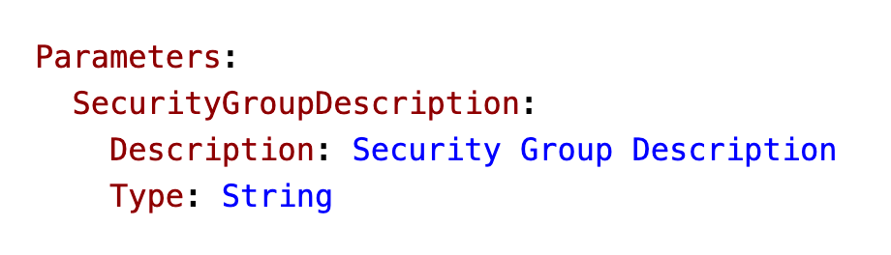
ORIGINAL PPT v4 · SOURCE SLIDE 236 · MODERNISED TECHNICAL DEEP DIVE
When should you use a Parameter?
1
Ask yourself this
Ask yourself this
Mechanism: templates define desired state; change sets expose impact; policies and hooks gate risk; stack events…
2
Failure mode
Failure mode: unmanaged console changes, implicit defaults, replacement-sensitive resources and missing rollback…
3
Evidence: validation result…
Evidence: validation result, reviewed change set, policy decision, stack events, health alarms, drift detail and…
CURRENT OPERATIONS LENS
Treat infrastructure automation as controlled change: validate, preview, approve, deploy, observe, reconcile drift and retain rollback evidence. Validate service limits and regional availability against current AWS documentation.
AWS Certified SysOps Administrator Associate Training · TGS-2024051413
© 2026 Tertiary Infotech Academy Pte Ltd
327

Slide 328
ORIGINAL PPT v4 · SOURCE SLIDE 237 · MODERNISED TECHNICAL DEEP DIVE
CloudFormation - Parameters Settings
1
CommaDelimitedList
2
List<Number>
3
AWS-Specific Parameter
4
(to help catch invalid values
CommaDelimitedList
List<AWS-Specific Parameter>
Min/MaxLength
Mechanism: templates define desired state; change sets expose impact; policies and hooks gate risk; stack events and drift detection expose outcome.
List<Number>
SSM Parameter (get parameter value from SSM Parameter store)
Min/MaxValue
AWS-Specific Parameter
Description
Allowed Values (array)
Failure mode: unmanaged console changes, implicit defaults, replacement-sensitive resources and missing rollback signals create difficult recovery…
(to help catch invalid values - match against existing values in the AWS account)
Constraint Description (String)
AllowedPattern (regex)
CURRENT OPERATIONS LENS
Treat infrastructure automation as controlled change: validate, preview, approve, deploy, observe, reconcile drift and retain rollback evidence. Validate service limits and regional availability against current AWS documentation.
AWS Certified SysOps Administrator Associate Training · TGS-2024051413
© 2026 Tertiary Infotech Academy Pte Ltd
328

Slide 329
ORIGINAL PPT v4 · SOURCE SLIDE 238 · MODERNISED TECHNICAL DEEP DIVE
CloudFormation - Parameters Example
1
AllowedValues NoEcho
2
Failure mode
3
Evidence: validation result…
4
Decision point
AllowedValues NoEcho
Mechanism: templates define desired state; change sets expose impact; policies and hooks gate risk; stack events and drift detection expose outcome.
Failure mode: unmanaged console changes, implicit defaults, replacement-sensitive resources and missing rollback signals create difficult recovery…
Evidence: validation result, reviewed change set, policy decision, stack events, health alarms, drift detail and reconciled source must all be…
Decision point: reconcile an emergency change by deciding whether the template or the live state is authoritative, then restore one controlled source…
CURRENT OPERATIONS LENS
Treat infrastructure automation as controlled change: validate, preview, approve, deploy, observe, reconcile drift and retain rollback evidence. Validate service limits and regional availability against current AWS documentation.
AWS Certified SysOps Administrator Associate Training · TGS-2024051413
© 2026 Tertiary Infotech Academy Pte Ltd
329

Slide 330
ORIGINAL PPT v4 · SOURCE SLIDE 239 · MODERNISED TECHNICAL DEEP DIVE
How to Reference a Parameter?
1
The Fn
2
Parameters can be used anywhere
3
The shorthand for this in
4
The function can also reference
The Fn::Ref function can be leveraged to reference parameters
Mechanism: templates define desired state; change sets expose impact; policies and hooks gate risk; stack events and drift detection expose outcome.
Parameters can be used anywhere in a template
Failure mode: unmanaged console changes, implicit defaults, replacement-sensitive resources and missing rollback signals create difficult recovery…
The shorthand for this in YAML is !Ref
Evidence: validation result, reviewed change set, policy decision, stack events, health alarms, drift detail and reconciled source must all be…
The function can also reference other elements within the template
CURRENT OPERATIONS LENS
Treat infrastructure automation as controlled change: validate, preview, approve, deploy, observe, reconcile drift and retain rollback evidence. Validate service limits and regional availability against current AWS documentation.
AWS Certified SysOps Administrator Associate Training · TGS-2024051413
© 2026 Tertiary Infotech Academy Pte Ltd
330

Slide 331
ORIGINAL PPT v4 · SOURCE SLIDE 240 · MODERNISED TECHNICAL DEEP DIVE
CloudFormation - Pseudo Parameters
1
AWS offers us Pseudo Parameters
2
These can be used at
3
Important pseudo parameters
4
Evidence: validation result…
AWS offers us Pseudo Parameters in any CloudFormation template
Mechanism: templates define desired state; change sets expose impact; policies and hooks gate risk; stack events and drift detection expose outcome.
These can be used at any time and are enabled by default
Important pseudo parameters
Failure mode: unmanaged console changes, implicit defaults, replacement-sensitive resources and missing rollback signals create difficult recovery…
Evidence: validation result, reviewed change set, policy decision, stack events, health alarms, drift detail and reconciled source must all be…
CURRENT OPERATIONS LENS
Treat infrastructure automation as controlled change: validate, preview, approve, deploy, observe, reconcile drift and retain rollback evidence. Validate service limits and regional availability against current AWS documentation.
AWS Certified SysOps Administrator Associate Training · TGS-2024051413
© 2026 Tertiary Infotech Academy Pte Ltd
331

Slide 332
ORIGINAL PPT v4 · SOURCE SLIDE 241 · MODERNISED TECHNICAL DEEP DIVE
CloudFormation - Mappings
1
Mappings are fixed variables…
2
They’re very handy to…
3
All the values are hardcoded
4
Evidence: validation result…
Mappings are fixed variables within your CloudFormation template
Mechanism: templates define desired state; change sets expose impact; policies and hooks gate risk; stack events and drift detection expose outcome.
They’re very handy to differentiate between different environments (dev vs prod), regions (AWS regions), AMI types…
All the values are hardcoded within the template
Failure mode: unmanaged console changes, implicit defaults, replacement-sensitive resources and missing rollback signals create difficult recovery…
Evidence: validation result, reviewed change set, policy decision, stack events, health alarms, drift detail and reconciled source must all be…
CURRENT OPERATIONS LENS
Treat infrastructure automation as controlled change: validate, preview, approve, deploy, observe, reconcile drift and retain rollback evidence. Validate service limits and regional availability against current AWS documentation.
AWS Certified SysOps Administrator Associate Training · TGS-2024051413
© 2026 Tertiary Infotech Academy Pte Ltd
332

Slide 333
ORIGINAL PPT v4 · SOURCE SLIDE 242 · MODERNISED TECHNICAL DEEP DIVE
Accessing Mapping Values (Fn::FindInMap)
1
We use Fn
2
!FindInMap [ MapName…
3
Mappings work great for AMIs
4
Evidence: validation result…
We use Fn::FindInMap to return a named value from a specific key
!FindInMap [ MapName, TopLevelKey, SecondLevelKey ]
Mechanism: templates define desired state; change sets expose impact; policies and hooks gate risk; stack events and drift detection expose outcome.
Mappings work great for AMIs Because AMIs are region-specific!
Failure mode: unmanaged console changes, implicit defaults, replacement-sensitive resources and missing rollback signals create difficult recovery…
Evidence: validation result, reviewed change set, policy decision, stack events, health alarms, drift detail and reconciled source must all be…
CURRENT OPERATIONS LENS
Treat infrastructure automation as controlled change: validate, preview, approve, deploy, observe, reconcile drift and retain rollback evidence. Validate service limits and regional availability against current AWS documentation.
AWS Certified SysOps Administrator Associate Training · TGS-2024051413
© 2026 Tertiary Infotech Academy Pte Ltd
333

Slide 334
ORIGINAL PPT v4 · SOURCE SLIDE 243 · MODERNISED TECHNICAL DEEP DIVE
When would you use Mappings vs Parameters?
1
Mappings are great when you
2
Availability Zone
3
AWS Account
4
Environment (dev vs prod)
Mappings are great when you know in advance all the values that can be taken and that they can be deduced from variables such as
They allow safer control over the template
Availability Zone
Use parameters when the values are really user specific
AWS Account
Mechanism: templates define desired state; change sets expose impact; policies and hooks gate risk; stack events and drift detection expose outcome.
Environment (dev vs prod)
Failure mode: unmanaged console changes, implicit defaults, replacement-sensitive resources and missing rollback signals create difficult recovery…
CURRENT OPERATIONS LENS
Treat infrastructure automation as controlled change: validate, preview, approve, deploy, observe, reconcile drift and retain rollback evidence. Validate service limits and regional availability against current AWS documentation.
AWS Certified SysOps Administrator Associate Training · TGS-2024051413
© 2026 Tertiary Infotech Academy Pte Ltd
334

Slide 335
ORIGINAL PPT v4 · SOURCE SLIDE 244 · MODERNISED TECHNICAL DEEP DIVE
CloudFormation - Outputs
1
The Outputs section declares…
2
You can also view the
3
They’re very useful for example
4
It’s the best way to
The Outputs section declares optional outputs values that we can import into other stacks (if you export them first)!
Application Stack
You can also view the outputs in the AWS Console or in using the AWS CLI
Network Stack
They’re very useful for example if you define a network CloudFormation, and output the variables such as VPC ID and your Subnet IDs
VPC ID: vpc-2f09a348
It’s the best way to perform some collaboration cross stack, as you let expert handle their own part of the stack
Exported Output
CURRENT OPERATIONS LENS
Treat infrastructure automation as controlled change: validate, preview, approve, deploy, observe, reconcile drift and retain rollback evidence. Validate service limits and regional availability against current AWS documentation.
AWS Certified SysOps Administrator Associate Training · TGS-2024051413
© 2026 Tertiary Infotech Academy Pte Ltd
335

Slide 336
ORIGINAL PPT v4 · SOURCE SLIDE 245 · MODERNISED TECHNICAL DEEP DIVE
CloudFormation - Outputs
1
Creating a SSH Security Group
2
We create an output that
3
Failure mode
4
Evidence: validation result…
Creating a SSH Security Group as part of one template
We create an output that references that security group
Mechanism: templates define desired state; change sets expose impact; policies and hooks gate risk; stack events and drift detection expose outcome.
Failure mode: unmanaged console changes, implicit defaults, replacement-sensitive resources and missing rollback signals create difficult recovery…
Evidence: validation result, reviewed change set, policy decision, stack events, health alarms, drift detail and reconciled source must all be…
CURRENT OPERATIONS LENS
Treat infrastructure automation as controlled change: validate, preview, approve, deploy, observe, reconcile drift and retain rollback evidence. Validate service limits and regional availability against current AWS documentation.
AWS Certified SysOps Administrator Associate Training · TGS-2024051413
© 2026 Tertiary Infotech Academy Pte Ltd
336

Slide 337
ORIGINAL PPT v4 · SOURCE SLIDE 246 · MODERNISED TECHNICAL DEEP DIVE
CloudFormation - Outputs Cross-Stack Reference
1
We then create a second
2
For this, we use the Fn
3
You can’t delete the underlying
4
Failure mode
We then create a second template that leverages that security group
For this, we use the Fn::ImportValue function
Mechanism: templates define desired state; change sets expose impact; policies and hooks gate risk; stack events and drift detection expose outcome.
You can’t delete the underlying stack until all the references are deleted
Failure mode: unmanaged console changes, implicit defaults, replacement-sensitive resources and missing rollback signals create difficult recovery…
CURRENT OPERATIONS LENS
Treat infrastructure automation as controlled change: validate, preview, approve, deploy, observe, reconcile drift and retain rollback evidence. Validate service limits and regional availability against current AWS documentation.
AWS Certified SysOps Administrator Associate Training · TGS-2024051413
© 2026 Tertiary Infotech Academy Pte Ltd
337

Slide 338
ORIGINAL PPT v4 · SOURCE SLIDE 247 · MODERNISED TECHNICAL DEEP DIVE
CloudFormation - Conditions
1
Conditions are used to control
2
Conditions can be whatever you
3
Environment (dev / test /
4
AWS Region
Conditions are used to control the creation of resources or outputs based on a condition
Any parameter value
Prod Stack
Conditions can be whatever you want them to be, but common ones are
Each condition can reference another condition, parameter value or mapping
Parameters
Environment (dev / test / prod)
EC2 Instance
Mechanism: templates define desired state; change sets expose impact; policies and hooks gate risk; stack events and drift detection expose outcome.
AWS Region
EBS Volume
Failure mode: unmanaged console changes, implicit defaults, replacement-sensitive resources and missing rollback signals create difficult recovery…
CURRENT OPERATIONS LENS
Treat infrastructure automation as controlled change: validate, preview, approve, deploy, observe, reconcile drift and retain rollback evidence. Validate service limits and regional availability against current AWS documentation.
AWS Certified SysOps Administrator Associate Training · TGS-2024051413
© 2026 Tertiary Infotech Academy Pte Ltd
338

Slide 339
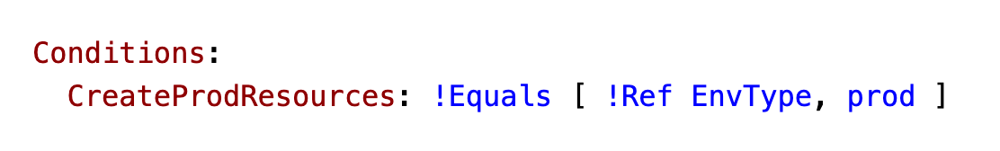
ORIGINAL PPT v4 · SOURCE SLIDE 248 · MODERNISED TECHNICAL DEEP DIVE
How to define a Condition
1
The logical ID is for
The logical ID is for you to choose. It’s how you name condition
2
Mechanism: templates define…
Mechanism: templates define desired state; change sets expose impact; policies and hooks gate risk; stack events…
3
Failure mode
Failure mode: unmanaged console changes, implicit defaults, replacement-sensitive resources and missing rollback…
CURRENT OPERATIONS LENS
Treat infrastructure automation as controlled change: validate, preview, approve, deploy, observe, reconcile drift and retain rollback evidence. Validate service limits and regional availability against current AWS documentation.
AWS Certified SysOps Administrator Associate Training · TGS-2024051413
© 2026 Tertiary Infotech Academy Pte Ltd
339

Slide 340
ORIGINAL PPT v4 · SOURCE SLIDE 249 · MODERNISED TECHNICAL DEEP DIVE
How to use a Condition
1
Conditions can be applied to
2
Mechanism: templates define…
3
Failure mode
4
Evidence: validation result…
Conditions can be applied to resources / outputs / etc…
Mechanism: templates define desired state; change sets expose impact; policies and hooks gate risk; stack events and drift detection expose outcome.
Failure mode: unmanaged console changes, implicit defaults, replacement-sensitive resources and missing rollback signals create difficult recovery…
Evidence: validation result, reviewed change set, policy decision, stack events, health alarms, drift detail and reconciled source must all be…
CURRENT OPERATIONS LENS
Treat infrastructure automation as controlled change: validate, preview, approve, deploy, observe, reconcile drift and retain rollback evidence. Validate service limits and regional availability against current AWS documentation.
AWS Certified SysOps Administrator Associate Training · TGS-2024051413
© 2026 Tertiary Infotech Academy Pte Ltd
340

Slide 341
ORIGINAL PPT v4 · SOURCE SLIDE 250 · MODERNISED TECHNICAL DEEP DIVE
CloudFormation - Intrinsic Functions
1
Fn::GetAtt
2
Fn::FindInMap
3
Fn::ImportValue
4
Fn::ForEach
Fn::GetAtt
Fn::ToJsonString
Fn::Select
Mechanism: templates define desired state; change sets expose impact; policies and hooks gate risk; stack events and drift detection expose outcome.
Fn::FindInMap
Condition Functions (Fn::If, Fn::Not, Fn::Equals, etc…)
Fn::Transform
Failure mode: unmanaged console changes, implicit defaults, replacement-sensitive resources and missing rollback signals create difficult recovery…
Fn::ImportValue
Fn::Base64
Fn::Length
Evidence: validation result, reviewed change set, policy decision, stack events, health alarms, drift detail and reconciled source must all be…
Fn::ForEach
Fn::GetAZs
Blue = must know
Decision point: reconcile an emergency change by deciding whether the template or the live state is authoritative, then restore one controlled source…
CURRENT OPERATIONS LENS
Treat infrastructure automation as controlled change: validate, preview, approve, deploy, observe, reconcile drift and retain rollback evidence. Validate service limits and regional availability against current AWS documentation.
AWS Certified SysOps Administrator Associate Training · TGS-2024051413
© 2026 Tertiary Infotech Academy Pte Ltd
341

Slide 342
ORIGINAL PPT v4 · SOURCE SLIDE 251 · MODERNISED TECHNICAL DEEP DIVE
Intrinsic Functions - Fn::Ref
1
The Fn
2
Parameters - returns the value
3
Resources - returns the physical
4
The shorthand for this in
The Fn::Ref function can be leveraged to reference
Mechanism: templates define desired state; change sets expose impact; policies and hooks gate risk; stack events and drift detection expose outcome.
Parameters - returns the value of the parameter
Failure mode: unmanaged console changes, implicit defaults, replacement-sensitive resources and missing rollback signals create difficult recovery…
Resources - returns the physical ID of the underlying resource (e.g., EC2 ID)
The shorthand for this in YAML is !Ref
Evidence: validation result, reviewed change set, policy decision, stack events, health alarms, drift detail and reconciled source must all be…
CURRENT OPERATIONS LENS
Treat infrastructure automation as controlled change: validate, preview, approve, deploy, observe, reconcile drift and retain rollback evidence. Validate service limits and regional availability against current AWS documentation.
AWS Certified SysOps Administrator Associate Training · TGS-2024051413
© 2026 Tertiary Infotech Academy Pte Ltd
342

Slide 343
ORIGINAL PPT v4 · SOURCE SLIDE 252 · MODERNISED TECHNICAL DEEP DIVE
Intrinsic Functions - Fn::GetAtt
1
Attributes are attached to any
2
To know the attributes of
3
Example: the AZ of an
4
Evidence: validation result…
Attributes are attached to any resources you create
Mechanism: templates define desired state; change sets expose impact; policies and hooks gate risk; stack events and drift detection expose outcome.
To know the attributes of your resources, the best place to look at is the documentation
Example: the AZ of an EC2 instance!
Failure mode: unmanaged console changes, implicit defaults, replacement-sensitive resources and missing rollback signals create difficult recovery…
Evidence: validation result, reviewed change set, policy decision, stack events, health alarms, drift detail and reconciled source must all be…
CURRENT OPERATIONS LENS
Treat infrastructure automation as controlled change: validate, preview, approve, deploy, observe, reconcile drift and retain rollback evidence. Validate service limits and regional availability against current AWS documentation.
AWS Certified SysOps Administrator Associate Training · TGS-2024051413
© 2026 Tertiary Infotech Academy Pte Ltd
343

Slide 344
ORIGINAL PPT v4 · SOURCE SLIDE 253 · MODERNISED TECHNICAL DEEP DIVE
Intrinsic Functions - Fn::FindInMap
1
We use Fn
2
!FindInMap [ MapName…
3
Failure mode
4
Evidence: validation result…
We use Fn::FindInMap to return a named value from a specific key
!FindInMap [ MapName, TopLevelKey, SecondLevelKey ]
Mechanism: templates define desired state; change sets expose impact; policies and hooks gate risk; stack events and drift detection expose outcome.
Failure mode: unmanaged console changes, implicit defaults, replacement-sensitive resources and missing rollback signals create difficult recovery…
Evidence: validation result, reviewed change set, policy decision, stack events, health alarms, drift detail and reconciled source must all be…
CURRENT OPERATIONS LENS
Treat infrastructure automation as controlled change: validate, preview, approve, deploy, observe, reconcile drift and retain rollback evidence. Validate service limits and regional availability against current AWS documentation.
AWS Certified SysOps Administrator Associate Training · TGS-2024051413
© 2026 Tertiary Infotech Academy Pte Ltd
344

Slide 345
ORIGINAL PPT v4 · SOURCE SLIDE 254 · MODERNISED TECHNICAL DEEP DIVE
Intrinsic Functions - Fn::ImportValue
1
Import values that are exported
2
For this, we use the Fn
3
Evidence: validation result…
4
Decision point
Import values that are exported in other stacks
Mechanism: templates define desired state; change sets expose impact; policies and hooks gate risk; stack events and drift detection expose outcome.
For this, we use the Fn::ImportValue function
Failure mode: unmanaged console changes, implicit defaults, replacement-sensitive resources and missing rollback signals create difficult recovery…
Evidence: validation result, reviewed change set, policy decision, stack events, health alarms, drift detail and reconciled source must all be…
Decision point: reconcile an emergency change by deciding whether the template or the live state is authoritative, then restore one controlled source…
CURRENT OPERATIONS LENS
Treat infrastructure automation as controlled change: validate, preview, approve, deploy, observe, reconcile drift and retain rollback evidence. Validate service limits and regional availability against current AWS documentation.
AWS Certified SysOps Administrator Associate Training · TGS-2024051413
© 2026 Tertiary Infotech Academy Pte Ltd
345

Slide 346
ORIGINAL PPT v4 · SOURCE SLIDE 255 · MODERNISED TECHNICAL DEEP DIVE
Intrinsic Functions - Fn::Base64
1
Convert String to it’s Base64
2
Example: pass encoded data to
3
Evidence: validation result…
4
Decision point
Convert String to it’s Base64 representation
Mechanism: templates define desired state; change sets expose impact; policies and hooks gate risk; stack events and drift detection expose outcome.
Example: pass encoded data to EC2 Instance’s UserData property
Failure mode: unmanaged console changes, implicit defaults, replacement-sensitive resources and missing rollback signals create difficult recovery…
Evidence: validation result, reviewed change set, policy decision, stack events, health alarms, drift detail and reconciled source must all be…
Decision point: reconcile an emergency change by deciding whether the template or the live state is authoritative, then restore one controlled source…
CURRENT OPERATIONS LENS
Treat infrastructure automation as controlled change: validate, preview, approve, deploy, observe, reconcile drift and retain rollback evidence. Validate service limits and regional availability against current AWS documentation.
AWS Certified SysOps Administrator Associate Training · TGS-2024051413
© 2026 Tertiary Infotech Academy Pte Ltd
346

Slide 347
ORIGINAL PPT v4 · SOURCE SLIDE 256 · MODERNISED TECHNICAL DEEP DIVE
Intrinsic Functions -Condition Functions
1
The logical ID is for
The logical ID is for you to choose. It’s how you name condition
2
Mechanism: templates define…
Mechanism: templates define desired state; change sets expose impact; policies and hooks gate risk; stack events…
3
Failure mode
Failure mode: unmanaged console changes, implicit defaults, replacement-sensitive resources and missing rollback…
CURRENT OPERATIONS LENS
Treat infrastructure automation as controlled change: validate, preview, approve, deploy, observe, reconcile drift and retain rollback evidence. Validate service limits and regional availability against current AWS documentation.
AWS Certified SysOps Administrator Associate Training · TGS-2024051413
© 2026 Tertiary Infotech Academy Pte Ltd
347

Slide 348
ORIGINAL PPT v4 · SOURCE SLIDE 257 · MODERNISED TECHNICAL DEEP DIVE
CloudFormation - Rollbacks
1
Stack Creation Fails
2
Default: everything rolls back…
3
Option to disable rollback and
4
Stack Update Fails
Stack Creation Fails
The stack automatically rolls back to the previous known working state
Or from the CLI using continue-update-rollback API call20
Default: everything rolls back (gets deleted). We can look at the log
Ability to see in the log what happened and error messages
Option to disable rollback and troubleshoot what happened
Rollback Failure? Fix resources manually then issue
Stack Update Fails
ContinueUpdateRollback API from Console
Mechanism: templates define desired state; change sets expose impact; policies and hooks gate risk; stack events and drift detection expose outcome.
CURRENT OPERATIONS LENS
Treat infrastructure automation as controlled change: validate, preview, approve, deploy, observe, reconcile drift and retain rollback evidence. Validate service limits and regional availability against current AWS documentation.
AWS Certified SysOps Administrator Associate Training · TGS-2024051413
© 2026 Tertiary Infotech Academy Pte Ltd
348

Slide 349
ORIGINAL PPT v4 · SOURCE SLIDE 258 · MODERNISED TECHNICAL DEEP DIVE
CloudFormation - Service Role
1
IAM role that allows…
2
Give ability to users to
3
stack resources even if they
4
You want to achieve the
IAM role that allows CloudFormation to create/update/delete stack resources on your behalf
But you don’t want to give the user all the required permissions to create the stack resources
Permissions
Give ability to users to create/update/delete the
User must have iam:PassRole permissions
s3:*Bucket
stack resources even if they don’t have permissions to work with the resources in the stack
cloudformation:*
Service Role
You want to achieve the least privilege principle
iam:PassRole
S3 bucket Stack
CURRENT OPERATIONS LENS
Treat infrastructure automation as controlled change: validate, preview, approve, deploy, observe, reconcile drift and retain rollback evidence. Validate service limits and regional availability against current AWS documentation.
AWS Certified SysOps Administrator Associate Training · TGS-2024051413
© 2026 Tertiary Infotech Academy Pte Ltd
349

Slide 350
ORIGINAL PPT v4 · SOURCE SLIDE 259 · MODERNISED TECHNICAL DEEP DIVE
CloudFormation Capabilities
1
CAPABILITY_NAMED_IAM and…
2
Specify CAPABILITY_NAMED_IAM if…
3
CAPABILITY_AUTO_EXPAND
4
Necessary when your…
CAPABILITY_NAMED_IAM and CAPABILITY_IAM Necessary to enable when you CloudFormation template is creating or updating IAM resources (IAM User, Role…
You’re acknowledging that your template may change before deploying
Specify CAPABILITY_NAMED_IAM if the resources are named
InsufficientCapabilitiesException
Mechanism: templates define desired state; change sets expose impact; policies and hooks gate risk; stack events and drift detection expose outcome.
CAPABILITY_AUTO_EXPAND
Exception that will be thrown by CloudFormation if the capabilities haven’t been acknowledged when deploying a template (security measure)
Necessary when your CloudFormation template includes Macros or Nested Stacks (stacks within stacks) to perform dynamic transformations
CURRENT OPERATIONS LENS
Treat infrastructure automation as controlled change: validate, preview, approve, deploy, observe, reconcile drift and retain rollback evidence. Validate service limits and regional availability against current AWS documentation.
AWS Certified SysOps Administrator Associate Training · TGS-2024051413
© 2026 Tertiary Infotech Academy Pte Ltd
350

Slide 351
TOPIC 06 · LEGACY COVERAGE INTEGRATION
Original PPT Coverage Retained — Topic 06
Modernised slides
45 technical slides extracted from the original v4 PowerPoint and rebuilt in the current visual system.
Traceability
Every blended slide names its original v4 source slide number in the kicker.
1
2
Current validation
Terminology is normalised; service limits and Region availability remain explicit current-documentation checks.
Procedure boundary
Click-by-click sequences, activities and quizzes are kept out of the deck and remain in the Learner Guide or lab package.
3
4
AWS Certified SysOps Administrator Associate Training · TGS-2024051413
© 2026 Tertiary Infotech Academy Pte Ltd
351

Slide 352
TOPIC 06 · CONCEPT-LED LAB BRIEF
Control Infrastructure Change and Configuration Drift
LAB 05
Apply K3, K4, A4 and A5 by validating a CloudFormation template, reviewing a change set, detecting drift and using a Systems Manager Automation runbook with verification.
Use desired-state evidence to identify drift, choose the correct state, reconcile through code and verify the application outcome.
YOU'LL BUILD
TOOLCHAIN
DONE WHEN
A validated CloudFormation stack, reviewed change set, drift report, reconciliation decision, Automation verification and cleanup record.
CloudFormation · Change Sets · Drift Detection · Systems Manager Automation · AWS CLI
The change set is reviewed before execution, drift evidence identifies the changed property, the decision record explains reconciliation, the Automation runbook verifies state, and validation emits LAB 05 PASS.
AWS Certified SysOps Administrator Associate Training · TGS-2024051413
© 2026 Tertiary Infotech Academy Pte Ltd
352

Slide 353
LAB 05 · CONCEPTUAL WORKFLOW
Lab 05 Evidence Model
1
2
3
4
5
Validate
Review
Detect
Reconcile
Verify
Desired state
Change set
Drift detail
Code decision
Automation output
PROCEDURE BOUNDARY
Detailed commands and numbered steps are in the Learner Guide and lab folder—not on these slides.
AWS Certified SysOps Administrator Associate Training · TGS-2024051413
© 2026 Tertiary Infotech Academy Pte Ltd
353

Slide 354
LAB 05 · ACCEPTANCE EVIDENCE
Control Infrastructure Change and Configuration Drift
✅ Expected result
The change set is reviewed before execution, drift evidence identifies the changed property, the decision record explains reconciliation, the Automation runbook verifies state, and validation emits LAB 05 PASS.
IF IT DOESN'T WORK
Input mismatch
Validation stop
Evidence differs
Reconcile identifiers, required fields and units with the supplied data dictionary.
Inspect the named rule and source row; preserve the check rather than bypassing it.
Check the denominator, time window and assumptions before rerunning from clean inputs.
AWS Certified SysOps Administrator Associate Training · TGS-2024051413
© 2026 Tertiary Infotech Academy Pte Ltd
354

Slide 355
TOPIC 06 · RETRIEVAL PRACTICE
Recap — Deployment, Provisioning and Automation
Explain
Templates and policies create a reviewable desired state.
Distinguish
Change sets reveal creates, replacements and deletions before the stack changes.
1
2
Apply
K3, K4, A4 and A5 by validating a CloudFormation template, reviewing a change set, detecting drift and using a Systems Manager Automation…
Evidence
The change set is reviewed before execution, drift evidence identifies the changed property, the decision record explains reconciliation, the Automation runbook…
3
4
AWS Certified SysOps Administrator Associate Training · TGS-2024051413
© 2026 Tertiary Infotech Academy Pte Ltd
355

Slide 356
07
TOPIC 07 · LO2 · LO3 · K1 · K3 · A1 · A7
Security, Identity and Compliance
IAM · Organizations · KMS · Config · Security Hub · GuardDuty · Inspector · Macie
AWS Certified SysOps Administrator Associate Training · TGS-2024051413
© 2026 Tertiary Infotech Academy Pte Ltd
356

Slide 357
BLUEPRINT · SOA-C03 Domain 4 · 16%
Key Ideas — Security, Identity and Compliance
Identity is the control plane
Short-lived credentials, least privilege and explicit trust bound administrative power.
Prevent, detect and respond
Policies prevent known bad states; telemetry detects deviation; runbooks contain and recover.
1
2
Encryption includes key operations
Access, rotation, grants, aliases and recovery must be governed—not only enabled.
Compliance requires evidence
A rule result is useful when linked to scope, owner, remediation and exception process.
3
4
AWS Certified SysOps Administrator Associate Training · TGS-2024051413
© 2026 Tertiary Infotech Academy Pte Ltd
357

Slide 358
TOPIC 07 · K1 · K3 · A1 · A7
Identity Policy Layers
Layer
What it controls
Common failure
Identity policy
Permissions granted to a principal
Overbroad action or resource
Resource policy
Who may access a resource
Unintended external principal
Permission boundary
Maximum identity permissions
Assuming it grants access
SCP
Maximum permissions in an organisation
Blocking required service operation
AWS Certified SysOps Administrator Associate Training · TGS-2024051413
© 2026 Tertiary Infotech Academy Pte Ltd
358

Slide 359
TOPIC 07 · K1 · K3 · A1 · A7
Access Evaluation
1
2
3
4
5
6
Authenticate
Context
Explicit deny
Allow
Boundary
Decision
Principal and session
Action, resource and…
Any matching deny wins
At least one applicable…
Maximum permitted set
Allow or deny with…
TROUBLESHOOTING
Use CloudTrail, policy simulator and access analysis to explain the decision path.
AWS Certified SysOps Administrator Associate Training · TGS-2024051413
© 2026 Tertiary Infotech Academy Pte Ltd
359

Slide 360
TOPIC 07 · K1 · K3 · A1 · A7
Security Findings Need Prioritisation
WHAT THE DATA SHOWS
Severity, exposure, asset value and exploitability drive response; high volume alone does not determine priority.
AWS Certified SysOps Administrator Associate Training · TGS-2024051413
© 2026 Tertiary Infotech Academy Pte Ltd
360

Slide 361
TOPIC 07 · K1 · K3 · A1 · A7
Security Services by Question
GuardDuty
What suspicious account, workload or network activity is occurring?
Inspector
Which compute workloads have vulnerabilities or exposure?
1
2
Macie
Where is sensitive data in S3 and how is it exposed?
Security Hub
How do findings and standards combine across accounts?
3
4
AWS Certified SysOps Administrator Associate Training · TGS-2024051413
© 2026 Tertiary Infotech Academy Pte Ltd
361

Slide 362
TOPIC 07 · K1 · K3 · A1 · A7
KMS Key Choices
Choice
Operational control
Use carefully
AWS owned
Service manages lifecycle
Limited customer control
AWS managed
Visible service key
Policy is service-oriented
Customer managed
Policy, grants, rotation and aliases
Availability and deletion governance
Multi-Region key
Related key material across Regions
Application and recovery design
AWS Certified SysOps Administrator Associate Training · TGS-2024051413
© 2026 Tertiary Infotech Academy Pte Ltd
362

Slide 363
TOPIC 07 · K1 · K3 · A1 · A7
Compliance Remediation
1
2
3
4
5
6
Define
Evaluate
Prioritise
Remediate
Verify
Exception
Required state
Config rule or control
Risk and scope
Automation or owner
Compliant state
Approved expiry and review
A7 OUTPUT
Service quality is a measurable standard with evidence, not a one-time checkbox.
AWS Certified SysOps Administrator Associate Training · TGS-2024051413
© 2026 Tertiary Infotech Academy Pte Ltd
363

Slide 364
Security Operations
Least privilege is a lifecycle, not a launch-day setting.
Observe actual use, remove unused permissions, constrain trust, investigate denied actions and revalidate after organisational change.
AWS Certified SysOps Administrator Associate Training · TGS-2024051413
© 2026 Tertiary Infotech Academy Pte Ltd
364

Slide 365
TOPIC 07 · NATIVE EDITABLE TECHNICAL CHART
Security Finding Age Profile
WHAT THE DATA SHOWS
Finding age is a service-quality signal: exceptions need owners and expiry dates, while overdue high-risk findings require escalation.
AWS Certified SysOps Administrator Associate Training · TGS-2024051413
© 2026 Tertiary Infotech Academy Pte Ltd
365

Slide 366
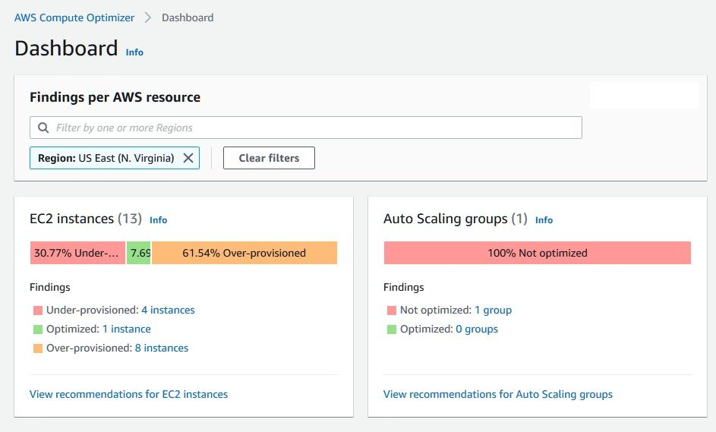
ORIGINAL PPT v4 · SOURCE SLIDE 656 · MODERNISED TECHNICAL DEEP DIVE
AWS Compute Optimizer
1
Reduce costs and improve…
Reduce costs and improve performance by
Mechanism: effective access is the intersection of identity policy, resource policy, permission boundary, session…
2
Failure mode
Failure mode: broad principals, unscoped PassRole, stale grants, public resource policies and long-lived…
3
Evidence: IAM Access Analyzer…
Evidence: IAM Access Analyzer findings, CloudTrail identity context, KMS key/grant policy, Config evaluations and…
CURRENT OPERATIONS LENS
Start with the trust boundary, evaluate effective access, protect data, record exceptions and verify that remediation reduced risk. Validate service limits and regional availability against current AWS documentation.
AWS Certified SysOps Administrator Associate Training · TGS-2024051413
© 2026 Tertiary Infotech Academy Pte Ltd
366

Slide 367
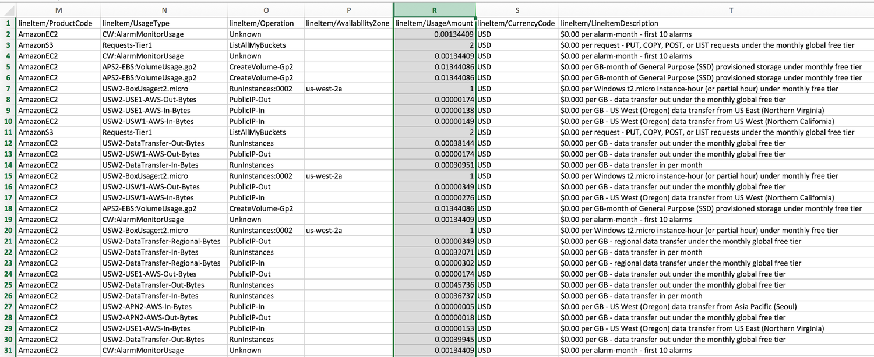
ORIGINAL PPT v4 · SOURCE SLIDE 657 · MODERNISED TECHNICAL DEEP DIVE
Cost and Usage Reports
1
Mechanism: effective access is the
Mechanism: effective access is the intersection of identity policy, resource policy, permission boundary, session…
2
Failure mode
Failure mode: broad principals, unscoped PassRole, stale grants, public resource policies and long-lived…
3
Evidence: IAM Access Analyzer…
Evidence: IAM Access Analyzer findings, CloudTrail identity context, KMS key/grant policy, Config evaluations and…
CURRENT OPERATIONS LENS
Start with the trust boundary, evaluate effective access, protect data, record exceptions and verify that remediation reduced risk. Validate service limits and regional availability against current AWS documentation.
AWS Certified SysOps Administrator Associate Training · TGS-2024051413
© 2026 Tertiary Infotech Academy Pte Ltd
367

Slide 368
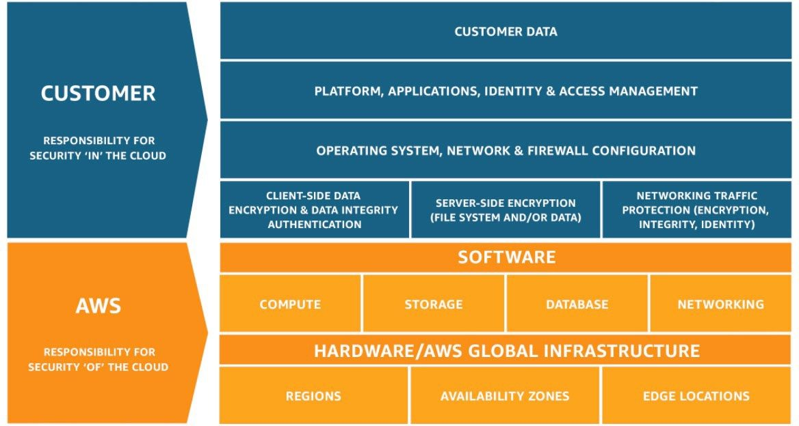
ORIGINAL PPT v4 · SOURCE SLIDE 672 · MODERNISED TECHNICAL DEEP DIVE
AWS Shared Responsibility Model
1
Mechanism: effective access is the
Mechanism: effective access is the intersection of identity policy, resource policy, permission boundary, session…
2
Failure mode
Failure mode: broad principals, unscoped PassRole, stale grants, public resource policies and long-lived…
3
Evidence: IAM Access Analyzer…
Evidence: IAM Access Analyzer findings, CloudTrail identity context, KMS key/grant policy, Config evaluations and…
CURRENT OPERATIONS LENS
Start with the trust boundary, evaluate effective access, protect data, record exceptions and verify that remediation reduced risk. Validate service limits and regional availability against current AWS documentation.
AWS Certified SysOps Administrator Associate Training · TGS-2024051413
© 2026 Tertiary Infotech Academy Pte Ltd
368

Slide 369
ORIGINAL PPT v4 · SOURCE SLIDE 673 · MODERNISED TECHNICAL DEEP DIVE
AWS Shared Responsibility Model
1
AWS responsibility
2
Protecting infrastructure…
3
Managed services like S3…
4
Customer responsibility
AWS responsibility - Security of the Cloud
For EC2 instance, customer is responsible for management of the guest OS (including security patches and updates), firewall & network configuration…
Protecting infrastructure (hardware, software, facilities, and networking) that runs all the AWS services
Encrypting application data
Managed services like S3, DynamoDB, RDS, etc.
Shared controls
Mechanism: effective access is the intersection of identity policy, resource policy, permission boundary, session policy, SCP/RCP and explicit denies.
Customer responsibility - Security in the Cloud
Patch Management, Configuration Management, Awareness & Training
CURRENT OPERATIONS LENS
Start with the trust boundary, evaluate effective access, protect data, record exceptions and verify that remediation reduced risk. Validate service limits and regional availability against current AWS documentation.
AWS Certified SysOps Administrator Associate Training · TGS-2024051413
© 2026 Tertiary Infotech Academy Pte Ltd
369

Slide 370
ORIGINAL PPT v4 · SOURCE SLIDE 674 · MODERNISED TECHNICAL DEEP DIVE
attacker
1
normal users
2
Not accessible Not responsive
3
application server
4
What’s a DDOS* Attack?
normal users
*Distributed Denial-of-Service
Mechanism: effective access is the intersection of identity policy, resource policy, permission boundary, session policy, SCP/RCP and explicit denies.
Not accessible Not responsive
Failure mode: broad principals, unscoped PassRole, stale grants, public resource policies and long-lived credentials expand the trust boundary…
application server
Evidence: IAM Access Analyzer findings, CloudTrail identity context, KMS key/grant policy, Config evaluations and exception records prove control…
What’s a DDOS* Attack?
Decision point: remediate with the smallest policy change, validate new access before deployment and verify that the finding resolves without…
CURRENT OPERATIONS LENS
Start with the trust boundary, evaluate effective access, protect data, record exceptions and verify that remediation reduced risk. Validate service limits and regional availability against current AWS documentation.
AWS Certified SysOps Administrator Associate Training · TGS-2024051413
© 2026 Tertiary Infotech Academy Pte Ltd
370

Slide 371
ORIGINAL PPT v4 · SOURCE SLIDE 675 · MODERNISED TECHNICAL DEEP DIVE
DDoS Protection on AWS
1
AWS Shield Standard
2
AWS Shield Advanced
3
AWS WAF
4
CloudFront and Route 53
AWS Shield Standard: protects against DDoS attack for your website and applications, for all customers at no additional costs
Availability protection using global edge network
AWS Shield Advanced: 24/7 premium DDoS protection
Combined with AWS Shield, provides attack mitigation at the edge
AWS WAF: filter specific requests based on rules
Be ready to scale - leverage AWS Auto Scaling
CloudFront and Route 53
Mechanism: effective access is the intersection of identity policy, resource policy, permission boundary, session policy, SCP/RCP and explicit denies.
CURRENT OPERATIONS LENS
Start with the trust boundary, evaluate effective access, protect data, record exceptions and verify that remediation reduced risk. Validate service limits and regional availability against current AWS documentation.
AWS Certified SysOps Administrator Associate Training · TGS-2024051413
© 2026 Tertiary Infotech Academy Pte Ltd
371

Slide 372
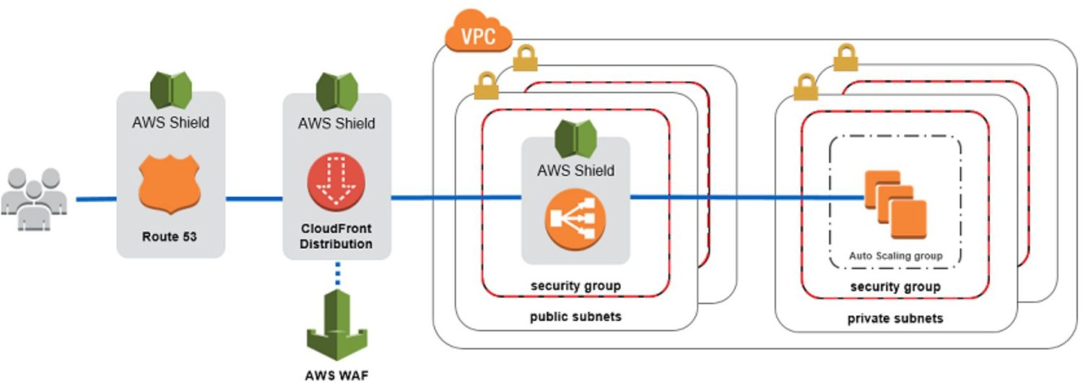
ORIGINAL PPT v4 · SOURCE SLIDE 676 · MODERNISED TECHNICAL DEEP DIVE
Sample Reference Architecture
1
Mechanism: effective access is the
Mechanism: effective access is the intersection of identity policy, resource policy, permission boundary, session…
2
Failure mode
Failure mode: broad principals, unscoped PassRole, stale grants, public resource policies and long-lived…
3
Evidence: IAM Access Analyzer…
Evidence: IAM Access Analyzer findings, CloudTrail identity context, KMS key/grant policy, Config evaluations and…
CURRENT OPERATIONS LENS
Start with the trust boundary, evaluate effective access, protect data, record exceptions and verify that remediation reduced risk. Validate service limits and regional availability against current AWS documentation.
AWS Certified SysOps Administrator Associate Training · TGS-2024051413
© 2026 Tertiary Infotech Academy Pte Ltd
372

Slide 373
ORIGINAL PPT v4 · SOURCE SLIDE 677 · MODERNISED TECHNICAL DEEP DIVE
AWS Shield
1
AWS Shield Standard
2
Free service that is activated
3
Provides protection from attacks…
4
AWS Shield Advanced
AWS Shield Standard
Optional DDoS mitigation service ($3,000 per month per organization)
Free service that is activated for every AWS customer
Protect against more sophisticated attack on Amazon EC2, Elastic Load Balancing (ELB), Amazon CloudFront, AWS Global Accelerator, and Route 53
Provides protection from attacks such as SYN/UDP Floods, Reflection attacks and other layer 3/layer 4 attacks
24/7 access to AWS DDoS response team (DRP)
AWS Shield Advanced
Protect against higher fees during usage spikes due to DDoS
CURRENT OPERATIONS LENS
Start with the trust boundary, evaluate effective access, protect data, record exceptions and verify that remediation reduced risk. Validate service limits and regional availability against current AWS documentation.
AWS Certified SysOps Administrator Associate Training · TGS-2024051413
© 2026 Tertiary Infotech Academy Pte Ltd
373

Slide 374
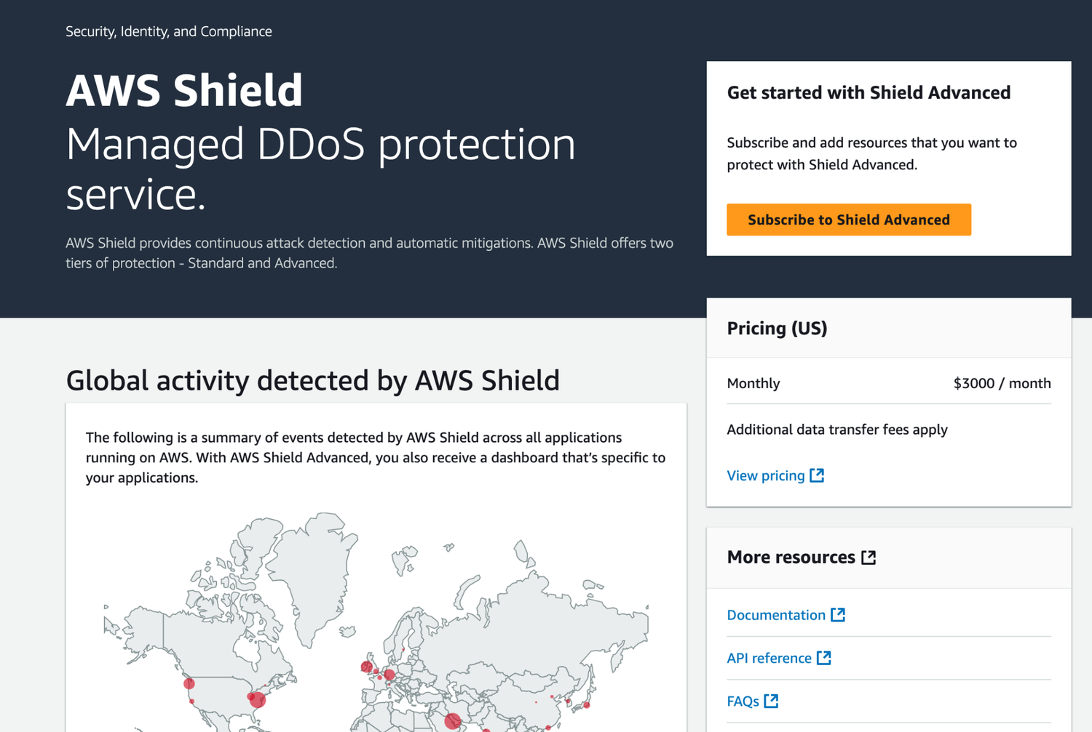
ORIGINAL PPT v4 · SOURCE SLIDE 678 · MODERNISED TECHNICAL DEEP DIVE
AWS Shield
1
Mechanism: effective access is the
Mechanism: effective access is the intersection of identity policy, resource policy, permission boundary, session…
2
Failure mode
Failure mode: broad principals, unscoped PassRole, stale grants, public resource policies and long-lived…
3
Evidence: IAM Access Analyzer…
Evidence: IAM Access Analyzer findings, CloudTrail identity context, KMS key/grant policy, Config evaluations and…
CURRENT OPERATIONS LENS
Start with the trust boundary, evaluate effective access, protect data, record exceptions and verify that remediation reduced risk. Validate service limits and regional availability against current AWS documentation.
AWS Certified SysOps Administrator Associate Training · TGS-2024051413
© 2026 Tertiary Infotech Academy Pte Ltd
374

Slide 375
ORIGINAL PPT v4 · SOURCE SLIDE 680 · MODERNISED TECHNICAL DEEP DIVE
AWS WAF - Web Application Firewall
1
Protects your web applications…
2
Layer 7 is HTTP (vs
3
Deploy on Application Load…
4
Define Web ACL (Web Access
Protects your web applications from common web exploits (Layer 7)
Rules can include: IP addresses, HTTP headers, HTTP body, or URI strings
Layer 7 is HTTP (vs Layer 4 is TCP)
Protects from common attack - SQL injection and Cross-Site (XSS)
Deploy on Application Load Balancer, API Gateway, CloudFront
Size constraints, geo-match (block countries)
Define Web ACL (Web Access Control List)
Rate-based rules (to count occurrences of events) - for DDOS protection
CURRENT OPERATIONS LENS
Start with the trust boundary, evaluate effective access, protect data, record exceptions and verify that remediation reduced risk. Validate service limits and regional availability against current AWS documentation.
AWS Certified SysOps Administrator Associate Training · TGS-2024051413
© 2026 Tertiary Infotech Academy Pte Ltd
375

Slide 376
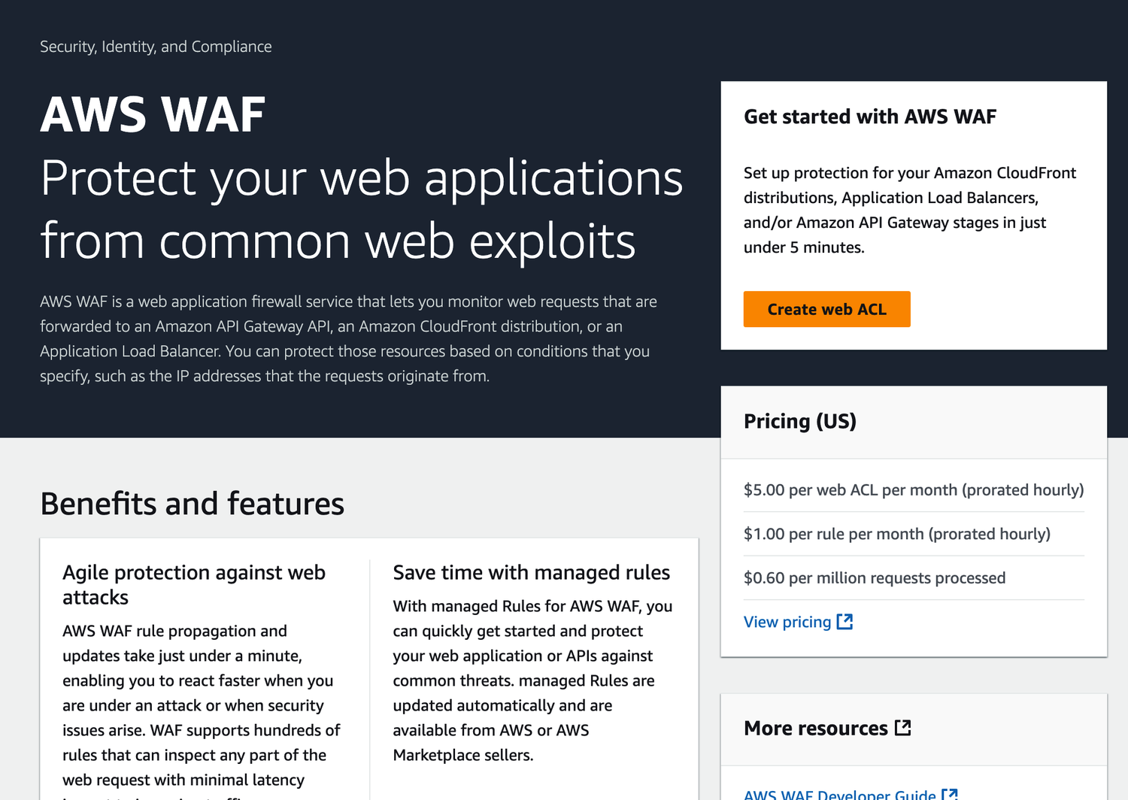
ORIGINAL PPT v4 · SOURCE SLIDE 681 · MODERNISED TECHNICAL DEEP DIVE
AWS WAF - Web Application Firewall
1
Mechanism: effective access is the
Mechanism: effective access is the intersection of identity policy, resource policy, permission boundary, session…
2
Failure mode
Failure mode: broad principals, unscoped PassRole, stale grants, public resource policies and long-lived…
3
Evidence: IAM Access Analyzer…
Evidence: IAM Access Analyzer findings, CloudTrail identity context, KMS key/grant policy, Config evaluations and…
CURRENT OPERATIONS LENS
Start with the trust boundary, evaluate effective access, protect data, record exceptions and verify that remediation reduced risk. Validate service limits and regional availability against current AWS documentation.
AWS Certified SysOps Administrator Associate Training · TGS-2024051413
© 2026 Tertiary Infotech Academy Pte Ltd
376

Slide 377
ORIGINAL PPT v4 · SOURCE SLIDE 683 · MODERNISED TECHNICAL DEEP DIVE
Penetration Testing on AWS Cloud
1
AWS customers are welcome to
2
Amazon EC2 instances, NAT…
3
Amazon RDS
4
Amazon CloudFront
AWS customers are welcome to carry out security assessments or penetration tests against their AWS infrastructures without prior approval for 8…
Amazon Aurora
Amazon Elastic Beanstalk environments
Amazon EC2 instances, NAT Gateways, and Elastic Load Balancers
Amazon API Gateways
List can increase over time (you won’t be tested on that at the exam)
Amazon RDS
AWS Lambda and Lambda Edge functions
Mechanism: effective access is the intersection of identity policy, resource policy, permission boundary, session policy, SCP/RCP and explicit denies.
Amazon CloudFront
Amazon Lightsail resources
Failure mode: broad principals, unscoped PassRole, stale grants, public resource policies and long-lived credentials expand the trust boundary…
CURRENT OPERATIONS LENS
Start with the trust boundary, evaluate effective access, protect data, record exceptions and verify that remediation reduced risk. Validate service limits and regional availability against current AWS documentation.
AWS Certified SysOps Administrator Associate Training · TGS-2024051413
© 2026 Tertiary Infotech Academy Pte Ltd
377

Slide 378
ORIGINAL PPT v4 · SOURCE SLIDE 684 · MODERNISED TECHNICAL DEEP DIVE
Penetration Testing on your AWS Cloud
1
Prohibited Activities
2
DNS zone walking via Amazon
3
Denial of Service (DoS)…
4
Port flooding
Prohibited Activities
Protocol flooding
Mechanism: effective access is the intersection of identity policy, resource policy, permission boundary, session policy, SCP/RCP and explicit denies.
DNS zone walking via Amazon Route 53 Hosted Zones
Request flooding (login request flooding, API request flooding)
Denial of Service (DoS), Distributed Denial of Service (DDoS), Simulated DoS, Simulated DDoS
For any other simulated events, contact aws-security-simulated-event@amazon.com
Port flooding
Failure mode: broad principals, unscoped PassRole, stale grants, public resource policies and long-lived credentials expand the trust boundary…
CURRENT OPERATIONS LENS
Start with the trust boundary, evaluate effective access, protect data, record exceptions and verify that remediation reduced risk. Validate service limits and regional availability against current AWS documentation.
AWS Certified SysOps Administrator Associate Training · TGS-2024051413
© 2026 Tertiary Infotech Academy Pte Ltd
378

Slide 379
ORIGINAL PPT v4 · SOURCE SLIDE 685 · MODERNISED TECHNICAL DEEP DIVE
Amazon Inspector
1
Automated Security Assessments
2
For EC2 instances
3
Leveraging the AWS System Manager
4
Analyze against unintended…
Automated Security Assessments
Analyze the running OS against known vulnerabilities
Identifies software vulnerabilities in function code and package dependencies
For EC2 instances
For Container Images push to Amazon ECR
Assessment of functions as they are deployed
Leveraging the AWS System Manager (SSM) agent
Assessment of Container Images as they are pushed
Reporting & integration with AWS Security Hub
Analyze against unintended network accessibility
For Lambda Functions
Send findings to Amazon Event Bridge
CURRENT OPERATIONS LENS
Start with the trust boundary, evaluate effective access, protect data, record exceptions and verify that remediation reduced risk. Validate service limits and regional availability against current AWS documentation.
AWS Certified SysOps Administrator Associate Training · TGS-2024051413
© 2026 Tertiary Infotech Academy Pte Ltd
379

Slide 380
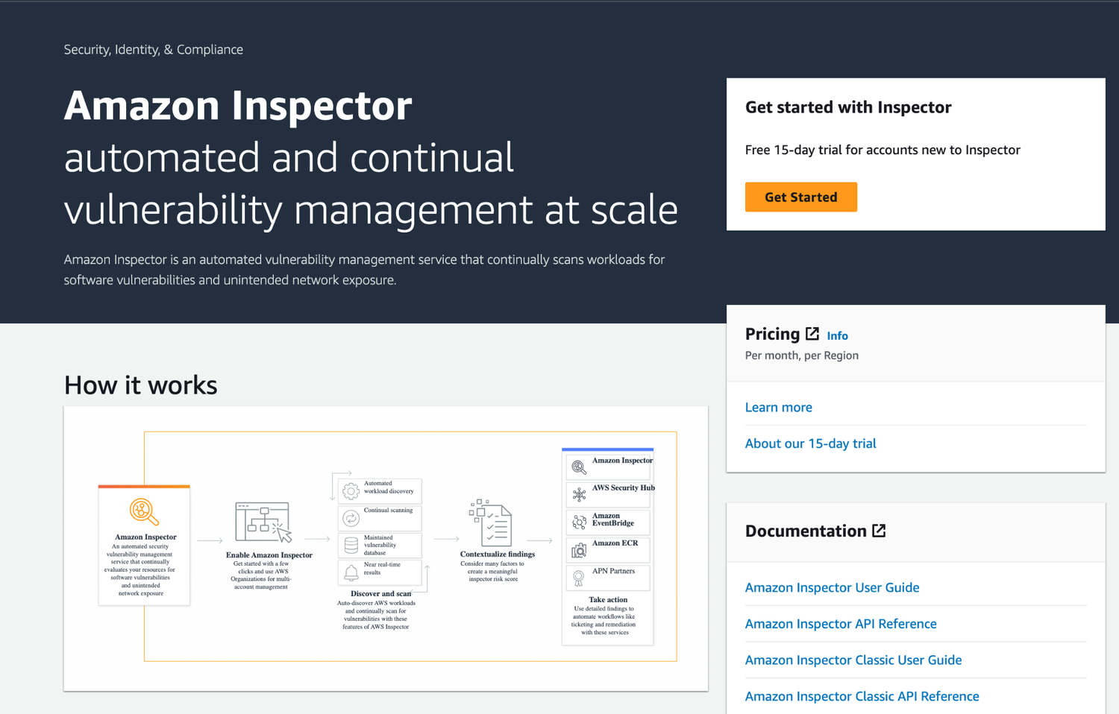
ORIGINAL PPT v4 · SOURCE SLIDE 686 · MODERNISED TECHNICAL DEEP DIVE
Amazon Inspector
1
Mechanism: effective access is the
Mechanism: effective access is the intersection of identity policy, resource policy, permission boundary, session…
2
Failure mode
Failure mode: broad principals, unscoped PassRole, stale grants, public resource policies and long-lived…
3
Evidence: IAM Access Analyzer…
Evidence: IAM Access Analyzer findings, CloudTrail identity context, KMS key/grant policy, Config evaluations and…
CURRENT OPERATIONS LENS
Start with the trust boundary, evaluate effective access, protect data, record exceptions and verify that remediation reduced risk. Validate service limits and regional availability against current AWS documentation.
AWS Certified SysOps Administrator Associate Training · TGS-2024051413
© 2026 Tertiary Infotech Academy Pte Ltd
380

Slide 381
ORIGINAL PPT v4 · SOURCE SLIDE 688 · MODERNISED TECHNICAL DEEP DIVE
What does Amazon Inspector evaluate?
1
Remember: only for EC2 instances,
2
Continuous scanning of the…
3
Package vulnerabilities (EC2, ECR…
4
Network reachability (EC2)
Remember: only for EC2 instances, Container Images & Lambda functions
A risk score is associated with all vulnerabilities for prioritization
Continuous scanning of the infrastructure, only when needed
Mechanism: effective access is the intersection of identity policy, resource policy, permission boundary, session policy, SCP/RCP and explicit denies.
Package vulnerabilities (EC2, ECR & Lambda) - database of CVE
Network reachability (EC2)
Failure mode: broad principals, unscoped PassRole, stale grants, public resource policies and long-lived credentials expand the trust boundary…
CURRENT OPERATIONS LENS
Start with the trust boundary, evaluate effective access, protect data, record exceptions and verify that remediation reduced risk. Validate service limits and regional availability against current AWS documentation.
AWS Certified SysOps Administrator Associate Training · TGS-2024051413
© 2026 Tertiary Infotech Academy Pte Ltd
381

Slide 382
ORIGINAL PPT v4 · SOURCE SLIDE 690 · MODERNISED TECHNICAL DEEP DIVE
Logging in AWS for security and compliance
1
To help compliance requirements…
2
Service Logs include
3
CloudTrail trails
4
Config Rules
To help compliance requirements, AWS provides many service-specific security and audit logs
CloudWatch Logs - for full data retention
WAF Logs - full logging of all requests analyzed by the service
Service Logs include
VPC Flow Logs - IP traffic within your VPC
Logs can be analyzed using AWS Athena if they're stored in S3
CloudTrail trails - trace all API calls
ELB Access Logs - metadata of requests made to your load balancers
You should encrypt logs in S3, control access using IAM & Bucket Policies, MFA
Config Rules - for config & compliance over time
CloudFront Logs - web distribution access logs
Move Logs to Glacier for cost savings
CURRENT OPERATIONS LENS
Start with the trust boundary, evaluate effective access, protect data, record exceptions and verify that remediation reduced risk. Validate service limits and regional availability against current AWS documentation.
AWS Certified SysOps Administrator Associate Training · TGS-2024051413
© 2026 Tertiary Infotech Academy Pte Ltd
382

Slide 383
ORIGINAL PPT v4 · SOURCE SLIDE 691 · MODERNISED TECHNICAL DEEP DIVE
Intelligent Threat discovery to protect your AWS Account
1
Uses Machine Learning algorithms…
2
Can be enabled at account
3
Input data includes
4
CloudTrail Events Logs
Uses Machine Learning algorithms, anomaly detection, 3rd party data
CloudTrail Management Events – create VPC subnet, create trail, …
Optional Feature - EKS Audit Logs, RDS & Aurora, EBS, Lambda, S3 Data Events…
Can be enabled at account or organization scope (30 days trial), no need to install software
CloudTrail S3 Data Events – get object, list objects, delete object, …
Can setup EventBridge rules to be notified in case of findings
Input data includes
VPC Flow Logs - unusual internal traffic, unusual IP address
EventBridge rules can target AWS Lambda or SNS
CloudTrail Events Logs - unusual API calls, unauthorized deployments
DNS Logs - compromised EC2 instances sending encoded data within DNS queries
Can protect against CryptoCurrency attacks (has a dedicated "finding" for it)
CURRENT OPERATIONS LENS
Start with the trust boundary, evaluate effective access, protect data, record exceptions and verify that remediation reduced risk. Validate service limits and regional availability against current AWS documentation.
AWS Certified SysOps Administrator Associate Training · TGS-2024051413
© 2026 Tertiary Infotech Academy Pte Ltd
383

Slide 384
ORIGINAL PPT v4 · SOURCE SLIDE 692 · MODERNISED TECHNICAL DEEP DIVE
Amazon GuardDuty
1
VPC Flow Logs
2
CloudTrail Logs
3
DNS Logs (AWS DNS)
4
EventBridge
VPC Flow Logs
Optional Features
Mechanism: effective access is the intersection of identity policy, resource policy, permission boundary, session policy, SCP/RCP and explicit denies.
CloudTrail Logs
EBS Volumes
Failure mode: broad principals, unscoped PassRole, stale grants, public resource policies and long-lived credentials expand the trust boundary…
DNS Logs (AWS DNS)
Lambda Network RDS & Aurora Activity Login Activity
EventBridge
EKS Audit Logs & Runtime Monitoring
Evidence: IAM Access Analyzer findings, CloudTrail identity context, KMS key/grant policy, Config evaluations and exception records prove control…
CURRENT OPERATIONS LENS
Start with the trust boundary, evaluate effective access, protect data, record exceptions and verify that remediation reduced risk. Validate service limits and regional availability against current AWS documentation.
AWS Certified SysOps Administrator Associate Training · TGS-2024051413
© 2026 Tertiary Infotech Academy Pte Ltd
384

Slide 385
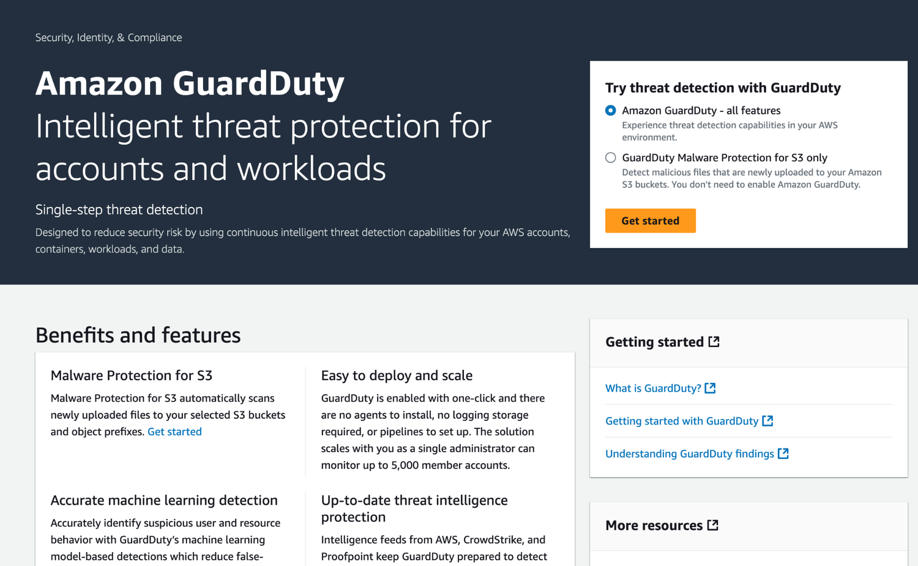
ORIGINAL PPT v4 · SOURCE SLIDE 693 · MODERNISED TECHNICAL DEEP DIVE
Amazon GuardDuty
1
Mechanism: effective access is the
Mechanism: effective access is the intersection of identity policy, resource policy, permission boundary, session…
2
Failure mode
Failure mode: broad principals, unscoped PassRole, stale grants, public resource policies and long-lived…
3
Evidence: IAM Access Analyzer…
Evidence: IAM Access Analyzer findings, CloudTrail identity context, KMS key/grant policy, Config evaluations and…
CURRENT OPERATIONS LENS
Start with the trust boundary, evaluate effective access, protect data, record exceptions and verify that remediation reduced risk. Validate service limits and regional availability against current AWS documentation.
AWS Certified SysOps Administrator Associate Training · TGS-2024051413
© 2026 Tertiary Infotech Academy Pte Ltd
385

Slide 386
ORIGINAL PPT v4 · SOURCE SLIDE 696 · MODERNISED TECHNICAL DEEP DIVE
AWS Macie
1
Amazon Macie is a fully
2
Macie helps identify and alert
3
S3 Buckets
4
Discover Sensitive Data (PII)
Amazon Macie is a fully managed data security and data privacy service that uses machine learning and pattern matching to discover and protect your…
Amazon EventBridge
Macie helps identify and alert you to sensitive data, such as personally identifiable information (PII)
integrations
S3 Buckets
Mechanism: effective access is the intersection of identity policy, resource policy, permission boundary, session policy, SCP/RCP and explicit denies.
Discover Sensitive Data (PII)
Failure mode: broad principals, unscoped PassRole, stale grants, public resource policies and long-lived credentials expand the trust boundary…
CURRENT OPERATIONS LENS
Start with the trust boundary, evaluate effective access, protect data, record exceptions and verify that remediation reduced risk. Validate service limits and regional availability against current AWS documentation.
AWS Certified SysOps Administrator Associate Training · TGS-2024051413
© 2026 Tertiary Infotech Academy Pte Ltd
386

Slide 387

ORIGINAL PPT v4 · SOURCE SLIDE 697 · MODERNISED TECHNICAL DEEP DIVE
AWS Macie
1
Mechanism: effective access is the
Mechanism: effective access is the intersection of identity policy, resource policy, permission boundary, session…
2
Failure mode
Failure mode: broad principals, unscoped PassRole, stale grants, public resource policies and long-lived…
3
Evidence: IAM Access Analyzer…
Evidence: IAM Access Analyzer findings, CloudTrail identity context, KMS key/grant policy, Config evaluations and…
CURRENT OPERATIONS LENS
Start with the trust boundary, evaluate effective access, protect data, record exceptions and verify that remediation reduced risk. Validate service limits and regional availability against current AWS documentation.
AWS Certified SysOps Administrator Associate Training · TGS-2024051413
© 2026 Tertiary Infotech Academy Pte Ltd
387

Slide 388
ORIGINAL PPT v4 · SOURCE SLIDE 700 · MODERNISED TECHNICAL DEEP DIVE
Trusted Advisor
1
No need to install anything
2
Analyze your AWS accounts and
3
Cost optimization
4
Performance
No need to install anything - high level AWS account assessment
Fault tolerance
Full Set of Checks
Analyze your AWS accounts and provides recommendation on 6 categories
Service limits
Programmatic Access using AWS Support API
Cost optimization
Operational Excellence
Mechanism: effective access is the intersection of identity policy, resource policy, permission boundary, session policy, SCP/RCP and explicit denies.
Performance
Business & Enterprise Support plan
Failure mode: broad principals, unscoped PassRole, stale grants, public resource policies and long-lived credentials expand the trust boundary…
CURRENT OPERATIONS LENS
Start with the trust boundary, evaluate effective access, protect data, record exceptions and verify that remediation reduced risk. Validate service limits and regional availability against current AWS documentation.
AWS Certified SysOps Administrator Associate Training · TGS-2024051413
© 2026 Tertiary Infotech Academy Pte Ltd
388

Slide 389
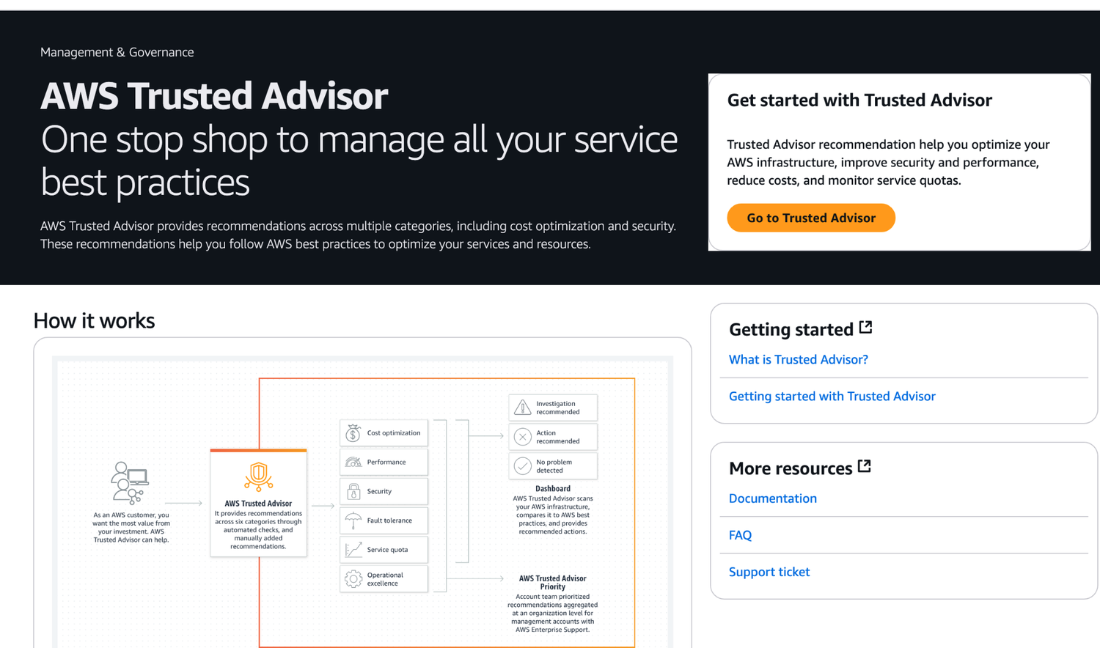
ORIGINAL PPT v4 · SOURCE SLIDE 701 · MODERNISED TECHNICAL DEEP DIVE
Trusted Advisor
1
Mechanism: effective access is the
Mechanism: effective access is the intersection of identity policy, resource policy, permission boundary, session…
2
Failure mode
Failure mode: broad principals, unscoped PassRole, stale grants, public resource policies and long-lived…
3
Evidence: IAM Access Analyzer…
Evidence: IAM Access Analyzer findings, CloudTrail identity context, KMS key/grant policy, Config evaluations and…
CURRENT OPERATIONS LENS
Start with the trust boundary, evaluate effective access, protect data, record exceptions and verify that remediation reduced risk. Validate service limits and regional availability against current AWS documentation.
AWS Certified SysOps Administrator Associate Training · TGS-2024051413
© 2026 Tertiary Infotech Academy Pte Ltd
389

Slide 390
ORIGINAL PPT v4 · SOURCE SLIDE 703 · MODERNISED TECHNICAL DEEP DIVE
Why encryption?
1
Encryption in flight (TLS /
2
Data is encrypted before sending
3
TLS certificates help with…
4
Encryption in flight ensures no
Encryption in flight (TLS / SSL)
HTTPS Website
aGVsbG8gd29 ybGQgZWh…
Data is encrypted before sending and decrypted after receiving
TLS Encryption
TLS certificates help with encryption (HTTPS)
TLS Decryption
Mechanism: effective access is the intersection of identity policy, resource policy, permission boundary, session policy, SCP/RCP and explicit denies.
Encryption in flight ensures no MITM (man in the middle attack) can happen
Username: admin Password: supersecret
CURRENT OPERATIONS LENS
Start with the trust boundary, evaluate effective access, protect data, record exceptions and verify that remediation reduced risk. Validate service limits and regional availability against current AWS documentation.
AWS Certified SysOps Administrator Associate Training · TGS-2024051413
© 2026 Tertiary Infotech Academy Pte Ltd
390

Slide 391
ORIGINAL PPT v4 · SOURCE SLIDE 704 · MODERNISED TECHNICAL DEEP DIVE
Why encryption?
1
Server-side encryption at rest
2
Data is encrypted after being
3
Data is decrypted before being
4
It is stored in an
Server-side encryption at rest
The encryption / decryption keys must be managed somewhere, and the server must have access to it
Data is encrypted after being received by the server
AWS Service (e.g., S3)
Data is decrypted before being sent
Encryption
Mechanism: effective access is the intersection of identity policy, resource policy, permission boundary, session policy, SCP/RCP and explicit denies.
It is stored in an encrypted form thanks to a key (usually a data key)
Decryption
CURRENT OPERATIONS LENS
Start with the trust boundary, evaluate effective access, protect data, record exceptions and verify that remediation reduced risk. Validate service limits and regional availability against current AWS documentation.
AWS Certified SysOps Administrator Associate Training · TGS-2024051413
© 2026 Tertiary Infotech Academy Pte Ltd
391

Slide 392
ORIGINAL PPT v4 · SOURCE SLIDE 705 · MODERNISED TECHNICAL DEEP DIVE
Why encryption?
1
Client-side encryption
2
Data is encrypted by the
3
Data will be decrypted by
4
The server should not be
Client-side encryption
Could leverage Envelope Encryption
Any storage service (FTP, S3, …)
Data is encrypted by the client and never decrypted by the server
Data key (client-side)
Decryption
Data will be decrypted by a receiving client
Encryption
Mechanism: effective access is the intersection of identity policy, resource policy, permission boundary, session policy, SCP/RCP and explicit denies.
The server should not be able to decrypt the data
Encrypted object
CURRENT OPERATIONS LENS
Start with the trust boundary, evaluate effective access, protect data, record exceptions and verify that remediation reduced risk. Validate service limits and regional availability against current AWS documentation.
AWS Certified SysOps Administrator Associate Training · TGS-2024051413
© 2026 Tertiary Infotech Academy Pte Ltd
392

Slide 393
ORIGINAL PPT v4 · SOURCE SLIDE 706 · MODERNISED TECHNICAL DEEP DIVE
AWS KMS (Key Management Service)
1
Anytime you hear “encryption” for
2
AWS manages encryption keys for
3
Fully integrated with IAM for
4
Easy way to control access
Anytime you hear “encryption” for an AWS service, it’s most likely KMS
Able to audit KMS Key usage using CloudTrail
Encrypted secrets can be stored in the code / environment variables
AWS manages encryption keys for us
Seamlessly integrated into most AWS services (EBS, S3, RDS, SSM…)
Fully integrated with IAM for authorization
Never ever store your secrets in plaintext, especially in your code!
Easy way to control access to your data
KMS Key Encryption also available through API calls (SDK, CLI)
CURRENT OPERATIONS LENS
Start with the trust boundary, evaluate effective access, protect data, record exceptions and verify that remediation reduced risk. Validate service limits and regional availability against current AWS documentation.
AWS Certified SysOps Administrator Associate Training · TGS-2024051413
© 2026 Tertiary Infotech Academy Pte Ltd
393

Slide 394
ORIGINAL PPT v4 · SOURCE SLIDE 707 · MODERNISED TECHNICAL DEEP DIVE
KMS Keys Types
1
KMs Keys is the new
2
Symmetric (AES-256 keys)
3
Single encryption key that is
4
AWS services that are integrated
KMs Keys is the new name of KMS Customer Master Key
You never get access to the KMS Key unencrypted (must call KMS API to use)
The public key is downloadable, but you can’t access the Private Key unencrypted
Symmetric (AES-256 keys)
Asymmetric (RSA & ECC key pairs)
Use case: encryption outside of AWS by users who can’t call the KMS API
Single encryption key that is used to Encrypt and Decrypt
Public (Encrypt) and Private Key (Decrypt) pair
AWS services that are integrated with KMS use Symmetric CMKs
Used for Encrypt/Decrypt, or Sign/Verify operations
CURRENT OPERATIONS LENS
Start with the trust boundary, evaluate effective access, protect data, record exceptions and verify that remediation reduced risk. Validate service limits and regional availability against current AWS documentation.
AWS Certified SysOps Administrator Associate Training · TGS-2024051413
© 2026 Tertiary Infotech Academy Pte Ltd
394

Slide 395
ORIGINAL PPT v4 · SOURCE SLIDE 708 · MODERNISED TECHNICAL DEEP DIVE
AWS KMS (Key Management Service)
1
Types of KMS Keys
2
AWS Owned Keys (free)
3
AWS Managed Key
4
Customer managed keys created in…
Types of KMS Keys
Customer managed keys imported: $1 / month
Customer-managed KMS Key: (must be enabled) automatic & on-demand
AWS Owned Keys (free): SSE-S3, SSE-SQS, SSE-DDB (default key)
+ pay for API call to KMS ($0.03 / 10000 calls)
Imported KMS Key: only manual rotation possible using alias
AWS Managed Key: free (aws/service-name, example: aws/rds or aws/ebs)
Automatic Key rotation
Customer managed keys created in KMS: $1 / month
AWS-managed KMS Key: automatic every 1 year
CURRENT OPERATIONS LENS
Start with the trust boundary, evaluate effective access, protect data, record exceptions and verify that remediation reduced risk. Validate service limits and regional availability against current AWS documentation.
AWS Certified SysOps Administrator Associate Training · TGS-2024051413
© 2026 Tertiary Infotech Academy Pte Ltd
395

Slide 396
ORIGINAL PPT v4 · SOURCE SLIDE 709 · MODERNISED TECHNICAL DEEP DIVE
Copying Snapshots across regions
1
EBS Volume Encrypted With KMS
2
EBS Snapshot Encrypted With KMS
3
Region eu-west-2
4
Region ap-southeast-2
EBS Volume Encrypted With KMS
KMS ReEncrypt with KMS Key B
EBS Snapshot Encrypted With KMS
Mechanism: effective access is the intersection of identity policy, resource policy, permission boundary, session policy, SCP/RCP and explicit denies.
Region eu-west-2
Failure mode: broad principals, unscoped PassRole, stale grants, public resource policies and long-lived credentials expand the trust boundary…
Region ap-southeast-2
Evidence: IAM Access Analyzer findings, CloudTrail identity context, KMS key/grant policy, Config evaluations and exception records prove control…
CURRENT OPERATIONS LENS
Start with the trust boundary, evaluate effective access, protect data, record exceptions and verify that remediation reduced risk. Validate service limits and regional availability against current AWS documentation.
AWS Certified SysOps Administrator Associate Training · TGS-2024051413
© 2026 Tertiary Infotech Academy Pte Ltd
396

Slide 397
ORIGINAL PPT v4 · SOURCE SLIDE 710 · MODERNISED TECHNICAL DEEP DIVE
KMS Key Policies
1
Control access to KMS keys,
2
Difference: you cannot control…
3
Default KMS Key Policy
4
Created if you don’t provide
Control access to KMS keys, “similar” to S3 bucket policies
Complete access to the key to the root user = entire AWS account
Useful for cross-account access of your KMS key
Difference: you cannot control access without them
Custom KMS Key Policy
Default KMS Key Policy
Define users, roles that can access the KMS key
Created if you don’t provide a specific KMS Key Policy
Define who can administer the key
CURRENT OPERATIONS LENS
Start with the trust boundary, evaluate effective access, protect data, record exceptions and verify that remediation reduced risk. Validate service limits and regional availability against current AWS documentation.
AWS Certified SysOps Administrator Associate Training · TGS-2024051413
© 2026 Tertiary Infotech Academy Pte Ltd
397

Slide 398
ORIGINAL PPT v4 · SOURCE SLIDE 712 · MODERNISED TECHNICAL DEEP DIVE
KMS Automatic Key Rotation
1
111122223333
2
KMS Key ID = 1234abcd-12ab-34cd-56…
3
444455556666
4
Automatic Key rotation
111122223333
AWS-managed KMS Keys: automatically rotated every 1 year
Previous key is kept active so you can decrypt old data
KMS Key ID = 1234abcd-12ab-34cd-56ef-1234567890ab
For Customer-Managed Symmetric KMS Key
New Key has the same KMS Key ID (only the backing key is changed)
444455556666
Automatic key rotation is optionally enabled
Backing Key Backing Key Saved Backing Key
Automatic Key rotation
Customize Rotation Period between 90 and 2560 days (default: 365 days)
CURRENT OPERATIONS LENS
Start with the trust boundary, evaluate effective access, protect data, record exceptions and verify that remediation reduced risk. Validate service limits and regional availability against current AWS documentation.
AWS Certified SysOps Administrator Associate Training · TGS-2024051413
© 2026 Tertiary Infotech Academy Pte Ltd
398

Slide 399
ORIGINAL PPT v4 · SOURCE SLIDE 713 · MODERNISED TECHNICAL DEEP DIVE
KMS On-Demand Key Rotation
1
For Customer-Managed Symmetric…
2
Does NOT require Automatic Key
3
Does NOT change existing Automatic
4
Limit to how many times
For Customer-Managed Symmetric KMS Key (not AWS managed CMK)
On Demand Key rotation
Backing Key Backing Key Saved Backing Key
Does NOT require Automatic Key Rotation to be enabled
111122223333
Does NOT change existing Automatic Rotation schedules
KMS Key ID = 1234abcd-12ab-34cd-56ef-1234567890ab
Limit to how many times you can trigger an on-demand key rotation
444455556666
CURRENT OPERATIONS LENS
Start with the trust boundary, evaluate effective access, protect data, record exceptions and verify that remediation reduced risk. Validate service limits and regional availability against current AWS documentation.
AWS Certified SysOps Administrator Associate Training · TGS-2024051413
© 2026 Tertiary Infotech Academy Pte Ltd
399

Slide 400
ORIGINAL PPT v4 · SOURCE SLIDE 714 · MODERNISED TECHNICAL DEEP DIVE
KMS Manual Key Rotation
1
(Customer-Managed Symmetric KMS…
2
111122223333
3
Alias = MyCustomKey
4
KMS Key ID = 1234abcd-12ab-34cd-56…
(Customer-Managed Symmetric KMS Key & Imports)
When you want to rotate key (example: every month)
Good solution to rotate KMS Key that are not eligible for automatic rotation (like asymmetric KMS key)
111122223333
New Key has a different KMS Key ID
Rotate Key Manually
Alias = MyCustomKey
Keep the previous key active so you can decrypt old data
111122223333 444455556666
KMS Key ID = 1234abcd-12ab-34cd-56ef-1234567890ab
Better to use aliases in this case (to hide the change of key for the application)
KMS Key ID = 1234abcd-12ab-34cd-56ef-1234567890ab KMS Key ID = 0978dcba-09fe-65ba-ab0987654321
CURRENT OPERATIONS LENS
Start with the trust boundary, evaluate effective access, protect data, record exceptions and verify that remediation reduced risk. Validate service limits and regional availability against current AWS documentation.
AWS Certified SysOps Administrator Associate Training · TGS-2024051413
© 2026 Tertiary Infotech Academy Pte Ltd
400

Slide 401
ORIGINAL PPT v4 · SOURCE SLIDE 715 · MODERNISED TECHNICAL DEEP DIVE
KMS Alias Updating
1
Key Alias = MyAppKey
2
UpdateAlias API
3
KMS Key ID = eba96e8f-7f66-4d5a-ae…
4
KMS Key ID = 881cd7f5-b3eb-43e2-82…
Key Alias = MyAppKey
Better to use aliases in this case (to hide the change of key for the application)
UpdateAlias API
Application
Mechanism: effective access is the intersection of identity policy, resource policy, permission boundary, session policy, SCP/RCP and explicit denies.
KMS Key ID = eba96e8f-7f66-4d5a-aeb6-f32ae8d65d85
Failure mode: broad principals, unscoped PassRole, stale grants, public resource policies and long-lived credentials expand the trust boundary…
KMS Key ID = 881cd7f5-b3eb-43e2-82fc-d6f5bda81e00
Evidence: IAM Access Analyzer findings, CloudTrail identity context, KMS key/grant policy, Config evaluations and exception records prove control…
CURRENT OPERATIONS LENS
Start with the trust boundary, evaluate effective access, protect data, record exceptions and verify that remediation reduced risk. Validate service limits and regional availability against current AWS documentation.
AWS Certified SysOps Administrator Associate Training · TGS-2024051413
© 2026 Tertiary Infotech Academy Pte Ltd
401

Slide 402
ORIGINAL PPT v4 · SOURCE SLIDE 717 · MODERNISED TECHNICAL DEEP DIVE
Sharing KMS Encrypted RDS DB Snapshots
1
You can share RDS DB
2
Account A (111122223333)
3
Account B (444455556666)
4
access through CMK Key Policy
You can share RDS DB snapshots encrypted with KMS CMK with other accounts but must first share the KMS CMK with the target account using Key Policy
DB Instance
Account A (111122223333)
(Snapshot: mydbsnapshot)
Mechanism: effective access is the intersection of identity policy, resource policy, permission boundary, session policy, SCP/RCP and explicit denies.
Account B (444455556666)
(encrypted)
Failure mode: broad principals, unscoped PassRole, stale grants, public resource policies and long-lived credentials expand the trust boundary…
access through CMK Key Policy
Key Policy
Evidence: IAM Access Analyzer findings, CloudTrail identity context, KMS key/grant policy, Config evaluations and exception records prove control…
CURRENT OPERATIONS LENS
Start with the trust boundary, evaluate effective access, protect data, record exceptions and verify that remediation reduced risk. Validate service limits and regional availability against current AWS documentation.
AWS Certified SysOps Administrator Associate Training · TGS-2024051413
© 2026 Tertiary Infotech Academy Pte Ltd
402

Slide 403
ORIGINAL PPT v4 · SOURCE SLIDE 718 · MODERNISED TECHNICAL DEEP DIVE
KMS Key Deletion Considerations
1
Schedule CMK for deletion with
2
CMK’s status is "Pending deletion"
3
During the CMK’s deletion waiting
4
The CMK can't be used
Schedule CMK for deletion with a waiting period of 7 to 30 days
The key is not rotated even if planned
CMK’s status is "Pending deletion" during the waiting period
You can cancel the key deletion during the waiting period
During the CMK’s deletion waiting period
Consider disabling your key instead of deleting it if you’re not sure!
The CMK can't be used for cryptographic operations (e.g., can’t decrypt KMS- encrypted objects in S3 - SSE-KMS)
CURRENT OPERATIONS LENS
Start with the trust boundary, evaluate effective access, protect data, record exceptions and verify that remediation reduced risk. Validate service limits and regional availability against current AWS documentation.
AWS Certified SysOps Administrator Associate Training · TGS-2024051413
© 2026 Tertiary Infotech Academy Pte Ltd
403

Slide 404
ORIGINAL PPT v4 · SOURCE SLIDE 719 · MODERNISED TECHNICAL DEEP DIVE
KMS Key Deletion - CloudWatch Alarm
1
Use CloudTrail, CloudWatch Logs…
2
Amazon SNS
3
CloudWatch
4
Metric Filter
Use CloudTrail, CloudWatch Logs, CloudWatch Alarms and SNS to be notified when someone tries to use a CMK that’s "Pending deletion" in a…
“* is pending deletion”
log API calls (DENIED)
Amazon SNS
(Pending deletion)
Mechanism: effective access is the intersection of identity policy, resource policy, permission boundary, session policy, SCP/RCP and explicit denies.
CloudWatch
CloudTrail
Failure mode: broad principals, unscoped PassRole, stale grants, public resource policies and long-lived credentials expand the trust boundary…
Metric Filter
cryptographic operation
Evidence: IAM Access Analyzer findings, CloudTrail identity context, KMS key/grant policy, Config evaluations and exception records prove control…
CURRENT OPERATIONS LENS
Start with the trust boundary, evaluate effective access, protect data, record exceptions and verify that remediation reduced risk. Validate service limits and regional availability against current AWS documentation.
AWS Certified SysOps Administrator Associate Training · TGS-2024051413
© 2026 Tertiary Infotech Academy Pte Ltd
404

Slide 405
ORIGINAL PPT v4 · SOURCE SLIDE 720 · MODERNISED TECHNICAL DEEP DIVE
CloudHSM
1
KMS => AWS manages the
2
CloudHSM => AWS provisions…
3
Dedicated Hardware (HSM = Hardware
4
You manage your own encryption
KMS => AWS manages the software for encryption
HSM device is tamper resistant, FIPS 140-2 Level 3 compliance
Redshift supports CloudHSM for database encryption and key management
CloudHSM => AWS provisions encryption hardware
Supports both symmetric and asymmetric encryption (SSL/TLS keys)
Good option to use with SSE-C encryption
Dedicated Hardware (HSM = Hardware Security Module)
No free tier available
You manage your own encryption keys entirely (not AWS)
Must use the CloudHSM Client Software
CURRENT OPERATIONS LENS
Start with the trust boundary, evaluate effective access, protect data, record exceptions and verify that remediation reduced risk. Validate service limits and regional availability against current AWS documentation.
AWS Certified SysOps Administrator Associate Training · TGS-2024051413
© 2026 Tertiary Infotech Academy Pte Ltd
405

Slide 406
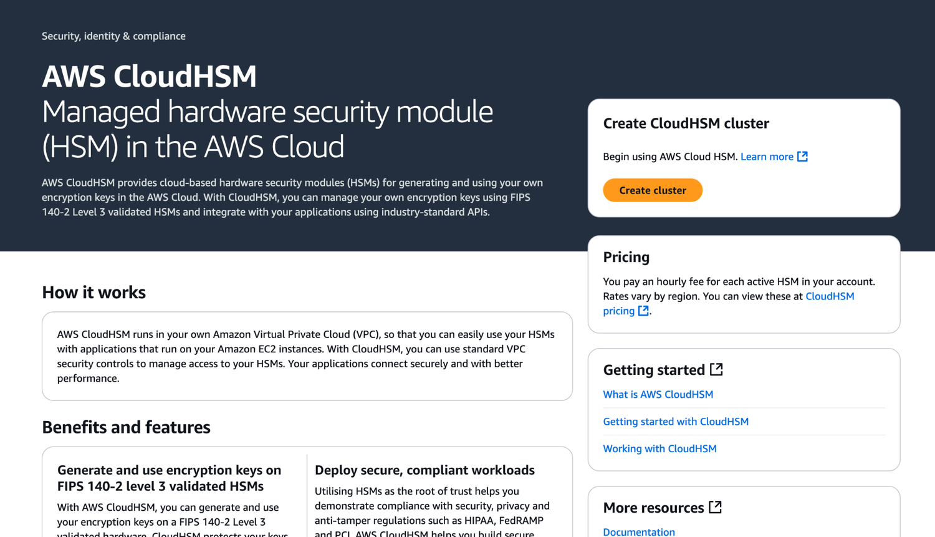
ORIGINAL PPT v4 · SOURCE SLIDE 721 · MODERNISED TECHNICAL DEEP DIVE
CloudHSM
1
Mechanism: effective access is the
Mechanism: effective access is the intersection of identity policy, resource policy, permission boundary, session…
2
Failure mode
Failure mode: broad principals, unscoped PassRole, stale grants, public resource policies and long-lived…
3
Evidence: IAM Access Analyzer…
Evidence: IAM Access Analyzer findings, CloudTrail identity context, KMS key/grant policy, Config evaluations and…
CURRENT OPERATIONS LENS
Start with the trust boundary, evaluate effective access, protect data, record exceptions and verify that remediation reduced risk. Validate service limits and regional availability against current AWS documentation.
AWS Certified SysOps Administrator Associate Training · TGS-2024051413
© 2026 Tertiary Infotech Academy Pte Ltd
406

Slide 407
ORIGINAL PPT v4 · SOURCE SLIDE 722 · MODERNISED TECHNICAL DEEP DIVE
CloudHSM Diagram
1
AWS CloudHSM
2
CloudHSM Client
3
AWS manages the Hardware
4
SSL Connection
AWS CloudHSM
User manages the Keys
Manage the Keys
Mechanism: effective access is the intersection of identity policy, resource policy, permission boundary, session policy, SCP/RCP and explicit denies.
CloudHSM Client
IAM permissions
Manage the Users
Failure mode: broad principals, unscoped PassRole, stale grants, public resource policies and long-lived credentials expand the trust boundary…
AWS manages the Hardware
CRUD an HSM Cluster
Evidence: IAM Access Analyzer findings, CloudTrail identity context, KMS key/grant policy, Config evaluations and exception records prove control…
SSL Connection
CloudHSM Software
Decision point: remediate with the smallest policy change, validate new access before deployment and verify that the finding resolves without…
CURRENT OPERATIONS LENS
Start with the trust boundary, evaluate effective access, protect data, record exceptions and verify that remediation reduced risk. Validate service limits and regional availability against current AWS documentation.
AWS Certified SysOps Administrator Associate Training · TGS-2024051413
© 2026 Tertiary Infotech Academy Pte Ltd
407

Slide 408
ORIGINAL PPT v4 · SOURCE SLIDE 723 · MODERNISED TECHNICAL DEEP DIVE
CloudHSM - High Availability
1
CloudHSM clusters are spread…
2
Great for availability and…
3
CloudHSM 1
4
CloudHSM Client
CloudHSM clusters are spread across Multi AZ (HA)
Availability Zone 1
Great for availability and durability
CloudHSM 2
Mechanism: effective access is the intersection of identity policy, resource policy, permission boundary, session policy, SCP/RCP and explicit denies.
CloudHSM 1
Availability Zone 2
Failure mode: broad principals, unscoped PassRole, stale grants, public resource policies and long-lived credentials expand the trust boundary…
CloudHSM Client
Evidence: IAM Access Analyzer findings, CloudTrail identity context, KMS key/grant policy, Config evaluations and exception records prove control…
CURRENT OPERATIONS LENS
Start with the trust boundary, evaluate effective access, protect data, record exceptions and verify that remediation reduced risk. Validate service limits and regional availability against current AWS documentation.
AWS Certified SysOps Administrator Associate Training · TGS-2024051413
© 2026 Tertiary Infotech Academy Pte Ltd
408

Slide 409
ORIGINAL PPT v4 · SOURCE SLIDE 724 · MODERNISED TECHNICAL DEEP DIVE
CloudHSM - Integration with AWS Services
1
Through integration with AWS KMS
2
Configure KMS Custom Key Store
3
Example: EBS, S3, RDS …
4
EBS Volume
Through integration with AWS KMS
(Custom Key Store)
Mechanism: effective access is the intersection of identity policy, resource policy, permission boundary, session policy, SCP/RCP and explicit denies.
Configure KMS Custom Key Store with CloudHSM
KMS Encryption
Failure mode: broad principals, unscoped PassRole, stale grants, public resource policies and long-lived credentials expand the trust boundary…
Example: EBS, S3, RDS …
CloudTrail
Evidence: IAM Access Analyzer findings, CloudTrail identity context, KMS key/grant policy, Config evaluations and exception records prove control…
EBS Volume
keys usage logs
Decision point: remediate with the smallest policy change, validate new access before deployment and verify that the finding resolves without…
CURRENT OPERATIONS LENS
Start with the trust boundary, evaluate effective access, protect data, record exceptions and verify that remediation reduced risk. Validate service limits and regional availability against current AWS documentation.
AWS Certified SysOps Administrator Associate Training · TGS-2024051413
© 2026 Tertiary Infotech Academy Pte Ltd
409

Slide 410
ORIGINAL PPT v4 · SOURCE SLIDE 728 · MODERNISED TECHNICAL DEEP DIVE
AWS Artifact (not really a service)
1
Portal that provides customers…
2
Artifact Reports
3
Artifact Agreements
4
Can be used to support
Portal that provides customers with on-demand access to AWS compliance documentation and AWS agreements
Artifact Reports - Allows you to download AWS security and compliance documents from third-party auditors, like AWS ISO certifications, Payment Card…
Artifact Agreements - Allows you to review, accept, and track the status of AWS agreements such as the Business Associate Addendum (BAA) or the…
Can be used to support internal audit or compliance
Mechanism: effective access is the intersection of identity policy, resource policy, permission boundary, session policy, SCP/RCP and explicit denies.
CURRENT OPERATIONS LENS
Start with the trust boundary, evaluate effective access, protect data, record exceptions and verify that remediation reduced risk. Validate service limits and regional availability against current AWS documentation.
AWS Certified SysOps Administrator Associate Training · TGS-2024051413
© 2026 Tertiary Infotech Academy Pte Ltd
410

Slide 411
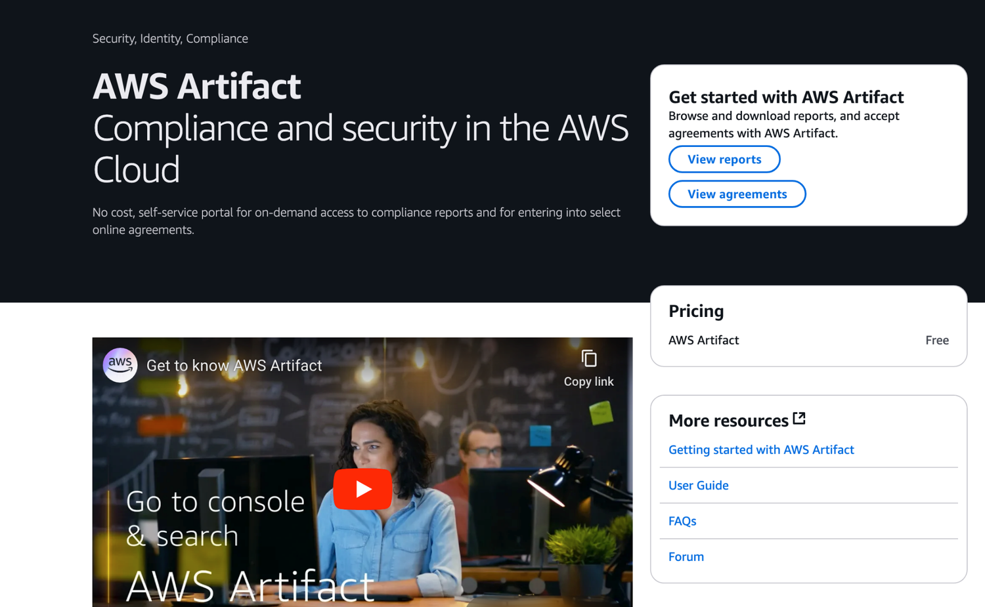
ORIGINAL PPT v4 · SOURCE SLIDE 729 · MODERNISED TECHNICAL DEEP DIVE
AWS Artifact (not really a service)
1
Mechanism: effective access is the
Mechanism: effective access is the intersection of identity policy, resource policy, permission boundary, session…
2
Failure mode
Failure mode: broad principals, unscoped PassRole, stale grants, public resource policies and long-lived…
3
Evidence: IAM Access Analyzer…
Evidence: IAM Access Analyzer findings, CloudTrail identity context, KMS key/grant policy, Config evaluations and…
CURRENT OPERATIONS LENS
Start with the trust boundary, evaluate effective access, protect data, record exceptions and verify that remediation reduced risk. Validate service limits and regional availability against current AWS documentation.
AWS Certified SysOps Administrator Associate Training · TGS-2024051413
© 2026 Tertiary Infotech Academy Pte Ltd
411

Slide 412
ORIGINAL PPT v4 · SOURCE SLIDE 731 · MODERNISED TECHNICAL DEEP DIVE
AWS Certificate Manager (ACM)
1
Easily provision, manage, and…
2
Provide in-flight encryption for…
3
Supports both public and private
4
Free of charge for public
Easily provision, manage, and deploy TLS Certificates
Automatic TLS certificate renewal
APIs on API Gateway
Provide in-flight encryption for websites (HTTPS)
Integrations with (load TLS certificates on)
Cannot use ACM with EC2 (can’t be extracted)
Supports both public and private TLS certificates
Elastic Load Balancers (CLB, ALB, NLB)
Auto Scaling group
Free of charge for public TLS certificates
CloudFront Distributions
EC2 Instance
CURRENT OPERATIONS LENS
Start with the trust boundary, evaluate effective access, protect data, record exceptions and verify that remediation reduced risk. Validate service limits and regional availability against current AWS documentation.
AWS Certified SysOps Administrator Associate Training · TGS-2024051413
© 2026 Tertiary Infotech Academy Pte Ltd
412

Slide 413
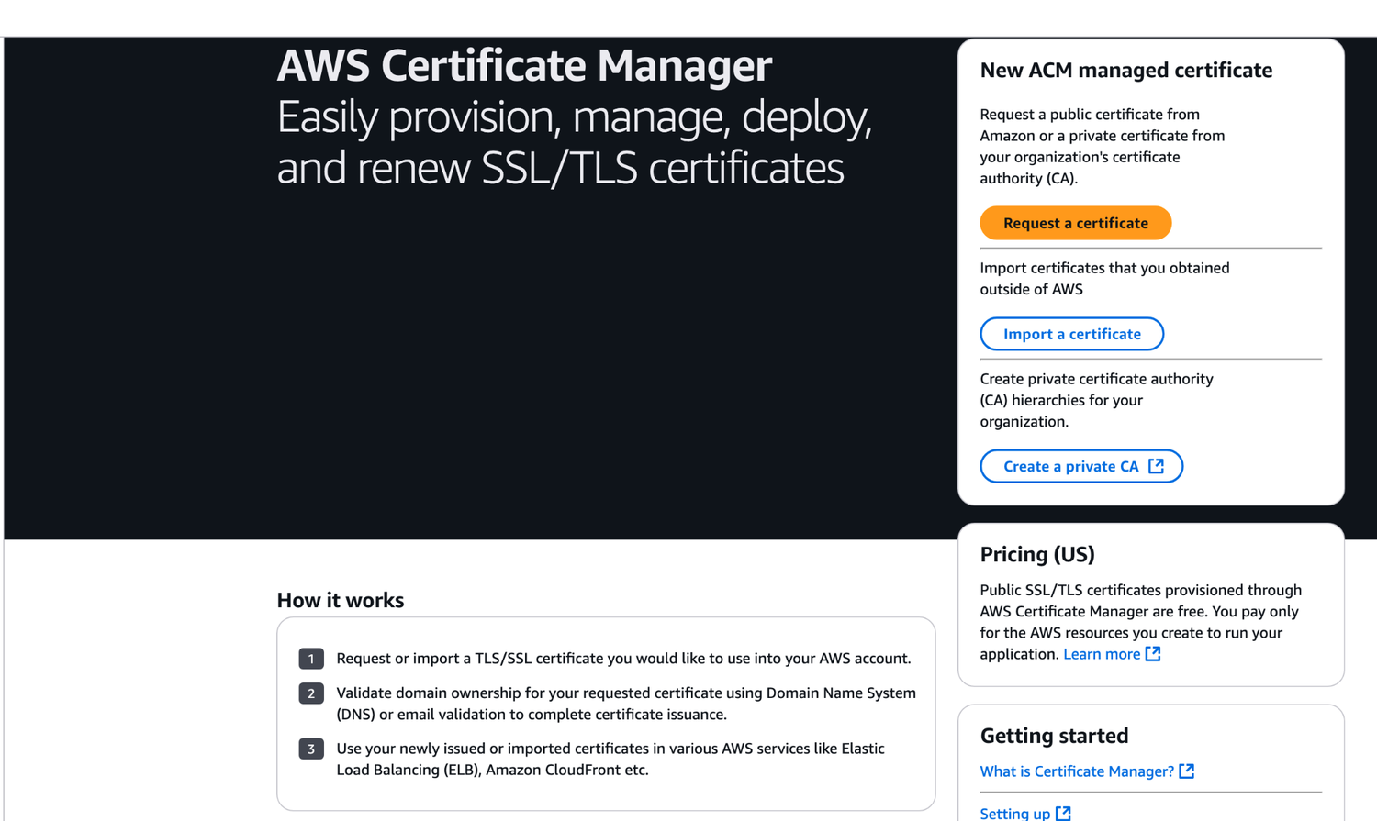
ORIGINAL PPT v4 · SOURCE SLIDE 732 · MODERNISED TECHNICAL DEEP DIVE
AWS Certificate Manager (ACM)
1
Mechanism: effective access is the
Mechanism: effective access is the intersection of identity policy, resource policy, permission boundary, session…
2
Failure mode
Failure mode: broad principals, unscoped PassRole, stale grants, public resource policies and long-lived…
3
Evidence: IAM Access Analyzer…
Evidence: IAM Access Analyzer findings, CloudTrail identity context, KMS key/grant policy, Config evaluations and…
CURRENT OPERATIONS LENS
Start with the trust boundary, evaluate effective access, protect data, record exceptions and verify that remediation reduced risk. Validate service limits and regional availability against current AWS documentation.
AWS Certified SysOps Administrator Associate Training · TGS-2024051413
© 2026 Tertiary Infotech Academy Pte Ltd
413

Slide 414
ORIGINAL PPT v4 · SOURCE SLIDE 733 · MODERNISED TECHNICAL DEEP DIVE
ACM - Requesting Public Certificates
1
List domain names to be
2
Fully Qualified Domain Name (FQDN)
3
Wildcard Domain
4
Select Validation Method
List domain names to be included in the certificate
DNS Validation is preferred for automation purposes
The Public Certificate will be enrolled for automatic renewal
Fully Qualified Domain Name (FQDN): corp.example.com
Email validation will send emails to contact addresses in the WHOIS database
ACM automatically renews ACM-generated certificates 60 days before expiry
Wildcard Domain: *.example.com
DNS Validation will leverage a CNAME record to DNS config (ex: Route 53)
Select Validation Method: DNS Validation or Email validation
It will take a few hours to get verified
CURRENT OPERATIONS LENS
Start with the trust boundary, evaluate effective access, protect data, record exceptions and verify that remediation reduced risk. Validate service limits and regional availability against current AWS documentation.
AWS Certified SysOps Administrator Associate Training · TGS-2024051413
© 2026 Tertiary Infotech Academy Pte Ltd
414

Slide 415
ORIGINAL PPT v4 · SOURCE SLIDE 734 · MODERNISED TECHNICAL DEEP DIVE
ACM - Importing Public Certificates
1
Option to generate the certificate
2
outside of ACM and then
3
No automatic renewal, must import
4
ACM sends daily expiration events
Option to generate the certificate
starting 45 days prior to expiration
AWS Config
outside of ACM and then import it
The # of days can be configured
EventBridge
No automatic renewal, must import a new certificate before expiry
Events are appearing in EventBridge
Rule events: Non-compliance
ACM sends daily expiration events
AWS Config was a managed rule named acm-certificate-expiration-check to check for expiring certificates (configurable number of days)
ACM Events
CURRENT OPERATIONS LENS
Start with the trust boundary, evaluate effective access, protect data, record exceptions and verify that remediation reduced risk. Validate service limits and regional availability against current AWS documentation.
AWS Certified SysOps Administrator Associate Training · TGS-2024051413
© 2026 Tertiary Infotech Academy Pte Ltd
415

Slide 416
ORIGINAL PPT v4 · SOURCE SLIDE 735 · MODERNISED TECHNICAL DEEP DIVE
ACM - Integration with ALB
1
Auto Scaling group
2
EC2 Instance
3
AWS Certificate Manager
4
Application Load Balancer
Auto Scaling group
With HTTP -> HTTPS redirect rule
Mechanism: effective access is the intersection of identity policy, resource policy, permission boundary, session policy, SCP/RCP and explicit denies.
EC2 Instance
provision and maintain TLS certs
Failure mode: broad principals, unscoped PassRole, stale grants, public resource policies and long-lived credentials expand the trust boundary…
AWS Certificate Manager
Redirect to HTTPS HTTPS
Evidence: IAM Access Analyzer findings, CloudTrail identity context, KMS key/grant policy, Config evaluations and exception records prove control…
Application Load Balancer
Decision point: remediate with the smallest policy change, validate new access before deployment and verify that the finding resolves without…
CURRENT OPERATIONS LENS
Start with the trust boundary, evaluate effective access, protect data, record exceptions and verify that remediation reduced risk. Validate service limits and regional availability against current AWS documentation.
AWS Certified SysOps Administrator Associate Training · TGS-2024051413
© 2026 Tertiary Infotech Academy Pte Ltd
416

Slide 417
ORIGINAL PPT v4 · SOURCE SLIDE 737 · MODERNISED TECHNICAL DEEP DIVE
ACM - Integration with API Gateway
1
Create a Custom Domain Name
2
Edge-Optimized (default)
3
Requests are routed through the
4
The API Gateway still lives
Create a Custom Domain Name in API Gateway
The TLS Certificate must be in the same region as CloudFront, in us-east-1
CloudFront
Edge-Optimized (default): For global clients
Then setup CNAME or (better) A-Alias record in Route 53
linked certificate
Requests are routed through the CloudFront Edge locations (improves latency)
For clients within the same region
API Gateway
The API Gateway still lives in only one region
The TLS Certificate must be imported on API Gateway, in the same region as the API Stage
Edge-Optimized
CURRENT OPERATIONS LENS
Start with the trust boundary, evaluate effective access, protect data, record exceptions and verify that remediation reduced risk. Validate service limits and regional availability against current AWS documentation.
AWS Certified SysOps Administrator Associate Training · TGS-2024051413
© 2026 Tertiary Infotech Academy Pte Ltd
417

Slide 418
ORIGINAL PPT v4 · SOURCE SLIDE 738 · MODERNISED TECHNICAL DEEP DIVE
API Gateway - Endpoint Types
1
Edge-Optimized (default)
2
Requests are routed through the
3
The API Gateway still lives
4
For clients within the same
Edge-Optimized (default): For global clients
Could manually combine with CloudFront (more control over the caching strategies and the distribution)
Requests are routed through the CloudFront Edge locations (improves latency)
Can only be accessed from your VPC using an interface VPC endpoint (ENI)
The API Gateway still lives in only one region
Use a resource policy to define access
For clients within the same region
Mechanism: effective access is the intersection of identity policy, resource policy, permission boundary, session policy, SCP/RCP and explicit denies.
CURRENT OPERATIONS LENS
Start with the trust boundary, evaluate effective access, protect data, record exceptions and verify that remediation reduced risk. Validate service limits and regional availability against current AWS documentation.
AWS Certified SysOps Administrator Associate Training · TGS-2024051413
© 2026 Tertiary Infotech Academy Pte Ltd
418

Slide 419
ORIGINAL PPT v4 · SOURCE SLIDE 739 · MODERNISED TECHNICAL DEEP DIVE
SSM Parameter Store
1
Secure storage for configuration…
2
Optional Seamless Encryption…
3
Serverless, scalable, durable…
4
Version tracking of…
Secure storage for configuration and secrets
Configuration management using path & IAM
Applications
Optional Seamless Encryption using KMS
Notifications with Amazon EventBridge
Plaintext configuration
Serverless, scalable, durable, easy SDK
Integration with CloudFormation
Encrypted configuration
Version tracking of configurations / secrets
SSM Parameter
Check IAM permissions
CURRENT OPERATIONS LENS
Start with the trust boundary, evaluate effective access, protect data, record exceptions and verify that remediation reduced risk. Validate service limits and regional availability against current AWS documentation.
AWS Certified SysOps Administrator Associate Training · TGS-2024051413
© 2026 Tertiary Infotech Academy Pte Ltd
419

Slide 420
ORIGINAL PPT v4 · SOURCE SLIDE 740 · MODERNISED TECHNICAL DEEP DIVE
SSM Parameter Store Hierarchy
1
/my-department/
2
db-password
3
other-app/
4
/other-department/
/my-department/
/aws/reference/secretsmanager/secret_ID_in_Secrets_Manager
Prod Lambda Function
Mechanism: effective access is the intersection of identity policy, resource policy, permission boundary, session policy, SCP/RCP and explicit denies.
db-password
/aws/service/ami-amazon-linux-latest/amzn2-ami-hvm-x86_64-gp2
Failure mode: broad principals, unscoped PassRole, stale grants, public resource policies and long-lived credentials expand the trust boundary…
other-app/
Dev Lambda Function
Evidence: IAM Access Analyzer findings, CloudTrail identity context, KMS key/grant policy, Config evaluations and exception records prove control…
/other-department/
GetParameters or GetParametersByPath API
Decision point: remediate with the smallest policy change, validate new access before deployment and verify that the finding resolves without…
CURRENT OPERATIONS LENS
Start with the trust boundary, evaluate effective access, protect data, record exceptions and verify that remediation reduced risk. Validate service limits and regional availability against current AWS documentation.
AWS Certified SysOps Administrator Associate Training · TGS-2024051413
© 2026 Tertiary Infotech Academy Pte Ltd
420

Slide 421
TOPIC 07 · LEGACY COVERAGE INTEGRATION
Original PPT Coverage Retained — Topic 07
Modernised slides
55 technical slides extracted from the original v4 PowerPoint and rebuilt in the current visual system.
Traceability
Every blended slide names its original v4 source slide number in the kicker.
1
2
Current validation
Terminology is normalised; service limits and Region availability remain explicit current-documentation checks.
Procedure boundary
Click-by-click sequences, activities and quizzes are kept out of the deck and remain in the Learner Guide or lab package.
3
4
AWS Certified SysOps Administrator Associate Training · TGS-2024051413
© 2026 Tertiary Infotech Academy Pte Ltd
421

Slide 422
TOPIC 07 · CONCEPT-LED LAB BRIEF
Build a Multi-Account Compliance Evidence Flow
LAB 07
Apply K1, K3, A1 and A7 by evaluating required tags and encryption, aggregating findings and documenting a controlled remediation exception.
Deploy Config-style controls, review findings and produce auditable remediation and exception evidence.
YOU'LL BUILD
TOOLCHAIN
DONE WHEN
A Config rule template, tag policy, findings register, remediation decision and service-quality scorecard.
AWS Config · Organizations · Security Hub · EventBridge · Systems Manager Automation
Required controls evaluate learner-owned resources, findings are prioritised with context, remediation has owner/SLA/verification, the exception expires, and validation emits LAB 07 PASS.
AWS Certified SysOps Administrator Associate Training · TGS-2024051413
© 2026 Tertiary Infotech Academy Pte Ltd
422

Slide 423
LAB 07 · CONCEPTUAL WORKFLOW
Lab 07 Evidence Model
1
2
3
4
5
Record
Evaluate
Aggregate
Remediate
Evidence
Configuration state
Rule result
Account scope
Approved control
Exception and result
PROCEDURE BOUNDARY
Detailed commands and numbered steps are in the Learner Guide and lab folder—not on these slides.
AWS Certified SysOps Administrator Associate Training · TGS-2024051413
© 2026 Tertiary Infotech Academy Pte Ltd
423

Slide 424
LAB 07 · ACCEPTANCE EVIDENCE
Build a Multi-Account Compliance Evidence Flow
✅ Expected result
Required controls evaluate learner-owned resources, findings are prioritised with context, remediation has owner/SLA/verification, the exception expires, and validation emits LAB 07 PASS.
IF IT DOESN'T WORK
Input mismatch
Validation stop
Evidence differs
Reconcile identifiers, required fields and units with the supplied data dictionary.
Inspect the named rule and source row; preserve the check rather than bypassing it.
Check the denominator, time window and assumptions before rerunning from clean inputs.
AWS Certified SysOps Administrator Associate Training · TGS-2024051413
© 2026 Tertiary Infotech Academy Pte Ltd
424

Slide 425
TOPIC 07 · CONCEPT-LED LAB BRIEF
Diagnose IAM Access and Protect Data with KMS
LAB 08
Apply K1, K3, A1 and A7 by explaining an access decision, narrowing permissions and verifying encryption and key-policy behaviour.
Use policy evidence to distinguish identity, resource and KMS decisions, then implement and verify least privilege.
YOU'LL BUILD
TOOLCHAIN
DONE WHEN
A policy-evaluation worksheet, corrected least-privilege policy, KMS key-policy review and encrypted-object evidence.
IAM · Access Analyzer · Policy Simulator · KMS · S3 · CloudTrail
The decision path explains the deny, corrected policy uses exact actions/resources, encrypted-object metadata is verified, Access Analyzer reports no ERROR, and validation emits LAB 08 PASS.
AWS Certified SysOps Administrator Associate Training · TGS-2024051413
© 2026 Tertiary Infotech Academy Pte Ltd
425

Slide 426
LAB 08 · CONCEPTUAL WORKFLOW
Lab 08 Evidence Model
1
2
3
4
5
Identity
Protect
Detect
Respond
Assure
Role and boundary
KMS policy
Finding or event
Bounded action
Access evidence
PROCEDURE BOUNDARY
Detailed commands and numbered steps are in the Learner Guide and lab folder—not on these slides.
AWS Certified SysOps Administrator Associate Training · TGS-2024051413
© 2026 Tertiary Infotech Academy Pte Ltd
426

Slide 427
LAB 08 · ACCEPTANCE EVIDENCE
Diagnose IAM Access and Protect Data with KMS
✅ Expected result
The decision path explains the deny, corrected policy uses exact actions/resources, encrypted-object metadata is verified, Access Analyzer reports no ERROR, and validation emits LAB 08 PASS.
IF IT DOESN'T WORK
Input mismatch
Validation stop
Evidence differs
Reconcile identifiers, required fields and units with the supplied data dictionary.
Inspect the named rule and source row; preserve the check rather than bypassing it.
Check the denominator, time window and assumptions before rerunning from clean inputs.
AWS Certified SysOps Administrator Associate Training · TGS-2024051413
© 2026 Tertiary Infotech Academy Pte Ltd
427

Slide 428
TOPIC 07 · RETRIEVAL PRACTICE
Recap — Security, Identity and Compliance
Explain
Short-lived credentials, least privilege and explicit trust bound administrative power.
Distinguish
Policies prevent known bad states; telemetry detects deviation; runbooks contain and recover.
1
2
Apply
K1, K3, A1 and A7 by evaluating required tags and encryption, aggregating findings and documenting a controlled remediation exception.
Evidence
Required controls evaluate learner-owned resources, findings are prioritised with context, remediation has owner/SLA/verification, the exception expires, and…
3
4
AWS Certified SysOps Administrator Associate Training · TGS-2024051413
© 2026 Tertiary Infotech Academy Pte Ltd
428

Slide 429
08
TOPIC 08 · LO5 · K2 · A2
Networking, DNS and Content Delivery
VPC · routes · security groups · NACLs · endpoints · Route 53 · CloudFront
AWS Certified SysOps Administrator Associate Training · TGS-2024051413
© 2026 Tertiary Infotech Academy Pte Ltd
429

Slide 430
BLUEPRINT · SOA-C03 Domain 5 · 18%
Key Ideas — Networking, DNS and Content Delivery
Connectivity is a path
DNS, route, policy, state, endpoint and application health must all succeed.
Security groups are stateful
Return traffic is automatically allowed; network ACLs evaluate each direction.
1
2
Private connectivity reduces exposure
VPC endpoints, Transit Gateway and hybrid links change routing and policy boundaries.
DNS is a control surface
Routing policy, health evaluation, TTL and resolver behaviour affect recovery.
3
4
AWS Certified SysOps Administrator Associate Training · TGS-2024051413
© 2026 Tertiary Infotech Academy Pte Ltd
430

Slide 431
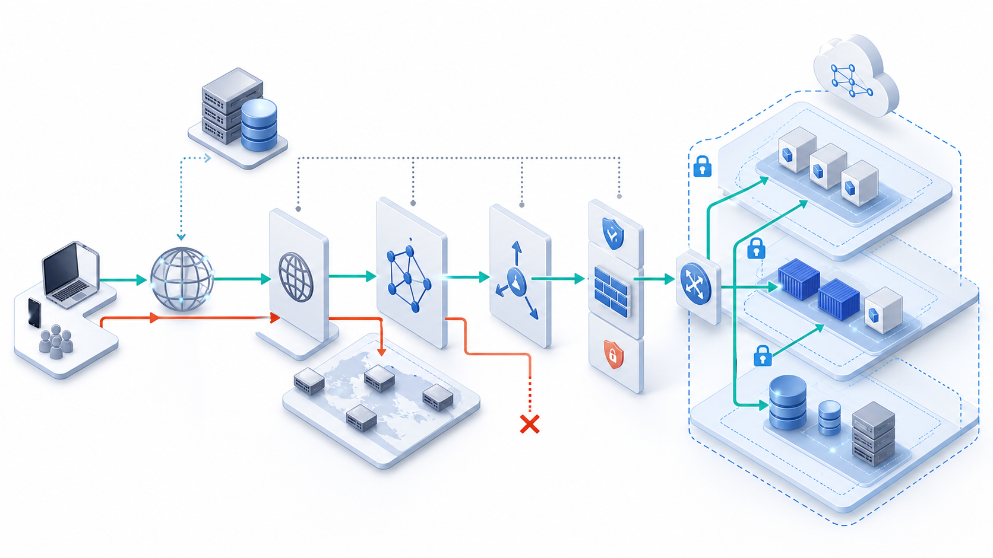
IMAGEGEN VISUAL · TOPIC 08
Trace the Complete Request Path
READ THE SYSTEM
Follow DNS, edge, routing, policy, load balancing and target health in order; compare the intended path with the blocked path before changing configuration.
AWS Certified SysOps Administrator Associate Training · TGS-2024051413
© 2026 Tertiary Infotech Academy Pte Ltd
431

Slide 432
TOPIC 08 · K2 · A2
Connectivity Troubleshooting Order
1
2
3
4
5
6
Name
Route
Policy
State
Target
Evidence
DNS answer and TTL
Longest prefix and target
SG, NACL and endpoint…
NAT, connection and…
Listener, port and health
Flow logs and application…
A2 STANDARD
Test from source to destination and record the first failed control boundary.
AWS Certified SysOps Administrator Associate Training · TGS-2024051413
© 2026 Tertiary Infotech Academy Pte Ltd
432

Slide 433
TOPIC 08 · K2 · A2
Security Group vs Network ACL
Property
Security group
Network ACL
Scope
Elastic network interface
Subnet
State
Stateful
Stateless
Rules
Allow only
Numbered allow and deny
Evaluation
All rules together
Lowest rule number first
AWS Certified SysOps Administrator Associate Training · TGS-2024051413
© 2026 Tertiary Infotech Academy Pte Ltd
433

Slide 434
TOPIC 08 · K2 · A2
DNS TTL Trades Agility for Query Load
WHAT THE DATA SHOWS
Lower TTL can speed client refresh but increases query volume and cannot force every resolver to behave identically.
AWS Certified SysOps Administrator Associate Training · TGS-2024051413
© 2026 Tertiary Infotech Academy Pte Ltd
434

Slide 435
TOPIC 08 · K2 · A2
Route 53 Routing Policies
Simple
One or more values without health-based policy logic.
Weighted
Controlled traffic split for migration or experiments.
1
2
Latency
Direct users to the Region with lowest measured latency.
Failover
Primary and secondary routing driven by health.
3
4
AWS Certified SysOps Administrator Associate Training · TGS-2024051413
© 2026 Tertiary Infotech Academy Pte Ltd
435

Slide 436
TOPIC 08 · K2 · A2
VPC Endpoint Types
Endpoint
Connectivity
Common use
Gateway
Route-table target
S3 and DynamoDB
Interface
Private IP through PrivateLink
Many AWS and partner services
Gateway Load Balancer
Inspection appliance insertion
Central security services
Resource / service network
VPC Lattice private application access
Cross-VPC service connectivity
AWS Certified SysOps Administrator Associate Training · TGS-2024051413
© 2026 Tertiary Infotech Academy Pte Ltd
436

Slide 437
TOPIC 08 · K2 · A2
CloudFront Operations
Cache
Origin
Security
• Cache key and TTL
• Invalidation and versioned objects
• Origin access control
• Origin health and failover
• TLS certificate and WAF
• Logs and real-time metrics
AWS Certified SysOps Administrator Associate Training · TGS-2024051413
© 2026 Tertiary Infotech Academy Pte Ltd
437

Slide 438
Network Diagnosis
A timeout is a symptom, not a location.
Use DNS results, route tables, reachability analysis, flow logs, load-balancer health and application evidence to isolate the boundary.
AWS Certified SysOps Administrator Associate Training · TGS-2024051413
© 2026 Tertiary Infotech Academy Pte Ltd
438

Slide 439
TOPIC 08 · NATIVE EDITABLE TECHNICAL CHART
Request-Path Latency Budget
WHAT THE DATA SHOWS
The application tier dominates p95, but network evidence must confirm that retries, path asymmetry or packet loss are not inflating it.
AWS Certified SysOps Administrator Associate Training · TGS-2024051413
© 2026 Tertiary Infotech Academy Pte Ltd
439

Slide 440
ORIGINAL PPT v4 · SOURCE SLIDE 491 · MODERNISED TECHNICAL DEEP DIVE
Amazon CloudFront
1
Content Delivery Network (CDN)
2
Improves read performance…
3
Improves users experience
4
216 Point of Presence globally
Content Delivery Network (CDN)
DDoS protection (because worldwide), integration with Shield, AWS Web Application Firewall
Improves read performance, content is cached at the edge
Mechanism: Route 53 selects an endpoint, edge services apply policy, routes choose a next hop, stateful and stateless controls filter traffic, and…
Improves users experience
Failure mode: asymmetric routing, overlapping CIDRs, return-path gaps, health-check mismatch and security-rule scope can produce identical user…
216 Point of Presence globally (edge locations)
Evidence: resolver result, route tables, Reachability Analyzer, Flow Logs, load-balancer logs, target health and application traces locate the…
CURRENT OPERATIONS LENS
Trace name resolution, routing, policy, transport and application health in order; separate static reachability from live data-plane behaviour. Validate service limits and regional availability against current AWS documentation.
AWS Certified SysOps Administrator Associate Training · TGS-2024051413
© 2026 Tertiary Infotech Academy Pte Ltd
440

Slide 441
ORIGINAL PPT v4 · SOURCE SLIDE 493 · MODERNISED TECHNICAL DEEP DIVE
CloudFront - Origins
1
For distributing files and caching
2
Enhanced security with CloudFront…
3
OAC is replacing Origin Access
4
CloudFront can be used as
For distributing files and caching them at the edge
Custom Origin (HTTP)
Any HTTP backend you want
Enhanced security with CloudFront Origin Access Control (OAC)
Application Load Balancer
OAC is replacing Origin Access Identity (OAI)
EC2 instance
Mechanism: Route 53 selects an endpoint, edge services apply policy, routes choose a next hop, stateful and stateless controls filter traffic, and…
CloudFront can be used as an ingress (to upload files to S3)
S3 website (must first enable the bucket as a static S3 website)
CURRENT OPERATIONS LENS
Trace name resolution, routing, policy, transport and application health in order; separate static reachability from live data-plane behaviour. Validate service limits and regional availability against current AWS documentation.
AWS Certified SysOps Administrator Associate Training · TGS-2024051413
© 2026 Tertiary Infotech Academy Pte Ltd
441

Slide 442
ORIGINAL PPT v4 · SOURCE SLIDE 494 · MODERNISED TECHNICAL DEEP DIVE
CloudFront at a high level
1
CloudFront Edge Location
2
Forward Request to your Origin
3
Local Cache
4
GET /beach.jpg?size=300x300…
CloudFront Edge Location
User-Agent: Mozilla/4.0 (compatible; MSIE5.01; Windows NT) Host: www.example.com
Forward Request to your Origin
Accept-Encoding: gzip, deflate
Mechanism: Route 53 selects an endpoint, edge services apply policy, routes choose a next hop, stateful and stateless controls filter traffic, and…
Local Cache
Failure mode: asymmetric routing, overlapping CIDRs, return-path gaps, health-check mismatch and security-rule scope can produce identical user…
GET /beach.jpg?size=300x300 HTTP/1.1
Evidence: resolver result, route tables, Reachability Analyzer, Flow Logs, load-balancer logs, target health and application traces locate the…
CURRENT OPERATIONS LENS
Trace name resolution, routing, policy, transport and application health in order; separate static reachability from live data-plane behaviour. Validate service limits and regional availability against current AWS documentation.
AWS Certified SysOps Administrator Associate Training · TGS-2024051413
© 2026 Tertiary Infotech Academy Pte Ltd
442

Slide 443
ORIGINAL PPT v4 · SOURCE SLIDE 495 · MODERNISED TECHNICAL DEEP DIVE
CloudFront - S3 as an Origin
1
Los Angeles
2
Edge Mumbai
3
Public www
4
Origin Access Control
Los Angeles
+ S3 bucket policy
Mechanism: Route 53 selects an endpoint, edge services apply policy, routes choose a next hop, stateful and stateless controls filter traffic, and…
Edge Mumbai
Origin (S3 bucket)
Failure mode: asymmetric routing, overlapping CIDRs, return-path gaps, health-check mismatch and security-rule scope can produce identical user…
Public www
Private AWS
Evidence: resolver result, route tables, Reachability Analyzer, Flow Logs, load-balancer logs, target health and application traces locate the…
Origin Access Control
Decision point: static analyzers prove configured reachability but send no packets; combine them with live data-plane evidence before declaring the…
CURRENT OPERATIONS LENS
Trace name resolution, routing, policy, transport and application health in order; separate static reachability from live data-plane behaviour. Validate service limits and regional availability against current AWS documentation.
AWS Certified SysOps Administrator Associate Training · TGS-2024051413
© 2026 Tertiary Infotech Academy Pte Ltd
443

Slide 444
ORIGINAL PPT v4 · SOURCE SLIDE 496 · MODERNISED TECHNICAL DEEP DIVE
CloudFront vs S3 Cross Region Replication
1
CloudFront
2
Global Edge network
3
Files are cached for a
4
Great for static content that
CloudFront
S3 Cross Region Replication
Mechanism: Route 53 selects an endpoint, edge services apply policy, routes choose a next hop, stateful and stateless controls filter traffic, and…
Global Edge network
Must be setup for each region you want replication to happen
Files are cached for a TTL (maybe a day)
Files are updated in near real-time
Great for static content that must be available everything
Great for dynamic content that needs to be available at low-latency in few regions
CURRENT OPERATIONS LENS
Trace name resolution, routing, policy, transport and application health in order; separate static reachability from live data-plane behaviour. Validate service limits and regional availability against current AWS documentation.
AWS Certified SysOps Administrator Associate Training · TGS-2024051413
© 2026 Tertiary Infotech Academy Pte Ltd
444

Slide 445
ORIGINAL PPT v4 · SOURCE SLIDE 498 · MODERNISED TECHNICAL DEEP DIVE
CloudFront - ALB or EC2 as an origin
1
Edge Location
2
Public IPs
3
Allow Security Group of Load
4
Allow Public IP of Edge
Edge Location
Security group
Must be Public
Mechanism: Route 53 selects an endpoint, edge services apply policy, routes choose a next hop, stateful and stateless controls filter traffic, and…
Public IPs
EC2 Instances
Failure mode: asymmetric routing, overlapping CIDRs, return-path gaps, health-check mismatch and security-rule scope can produce identical user…
Allow Security Group of Load Balancer
Can be Private
Evidence: resolver result, route tables, Reachability Analyzer, Flow Logs, load-balancer logs, target health and application traces locate the…
Allow Public IP of Edge Locations
Application Load Balancer
Decision point: static analyzers prove configured reachability but send no packets; combine them with live data-plane evidence before declaring the…
CURRENT OPERATIONS LENS
Trace name resolution, routing, policy, transport and application health in order; separate static reachability from live data-plane behaviour. Validate service limits and regional availability against current AWS documentation.
AWS Certified SysOps Administrator Associate Training · TGS-2024051413
© 2026 Tertiary Infotech Academy Pte Ltd
445

Slide 446
ORIGINAL PPT v4 · SOURCE SLIDE 499 · MODERNISED TECHNICAL DEEP DIVE
CloudFront Geo Restriction
1
You can restrict who can
2
Allowlist: Allow your users to
3
Blocklist: Prevent your users from
4
The “country” is determined using
You can restrict who can access your distribution
Use case: Copyright Laws to control access to content
Allowlist: Allow your users to access your content only if they're in one of the countries on a list of approved countries.
Blocklist: Prevent your users from accessing your content if they're in one of the countries on a list of banned countries.
The “country” is determined using a 3rd party Geo-IP database
CURRENT OPERATIONS LENS
Trace name resolution, routing, policy, transport and application health in order; separate static reachability from live data-plane behaviour. Validate service limits and regional availability against current AWS documentation.
AWS Certified SysOps Administrator Associate Training · TGS-2024051413
© 2026 Tertiary Infotech Academy Pte Ltd
446

Slide 447
ORIGINAL PPT v4 · SOURCE SLIDE 500 · MODERNISED TECHNICAL DEEP DIVE
CloudFront Access Logs
1
Logs every request made to
2
Edge Location
3
Origin Bucket
4
Logs Bucket
Logs every request made to CloudFront into a logging S3 bucket
Log File (Distribution A)
Edge Location
Log File (Distribution B)
Mechanism: Route 53 selects an endpoint, edge services apply policy, routes choose a next hop, stateful and stateless controls filter traffic, and…
Origin Bucket
data about requests
Failure mode: asymmetric routing, overlapping CIDRs, return-path gaps, health-check mismatch and security-rule scope can produce identical user…
Logs Bucket
Evidence: resolver result, route tables, Reachability Analyzer, Flow Logs, load-balancer logs, target health and application traces locate the…
CURRENT OPERATIONS LENS
Trace name resolution, routing, policy, transport and application health in order; separate static reachability from live data-plane behaviour. Validate service limits and regional availability against current AWS documentation.
AWS Certified SysOps Administrator Associate Training · TGS-2024051413
© 2026 Tertiary Infotech Academy Pte Ltd
447

Slide 448
ORIGINAL PPT v4 · SOURCE SLIDE 501 · MODERNISED TECHNICAL DEEP DIVE
CloudFront Reports
1
It’s possible to generate reports
2
Cache Statistics Report
3
Popular Objects Report
4
Top Referrers Report
It’s possible to generate reports on
Usage Reports
Mechanism: Route 53 selects an endpoint, edge services apply policy, routes choose a next hop, stateful and stateless controls filter traffic, and…
Cache Statistics Report
Viewers Report
Failure mode: asymmetric routing, overlapping CIDRs, return-path gaps, health-check mismatch and security-rule scope can produce identical user…
Popular Objects Report
These reports are based on the data from the Access Logs.
Top Referrers Report
Evidence: resolver result, route tables, Reachability Analyzer, Flow Logs, load-balancer logs, target health and application traces locate the…
CURRENT OPERATIONS LENS
Trace name resolution, routing, policy, transport and application health in order; separate static reachability from live data-plane behaviour. Validate service limits and regional availability against current AWS documentation.
AWS Certified SysOps Administrator Associate Training · TGS-2024051413
© 2026 Tertiary Infotech Academy Pte Ltd
448

Slide 449
ORIGINAL PPT v4 · SOURCE SLIDE 502 · MODERNISED TECHNICAL DEEP DIVE
CloudFront troubleshooting
1
CloudFront caches HTTP 4xx and
2
4xx error code indicates that
3
5xx error codes indicates Gateway
4
Failure mode
CloudFront caches HTTP 4xx and 5xx status codes returned by S3 ( or the origin server)
4xx error code indicates that user doesn’t have access to the underlying bucket (403) or the object user is requesting is not found (404)
5xx error codes indicates Gateway issues
Mechanism: Route 53 selects an endpoint, edge services apply policy, routes choose a next hop, stateful and stateless controls filter traffic, and…
Failure mode: asymmetric routing, overlapping CIDRs, return-path gaps, health-check mismatch and security-rule scope can produce identical user…
CURRENT OPERATIONS LENS
Trace name resolution, routing, policy, transport and application health in order; separate static reachability from live data-plane behaviour. Validate service limits and regional availability against current AWS documentation.
AWS Certified SysOps Administrator Associate Training · TGS-2024051413
© 2026 Tertiary Infotech Academy Pte Ltd
449

Slide 450
ORIGINAL PPT v4 · SOURCE SLIDE 503 · MODERNISED TECHNICAL DEEP DIVE
CloudFront Caching
1
Cache based on
2
Session Cookies
3
Query String Parameters
4
The cache lives at each
Cache based on
You want to maximize the cache hit rate to minimize requests on the origin
Expire based on TTL
Session Cookies
Control the TTL (0 seconds to 1 year), can
Edge Location
Query String Parameters
be set by the origin using the Cache- Control header, Expires header…
Check / Update cache Based on Headers / Cookies
The cache lives at each CloudFront Edge Location
You can invalidate part of the cache using the CreateInvalidation API
CURRENT OPERATIONS LENS
Trace name resolution, routing, policy, transport and application health in order; separate static reachability from live data-plane behaviour. Validate service limits and regional availability against current AWS documentation.
AWS Certified SysOps Administrator Associate Training · TGS-2024051413
© 2026 Tertiary Infotech Academy Pte Ltd
450

Slide 451
ORIGINAL PPT v4 · SOURCE SLIDE 504 · MODERNISED TECHNICAL DEEP DIVE
CloudFront Cache Behaviour for Headers
1
Forward all headers to your
2
=> no caching, every request
3
=> TTL must be set
4
Forward a whitelist of headers
Forward all headers to your origin
caching based on values in all the specified headers
GET /image/cat.jpg HTTP/1.1
=> no caching, every request to origin
(None) == Forward only the default headers
Host: pics.mywebsite.com
=> TTL must be set to 0
no caching based on request headers
User-Agent: Mozilla/5.0 (Mac OS X 10_15_2….) Date: Tue, 28 Jan 2020 17:01:57 GMT
Forward a whitelist of headers
Best caching performance
Authorization: SAPISIDHASH fdd00ecee39fe….
CURRENT OPERATIONS LENS
Trace name resolution, routing, policy, transport and application health in order; separate static reachability from live data-plane behaviour. Validate service limits and regional availability against current AWS documentation.
AWS Certified SysOps Administrator Associate Training · TGS-2024051413
© 2026 Tertiary Infotech Academy Pte Ltd
451

Slide 452
ORIGINAL PPT v4 · SOURCE SLIDE 505 · MODERNISED TECHNICAL DEEP DIVE
CloudFront Caching – Whitelist Headers
1
Edge Location
2
GET /image/cat.jpg HTTP/1.1
3
Host: pics.mywebsite.com
4
User-Agent: Mozilla/5.0 (Mac OS X
Edge Location
Authorization: SAPISIDHASH fdd00ecee39fe….
Better caching because less headers values
GET /image/cat.jpg HTTP/1.1
Keep-Alive: 300 Accept-Ranges: bytes
Mechanism: Route 53 selects an endpoint, edge services apply policy, routes choose a next hop, stateful and stateless controls filter traffic, and…
Host: pics.mywebsite.com
whitelisting
Failure mode: asymmetric routing, overlapping CIDRs, return-path gaps, health-check mismatch and security-rule scope can produce identical user…
User-Agent: Mozilla/5.0 (Mac OS X 10_15_2….) Date: Tue, 28 Jan 2020 17:01:57 GMT
Cache based on Host & Authorization
CURRENT OPERATIONS LENS
Trace name resolution, routing, policy, transport and application health in order; separate static reachability from live data-plane behaviour. Validate service limits and regional availability against current AWS documentation.
AWS Certified SysOps Administrator Associate Training · TGS-2024051413
© 2026 Tertiary Infotech Academy Pte Ltd
452

Slide 453
ORIGINAL PPT v4 · SOURCE SLIDE 506 · MODERNISED TECHNICAL DEEP DIVE
CloudFront Origin Headers vs Cache Behavior
1
Origin Custom Headers
2
Origin-level setting
3
Set a constant header /
4
Behavior setting
Origin Custom Headers
Cache-related settings
Mechanism: Route 53 selects an endpoint, edge services apply policy, routes choose a next hop, stateful and stateless controls filter traffic, and…
Origin-level setting
Contains the whitelist of headers to forward
Failure mode: asymmetric routing, overlapping CIDRs, return-path gaps, health-check mismatch and security-rule scope can produce identical user…
Set a constant header / header value for all requests to origin
Behavior setting
Evidence: resolver result, route tables, Reachability Analyzer, Flow Logs, load-balancer logs, target health and application traces locate the…
CURRENT OPERATIONS LENS
Trace name resolution, routing, policy, transport and application health in order; separate static reachability from live data-plane behaviour. Validate service limits and regional availability against current AWS documentation.
AWS Certified SysOps Administrator Associate Training · TGS-2024051413
© 2026 Tertiary Infotech Academy Pte Ltd
453

Slide 454
ORIGINAL PPT v4 · SOURCE SLIDE 507 · MODERNISED TECHNICAL DEEP DIVE
CloudFront Caching TTL
1
“Cache-Control: max-age” is…
2
If the origin always sends
3
In case you want to
4
In case the Cache-Control header
“Cache-Control: max-age” is preferred to “Expires” header
Default TTL
Mechanism: Route 53 selects an endpoint, edge services apply policy, routes choose a next hop, stateful and stateless controls filter traffic, and…
If the origin always sends back the header Cache-Control then you can set the TTL to be controlled only by that header
Cache-Control (optional)
In case you want to set min/max boundaries, you choose “customize” for the Object Caching setting
In case the Cache-Control header is missing, it will default to “default value”
CURRENT OPERATIONS LENS
Trace name resolution, routing, policy, transport and application health in order; separate static reachability from live data-plane behaviour. Validate service limits and regional availability against current AWS documentation.
AWS Certified SysOps Administrator Associate Training · TGS-2024051413
© 2026 Tertiary Infotech Academy Pte Ltd
454

Slide 455
ORIGINAL PPT v4 · SOURCE SLIDE 508 · MODERNISED TECHNICAL DEEP DIVE
CloudFront Cache Behaviour for Cookies
1
Cookies is a specific request
2
Default: do not process the
3
Caching is not based on
4
Cookies are not forwarded
Cookies is a specific request header
Forward a whitelist of cookies
GET /image/cat.jpg HTTP/1.1
Default: do not process the cookies
caching based on values in all the specified cookies
Cookie: username=John Doe; location=uk; lang = eng; user_id = 12342
Caching is not based on cookies
Forward all cookies
Mechanism: Route 53 selects an endpoint, edge services apply policy, routes choose a next hop, stateful and stateless controls filter traffic, and…
Cookies are not forwarded
Worst caching performance
Failure mode: asymmetric routing, overlapping CIDRs, return-path gaps, health-check mismatch and security-rule scope can produce identical user…
CURRENT OPERATIONS LENS
Trace name resolution, routing, policy, transport and application health in order; separate static reachability from live data-plane behaviour. Validate service limits and regional availability against current AWS documentation.
AWS Certified SysOps Administrator Associate Training · TGS-2024051413
© 2026 Tertiary Infotech Academy Pte Ltd
455

Slide 456
ORIGINAL PPT v4 · SOURCE SLIDE 509 · MODERNISED TECHNICAL DEEP DIVE
CloudFront Caching - Cookies
1
Edge Location
2
GET /image/cat.jpg HTTP/1.1
3
Cookie: username=John Doe…
4
Cookie: user_id = 12342
Edge Location
Whitelisting on user_id
Mechanism: Route 53 selects an endpoint, edge services apply policy, routes choose a next hop, stateful and stateless controls filter traffic, and…
GET /image/cat.jpg HTTP/1.1
Cache based on yser_id
Failure mode: asymmetric routing, overlapping CIDRs, return-path gaps, health-check mismatch and security-rule scope can produce identical user…
Cookie: username=John Doe; location=uk; lang = eng; user_id = 12342
Better caching because less cookies values
Cookie: user_id = 12342
Evidence: resolver result, route tables, Reachability Analyzer, Flow Logs, load-balancer logs, target health and application traces locate the…
CURRENT OPERATIONS LENS
Trace name resolution, routing, policy, transport and application health in order; separate static reachability from live data-plane behaviour. Validate service limits and regional availability against current AWS documentation.
AWS Certified SysOps Administrator Associate Training · TGS-2024051413
© 2026 Tertiary Infotech Academy Pte Ltd
456

Slide 457
ORIGINAL PPT v4 · SOURCE SLIDE 510 · MODERNISED TECHNICAL DEEP DIVE
CloudFront Cache Behaviour for Query Strings
1
Query Strings Parameters are in
2
Default: do not process the
3
Caching is not based on
4
Parameters are not forwarded
Query Strings Parameters are in the URL
Forward a whitelist of query strings
GET /image/cat.jpg?border=red&size=large HTTP/1.1
Default: do not process the query strings
Caching based on the parameter whitelist
Caching is not based on query strings
Forward all query strings
Parameters are not forwarded
Caching based on all parameters
Mechanism: Route 53 selects an endpoint, edge services apply policy, routes choose a next hop, stateful and stateless controls filter traffic, and…
CURRENT OPERATIONS LENS
Trace name resolution, routing, policy, transport and application health in order; separate static reachability from live data-plane behaviour. Validate service limits and regional availability against current AWS documentation.
AWS Certified SysOps Administrator Associate Training · TGS-2024051413
© 2026 Tertiary Infotech Academy Pte Ltd
457

Slide 458
ORIGINAL PPT v4 · SOURCE SLIDE 511 · MODERNISED TECHNICAL DEEP DIVE
CloudFront Caching - Query String Parameters
1
Edge Location
2
GET /image/cat.jpg?border=red&size…
3
GET /image/cat.jpg?size=large…
4
Whitelisting on size
Edge Location
Cache based on size
Mechanism: Route 53 selects an endpoint, edge services apply policy, routes choose a next hop, stateful and stateless controls filter traffic, and…
GET /image/cat.jpg?border=red&size=large HTTP/1.1
Better caching because less query string values
GET /image/cat.jpg?size=large HTTP/1.1
Failure mode: asymmetric routing, overlapping CIDRs, return-path gaps, health-check mismatch and security-rule scope can produce identical user…
Whitelisting on size
Evidence: resolver result, route tables, Reachability Analyzer, Flow Logs, load-balancer logs, target health and application traces locate the…
CURRENT OPERATIONS LENS
Trace name resolution, routing, policy, transport and application health in order; separate static reachability from live data-plane behaviour. Validate service limits and regional availability against current AWS documentation.
AWS Certified SysOps Administrator Associate Training · TGS-2024051413
© 2026 Tertiary Infotech Academy Pte Ltd
458

Slide 459
ORIGINAL PPT v4 · SOURCE SLIDE 512 · MODERNISED TECHNICAL DEEP DIVE
CloudFront - Maximize cache hits by separating static and dynamic distributions
1
Dynamic Content (REST, HTTP…
2
API Gateway + Lambda
3
CloudFront
4
Static requests
Dynamic Content (REST, HTTP server)
Static content
Mechanism: Route 53 selects an endpoint, edge services apply policy, routes choose a next hop, stateful and stateless controls filter traffic, and…
API Gateway + Lambda
Cache based on correct headers and cookie
CloudFront
No headers / session caching rules Required for maximizing cache hits
Static requests
Failure mode: asymmetric routing, overlapping CIDRs, return-path gaps, health-check mismatch and security-rule scope can produce identical user…
CURRENT OPERATIONS LENS
Trace name resolution, routing, policy, transport and application health in order; separate static reachability from live data-plane behaviour. Validate service limits and regional availability against current AWS documentation.
AWS Certified SysOps Administrator Associate Training · TGS-2024051413
© 2026 Tertiary Infotech Academy Pte Ltd
459

Slide 460
ORIGINAL PPT v4 · SOURCE SLIDE 513 · MODERNISED TECHNICAL DEEP DIVE
CloudFront - Increasing Cache Ratio
1
Monitor the CloudWatch metric…
2
Specify how long to cache your…
3
Specify none or the minimally
4
Specify none or the minimally
Monitor the CloudWatch metric CacheHitRate
Specify none or the minimally required query string parameters
Specify how long to cache your objects: Cache-Control max-age header
Separate static and dynamic distributions (two origins)
Specify none or the minimally required headers
Mechanism: Route 53 selects an endpoint, edge services apply policy, routes choose a next hop, stateful and stateless controls filter traffic, and…
Specify none or the minimally required cookies
Failure mode: asymmetric routing, overlapping CIDRs, return-path gaps, health-check mismatch and security-rule scope can produce identical user…
CURRENT OPERATIONS LENS
Trace name resolution, routing, policy, transport and application health in order; separate static reachability from live data-plane behaviour. Validate service limits and regional availability against current AWS documentation.
AWS Certified SysOps Administrator Associate Training · TGS-2024051413
© 2026 Tertiary Infotech Academy Pte Ltd
460

Slide 461
ORIGINAL PPT v4 · SOURCE SLIDE 514 · MODERNISED TECHNICAL DEEP DIVE
CloudFront with ALB sticky sessions
1
Must forward / whitelist the
2
Set a TTL to a
3
forward cookies
4
Edge Location
Must forward / whitelist the cookie that controls the session affinity to the origin to allow the session affinity to work
GET /orders/all HTTP/1.1
CloudFront
Set a TTL to a value lesser than when the authentication cookie expires
Cookie: AWSALB=…
Target Group
forward cookies
Whitelisting on
Application Load Balancer
Mechanism: Route 53 selects an endpoint, edge services apply policy, routes choose a next hop, stateful and stateless controls filter traffic, and…
Edge Location
AWSALB cookie
Failure mode: asymmetric routing, overlapping CIDRs, return-path gaps, health-check mismatch and security-rule scope can produce identical user…
CURRENT OPERATIONS LENS
Trace name resolution, routing, policy, transport and application health in order; separate static reachability from live data-plane behaviour. Validate service limits and regional availability against current AWS documentation.
AWS Certified SysOps Administrator Associate Training · TGS-2024051413
© 2026 Tertiary Infotech Academy Pte Ltd
461

Slide 462
ORIGINAL PPT v4 · SOURCE SLIDE 776 · MODERNISED TECHNICAL DEEP DIVE
What is DNS?
1
Domain Name System which…
2
www.google.com => 172.217.18.36
3
DNS is the backbone of
4
DNS uses hierarchical naming…
Domain Name System which translates the human friendly hostnames into the machine IP addresses
example.com www.example.com api.example.com
www.google.com => 172.217.18.36
Mechanism: Route 53 selects an endpoint, edge services apply policy, routes choose a next hop, stateful and stateless controls filter traffic, and…
DNS is the backbone of the Internet
Failure mode: asymmetric routing, overlapping CIDRs, return-path gaps, health-check mismatch and security-rule scope can produce identical user…
DNS uses hierarchical naming structure
Evidence: resolver result, route tables, Reachability Analyzer, Flow Logs, load-balancer logs, target health and application traces locate the…
CURRENT OPERATIONS LENS
Trace name resolution, routing, policy, transport and application health in order; separate static reachability from live data-plane behaviour. Validate service limits and regional availability against current AWS documentation.
AWS Certified SysOps Administrator Associate Training · TGS-2024051413
© 2026 Tertiary Infotech Academy Pte Ltd
462

Slide 463
ORIGINAL PPT v4 · SOURCE SLIDE 777 · MODERNISED TECHNICAL DEEP DIVE
DNS Terminologies
1
Sub Domain
2
FQDN (Fully Qualified Domain Name)
3
Domain Registrar
4
DNS Records
Sub Domain
Zone File: contains DNS records
Mechanism: Route 53 selects an endpoint, edge services apply policy, routes choose a next hop, stateful and stateless controls filter traffic, and…
FQDN (Fully Qualified Domain Name)
Name Server: resolves DNS queries (Authoritative or Non-Authoritative)
Domain Registrar: Amazon Route 53, GoDaddy, …
Top Level Domain (TLD): .com, .us, .in, .gov, .org, …
DNS Records: A, AAAA, CNAME, NS, …
Second Level Domain (STD): amazon.com, google.com, …
CURRENT OPERATIONS LENS
Trace name resolution, routing, policy, transport and application health in order; separate static reachability from live data-plane behaviour. Validate service limits and regional availability against current AWS documentation.
AWS Certified SysOps Administrator Associate Training · TGS-2024051413
© 2026 Tertiary Infotech Academy Pte Ltd
463

Slide 464
ORIGINAL PPT v4 · SOURCE SLIDE 778 · MODERNISED TECHNICAL DEEP DIVE
How DNS Works
1
Local DNS Server
2
Assigned and Managed by your
3
example.com?
4
Root DNS Server
Local DNS Server
TLD DNS Server
Managed by ICANN
Mechanism: Route 53 selects an endpoint, edge services apply policy, routes choose a next hop, stateful and stateless controls filter traffic, and…
Assigned and Managed by your company or assigned by your ISP dynamically
.com NS 1.2.3.4
Managed by Domain Registrar (e.g., Amazon Registrar, Inc.)
example.com?
example.com NS 5.6.7.8
SLD DNS Server
Failure mode: asymmetric routing, overlapping CIDRs, return-path gaps, health-check mismatch and security-rule scope can produce identical user…
Root DNS Server
example.com IP 9.10.11.12
Managed by IANA (Branch of ICANN)
CURRENT OPERATIONS LENS
Trace name resolution, routing, policy, transport and application health in order; separate static reachability from live data-plane behaviour. Validate service limits and regional availability against current AWS documentation.
AWS Certified SysOps Administrator Associate Training · TGS-2024051413
© 2026 Tertiary Infotech Academy Pte Ltd
464

Slide 465
ORIGINAL PPT v4 · SOURCE SLIDE 779 · MODERNISED TECHNICAL DEEP DIVE
Amazon Route 53
1
A highly available, scalable…
2
Authoritative = the customer (you)
3
Route 53 is also a
4
Ability to check the health
A highly available, scalable, fully managed and Authoritative DNS
The only AWS service which provides 100% availability SLA
EC2 Instance
Authoritative = the customer (you) can update the DNS records
Why Route 53? 53 is a reference to the traditional DNS port
Route 53 is also a Domain Registrar
example.com?
Mechanism: Route 53 selects an endpoint, edge services apply policy, routes choose a next hop, stateful and stateless controls filter traffic, and…
Ability to check the health of your resources
54.22.33.44
Failure mode: asymmetric routing, overlapping CIDRs, return-path gaps, health-check mismatch and security-rule scope can produce identical user…
CURRENT OPERATIONS LENS
Trace name resolution, routing, policy, transport and application health in order; separate static reachability from live data-plane behaviour. Validate service limits and regional availability against current AWS documentation.
AWS Certified SysOps Administrator Associate Training · TGS-2024051413
© 2026 Tertiary Infotech Academy Pte Ltd
465

Slide 466
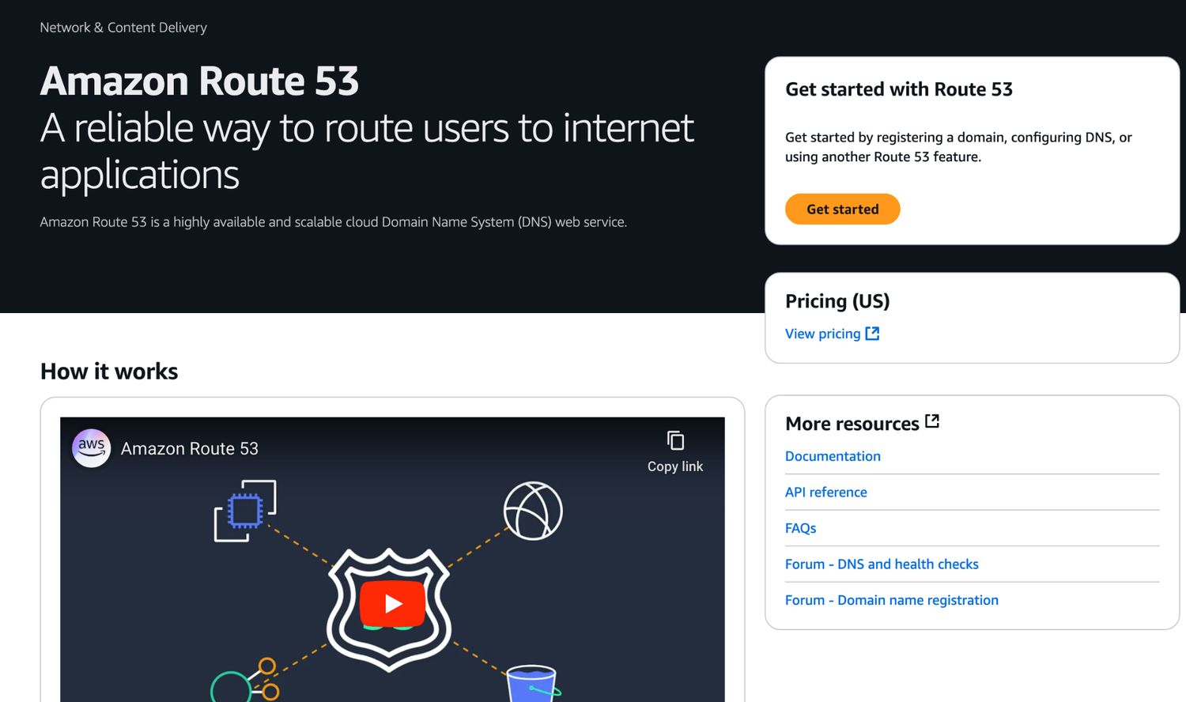
ORIGINAL PPT v4 · SOURCE SLIDE 780 · MODERNISED TECHNICAL DEEP DIVE
Amazon Route 53
1
Mechanism: Route 53 selects an
Mechanism: Route 53 selects an endpoint, edge services apply policy, routes choose a next hop, stateful and…
2
Failure mode
Failure mode: asymmetric routing, overlapping CIDRs, return-path gaps, health-check mismatch and security-rule…
3
Evidence: resolver result, route…
Evidence: resolver result, route tables, Reachability Analyzer, Flow Logs, load-balancer logs, target health and…
CURRENT OPERATIONS LENS
Trace name resolution, routing, policy, transport and application health in order; separate static reachability from live data-plane behaviour. Validate service limits and regional availability against current AWS documentation.
AWS Certified SysOps Administrator Associate Training · TGS-2024051413
© 2026 Tertiary Infotech Academy Pte Ltd
466

Slide 467
ORIGINAL PPT v4 · SOURCE SLIDE 782 · MODERNISED TECHNICAL DEEP DIVE
Route 53 - Records
1
How you want to route
2
Each record contains
3
Domain/SubDomain namer
4
Record Type
How you want to route traffic for a domain
Value - e.g., 12.34.56.78
(must know) A / AAAA / CNAME / NS
Each record contains
Routing Policy - how Route 53 responds to queries
(advanced) CAA / DS / MX / NAPTR / PTR / SOA / TXT / SPF / SRV
Domain/SubDomain namer - e.g., example.com
TTL - amount of time the record cached at DNS Resolvers
Record Type - e.g., A or AAAA
Route 53 supports the following DNS record types
CURRENT OPERATIONS LENS
Trace name resolution, routing, policy, transport and application health in order; separate static reachability from live data-plane behaviour. Validate service limits and regional availability against current AWS documentation.
AWS Certified SysOps Administrator Associate Training · TGS-2024051413
© 2026 Tertiary Infotech Academy Pte Ltd
467

Slide 468
ORIGINAL PPT v4 · SOURCE SLIDE 783 · MODERNISED TECHNICAL DEEP DIVE
Route 53 - Record Types
1
A - maps a hostname
2
AAAA - maps a hostname
3
CNAME - maps a hostname
4
The target is a domain
A - maps a hostname to IPv4
Can’t create a CNAME record for the top node of a DNS namespace (Zone Apex)
AAAA - maps a hostname to IPv6
Example: you can’t create for example.com, but you can create for www.example.com
CNAME - maps a hostname to another hostname
NS - Name Servers for the Hosted Zone
The target is a domain name which must have an A or AAAA record
Control how traffic is routed for a domain
CURRENT OPERATIONS LENS
Trace name resolution, routing, policy, transport and application health in order; separate static reachability from live data-plane behaviour. Validate service limits and regional availability against current AWS documentation.
AWS Certified SysOps Administrator Associate Training · TGS-2024051413
© 2026 Tertiary Infotech Academy Pte Ltd
468

Slide 469
ORIGINAL PPT v4 · SOURCE SLIDE 784 · MODERNISED TECHNICAL DEEP DIVE
Route 53 - Hosted Zones
1
A container for records that
2
Puiblic Hosted Zones
3
Private Hosted Zones
4
You pay $0.50 per month
A container for records that define how to route traffic to a domain and its subdomains
Puiblic Hosted Zones - contains records that specify how to route traffic on the Internet (public domain names) application1.mypublicdomain.com
Private Hosted Zones - contain records that specify how you route traffic within one or more VPCs (private domain names) application1.company.internal
You pay $0.50 per month per hosted zone
Mechanism: Route 53 selects an endpoint, edge services apply policy, routes choose a next hop, stateful and stateless controls filter traffic, and…
CURRENT OPERATIONS LENS
Trace name resolution, routing, policy, transport and application health in order; separate static reachability from live data-plane behaviour. Validate service limits and regional availability against current AWS documentation.
AWS Certified SysOps Administrator Associate Training · TGS-2024051413
© 2026 Tertiary Infotech Academy Pte Ltd
469

Slide 470
ORIGINAL PPT v4 · SOURCE SLIDE 785 · MODERNISED TECHNICAL DEEP DIVE
Route 53 - Public vs Private Hosted Zones
1
EC2 Instance
2
(Public IP)
3
Application
4
Load Balancer
EC2 Instance
Public Hosted Zone
EC2 Instance EC2 Instance
Mechanism: Route 53 selects an endpoint, edge services apply policy, routes choose a next hop, stateful and stateless controls filter traffic, and…
(Public IP)
Amazon CloudFront
(webapp.example.internal) (api.example.internal)
Failure mode: asymmetric routing, overlapping CIDRs, return-path gaps, health-check mismatch and security-rule scope can produce identical user…
Application
54.22.33.44
(Private IP) (Private IP)
Evidence: resolver result, route tables, Reachability Analyzer, Flow Logs, load-balancer logs, target health and application traces locate the…
Load Balancer
Private Hosted Zone
DB Instance
Decision point: static analyzers prove configured reachability but send no packets; combine them with live data-plane evidence before declaring the…
CURRENT OPERATIONS LENS
Trace name resolution, routing, policy, transport and application health in order; separate static reachability from live data-plane behaviour. Validate service limits and regional availability against current AWS documentation.
AWS Certified SysOps Administrator Associate Training · TGS-2024051413
© 2026 Tertiary Infotech Academy Pte Ltd
470

Slide 471
ORIGINAL PPT v4 · SOURCE SLIDE 787 · MODERNISED TECHNICAL DEEP DIVE
Route 53 - Records TTL (Time To Live)
1
Web Server
2
DNS Request
3
myapp.example.com?
4
Amazon Route 53
Web Server
A 12.34.56.78
High TTL - e.g. 24 hr
DNS Request
HTTP Request
Less traffic on Route 53
Mechanism: Route 53 selects an endpoint, edge services apply policy, routes choose a next hop, stateful and stateless controls filter traffic, and…
myapp.example.com?
HTTP Response
Possibly outdated records
Failure mode: asymmetric routing, overlapping CIDRs, return-path gaps, health-check mismatch and security-rule scope can produce identical user…
Amazon Route 53
Will cache the result for The TTL of the record
Low TTL - e.g. 60 sec
CURRENT OPERATIONS LENS
Trace name resolution, routing, policy, transport and application health in order; separate static reachability from live data-plane behaviour. Validate service limits and regional availability against current AWS documentation.
AWS Certified SysOps Administrator Associate Training · TGS-2024051413
© 2026 Tertiary Infotech Academy Pte Ltd
471

Slide 472
ORIGINAL PPT v4 · SOURCE SLIDE 788 · MODERNISED TECHNICAL DEEP DIVE
CNAME vs Alias
1
AWS Resources (Load Balancer…
2
Ib1-1234.us-east2.elb.amazonaws.co…
3
Points a hostname to any
4
ONLY FOR NON ROOT DOMAIN
AWS Resources (Load Balancer, CloudFront...) expose an AWS hostname
Points a hostname to an AWS Resource (app.mydomain.com => blabla.amazonaws.com)
Ib1-1234.us-east2.elb.amazonaws.com and you want myapp.mydomain.com
Works for ROOT DOMAIN and NON ROOT DOMAIN (aka mydomain.com)
Points a hostname to any other hostname. (app.mydomain.com => blabla.anything.com)
Free of charge
ONLY FOR NON ROOT DOMAIN (aka something.mydomain.com)
Native health check
CURRENT OPERATIONS LENS
Trace name resolution, routing, policy, transport and application health in order; separate static reachability from live data-plane behaviour. Validate service limits and regional availability against current AWS documentation.
AWS Certified SysOps Administrator Associate Training · TGS-2024051413
© 2026 Tertiary Infotech Academy Pte Ltd
472

Slide 473
ORIGINAL PPT v4 · SOURCE SLIDE 789 · MODERNISED TECHNICAL DEEP DIVE
Route 53 - Alias Records
1
Maps a hostname to an
2
An extension to DNS functionality
3
Automatically recognizes changes…
4
Unlike CNAME, it can be
Maps a hostname to an AWS resource
Alias Record is always of type A/AAAA for
Amazon Route 53
An extension to DNS functionality
AWS resources (IPv4 / IPv6)
Alias Record (Enabled)
Automatically recognizes changes in the resource’s IP addresses
You can't set the TTL
AWS-Managed
Unlike CNAME, it can be used for the top node of a DNS namespace (Zone Apex), e.g.: example.com
MyALB-123456789.us-east-1.elb.amazonaws.com
(IP Addresses might change)
CURRENT OPERATIONS LENS
Trace name resolution, routing, policy, transport and application health in order; separate static reachability from live data-plane behaviour. Validate service limits and regional availability against current AWS documentation.
AWS Certified SysOps Administrator Associate Training · TGS-2024051413
© 2026 Tertiary Infotech Academy Pte Ltd
473

Slide 474
ORIGINAL PPT v4 · SOURCE SLIDE 790 · MODERNISED TECHNICAL DEEP DIVE
Route 53 - Alias Records Targets
1
Elastic Load Balancers
2
CloudFront Distributions
3
API Gateway
4
Elastic Beanstalk environments
Elastic Load Balancers
S3 Websites
You cannot set an ALIAS record for an EC2 DNS name
CloudFront Distributions
VPC Interface Endpoints
Global Accelerator
Mechanism: Route 53 selects an endpoint, edge services apply policy, routes choose a next hop, stateful and stateless controls filter traffic, and…
API Gateway
Global Accelerator accelerator
Elastic Load Balancer
Failure mode: asymmetric routing, overlapping CIDRs, return-path gaps, health-check mismatch and security-rule scope can produce identical user…
Elastic Beanstalk environments
Route 53 record in the same hosted zone
Amazon CloudFront
CURRENT OPERATIONS LENS
Trace name resolution, routing, policy, transport and application health in order; separate static reachability from live data-plane behaviour. Validate service limits and regional availability against current AWS documentation.
AWS Certified SysOps Administrator Associate Training · TGS-2024051413
© 2026 Tertiary Infotech Academy Pte Ltd
474

Slide 475
ORIGINAL PPT v4 · SOURCE SLIDE 791 · MODERNISED TECHNICAL DEEP DIVE
Route 53 - Routing Policies
1
Define how Route 53 responds
2
Don’t get confused by the
3
It’s not the same as
4
DNS does not route any
Define how Route 53 responds to DNS queries
Route 53 Supports the following Routing Policies
Geoproximity (using Route 53 Traffic Flow feature)
Don’t get confused by the word “Routing”
Latency based
Mechanism: Route 53 selects an endpoint, edge services apply policy, routes choose a next hop, stateful and stateless controls filter traffic, and…
It’s not the same as Load balancer routing which routes the traffic
Geolocation
DNS does not route any traffic, it only responds to the DNS queries
Multi-Value Answer
CURRENT OPERATIONS LENS
Trace name resolution, routing, policy, transport and application health in order; separate static reachability from live data-plane behaviour. Validate service limits and regional availability against current AWS documentation.
AWS Certified SysOps Administrator Associate Training · TGS-2024051413
© 2026 Tertiary Infotech Academy Pte Ltd
475

Slide 476
ORIGINAL PPT v4 · SOURCE SLIDE 792 · MODERNISED TECHNICAL DEEP DIVE
Routing Policies - Simple
1
Typically, route traffic to a
2
Can specify multiple values in
3
If mutliple values are returned
4
random one is chosen by
Typically, route traffic to a single resource
When Alias enabled, specify only one AWS resource
Amazon Route 53
Can specify multiple values in the same record
Can’t be associated with Health Checks
Single Value
If mutliple values are returned a
foo.example.com
A 55.66.77.88
Mechanism: Route 53 selects an endpoint, edge services apply policy, routes choose a next hop, stateful and stateless controls filter traffic, and…
random one is chosen by the client
A 11.22.33.44
A 99.11.22.33
CURRENT OPERATIONS LENS
Trace name resolution, routing, policy, transport and application health in order; separate static reachability from live data-plane behaviour. Validate service limits and regional availability against current AWS documentation.
AWS Certified SysOps Administrator Associate Training · TGS-2024051413
© 2026 Tertiary Infotech Academy Pte Ltd
476

Slide 477
ORIGINAL PPT v4 · SOURCE SLIDE 793 · MODERNISED TECHNICAL DEEP DIVE
Route 53 Weighted Routing — Selection Logic
1
Traffic share = record weight
2
Weights are relative values and
3
A weight of zero stops
4
Health checks remove unhealthy…
Traffic share = record weight divided by the sum of weights for eligible records.
Weights are relative values and do not need to total 100.
A weight of zero stops normal selection unless every eligible record has zero weight.
Health checks remove unhealthy endpoints before the remaining weights are evaluated.
CURRENT OPERATIONS LENS
Trace name resolution, routing, policy, transport and application health in order; separate static reachability from live data-plane behaviour. Validate service limits and regional availability against current AWS documentation.
AWS Certified SysOps Administrator Associate Training · TGS-2024051413
© 2026 Tertiary Infotech Academy Pte Ltd
477

Slide 478
ORIGINAL PPT v4 · SOURCE SLIDE 794 · MODERNISED TECHNICAL DEEP DIVE
Route 53 Latency-Based Routing — Decision Model
1
Selection: Route 53 chooses the
2
Measurement: the decision uses AWS
3
Health: associate health checks so
4
Evidence: compare resolver…
Selection: Route 53 chooses the record associated with the AWS Region expected to provide the lowest network latency for the requester.
Measurement: the decision uses AWS latency measurements between users and Regions, not geographic distance alone.
Health: associate health checks so unhealthy endpoints are excluded before a latency-based answer is returned.
Evidence: compare resolver answers, endpoint health and application latency from representative user locations before changing policy.
CURRENT OPERATIONS LENS
Trace name resolution, routing, policy, transport and application health in order; separate static reachability from live data-plane behaviour. Validate service limits and regional availability against current AWS documentation.
AWS Certified SysOps Administrator Associate Training · TGS-2024051413
© 2026 Tertiary Infotech Academy Pte Ltd
478

Slide 479
ORIGINAL PPT v4 · SOURCE SLIDE 795 · MODERNISED TECHNICAL DEEP DIVE
Route 53 - Health Checks
1
HTTP Health Checks are only
2
Health Check => Automated DNS
3
Health checks that monitor an
4
Health checks that monitor other
HTTP Health Checks are only for public resources
Health checks that monitor CloudWatch Alarms (full control !!) – e.g., throttles of DynamoDB, alarms on RDS, custom metrics,
DNS Record (latency, geoproximity, …)
Health Check => Automated DNS Failover
… (helpful for private resources)
Auto Scaling group
Health checks that monitor an endpoint (application, server, other AWS resource)
Health Checks are integrated with CW metrics
EC2 Instance
Health checks that monitor other health checks (Calculated Health Checks)
Amazon Route 53
Health Check
CURRENT OPERATIONS LENS
Trace name resolution, routing, policy, transport and application health in order; separate static reachability from live data-plane behaviour. Validate service limits and regional availability against current AWS documentation.
AWS Certified SysOps Administrator Associate Training · TGS-2024051413
© 2026 Tertiary Infotech Academy Pte Ltd
479

Slide 480
ORIGINAL PPT v4 · SOURCE SLIDE 796 · MODERNISED TECHNICAL DEEP DIVE
eu-west-1
1
Health Checker (us-east-1)
2
Health Checks
3
about 15 global health checkers
4
Healthy/Unhealthy Threshold
Health Checker (us-east-1)
Interval – 30 sec (can set to 10 sec – higher cost)
Health Checks pass only when the endpoint responds with the 2xx and 3xx status codes
Health Checks - Monitor an Endpoint
Supported protocol: HTTP, HTTPS and TCP
Health Checks can be setup to pass / fail based on the text in the first 5120 bytes of the response
about 15 global health checkers will check the endpoint health
If> 18% of health checkers report the endpoint is healthy, Route 53 considers it Healthy. Otherwise, it’s Unhealthy
Configure your router/firewall to allow incoming requests from Route 53 Health Checkers
Healthy/Unhealthy Threshold – 3 (default)
Ability to choose which locations you want Route 53 to use
HTTP Request
CURRENT OPERATIONS LENS
Trace name resolution, routing, policy, transport and application health in order; separate static reachability from live data-plane behaviour. Validate service limits and regional availability against current AWS documentation.
AWS Certified SysOps Administrator Associate Training · TGS-2024051413
© 2026 Tertiary Infotech Academy Pte Ltd
480

Slide 481
ORIGINAL PPT v4 · SOURCE SLIDE 797 · MODERNISED TECHNICAL DEEP DIVE
Amazon Route 53
1
Route 53
2
Combine the results of multiple
3
You can use OR, AND
4
Can monitor up to 256
Route 53 - Calculated Health Checks
Specify how many of the health checks need to pass to make the parent pass
Check Check
Combine the results of multiple Health Checks into a single Health Check
Usage: perform maintenance to your website without causing all health checks to fail
(Child) (Child)
You can use OR, AND or NOT
Health Check
EC2 Instance
Can monitor up to 256 Child Health Checks
Health Health
CURRENT OPERATIONS LENS
Trace name resolution, routing, policy, transport and application health in order; separate static reachability from live data-plane behaviour. Validate service limits and regional availability against current AWS documentation.
AWS Certified SysOps Administrator Associate Training · TGS-2024051413
© 2026 Tertiary Infotech Academy Pte Ltd
481

Slide 482
ORIGINAL PPT v4 · SOURCE SLIDE 798 · MODERNISED TECHNICAL DEEP DIVE
Health Checks - Private Hosted Zones
1
Route 53 health checkers are
2
They can’t access private…
3
You can create a CloudWatch
4
Health Checker (us-east-1)
Route 53 health checkers are outside the VPC
Private subnet
They can’t access private endpoints (private VPC or on-premises resource)
CloudWatch Alarm
You can create a CloudWatch Metric and associate a CloudWatch Alarm, then create a Health Check that checks the alarm itself
Health Checker (us-east-1)
Mechanism: Route 53 selects an endpoint, edge services apply policy, routes choose a next hop, stateful and stateless controls filter traffic, and…
CURRENT OPERATIONS LENS
Trace name resolution, routing, policy, transport and application health in order; separate static reachability from live data-plane behaviour. Validate service limits and regional availability against current AWS documentation.
AWS Certified SysOps Administrator Associate Training · TGS-2024051413
© 2026 Tertiary Infotech Academy Pte Ltd
482

Slide 483
ORIGINAL PPT v4 · SOURCE SLIDE 799 · MODERNISED TECHNICAL DEEP DIVE
Routing Policies - Failover (Active-Passive)
1
EC2 Instance
2
Health Check
3
(mandatory)
4
Amazon Route 53
EC2 Instance
(Secondary – Disaster Recovery)
Mechanism: Route 53 selects an endpoint, edge services apply policy, routes choose a next hop, stateful and stateless controls filter traffic, and…
Health Check
DNS Requests
Failure mode: asymmetric routing, overlapping CIDRs, return-path gaps, health-check mismatch and security-rule scope can produce identical user…
(mandatory)
Evidence: resolver result, route tables, Reachability Analyzer, Flow Logs, load-balancer logs, target health and application traces locate the…
Amazon Route 53
Decision point: static analyzers prove configured reachability but send no packets; combine them with live data-plane evidence before declaring the…
CURRENT OPERATIONS LENS
Trace name resolution, routing, policy, transport and application health in order; separate static reachability from live data-plane behaviour. Validate service limits and regional availability against current AWS documentation.
AWS Certified SysOps Administrator Associate Training · TGS-2024051413
© 2026 Tertiary Infotech Academy Pte Ltd
483

Slide 484
ORIGINAL PPT v4 · SOURCE SLIDE 800 · MODERNISED TECHNICAL DEEP DIVE
Routing Policies - Geolocation
1
Different from Latency-based!
2
This routing is based on
3
Specify location by Continent…
4
Should create a "Default" record
Different from Latency-based!
Use cases: website localization, restrict content distribution, load balancing …
A 99.11.22.33
This routing is based on user location
Can be associated with Health Checks
Specify location by Continent, Country or by US State (if there’s overlapping, most precise location selected)
A 11.22.33.44
Should create a "Default" record (in case there’s no match on location)
A 55.66.77.88
CURRENT OPERATIONS LENS
Trace name resolution, routing, policy, transport and application health in order; separate static reachability from live data-plane behaviour. Validate service limits and regional availability against current AWS documentation.
AWS Certified SysOps Administrator Associate Training · TGS-2024051413
© 2026 Tertiary Infotech Academy Pte Ltd
484

Slide 485
ORIGINAL PPT v4 · SOURCE SLIDE 801 · MODERNISED TECHNICAL DEEP DIVE
Routing Policies - Geoproximity
1
Route traffic to your resources
2
Ability to shift more traffic
3
To change the size of
4
To expand (1 to 99)
Route traffic to your resources based on the geographic location of users and resources
To shrink (-1 to -99) – less traffic to the resource
You must use Route 53 Traffic Flow to use this feature
Ability to shift more traffic to resources based on the defined bias
Resources can be
To change the size of the geographic region, specify bias values
AWS resources (specify AWS region)
To expand (1 to 99) – more traffic to the resource
Non-AWS resources (specify Latitude and Longitude)
CURRENT OPERATIONS LENS
Trace name resolution, routing, policy, transport and application health in order; separate static reachability from live data-plane behaviour. Validate service limits and regional availability against current AWS documentation.
AWS Certified SysOps Administrator Associate Training · TGS-2024051413
© 2026 Tertiary Infotech Academy Pte Ltd
485

Slide 486
ORIGINAL PPT v4 · SOURCE SLIDE 802 · MODERNISED TECHNICAL DEEP DIVE
Routing Policies - Geoproximity
1
us-west-1 Bias
2
us-east-1 Bias
3
Evidence: resolver result, route…
4
Decision point
us-west-1 Bias: 0
Mechanism: Route 53 selects an endpoint, edge services apply policy, routes choose a next hop, stateful and stateless controls filter traffic, and…
us-east-1 Bias: 0
Failure mode: asymmetric routing, overlapping CIDRs, return-path gaps, health-check mismatch and security-rule scope can produce identical user…
Evidence: resolver result, route tables, Reachability Analyzer, Flow Logs, load-balancer logs, target health and application traces locate the…
Decision point: static analyzers prove configured reachability but send no packets; combine them with live data-plane evidence before declaring the…
CURRENT OPERATIONS LENS
Trace name resolution, routing, policy, transport and application health in order; separate static reachability from live data-plane behaviour. Validate service limits and regional availability against current AWS documentation.
AWS Certified SysOps Administrator Associate Training · TGS-2024051413
© 2026 Tertiary Infotech Academy Pte Ltd
486

Slide 487
ORIGINAL PPT v4 · SOURCE SLIDE 803 · MODERNISED TECHNICAL DEEP DIVE
Routing Policies - Geoproximity
1
us-west-1 Bias
2
us-east-1 Bias
3
Higher bias in us-east-1
4
Decision point
us-west-1 Bias: 0
Mechanism: Route 53 selects an endpoint, edge services apply policy, routes choose a next hop, stateful and stateless controls filter traffic, and…
us-east-1 Bias: 50
Failure mode: asymmetric routing, overlapping CIDRs, return-path gaps, health-check mismatch and security-rule scope can produce identical user…
Higher bias in us-east-1
Evidence: resolver result, route tables, Reachability Analyzer, Flow Logs, load-balancer logs, target health and application traces locate the…
Decision point: static analyzers prove configured reachability but send no packets; combine them with live data-plane evidence before declaring the…
CURRENT OPERATIONS LENS
Trace name resolution, routing, policy, transport and application health in order; separate static reachability from live data-plane behaviour. Validate service limits and regional availability against current AWS documentation.
AWS Certified SysOps Administrator Associate Training · TGS-2024051413
© 2026 Tertiary Infotech Academy Pte Ltd
487

Slide 488
ORIGINAL PPT v4 · SOURCE SLIDE 805 · MODERNISED TECHNICAL DEEP DIVE
Route 53 - Traffic flow
1
Simplify the process of creating
2
Visual editor to manage complex
3
Configurations can be saved as
4
Traffic Flow Policy
Simplify the process of creating and maintaining records in large and complex configurations
Can be applied to different Route 53 Hosted Zones (different domain names)
Visual editor to manage complex routing decision trees
Supports versioning
Configurations can be saved as
Mechanism: Route 53 selects an endpoint, edge services apply policy, routes choose a next hop, stateful and stateless controls filter traffic, and…
Traffic Flow Policy
Failure mode: asymmetric routing, overlapping CIDRs, return-path gaps, health-check mismatch and security-rule scope can produce identical user…
CURRENT OPERATIONS LENS
Trace name resolution, routing, policy, transport and application health in order; separate static reachability from live data-plane behaviour. Validate service limits and regional availability against current AWS documentation.
AWS Certified SysOps Administrator Associate Training · TGS-2024051413
© 2026 Tertiary Infotech Academy Pte Ltd
488

Slide 489
ORIGINAL PPT v4 · SOURCE SLIDE 806 · MODERNISED TECHNICAL DEEP DIVE
Routing Policies - IP-based Routing
1
Routing is based on client's
2
You provide a list of
3
Use cases
4
Example: route end users from
Routing is based on client's IP addresses
CIDR Collection
Mechanism: Route 53 selects an endpoint, edge services apply policy, routes choose a next hop, stateful and stateless controls filter traffic, and…
You provide a list of CIDRs for your clients and the corresponding endpoints/locations (user-IP-to-endpoint mappings)
EC2 Instance
Use cases: Optimize performance, reduce network costs…
(203.0.113.56)
Failure mode: asymmetric routing, overlapping CIDRs, return-path gaps, health-check mismatch and security-rule scope can produce identical user…
Example: route end users from a particular ISP to a specific endpoint
(200.5.4.100)
CURRENT OPERATIONS LENS
Trace name resolution, routing, policy, transport and application health in order; separate static reachability from live data-plane behaviour. Validate service limits and regional availability against current AWS documentation.
AWS Certified SysOps Administrator Associate Training · TGS-2024051413
© 2026 Tertiary Infotech Academy Pte Ltd
489

Slide 490
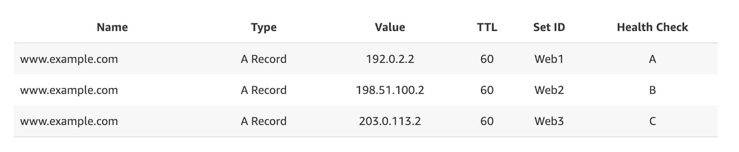
ORIGINAL PPT v4 · SOURCE SLIDE 807 · MODERNISED TECHNICAL DEEP DIVE
Routing Policies - Multi-Value
1
Use when routing traffic to
Use when routing traffic to multiple resources
Mechanism: Route 53 selects an endpoint, edge services apply policy, routes choose a next hop, stateful and…
2
Failure mode
Failure mode: asymmetric routing, overlapping CIDRs, return-path gaps, health-check mismatch and security-rule…
3
Evidence: resolver result, route…
Evidence: resolver result, route tables, Reachability Analyzer, Flow Logs, load-balancer logs, target health and…
CURRENT OPERATIONS LENS
Trace name resolution, routing, policy, transport and application health in order; separate static reachability from live data-plane behaviour. Validate service limits and regional availability against current AWS documentation.
AWS Certified SysOps Administrator Associate Training · TGS-2024051413
© 2026 Tertiary Infotech Academy Pte Ltd
490

Slide 491
ORIGINAL PPT v4 · SOURCE SLIDE 808 · MODERNISED TECHNICAL DEEP DIVE
Domain Registrar vs DNS Service
1
You buy or register your
2
The Domain Registrar usually…
3
But you can use another
4
Example: purchase the domain from
You buy or register your domain name with a Domain Registrar typically by paying annual charges (e.g., GoDaddy, Amazon Registrar Inc., …)
Amazon Route 53
The Domain Registrar usually provides you with a DNS service to manage your DNS records
example.com
But you can use another DNS service to manage your DNS records
manage DNS records
Example: purchase the domain from GoDaddy and use Route 53 to manage your DNS records
CURRENT OPERATIONS LENS
Trace name resolution, routing, policy, transport and application health in order; separate static reachability from live data-plane behaviour. Validate service limits and regional availability against current AWS documentation.
AWS Certified SysOps Administrator Associate Training · TGS-2024051413
© 2026 Tertiary Infotech Academy Pte Ltd
491

Slide 492
ORIGINAL PPT v4 · SOURCE SLIDE 809 · MODERNISED TECHNICAL DEEP DIVE
GoDaddy as Registrar & Route 53 as DNS Service
1
Amazon Route 53
2
Public Hosted Zone
3
stephanetheteacher.com
4
Decision point
Amazon Route 53
Mechanism: Route 53 selects an endpoint, edge services apply policy, routes choose a next hop, stateful and stateless controls filter traffic, and…
Public Hosted Zone
Failure mode: asymmetric routing, overlapping CIDRs, return-path gaps, health-check mismatch and security-rule scope can produce identical user…
stephanetheteacher.com
Evidence: resolver result, route tables, Reachability Analyzer, Flow Logs, load-balancer logs, target health and application traces locate the…
Decision point: static analyzers prove configured reachability but send no packets; combine them with live data-plane evidence before declaring the…
CURRENT OPERATIONS LENS
Trace name resolution, routing, policy, transport and application health in order; separate static reachability from live data-plane behaviour. Validate service limits and regional availability against current AWS documentation.
AWS Certified SysOps Administrator Associate Training · TGS-2024051413
© 2026 Tertiary Infotech Academy Pte Ltd
492

Slide 493
ORIGINAL PPT v4 · SOURCE SLIDE 810 · MODERNISED TECHNICAL DEEP DIVE
3rd Party Registrar with Amazon Route 53
1
If you buy your domain
2
Create a Hosted Zone in
3
Update NS Records on 3rd
4
Domain Registrar != DNS Service
If you buy your domain on a 3rd party registrar, you can still use route 53 as the DNS Service provider
But every Domain Registrar usually comes with some DNS features
Create a Hosted Zone in Route 53
Mechanism: Route 53 selects an endpoint, edge services apply policy, routes choose a next hop, stateful and stateless controls filter traffic, and…
Update NS Records on 3rd party website to use Route 53 Name Servers
Domain Registrar != DNS Service
Failure mode: asymmetric routing, overlapping CIDRs, return-path gaps, health-check mismatch and security-rule scope can produce identical user…
CURRENT OPERATIONS LENS
Trace name resolution, routing, policy, transport and application health in order; separate static reachability from live data-plane behaviour. Validate service limits and regional availability against current AWS documentation.
AWS Certified SysOps Administrator Associate Training · TGS-2024051413
© 2026 Tertiary Infotech Academy Pte Ltd
493

Slide 494
ORIGINAL PPT v4 · SOURCE SLIDE 812 · MODERNISED TECHNICAL DEEP DIVE
Route 53 Resolver — Hybrid DNS Architecture
1
VPC Resolver
2
Inbound endpoints
3
Outbound endpoints
4
Operational evidence
VPC Resolver: answers queries for VPC-local names, private hosted zones and public DNS names available to the workload.
Inbound endpoints: allow approved on-premises DNS resolvers to query private AWS namespaces through dedicated endpoint IP addresses.
Outbound endpoints: forward selected domain queries from VPCs to on-premises resolvers using resolver rules.
Operational evidence: verify rule association, network path, security-group scope, query logs and authoritative answers in both directions.
CURRENT OPERATIONS LENS
Trace name resolution, routing, policy, transport and application health in order; separate static reachability from live data-plane behaviour. Validate service limits and regional availability against current AWS documentation.
AWS Certified SysOps Administrator Associate Training · TGS-2024051413
© 2026 Tertiary Infotech Academy Pte Ltd
494

Slide 495
TOPIC 08 · LEGACY COVERAGE INTEGRATION
Original PPT Coverage Retained — Topic 08
Modernised slides
55 technical slides extracted from the original v4 PowerPoint and rebuilt in the current visual system.
Traceability
Every blended slide names its original v4 source slide number in the kicker.
1
2
Current validation
Terminology is normalised; service limits and Region availability remain explicit current-documentation checks.
Procedure boundary
Click-by-click sequences, activities and quizzes are kept out of the deck and remain in the Learner Guide or lab package.
3
4
AWS Certified SysOps Administrator Associate Training · TGS-2024051413
© 2026 Tertiary Infotech Academy Pte Ltd
495

Slide 496
TOPIC 08 · CONCEPT-LED LAB BRIEF
Troubleshoot a VPC Connectivity Path
LAB 09
Apply K2 and A2 by isolating a failed request through DNS, routes, security groups, network ACLs, target health and VPC Flow Logs.
Diagnose the first failed control boundary using a repeatable evidence ladder and implement one verified correction.
YOU'LL BUILD
TOOLCHAIN
DONE WHEN
A VPC diagnostic worksheet, reachability/flow-log evidence, corrected network control and before/after result.
VPC · Reachability Analyzer · Flow Logs · Security Groups · NACLs · Endpoints
The report follows the path in order, names the first failed boundary with evidence, changes one learner-owned control, verifies success with the same test, and validation emits LAB 09 PASS.
AWS Certified SysOps Administrator Associate Training · TGS-2024051413
© 2026 Tertiary Infotech Academy Pte Ltd
496

Slide 497
LAB 09 · CONCEPTUAL WORKFLOW
Lab 09 Evidence Model
1
2
3
4
5
Name
Route
Reach
Observe
Resolve
DNS result
Table and SG
NACL and path
Logs and metrics
Smallest change
PROCEDURE BOUNDARY
Detailed commands and numbered steps are in the Learner Guide and lab folder—not on these slides.
AWS Certified SysOps Administrator Associate Training · TGS-2024051413
© 2026 Tertiary Infotech Academy Pte Ltd
497

Slide 498
LAB 09 · ACCEPTANCE EVIDENCE
Troubleshoot a VPC Connectivity Path
✅ Expected result
The report follows the path in order, names the first failed boundary with evidence, changes one learner-owned control, verifies success with the same test, and validation emits LAB 09 PASS.
IF IT DOESN'T WORK
Input mismatch
Validation stop
Evidence differs
Reconcile identifiers, required fields and units with the supplied data dictionary.
Inspect the named rule and source row; preserve the check rather than bypassing it.
Check the denominator, time window and assumptions before rerunning from clean inputs.
AWS Certified SysOps Administrator Associate Training · TGS-2024051413
© 2026 Tertiary Infotech Academy Pte Ltd
498

Slide 499
TOPIC 08 · CONCEPT-LED LAB BRIEF
Operate DNS and Content-Delivery Failover
LAB 10
Apply K2 and A2 by configuring health-aware DNS and CloudFront behaviour, then proving client-visible routing and cache outcomes.
Model primary/secondary routing, inspect health status and TTL, then verify CloudFront origin and cache evidence.
YOU'LL BUILD
TOOLCHAIN
DONE WHEN
A Route 53 health-check definition, failover record plan, CloudFront operations checklist and measured failover report.
Route 53 · Health Checks · CloudFront · S3 · CloudWatch
Health and record evidence are linked, failover timing is measured rather than assumed, cache and DNS effects are distinguished, baseline is restored, and validation emits LAB 10 PASS.
AWS Certified SysOps Administrator Associate Training · TGS-2024051413
© 2026 Tertiary Infotech Academy Pte Ltd
499

Slide 500
LAB 10 · CONCEPTUAL WORKFLOW
Lab 10 Evidence Model
1
2
3
4
5
Health
Route
Deliver
Fail over
Verify
Endpoint signal
Policy decision
Edge behaviour
Alternate origin
User result
PROCEDURE BOUNDARY
Detailed commands and numbered steps are in the Learner Guide and lab folder—not on these slides.
AWS Certified SysOps Administrator Associate Training · TGS-2024051413
© 2026 Tertiary Infotech Academy Pte Ltd
500

Slide 501
LAB 10 · ACCEPTANCE EVIDENCE
Operate DNS and Content-Delivery Failover
✅ Expected result
Health and record evidence are linked, failover timing is measured rather than assumed, cache and DNS effects are distinguished, baseline is restored, and validation emits LAB 10 PASS.
IF IT DOESN'T WORK
Input mismatch
Validation stop
Evidence differs
Reconcile identifiers, required fields and units with the supplied data dictionary.
Inspect the named rule and source row; preserve the check rather than bypassing it.
Check the denominator, time window and assumptions before rerunning from clean inputs.
AWS Certified SysOps Administrator Associate Training · TGS-2024051413
© 2026 Tertiary Infotech Academy Pte Ltd
501

Slide 502
TOPIC 08 · RETRIEVAL PRACTICE
Recap — Networking, DNS and Content Delivery
Explain
DNS, route, policy, state, endpoint and application health must all succeed.
Distinguish
Return traffic is automatically allowed; network ACLs evaluate each direction.
1
2
Apply
K2 and A2 by isolating a failed request through DNS, routes, security groups, network ACLs, target health and VPC Flow Logs.
Evidence
The report follows the path in order, names the first failed boundary with evidence, changes one learner-owned control, verifies success with the same test, and…
3
4
AWS Certified SysOps Administrator Associate Training · TGS-2024051413
© 2026 Tertiary Infotech Academy Pte Ltd
502

Slide 503
09
TOPIC 09 · LO1 · LO2 · LO4 · K1 · K4 · A1 · A4 · A6
Storage, Data and Database Operations
S3 · EBS · EFS · RDS · DynamoDB · lifecycle · performance · data protection
AWS Certified SysOps Administrator Associate Training · TGS-2024051413
© 2026 Tertiary Infotech Academy Pte Ltd
503

Slide 504
BLUEPRINT · Cross-domain operations
Key Ideas — Storage, Data and Database Operations
Choose by access pattern
Object, block, file and database services solve different consistency, latency and sharing needs.
Performance has service-specific limits
IOPS, throughput, connections, partitions and caching require different evidence.
1
2
Data protection is layered
Encryption, versioning, snapshots, backup and replication address different risks.
Managed does not mean unmanaged
Customers still own schema, configuration, access, capacity and recovery choices.
3
4
AWS Certified SysOps Administrator Associate Training · TGS-2024051413
© 2026 Tertiary Infotech Academy Pte Ltd
504

Slide 505
TOPIC 09 · K1 · K4 · A1 · A4 · A6
Storage Selection
Service
Access model
Operational fit
S3
Object and API
Durable data lake, backup and static content
EBS
Block device to compute
Low-latency instance and database volumes
EFS
Shared NFS file system
Elastic multi-instance Linux file access
FSx
Managed specialised file system
Windows, Lustre, NetApp or OpenZFS workloads
AWS Certified SysOps Administrator Associate Training · TGS-2024051413
© 2026 Tertiary Infotech Academy Pte Ltd
505

Slide 506
TOPIC 09 · K1 · K4 · A1 · A4 · A6
S3 Data Protection
1
2
3
4
5
6
Block
Authorise
Encrypt
Version
Lifecycle
Replicate
Public access controls
Identity and bucket policy
Default SSE and KMS
Recover overwrite or…
Transition and expire
Account or Region copy
A1 CONNECTION
Protection combines preventive access, recoverability, retention and evidence.
AWS Certified SysOps Administrator Associate Training · TGS-2024051413
© 2026 Tertiary Infotech Academy Pte Ltd
506

Slide 507
TOPIC 09 · K1 · K4 · A1 · A4 · A6
EBS Performance Must Match Workload
WHAT THE DATA SHOWS
IOPS and throughput are different dimensions; select volume type and configuration from measured workload behaviour.
AWS Certified SysOps Administrator Associate Training · TGS-2024051413
© 2026 Tertiary Infotech Academy Pte Ltd
507

Slide 508
TOPIC 09 · K1 · K4 · A1 · A4 · A6
RDS Availability and Scale
Feature
Primary goal
Operational note
Multi-AZ
Availability and failover
Standby is not a read-scaling target
Read replica
Read scale and reporting
Replication lag and promotion plan
Automated backup
Point-in-time recovery
Retention and restore testing
RDS Proxy
Connection pooling and resilience
Application compatibility and limits
AWS Certified SysOps Administrator Associate Training · TGS-2024051413
© 2026 Tertiary Infotech Academy Pte Ltd
508

Slide 509
TOPIC 09 · K1 · K4 · A1 · A4 · A6
DynamoDB Operations
Capacity
On-demand or provisioned with auto scaling and adaptive capacity.
Partition key
Distribute traffic; avoid hot keys and unbounded item growth.
1
2
Recovery
Point-in-time recovery, on-demand backup and restore.
Global table
Multi-Region active access with application-aware conflict behaviour.
3
4
AWS Certified SysOps Administrator Associate Training · TGS-2024051413
© 2026 Tertiary Infotech Academy Pte Ltd
509

Slide 510
TOPIC 09 · K1 · K4 · A1 · A4 · A6
Database Incident Evidence
Resource
Engine
Change
• CPU, memory and storage
• Connections and queue depth
• Slow queries and locks
• Wait events and plans
• Configuration and schema history
• Deployment and failover events
AWS Certified SysOps Administrator Associate Training · TGS-2024051413
© 2026 Tertiary Infotech Academy Pte Ltd
510

Slide 511
Data Operations
Durability claims do not replace recovery design.
Protect the correct scope, control access, monitor jobs, test restore, validate application behaviour and measure actual RTO/RPO.
AWS Certified SysOps Administrator Associate Training · TGS-2024051413
© 2026 Tertiary Infotech Academy Pte Ltd
511

Slide 512
TOPIC 09 · NATIVE EDITABLE TECHNICAL CHART
Data Service Recovery Characteristics
WHAT THE DATA SHOWS
Recovery speed is not a product ranking; architecture, data size, dependencies and validation depth determine the measured outcome.
AWS Certified SysOps Administrator Associate Training · TGS-2024051413
© 2026 Tertiary Infotech Academy Pte Ltd
512

Slide 513
ORIGINAL PPT v4 · SOURCE SLIDE 361 · MODERNISED TECHNICAL DEEP DIVE
EBS vs EFS - Elastic Block Storage
1
EBS volumes…
2
one instance (except multi-attach…
3
are locked at the Availability
4
gp2: IO increases if the
EBS volumes…
gp3 & io1: can increase IO independently
EBS backups use IO and you shouldn’t run
one instance (except multi-attach io1/io2)
To migrate an EBS volume across AZ
them while your application is handling a lot of traffic
are locked at the Availability Zone (AZ) level
Take a snapshot
Root EBS Volumes of instances get terminated by default if the EC2 instance gets terminated. (you can disable that)
gp2: IO increases if the disk size increases
Restore the snapshot to another AZ
Availability Zone 1
CURRENT OPERATIONS LENS
Match durability, performance, consistency, scaling and recovery characteristics to the workload's measurable service objective. Validate service limits and regional availability against current AWS documentation.
AWS Certified SysOps Administrator Associate Training · TGS-2024051413
© 2026 Tertiary Infotech Academy Pte Ltd
513

Slide 514
ORIGINAL PPT v4 · SOURCE SLIDE 362 · MODERNISED TECHNICAL DEEP DIVE
EBS vs EFS - Elastic File System
1
Mounting 100s of instances across
2
EFS share website files…
3
Only for Linux Instances (POSIX)
4
EFS has a higher price
Mounting 100s of instances across AZ
Can leverage Storage Tiers for cost savings
EFS share website files (WordPress)
Remember: EFS vs EBS vs Instance Store
Only for Linux Instances (POSIX)
Availability Zone 1
Mechanism: block, file, object and database services expose different attachment, consistency, scaling, replication, backup and failover behaviours.
EFS has a higher price point than EBS
Availability Zone 2
CURRENT OPERATIONS LENS
Match durability, performance, consistency, scaling and recovery characteristics to the workload's measurable service objective. Validate service limits and regional availability against current AWS documentation.
AWS Certified SysOps Administrator Associate Training · TGS-2024051413
© 2026 Tertiary Infotech Academy Pte Ltd
514

Slide 515
ORIGINAL PPT v4 · SOURCE SLIDE 363 · MODERNISED TECHNICAL DEEP DIVE
EFS - Access Points
1
Easily manage applications access…
2
Enforce a POSIX user and
3
Restrict access to a directory
4
Can restrict access from NFS
Easily manage applications access to NFS environments
EFS File System
Path: /data
Enforce a POSIX user and group to use when accessing the file system
Access Point 1
Analytics Users/Groups
Restrict access to a directory within the file system and optionally specify a different root directory
Path: /config
Developers Users/Groups
Can restrict access from NFS clients using IAM policies
Access Point 2
Permissions
CURRENT OPERATIONS LENS
Match durability, performance, consistency, scaling and recovery characteristics to the workload's measurable service objective. Validate service limits and regional availability against current AWS documentation.
AWS Certified SysOps Administrator Associate Training · TGS-2024051413
© 2026 Tertiary Infotech Academy Pte Ltd
515

Slide 516
ORIGINAL PPT v4 · SOURCE SLIDE 365 · MODERNISED TECHNICAL DEEP DIVE
EFS - Operations
1
Operations that can be done
2
Lifecycle Policy (enable IA or
3
Throughput Mode and Provisioned…
4
EFS Access Points
Operations that can be done in place
Operations that require a migration using DataSync (replicates all file attributes and metadata)
EFS File System
Lifecycle Policy (enable IA or change IA settings)
Migration to encrypted EFS
(destination - encrypted)
Throughput Mode and Provisioned Throughput Numbers
Performance Mode (e.g. Max IO)
EFS Access Points
AWS DataSync
Mechanism: block, file, object and database services expose different attachment, consistency, scaling, replication, backup and failover behaviours.
CURRENT OPERATIONS LENS
Match durability, performance, consistency, scaling and recovery characteristics to the workload's measurable service objective. Validate service limits and regional availability against current AWS documentation.
AWS Certified SysOps Administrator Associate Training · TGS-2024051413
© 2026 Tertiary Infotech Academy Pte Ltd
516

Slide 517
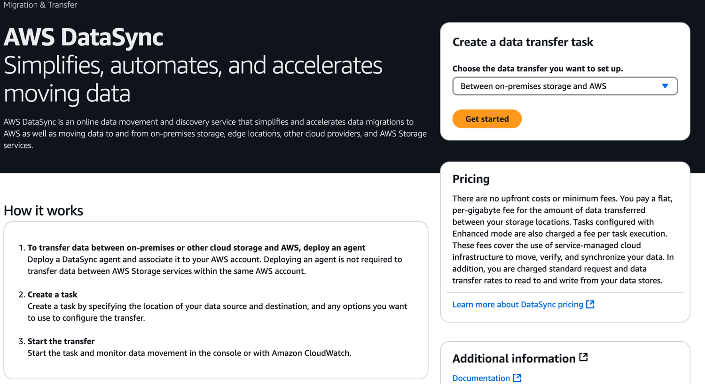
ORIGINAL PPT v4 · SOURCE SLIDE 366 · MODERNISED TECHNICAL DEEP DIVE
AWS DataSync
1
Mechanism: block, file, object and
Mechanism: block, file, object and database services expose different attachment, consistency, scaling…
2
Failure mode
Failure mode: throughput limits, burst-credit exhaustion, hot partitions, replica lag, connection storms and…
3
Evidence: queue depth…
Evidence: queue depth, IOPS/throughput, latency, storage headroom, replica lag, query statistics, backup age and…
CURRENT OPERATIONS LENS
Match durability, performance, consistency, scaling and recovery characteristics to the workload's measurable service objective. Validate service limits and regional availability against current AWS documentation.
AWS Certified SysOps Administrator Associate Training · TGS-2024051413
© 2026 Tertiary Infotech Academy Pte Ltd
517

Slide 518
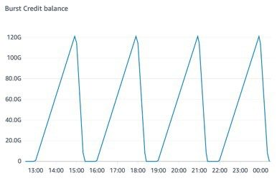
ORIGINAL PPT v4 · SOURCE SLIDE 368 · MODERNISED TECHNICAL DEEP DIVE
EFS - CloudWatch Metrics
1
PercentIOLimit
PercentIOLimit
Mechanism: block, file, object and database services expose different attachment, consistency, scaling…
2
Failure mode
Failure mode: throughput limits, burst-credit exhaustion, hot partitions, replica lag, connection storms and…
3
Evidence: queue depth…
Evidence: queue depth, IOPS/throughput, latency, storage headroom, replica lag, query statistics, backup age and…
CURRENT OPERATIONS LENS
Match durability, performance, consistency, scaling and recovery characteristics to the workload's measurable service objective. Validate service limits and regional availability against current AWS documentation.
AWS Certified SysOps Administrator Associate Training · TGS-2024051413
© 2026 Tertiary Infotech Academy Pte Ltd
518

Slide 519
ORIGINAL PPT v4 · SOURCE SLIDE 370 · MODERNISED TECHNICAL DEEP DIVE
Amazon S3
1
Amazon S3 is one of
2
It’s advertised as ”infinitely…
3
Many websites use Amazon S3
4
Many AWS services use Amazon
Amazon S3 is one of the main building blocks of AWS
We’ll have a step-by-step approach to S3
It’s advertised as ”infinitely scaling” storage
Mechanism: block, file, object and database services expose different attachment, consistency, scaling, replication, backup and failover behaviours.
Many websites use Amazon S3 as a backbone
Failure mode: throughput limits, burst-credit exhaustion, hot partitions, replica lag, connection storms and key-policy gaps often look like…
Many AWS services use Amazon S3 as an integration as well
CURRENT OPERATIONS LENS
Match durability, performance, consistency, scaling and recovery characteristics to the workload's measurable service objective. Validate service limits and regional availability against current AWS documentation.
AWS Certified SysOps Administrator Associate Training · TGS-2024051413
© 2026 Tertiary Infotech Academy Pte Ltd
519

Slide 520

ORIGINAL PPT v4 · SOURCE SLIDE 372 · MODERNISED TECHNICAL DEEP DIVE
Amazon S3 Use cases
1
Backup and storage
Backup and storage
Mechanism: block, file, object and database services expose different attachment, consistency, scaling…
2
Failure mode
Failure mode: throughput limits, burst-credit exhaustion, hot partitions, replica lag, connection storms and…
3
Evidence: queue depth…
Evidence: queue depth, IOPS/throughput, latency, storage headroom, replica lag, query statistics, backup age and…
CURRENT OPERATIONS LENS
Match durability, performance, consistency, scaling and recovery characteristics to the workload's measurable service objective. Validate service limits and regional availability against current AWS documentation.
AWS Certified SysOps Administrator Associate Training · TGS-2024051413
© 2026 Tertiary Infotech Academy Pte Ltd
520

Slide 521
ORIGINAL PPT v4 · SOURCE SLIDE 374 · MODERNISED TECHNICAL DEEP DIVE
Amazon S3 - Objects
1
Object (files) have a Key
2
The key is the FULL
3
s3://my-bucket/my_file.txt
4
s3://my-bucket/my_folder1/another_…
Object (files) have a Key
They key is composed of prefix + object name
The key is the FULL path
There’s no concept of “directories” within buckets (although the UI will trick you to think otherwise)
s3://my-bucket/my_file.txt
Just keys with very long names that contain slashes (“/”)
s3://my-bucket/my_folder1/another_folder/my_file.txt
S3 Bucket with Objects
Mechanism: block, file, object and database services expose different attachment, consistency, scaling, replication, backup and failover behaviours.
CURRENT OPERATIONS LENS
Match durability, performance, consistency, scaling and recovery characteristics to the workload's measurable service objective. Validate service limits and regional availability against current AWS documentation.
AWS Certified SysOps Administrator Associate Training · TGS-2024051413
© 2026 Tertiary Infotech Academy Pte Ltd
521

Slide 522
ORIGINAL PPT v4 · SOURCE SLIDE 375 · MODERNISED TECHNICAL DEEP DIVE
Amazon S3 - Objects (cont.)
1
Object values are the content
2
Max. Object Size is 5TB
3
If uploading more than 5GB,
4
Metadata (list of text key
Object values are the content of the body
Tags (Unicode key / value pair – up to 10) – useful for security / lifecycle
Max. Object Size is 5TB (5000GB)
Version ID (if versioning is enabled)
If uploading more than 5GB, must use “multi-part upload”
Mechanism: block, file, object and database services expose different attachment, consistency, scaling, replication, backup and failover behaviours.
Metadata (list of text key / value pairs – system or user metadata)
CURRENT OPERATIONS LENS
Match durability, performance, consistency, scaling and recovery characteristics to the workload's measurable service objective. Validate service limits and regional availability against current AWS documentation.
AWS Certified SysOps Administrator Associate Training · TGS-2024051413
© 2026 Tertiary Infotech Academy Pte Ltd
522

Slide 523
ORIGINAL PPT v4 · SOURCE SLIDE 376 · MODERNISED TECHNICAL DEEP DIVE
Amazon S3 - Security
1
User-Based
2
IAM Policies
3
Resource-Based
4
Bucket policies
User-Based
Object Access Control List (ACL) - finer grain (can be disabled)
AND there’s no explicit DENY
IAM Policies - which API calls should be allowed for a specific user from IAM
Bucket Access Control List (ACL) - less common (can be disabled)
Encryption: encrypt objects in Amazon S3 using encryption keys
Resource-Based
Note: an IAM principal can access an S3 object if
Bucket policies - bucket wide rules from the S3 console - allows cross account
The user IAM permissions ALLOW it OR the resource policy ALLOWS it
CURRENT OPERATIONS LENS
Match durability, performance, consistency, scaling and recovery characteristics to the workload's measurable service objective. Validate service limits and regional availability against current AWS documentation.
AWS Certified SysOps Administrator Associate Training · TGS-2024051413
© 2026 Tertiary Infotech Academy Pte Ltd
523

Slide 524
ORIGINAL PPT v4 · SOURCE SLIDE 378 · MODERNISED TECHNICAL DEEP DIVE
S3 Bucket Policies
1
JSON based policies
2
Resources: buckets and objects
3
Effect: Allow / Deny
4
Actions: Set of API to
JSON based policies
Principal: The account or user to apply the policy to
Grant access to another account (Cross Account)
Resources: buckets and objects
Use S3 bucket for policy to
Effect: Allow / Deny
Grant public access to the bucket
Actions: Set of API to Allow or Deny
Force objects to be encrypted at upload
CURRENT OPERATIONS LENS
Match durability, performance, consistency, scaling and recovery characteristics to the workload's measurable service objective. Validate service limits and regional availability against current AWS documentation.
AWS Certified SysOps Administrator Associate Training · TGS-2024051413
© 2026 Tertiary Infotech Academy Pte Ltd
524

Slide 525
ORIGINAL PPT v4 · SOURCE SLIDE 379 · MODERNISED TECHNICAL DEEP DIVE
Example: Public Access - Use Bucket Policy
1
Anonymous www website visitor
2
S3 Bucket Policy Allows Public
3
Evidence: queue depth…
4
Decision point
Anonymous www website visitor
Mechanism: block, file, object and database services expose different attachment, consistency, scaling, replication, backup and failover behaviours.
S3 Bucket Policy Allows Public Access
Failure mode: throughput limits, burst-credit exhaustion, hot partitions, replica lag, connection storms and key-policy gaps often look like…
Evidence: queue depth, IOPS/throughput, latency, storage headroom, replica lag, query statistics, backup age and restore validation isolate the…
Decision point: choose the data service and recovery method from access pattern, durability, consistency, RTO/RPO and operational ownership—not only…
CURRENT OPERATIONS LENS
Match durability, performance, consistency, scaling and recovery characteristics to the workload's measurable service objective. Validate service limits and regional availability against current AWS documentation.
AWS Certified SysOps Administrator Associate Training · TGS-2024051413
© 2026 Tertiary Infotech Academy Pte Ltd
525

Slide 526
ORIGINAL PPT v4 · SOURCE SLIDE 380 · MODERNISED TECHNICAL DEEP DIVE
Example: User Access to S3 - IAM permissions
1
IAM Policy
2
Failure mode
3
Evidence: queue depth…
4
Decision point
IAM Policy
Mechanism: block, file, object and database services expose different attachment, consistency, scaling, replication, backup and failover behaviours.
Failure mode: throughput limits, burst-credit exhaustion, hot partitions, replica lag, connection storms and key-policy gaps often look like…
Evidence: queue depth, IOPS/throughput, latency, storage headroom, replica lag, query statistics, backup age and restore validation isolate the…
Decision point: choose the data service and recovery method from access pattern, durability, consistency, RTO/RPO and operational ownership—not only…
CURRENT OPERATIONS LENS
Match durability, performance, consistency, scaling and recovery characteristics to the workload's measurable service objective. Validate service limits and regional availability against current AWS documentation.
AWS Certified SysOps Administrator Associate Training · TGS-2024051413
© 2026 Tertiary Infotech Academy Pte Ltd
526

Slide 527
ORIGINAL PPT v4 · SOURCE SLIDE 382 · MODERNISED TECHNICAL DEEP DIVE
Advanced: Cross-Account Access - Use Bucket Policy
1
Other AWS account
2
S3 Bucket Policy Allows…
3
Evidence: queue depth…
4
Decision point
Other AWS account
Mechanism: block, file, object and database services expose different attachment, consistency, scaling, replication, backup and failover behaviours.
S3 Bucket Policy Allows Cross-Account
Failure mode: throughput limits, burst-credit exhaustion, hot partitions, replica lag, connection storms and key-policy gaps often look like…
Evidence: queue depth, IOPS/throughput, latency, storage headroom, replica lag, query statistics, backup age and restore validation isolate the…
Decision point: choose the data service and recovery method from access pattern, durability, consistency, RTO/RPO and operational ownership—not only…
CURRENT OPERATIONS LENS
Match durability, performance, consistency, scaling and recovery characteristics to the workload's measurable service objective. Validate service limits and regional availability against current AWS documentation.
AWS Certified SysOps Administrator Associate Training · TGS-2024051413
© 2026 Tertiary Infotech Academy Pte Ltd
527

Slide 528
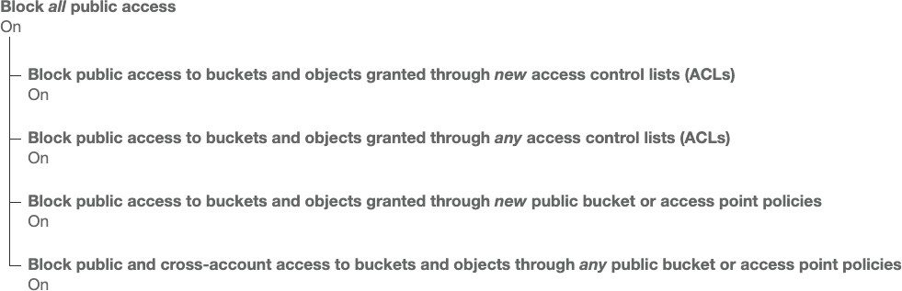
ORIGINAL PPT v4 · SOURCE SLIDE 383 · MODERNISED TECHNICAL DEEP DIVE
Bucket settings for Block Public Access
1
These settings were created to
These settings were created to prevent company data leaks
Mechanism: block, file, object and database services expose different attachment, consistency, scaling…
2
Failure mode
Failure mode: throughput limits, burst-credit exhaustion, hot partitions, replica lag, connection storms and…
3
Evidence: queue depth…
Evidence: queue depth, IOPS/throughput, latency, storage headroom, replica lag, query statistics, backup age and…
CURRENT OPERATIONS LENS
Match durability, performance, consistency, scaling and recovery characteristics to the workload's measurable service objective. Validate service limits and regional availability against current AWS documentation.
AWS Certified SysOps Administrator Associate Training · TGS-2024051413
© 2026 Tertiary Infotech Academy Pte Ltd
528

Slide 529
ORIGINAL PPT v4 · SOURCE SLIDE 384 · MODERNISED TECHNICAL DEEP DIVE
S3 Bucket Policies
1
Use S3 bucket for policy
2
Grant public access to the
3
Force objects to be encrypted
4
Grant access to another account
Use S3 bucket for policy to
Optional Conditions on
Examples here: bucket-policies.html
Grant public access to the bucket
Public IP or Elastic IP (not on Private IP)
Force objects to be encrypted at upload
Source VPC or Source VPC Endpoint – only works with VPC Endpoints
Grant access to another account (Cross account)
CloudFront Origin Identity
CURRENT OPERATIONS LENS
Match durability, performance, consistency, scaling and recovery characteristics to the workload's measurable service objective. Validate service limits and regional availability against current AWS documentation.
AWS Certified SysOps Administrator Associate Training · TGS-2024051413
© 2026 Tertiary Infotech Academy Pte Ltd
529

Slide 530
ORIGINAL PPT v4 · SOURCE SLIDE 385 · MODERNISED TECHNICAL DEEP DIVE
Bucket Policies Examples
1
"Version": "2012-10-17",
2
"Id": "Policy1734311494060",
3
"Statement": [
4
"Sid": "Stmt1734311424063",
"Version": "2012-10-17",
"Effect": "Allow",
Mechanism: block, file, object and database services expose different attachment, consistency, scaling, replication, backup and failover behaviours.
"Id": "Policy1734311494060",
"Principal": "*",
Failure mode: throughput limits, burst-credit exhaustion, hot partitions, replica lag, connection storms and key-policy gaps often look like…
"Statement": [
"Action": "s3:GetObject",
Evidence: queue depth, IOPS/throughput, latency, storage headroom, replica lag, query statistics, backup age and restore validation isolate the…
"Sid": "Stmt1734311424063",
"Resource": "arn:aws:s3:::alfred-ang-s3-buckets/*"
Decision point: choose the data service and recovery method from access pattern, durability, consistency, RTO/RPO and operational ownership—not only…
CURRENT OPERATIONS LENS
Match durability, performance, consistency, scaling and recovery characteristics to the workload's measurable service objective. Validate service limits and regional availability against current AWS documentation.
AWS Certified SysOps Administrator Associate Training · TGS-2024051413
© 2026 Tertiary Infotech Academy Pte Ltd
530

Slide 531
ORIGINAL PPT v4 · SOURCE SLIDE 387 · MODERNISED TECHNICAL DEEP DIVE
Amazon S3 - Static Website Hosting
1
S3 can host static websites
2
If you get a 403
3
(demo-bucket)
4
The website URL will be
S3 can host static websites and have them accessible on the Internet
If you get a 403 Forbidden error, make sure the bucket policy allows public reads!
(demo-bucket)
Mechanism: block, file, object and database services expose different attachment, consistency, scaling, replication, backup and failover behaviours.
The website URL will be (depending on the region)
Failure mode: throughput limits, burst-credit exhaustion, hot partitions, replica lag, connection storms and key-policy gaps often look like…
CURRENT OPERATIONS LENS
Match durability, performance, consistency, scaling and recovery characteristics to the workload's measurable service objective. Validate service limits and regional availability against current AWS documentation.
AWS Certified SysOps Administrator Associate Training · TGS-2024051413
© 2026 Tertiary Infotech Academy Pte Ltd
531

Slide 532
ORIGINAL PPT v4 · SOURCE SLIDE 389 · MODERNISED TECHNICAL DEEP DIVE
Amazon S3 - Versioning
1
You can version your files
2
It is enabled at the
3
Same key overwrite will change…
4
It is best practice to
You can version your files in Amazon S3
Protect against unintended deletes (ability to restore a version)
(my-bucket)
It is enabled at the bucket level
Easy roll back to previous version
s3://my-bucket/my-file.docx
Same key overwrite will change the “version”: 1, 2, 3….
Any file that is not versioned prior to enabling versioning will have version “null”
It is best practice to version your buckets
Suspending versioning does not delete the previous versions
CURRENT OPERATIONS LENS
Match durability, performance, consistency, scaling and recovery characteristics to the workload's measurable service objective. Validate service limits and regional availability against current AWS documentation.
AWS Certified SysOps Administrator Associate Training · TGS-2024051413
© 2026 Tertiary Infotech Academy Pte Ltd
532

Slide 533
ORIGINAL PPT v4 · SOURCE SLIDE 391 · MODERNISED TECHNICAL DEEP DIVE
Amazon S3 - Replication (CRR & SRR)
1
Must enable Versioning in source
2
Cross-Region Replication (CRR)
3
Same-Region Replication (SRR)
4
Buckets can be in different
Must enable Versioning in source and destination buckets
Copying is asynchronous
asynchronous replication
Cross-Region Replication (CRR)
Must give proper IAM permissions to S3
Same-Region Replication (SRR)
CRR - compliance, lower latency access, replication across accounts
Buckets can be in different AWS accounts
SRR - log aggregation, live replication between production and test accounts
CURRENT OPERATIONS LENS
Match durability, performance, consistency, scaling and recovery characteristics to the workload's measurable service objective. Validate service limits and regional availability against current AWS documentation.
AWS Certified SysOps Administrator Associate Training · TGS-2024051413
© 2026 Tertiary Infotech Academy Pte Ltd
533

Slide 534
ORIGINAL PPT v4 · SOURCE SLIDE 392 · MODERNISED TECHNICAL DEEP DIVE
Amazon S3 - Replication (Notes)
1
After you enable Replication, only
2
Optionally, you can replicate…
3
Replicates existing objects and…
4
For DELETE operations
After you enable Replication, only new objects are replicated
Can replicate delete markers from source to target (optional setting)
Then objects created in bucket 1 are not replicated to bucket 3
Optionally, you can replicate existing objects using S3 Batch Replication
Deletions with a version ID are not replicated (to avoid malicious deletes)
Replicates existing objects and objects that failed replication
There is no "chaining" of replication
For DELETE operations
If bucket 1 has replication into bucket 2, which has replication into bucket 3
CURRENT OPERATIONS LENS
Match durability, performance, consistency, scaling and recovery characteristics to the workload's measurable service objective. Validate service limits and regional availability against current AWS documentation.
AWS Certified SysOps Administrator Associate Training · TGS-2024051413
© 2026 Tertiary Infotech Academy Pte Ltd
534

Slide 535
ORIGINAL PPT v4 · SOURCE SLIDE 394 · MODERNISED TECHNICAL DEEP DIVE
S3 Storage Classes
1
Amazon S3 Standard
2
Amazon S3 Standard-Infrequent…
3
Amazon S3 One Zone-Infrequent…
4
Amazon S3 Glacier Instant…
Amazon S3 Standard - General Purpose
Amazon S3 Glacier Flexible Retrieval
Amazon S3 Standard-Infrequent Access (IA)
Amazon S3 Glacier Deep Archive
Amazon S3 One Zone-Infrequent Access
Amazon S3 Intelligent Tiering
Mechanism: block, file, object and database services expose different attachment, consistency, scaling, replication, backup and failover behaviours.
Amazon S3 Glacier Instant Retrieval
Can move between classes manually or using S3 Lifecycle configurations
CURRENT OPERATIONS LENS
Match durability, performance, consistency, scaling and recovery characteristics to the workload's measurable service objective. Validate service limits and regional availability against current AWS documentation.
AWS Certified SysOps Administrator Associate Training · TGS-2024051413
© 2026 Tertiary Infotech Academy Pte Ltd
535

Slide 536
ORIGINAL PPT v4 · SOURCE SLIDE 395 · MODERNISED TECHNICAL DEEP DIVE
S3 Durability and Availability
1
Durability
2
High durability (99.999999999%…
3
If you store 10,000,000 objects
4
Same for all storage classes
Durability
Availability
Mechanism: block, file, object and database services expose different attachment, consistency, scaling, replication, backup and failover behaviours.
High durability (99.999999999%, 11 9’s) of objects across multiple AZ
Measures how readily available a service is
If you store 10,000,000 objects with Amazon S3, you can on average expect to incur a loss of a single object once every 10,000 years
Varies depending on storage class
Same for all storage classes
Example: S3 standard has 99.99% availability = not available 53 minutes a year
CURRENT OPERATIONS LENS
Match durability, performance, consistency, scaling and recovery characteristics to the workload's measurable service objective. Validate service limits and regional availability against current AWS documentation.
AWS Certified SysOps Administrator Associate Training · TGS-2024051413
© 2026 Tertiary Infotech Academy Pte Ltd
536

Slide 537
ORIGINAL PPT v4 · SOURCE SLIDE 396 · MODERNISED TECHNICAL DEEP DIVE
S3 Standard - General Purpose
1
99.99% Availability
2
Used for frequently accessed data
3
Low latency and high throughput
4
Sustain 2 concurrent facility…
99.99% Availability
Use Cases: Big Data analytics, mobile & gaming applications, content distribution…
Used for frequently accessed data
Mechanism: block, file, object and database services expose different attachment, consistency, scaling, replication, backup and failover behaviours.
Low latency and high throughput
Failure mode: throughput limits, burst-credit exhaustion, hot partitions, replica lag, connection storms and key-policy gaps often look like…
Sustain 2 concurrent facility failures
Evidence: queue depth, IOPS/throughput, latency, storage headroom, replica lag, query statistics, backup age and restore validation isolate the…
CURRENT OPERATIONS LENS
Match durability, performance, consistency, scaling and recovery characteristics to the workload's measurable service objective. Validate service limits and regional availability against current AWS documentation.
AWS Certified SysOps Administrator Associate Training · TGS-2024051413
© 2026 Tertiary Infotech Academy Pte Ltd
537

Slide 538
ORIGINAL PPT v4 · SOURCE SLIDE 397 · MODERNISED TECHNICAL DEEP DIVE
S3 Storage Classes - Infrequent Access
1
For data that is less
2
Lower cost than S3 Standard
3
Amazon S3 Standard-Infrequent…
4
99.9% Availability
For data that is less frequently accessed, but requires rapid access when needed
Use cases: Disaster Recovery, backups
Use Cases: Storing secondary backup copies of on-premises data, or data you can recreate
Lower cost than S3 Standard
Amazon S3 One Zone-Infrequent Access (S3 Standard-IA)
Amazon S3 Standard-Infrequent Access (S3 Standard-IA)
High durability (99.999999999%) in a single AZ; data lost when AZ is destroyed
99.9% Availability
99.5% Availability
Mechanism: block, file, object and database services expose different attachment, consistency, scaling, replication, backup and failover behaviours.
CURRENT OPERATIONS LENS
Match durability, performance, consistency, scaling and recovery characteristics to the workload's measurable service objective. Validate service limits and regional availability against current AWS documentation.
AWS Certified SysOps Administrator Associate Training · TGS-2024051413
© 2026 Tertiary Infotech Academy Pte Ltd
538

Slide 539
ORIGINAL PPT v4 · SOURCE SLIDE 398 · MODERNISED TECHNICAL DEEP DIVE
Amazon S3 Glacier Storage Classes
1
Low-cost object storage meant for
2
Pricing: price for storage +
3
Amazon S3 Glacier Instant…
4
Millisecond retrieval, great for…
Low-cost object storage meant for archiving / backup
Minimum storage duration of 90 days
Standard (12 hours), Bulk (48 hours)
Pricing: price for storage + object retrieval cost
Amazon S3 Glacier Flexible Retrieval (formerly Amazon S3 Glacier)
Minimum storage duration of 180 days
Amazon S3 Glacier Instant Retrieval
Expedited (1 to 5 minutes), Standard (3 to 5 hours), Bulk (5 to 12 hours) – free
Millisecond retrieval, great for data accessed once a quarter
Amazon S3 Glacier Deep Archive - for long term storage
CURRENT OPERATIONS LENS
Match durability, performance, consistency, scaling and recovery characteristics to the workload's measurable service objective. Validate service limits and regional availability against current AWS documentation.
AWS Certified SysOps Administrator Associate Training · TGS-2024051413
© 2026 Tertiary Infotech Academy Pte Ltd
539

Slide 540
ORIGINAL PPT v4 · SOURCE SLIDE 399 · MODERNISED TECHNICAL DEEP DIVE
S3 Intelligent-Tiering
1
Small monthly monitoring and…
2
Moves objects automatically…
3
There are no retrieval charges
4
Frequent Access tier (automatic)
Small monthly monitoring and auto-tiering fee
Infrequent Access tier (automatic): objects not accessed for 30 days
Moves objects automatically between Access Tiers based on usage
Archive Instant Access tier (automatic): objects not accessed for 90 days
There are no retrieval charges in S3 Intelligent-Tiering
Archive Access tier (optional): configurable from 90 days to 700+ days
Frequent Access tier (automatic): default tier
Deep Archive Access tier (optional): config. from 180 days to 700+ days
CURRENT OPERATIONS LENS
Match durability, performance, consistency, scaling and recovery characteristics to the workload's measurable service objective. Validate service limits and regional availability against current AWS documentation.
AWS Certified SysOps Administrator Associate Training · TGS-2024051413
© 2026 Tertiary Infotech Academy Pte Ltd
540

Slide 541
ORIGINAL PPT v4 · SOURCE SLIDE 404 · MODERNISED TECHNICAL DEEP DIVE
Amazon S3 - Moving between Storage Classes
1
You can transition objects between
2
For infrequently accessed object…
3
For archive objects that you
4
Moving objects can be automated
You can transition objects between storage classes
Standard IA
Glacier Flexible Retrieval
For infrequently accessed object, move them to Stanard IA
Intelligent Tiering
Glacier Deep Archive
For archive objects that you don’t need fast access to, move them to Glacier or Glacier Deep Archive
One-Zone IA
Moving objects can be automated using a Lifecycle Rules
Glacier Instant Retrieval
CURRENT OPERATIONS LENS
Match durability, performance, consistency, scaling and recovery characteristics to the workload's measurable service objective. Validate service limits and regional availability against current AWS documentation.
AWS Certified SysOps Administrator Associate Training · TGS-2024051413
© 2026 Tertiary Infotech Academy Pte Ltd
541

Slide 542
ORIGINAL PPT v4 · SOURCE SLIDE 405 · MODERNISED TECHNICAL DEEP DIVE
Amazon S3 - Lifecycle Rules
1
Transition Actions
2
Move objects to Standard IA
3
Move to Glacier for archiving
4
Expiration Actions
Transition Actions - configure objects to transition to another storage class
Access log files can be set to delete after a 365 days
Rules can be created for certain objects Tags (example: Department: Finance)
Move objects to Standard IA class 60 days after creation
Can be used to delete old versions of files (if versioning is enabled)
Move to Glacier for archiving after 6 months
Can be used to delete incomplete Multi-Part uploads
Expiration Actions - configure objects to expire (delete) after some time
Rules can be created for a certain prefix (example: s3://mybucket/mp3/*)
CURRENT OPERATIONS LENS
Match durability, performance, consistency, scaling and recovery characteristics to the workload's measurable service objective. Validate service limits and regional availability against current AWS documentation.
AWS Certified SysOps Administrator Associate Training · TGS-2024051413
© 2026 Tertiary Infotech Academy Pte Ltd
542

Slide 543
ORIGINAL PPT v4 · SOURCE SLIDE 406 · MODERNISED TECHNICAL DEEP DIVE
Amazon S3 - Lifecycle Rules (Scenario 1)
1
Your application on EC2 creates
2
photos are uploaded to Amazon
3
S3 source images can be
4
S3 thumbnails can be on
Your application on EC2 creates images thumbnails after profile
Mechanism: block, file, object and database services expose different attachment, consistency, scaling, replication, backup and failover behaviours.
photos are uploaded to Amazon S3. These thumbnails can be easily recreated, and only need to be kept for 60 days. The source images should be able to…
S3 source images can be on Standard with a lifecycle configuration to trainsition them to Glacier after 60 days
S3 thumbnails can be on One-Zone IA with a lifecycle configuration to expire them (delete them) after 60 days
CURRENT OPERATIONS LENS
Match durability, performance, consistency, scaling and recovery characteristics to the workload's measurable service objective. Validate service limits and regional availability against current AWS documentation.
AWS Certified SysOps Administrator Associate Training · TGS-2024051413
© 2026 Tertiary Infotech Academy Pte Ltd
543

Slide 544
ORIGINAL PPT v4 · SOURCE SLIDE 407 · MODERNISED TECHNICAL DEEP DIVE
Amazon S3 - Lifecycle Rules (Scenario 2)
1
A rule in your company
2
be recoverable within 48 hours.
3
Enable S3 Versioning in order
4
Transition the “noncurrent…
A rule in your company states that you should be able to recover your deleted S3 objects immediately for 30 days, although this may happen rarely…
Transition afterwards the “noncurrent versions” to Glacier Deep Archive
be recoverable within 48 hours.
Mechanism: block, file, object and database services expose different attachment, consistency, scaling, replication, backup and failover behaviours.
Enable S3 Versioning in order to have object versions, so that “deleted objects” are in fact hidden by a “delete marker” and can be recovered
Transition the “noncurrent versions” of the object to Standard IA
CURRENT OPERATIONS LENS
Match durability, performance, consistency, scaling and recovery characteristics to the workload's measurable service objective. Validate service limits and regional availability against current AWS documentation.
AWS Certified SysOps Administrator Associate Training · TGS-2024051413
© 2026 Tertiary Infotech Academy Pte Ltd
544

Slide 545
ORIGINAL PPT v4 · SOURCE SLIDE 408 · MODERNISED TECHNICAL DEEP DIVE
Amazon S3 Analytics - Storage Class Analysis
1
Help you decide when to
2
Recommendations for Standard and…
3
Does NOT work for One-Zone
4
Report is updated daily
Help you decide when to transition objects to the right storage class
24 to 48 hours to start seeing data analysis
Recommendations for Standard and Stanard IA
Good first step to put together Lifecycle Rules (or improve them)!
Does NOT work for One-Zone IA or Glacier
S3 Analytics
Report is updated daily
.csv report
Mechanism: block, file, object and database services expose different attachment, consistency, scaling, replication, backup and failover behaviours.
CURRENT OPERATIONS LENS
Match durability, performance, consistency, scaling and recovery characteristics to the workload's measurable service objective. Validate service limits and regional availability against current AWS documentation.
AWS Certified SysOps Administrator Associate Training · TGS-2024051413
© 2026 Tertiary Infotech Academy Pte Ltd
545

Slide 546
ORIGINAL PPT v4 · SOURCE SLIDE 409 · MODERNISED TECHNICAL DEEP DIVE
S3 Event Notifications
1
Lambda Function
2
S3:ObjectCreated, S3:ObjectRemoved…
3
Object name filtering possible…
4
Use case
Lambda Function
Can create as many "S3 events" as desired
S3:ObjectCreated, S3:ObjectRemoved, S3:ObjectRestore, S3:Replication…
S3 event notifications typically deliver events in seconds but can sometimes take a minute or longer
Object name filtering possible (*.jpg)
Mechanism: block, file, object and database services expose different attachment, consistency, scaling, replication, backup and failover behaviours.
Use case: generate thumbnails of images uploaded to S3
Failure mode: throughput limits, burst-credit exhaustion, hot partitions, replica lag, connection storms and key-policy gaps often look like…
CURRENT OPERATIONS LENS
Match durability, performance, consistency, scaling and recovery characteristics to the workload's measurable service objective. Validate service limits and regional availability against current AWS documentation.
AWS Certified SysOps Administrator Associate Training · TGS-2024051413
© 2026 Tertiary Infotech Academy Pte Ltd
546

Slide 547
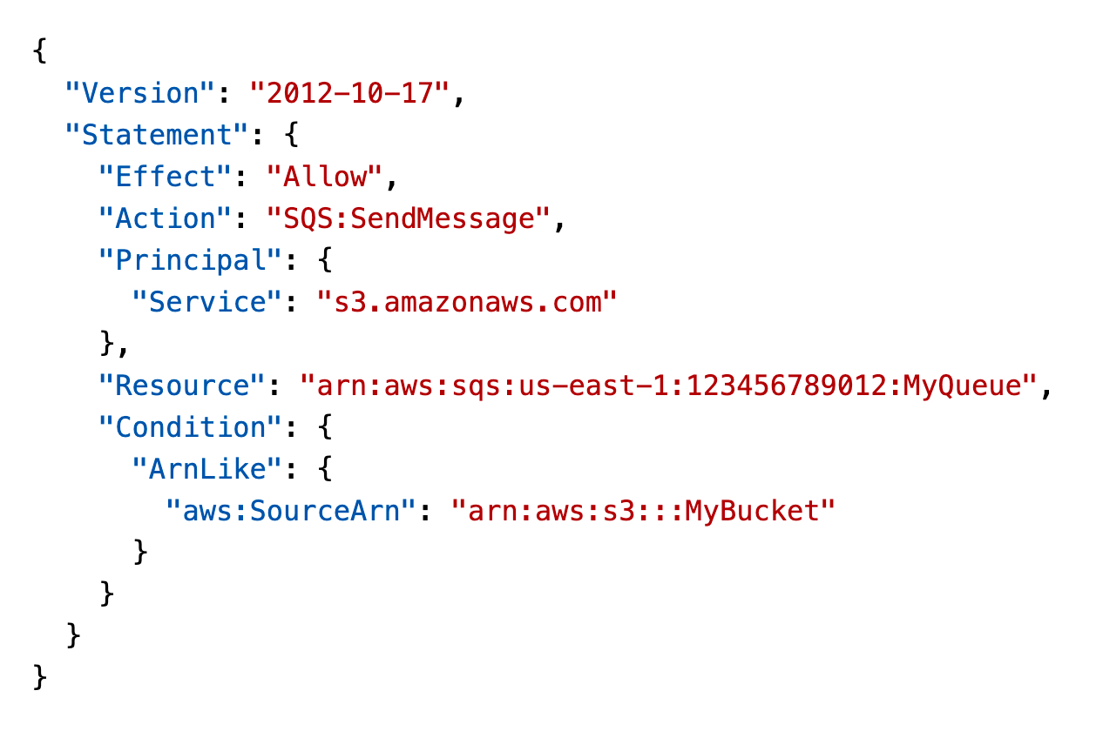
ORIGINAL PPT v4 · SOURCE SLIDE 410 · MODERNISED TECHNICAL DEEP DIVE
S3 Event Notifications - IAM Permissions
1
Lambda Resource Policy
Lambda Resource Policy
Mechanism: block, file, object and database services expose different attachment, consistency, scaling…
2
Failure mode
Failure mode: throughput limits, burst-credit exhaustion, hot partitions, replica lag, connection storms and…
3
Evidence: queue depth…
Evidence: queue depth, IOPS/throughput, latency, storage headroom, replica lag, query statistics, backup age and…
CURRENT OPERATIONS LENS
Match durability, performance, consistency, scaling and recovery characteristics to the workload's measurable service objective. Validate service limits and regional availability against current AWS documentation.
AWS Certified SysOps Administrator Associate Training · TGS-2024051413
© 2026 Tertiary Infotech Academy Pte Ltd
547

Slide 548
ORIGINAL PPT v4 · SOURCE SLIDE 411 · MODERNISED TECHNICAL DEEP DIVE
S3 Event Notifications with Amazon EventBridge
1
Amazon S3 bucket
2
All events
3
Amazon EventBridge
4
AWS services
Amazon S3 bucket
as destinations
Mechanism: block, file, object and database services expose different attachment, consistency, scaling, replication, backup and failover behaviours.
All events
Advanced filtering options with JSON rules (metadata, object size, name...)
Amazon EventBridge
Multiple Destinations - ex Step Functions, Kinesis Streams / Firehose…
AWS services
EventBridge Capabilties - Archive, Replay Events, Reliable delivery
CURRENT OPERATIONS LENS
Match durability, performance, consistency, scaling and recovery characteristics to the workload's measurable service objective. Validate service limits and regional availability against current AWS documentation.
AWS Certified SysOps Administrator Associate Training · TGS-2024051413
© 2026 Tertiary Infotech Academy Pte Ltd
548

Slide 549
ORIGINAL PPT v4 · SOURCE SLIDE 413 · MODERNISED TECHNICAL DEEP DIVE
S3 - Baseline Performance
1
Amazon S3 automatically scales to
2
Your application can achieve at
3
There are no limits to
4
Example (object path => prefix)
Amazon S3 automatically scales to high request rates, latency 100-200 ms
bucket/folder1/sub1/file => /folder1/sub1/
If you spread reads across all four prefixes evenly, you can achieve 22,000 requests per second for GET and HEAD
Your application can achieve at least 3,500 PUT/COPY/POST/DELETE or 5,500 GET/HEAD requests per second per prefix in a bucket.
bucket/folder1/sub2/file => /folder1/sub2/
There are no limits to the number of prefixes in a bucket.
bucket/1/file => /1/
Example (object path => prefix)
bucket/2/file => /2/
Mechanism: block, file, object and database services expose different attachment, consistency, scaling, replication, backup and failover behaviours.
CURRENT OPERATIONS LENS
Match durability, performance, consistency, scaling and recovery characteristics to the workload's measurable service objective. Validate service limits and regional availability against current AWS documentation.
AWS Certified SysOps Administrator Associate Training · TGS-2024051413
© 2026 Tertiary Infotech Academy Pte Ltd
549

Slide 550
ORIGINAL PPT v4 · SOURCE SLIDE 414 · MODERNISED TECHNICAL DEEP DIVE
S3 Performance
1
Multi-Part upload
2
recommended for files > 100MB,
3
Can help parallelize uploads…
4
S3 Transfer Acceleration
Multi-Part upload
Increase transfer speed by transferring file to an AWS edge location which will forward the data to the S3 bucket in the target region
Edge Location
recommended for files > 100MB, must use for files > 5GB
Compatible with multi-part upload
(public www)
Can help parallelize uploads (speed up transfers)
Parallel uploads
(private AWS)
S3 Transfer Acceleration
Divide In parts
File in USA
Mechanism: block, file, object and database services expose different attachment, consistency, scaling, replication, backup and failover behaviours.
CURRENT OPERATIONS LENS
Match durability, performance, consistency, scaling and recovery characteristics to the workload's measurable service objective. Validate service limits and regional availability against current AWS documentation.
AWS Certified SysOps Administrator Associate Training · TGS-2024051413
© 2026 Tertiary Infotech Academy Pte Ltd
550

Slide 551
ORIGINAL PPT v4 · SOURCE SLIDE 415 · MODERNISED TECHNICAL DEEP DIVE
S3 Performance - S3 Byte-Range Fetches
1
Can be used to speed
2
Parallelize GETs by requesting…
3
Better resilience in case of
4
Can be used to retrieve
Can be used to speed up downloads
File in S3
Parallelize GETs by requesting specific byte ranges
Byte-range request for header (first XX bytes)
Better resilience in case of failures
data (for example the head of a file)
Can be used to retrieve only partial
Requests in parallel
CURRENT OPERATIONS LENS
Match durability, performance, consistency, scaling and recovery characteristics to the workload's measurable service objective. Validate service limits and regional availability against current AWS documentation.
AWS Certified SysOps Administrator Associate Training · TGS-2024051413
© 2026 Tertiary Infotech Academy Pte Ltd
551

Slide 552
ORIGINAL PPT v4 · SOURCE SLIDE 416 · MODERNISED TECHNICAL DEEP DIVE
S3 Batch Operations
1
Perform bulk operations on…
2
Modify object metadata &…
3
Copy objects between S3 buckets
4
Encrypt un-encrypted objects
Perform bulk operations on existing S3 objects with a single request, example
Modify ACLs, tags
S3 Batch Operations manages retries, tracks progress, sends completion notifications, generate reports …
Modify object metadata & properties
Restore objects from S3 Glacier
You can use S3 Inventory to get object list to use
Copy objects between S3 buckets
Invoke Lambda function to perform custom action on each object
S3 Select to filter your objects
Encrypt un-encrypted objects
A job consists of a list of objects, the action to perform, and optional parameters
S3 Inventory
CURRENT OPERATIONS LENS
Match durability, performance, consistency, scaling and recovery characteristics to the workload's measurable service objective. Validate service limits and regional availability against current AWS documentation.
AWS Certified SysOps Administrator Associate Training · TGS-2024051413
© 2026 Tertiary Infotech Academy Pte Ltd
552

Slide 553
ORIGINAL PPT v4 · SOURCE SLIDE 417 · MODERNISED TECHNICAL DEEP DIVE
S3 Inventory
1
List objects and their…
2
Usage examples
3
Audit and report on the
4
Get the number of objects
List objects and their corresponding metadata (alternative to S3 List API operation)
Identify the total storage of previous object versions
You can filter generated report using S3 Select
Usage examples
Generate daily or weekly reports
Use cases: Business, Compliance, Regulatory needs, …
Audit and report on the replication and encryption status of your objects
Output files: CSV, ORC, or Apache Parquet
Get the number of objects in an S3 bucket
You can query all the data using Amazon Athena, Redshift, Presto, Hive, Spark…
CURRENT OPERATIONS LENS
Match durability, performance, consistency, scaling and recovery characteristics to the workload's measurable service objective. Validate service limits and regional availability against current AWS documentation.
AWS Certified SysOps Administrator Associate Training · TGS-2024051413
© 2026 Tertiary Infotech Academy Pte Ltd
553

Slide 554
ORIGINAL PPT v4 · SOURCE SLIDE 418 · MODERNISED TECHNICAL DEEP DIVE
Amazon S3 Glacier
1
Low-cost object storage meant for
2
Data is retained for the
3
Alternative to on-premises…
4
Average annual durability is…
Low-cost object storage meant for archiving / backup
Cost per storage per month ($0.004 / GB – Standard | $0.00099 / GB Deep Archive)
Exam tip: archival from S3 after XXX days => use Glacier
Data is retained for the longer term (10s of years)
Each item in Glacier is called "Archive" (up to 40TB)
Alternative to on-premises magnetic tape storage
Archives are stored in "Vaults"
Average annual durability is 99.999999999%
By default, data encrypted at rest using AES-256 – keys managed by AWS
CURRENT OPERATIONS LENS
Match durability, performance, consistency, scaling and recovery characteristics to the workload's measurable service objective. Validate service limits and regional availability against current AWS documentation.
AWS Certified SysOps Administrator Associate Training · TGS-2024051413
© 2026 Tertiary Infotech Academy Pte Ltd
554

Slide 555
ORIGINAL PPT v4 · SOURCE SLIDE 419 · MODERNISED TECHNICAL DEEP DIVE
Amazon S3 Glacier Operations
1
Vault Operations
2
Create & Delete
3
Retrieving Metadata
4
Download Inventory
Vault Operations
Glacier Operations
Delete - use Glacier Rest API or AWS SDKs by specifying archive ID
Create & Delete - delete only when there’s no archives in it
Upload- single operation or by parts (MultiPart upload) for larger archives
Restore links have an expiry date
Retrieving Metadata - creation date, number of archives, total size of all archives, …
Download - first initiate a retrieval job for the archive, Glacier then prepares it for download.
Retrieval Options
Download Inventory - list of archives in the vault (archive ID, creation date, size, …)
User then has a limited time to download the data from staging server. (optionally, specify a range or portion of bytes to retrieve)
Expedited (1 to 5 minutes retrieval) - $0.03 per GB and $10 per 1000 requests
CURRENT OPERATIONS LENS
Match durability, performance, consistency, scaling and recovery characteristics to the workload's measurable service objective. Validate service limits and regional availability against current AWS documentation.
AWS Certified SysOps Administrator Associate Training · TGS-2024051413
© 2026 Tertiary Infotech Academy Pte Ltd
555

Slide 556
ORIGINAL PPT v4 · SOURCE SLIDE 420 · MODERNISED TECHNICAL DEEP DIVE
Amazon S3 Glacier - Vault Policies & Vault Lock
1
Each Vault has
2
ONE vault access policy
3
ONE vault lock policy
4
Vault Policies are written in
Each Vault has
Vault Access Policy is like a bucket policy (restrict user / account permissions)
Example 2: implement WORM policy (write once read many)
ONE vault access policy
Vault Lock Policy is a policy you lock, for regulatory and compliance requirements.
Permissions
ONE vault lock policy
The policy is immutable, it can never be changed (that's why it’s called a LOCK)
Vault Access Policy
Vault Policies are written in JSON
Example 1: forbid deleting an archive if less than 1 year old
Vault Lock Policy
CURRENT OPERATIONS LENS
Match durability, performance, consistency, scaling and recovery characteristics to the workload's measurable service objective. Validate service limits and regional availability against current AWS documentation.
AWS Certified SysOps Administrator Associate Training · TGS-2024051413
© 2026 Tertiary Infotech Academy Pte Ltd
556

Slide 557
ORIGINAL PPT v4 · SOURCE SLIDE 421 · MODERNISED TECHNICAL DEEP DIVE
Glacier - Notifications for Restore Operations
1
Vault Notification Configuration
2
Configure a vault so that
3
Optionally, specify an SNS topic
4
S3 Event Notifications
Vault Notification Configuration
S3 supports the restoration of objects archived to S3 Glacier storage classes
Amazon Glacier
Configure a vault so that when a job completes a message is sent to SNS
s3:ObjectRestore:Post => notify when object restoration initiated
archive ready restore
Optionally, specify an SNS topic when you initiate a job
s3:ObjectRestore:Completed => notify when object restoration completed
send notification
S3 Event Notifications
initiate restore archive job
Mechanism: block, file, object and database services expose different attachment, consistency, scaling, replication, backup and failover behaviours.
CURRENT OPERATIONS LENS
Match durability, performance, consistency, scaling and recovery characteristics to the workload's measurable service objective. Validate service limits and regional availability against current AWS documentation.
AWS Certified SysOps Administrator Associate Training · TGS-2024051413
© 2026 Tertiary Infotech Academy Pte Ltd
557

Slide 558
ORIGINAL PPT v4 · SOURCE SLIDE 423 · MODERNISED TECHNICAL DEEP DIVE
S3 Multi Part Upload - Deep Dive
1
Upload large objects in parts
2
Recommended for files > 100MB,
3
Can help parallelize uploads…
4
Max. parts
Upload large objects in parts (any order)
Failures: restart uploading ONLY failed parts (improves performance)
(max. 10,000)
Recommended for files > 100MB, must use for files > 5GB
Use Lifecycle policy to automate old parts
parallel uploads
Can help parallelize uploads (speed up transfers)
Deletion of unfinished upload after x days (e.g., network outage)
Concatenating parts (COMPLETE request)
Max. parts: 10,000
Upload using AWS CLI or AWS SDK
CURRENT OPERATIONS LENS
Match durability, performance, consistency, scaling and recovery characteristics to the workload's measurable service objective. Validate service limits and regional availability against current AWS documentation.
AWS Certified SysOps Administrator Associate Training · TGS-2024051413
© 2026 Tertiary Infotech Academy Pte Ltd
558

Slide 559
ORIGINAL PPT v4 · SOURCE SLIDE 424 · MODERNISED TECHNICAL DEEP DIVE
Amazon Athena
1
Serverless query service to…
2
Uses standard SQL language to
3
Supports CSV, JSON, ORC, Avro,
4
Pricing: $5.00 per TB of
Serverless query service to analyze data stored in Amazon S3
Commonly used with Amazon Quicksight for reporting/dashboards
Amazon QuickSight
Uses standard SQL language to query the files (built on Presto)
Use cases: Business intelligence / analytics / reporting, analyze & query VPC Flow Logs, ELB Logs, CloudTrail trails, etc...
Reporting & Dashboards
Supports CSV, JSON, ORC, Avro, and Parquet
Exam Tip: analyze data in S3 using serverless SQL, use Athena
Pricing: $5.00 per TB of data scanned
Query & Analyze
CURRENT OPERATIONS LENS
Match durability, performance, consistency, scaling and recovery characteristics to the workload's measurable service objective. Validate service limits and regional availability against current AWS documentation.
AWS Certified SysOps Administrator Associate Training · TGS-2024051413
© 2026 Tertiary Infotech Academy Pte Ltd
559

Slide 560

ORIGINAL PPT v4 · SOURCE SLIDE 425 · MODERNISED TECHNICAL DEEP DIVE
Amazon Anthena
1
Mechanism: block, file, object and
Mechanism: block, file, object and database services expose different attachment, consistency, scaling…
2
Failure mode
Failure mode: throughput limits, burst-credit exhaustion, hot partitions, replica lag, connection storms and…
3
Evidence: queue depth…
Evidence: queue depth, IOPS/throughput, latency, storage headroom, replica lag, query statistics, backup age and…
CURRENT OPERATIONS LENS
Match durability, performance, consistency, scaling and recovery characteristics to the workload's measurable service objective. Validate service limits and regional availability against current AWS documentation.
AWS Certified SysOps Administrator Associate Training · TGS-2024051413
© 2026 Tertiary Infotech Academy Pte Ltd
560

Slide 561
ORIGINAL PPT v4 · SOURCE SLIDE 426 · MODERNISED TECHNICAL DEEP DIVE
Amazon Athena - Performance Improvement
1
Use Columnar data for cost-savings
2
Apache Parquet or ORC is
3
Huge performance improvement
4
Use Glue to convert your
Use Columnar data for cost-savings (less scan)
Compress data for smaller retrievals (bzip2, gzip, lz4, snappy, zlip, zstd…)
Example: s3://athena-examples/flight/parquet/year=1991/month=1/day=1/
Apache Parquet or ORC is recommended
Partition datasets in S3 for easy querying on virtual columns
Use larger files (> 128 MB) to minimize overhead
Huge performance improvement
s3://yourBucket/pathToTable
Mechanism: block, file, object and database services expose different attachment, consistency, scaling, replication, backup and failover behaviours.
Use Glue to convert your data to Parquet or ORC
/<PARTITION_COLUMN_NAME>=<VALUE>
CURRENT OPERATIONS LENS
Match durability, performance, consistency, scaling and recovery characteristics to the workload's measurable service objective. Validate service limits and regional availability against current AWS documentation.
AWS Certified SysOps Administrator Associate Training · TGS-2024051413
© 2026 Tertiary Infotech Academy Pte Ltd
561

Slide 562
ORIGINAL PPT v4 · SOURCE SLIDE 427 · MODERNISED TECHNICAL DEEP DIVE
Amazon Athena - Federated Query
1
Allows you to run SQL
2
Uses Data Source Connectors that
3
Store the results back in
4
Amazon Athena
Allows you to run SQL queries across data stored in relational, non-relational, object, and custom data sources (AWS or on-premises)
Database (On-Premises)
DocumentDB
Uses Data Source Connectors that run on AWS Lambda to run Federated Queries (e.g., CloudWatch Logs, DynamoDB, RDS, …)
(Data Source
HBase in EMR
Store the results back in Amazon S3
Connector)
SQL Server
Amazon Athena
ElastiCache
Mechanism: block, file, object and database services expose different attachment, consistency, scaling, replication, backup and failover behaviours.
CURRENT OPERATIONS LENS
Match durability, performance, consistency, scaling and recovery characteristics to the workload's measurable service objective. Validate service limits and regional availability against current AWS documentation.
AWS Certified SysOps Administrator Associate Training · TGS-2024051413
© 2026 Tertiary Infotech Academy Pte Ltd
562

Slide 563
ORIGINAL PPT v4 · SOURCE SLIDE 430 · MODERNISED TECHNICAL DEEP DIVE
Amazon S3 - Object Encryption
1
You can encrypt objects in
2
Server-Side Encryption (SSE)
3
Server-Side Encryption with…
4
Encrypts S3 objects using keys
You can encrypt objects in S3 buckets using one of 4 methods
Server-Side Encryption with KMS Keys stored in AWS KMS (SSE-KMS)
Cilent-Side Encryption
Server-Side Encryption (SSE)
Leverage AWS Key Management Service (AWS KMS) to manage encryption keys
It’s important to understand which ones are for which situation for the exam
Server-Side Encryption with Amazon S3-Managed Keys (SSE-S3) Enabled by Default
Server-Side Encryption with Customer-Provided Keys (SSE-C)
Encrypts S3 objects using keys handled, managed, and owned by AWS
When you want to manage your own encryption keys
CURRENT OPERATIONS LENS
Match durability, performance, consistency, scaling and recovery characteristics to the workload's measurable service objective. Validate service limits and regional availability against current AWS documentation.
AWS Certified SysOps Administrator Associate Training · TGS-2024051413
© 2026 Tertiary Infotech Academy Pte Ltd
563

Slide 564
ORIGINAL PPT v4 · SOURCE SLIDE 431 · MODERNISED TECHNICAL DEEP DIVE
Amazon S3 Encryption - SSE-S3
1
HTTP(S) + Header
2
Encryption using keys handled…
3
Object is encrypted server-side
4
Encryption type is AES-256
HTTP(S) + Header
Must set header "x-amz-server-side-encryption":"AES256"
Mechanism: block, file, object and database services expose different attachment, consistency, scaling, replication, backup and failover behaviours.
Encryption using keys handled, managed, and owned by AWS
Enabled by default for new buckets & new objects
Object is encrypted server-side
S3 Owned Key
Failure mode: throughput limits, burst-credit exhaustion, hot partitions, replica lag, connection storms and key-policy gaps often look like…
Encryption type is AES-256
Encryption
Evidence: queue depth, IOPS/throughput, latency, storage headroom, replica lag, query statistics, backup age and restore validation isolate the…
CURRENT OPERATIONS LENS
Match durability, performance, consistency, scaling and recovery characteristics to the workload's measurable service objective. Validate service limits and regional availability against current AWS documentation.
AWS Certified SysOps Administrator Associate Training · TGS-2024051413
© 2026 Tertiary Infotech Academy Pte Ltd
564

Slide 565
ORIGINAL PPT v4 · SOURCE SLIDE 432 · MODERNISED TECHNICAL DEEP DIVE
Amazon S3 Encryption - SSE-KMS
1
HTTP(S) + Header
2
Encryption using keys handled and
3
KMS advantages
4
Object is encrypted server side
HTTP(S) + Header
Must set header "x-amz-server-side-encryption":"AWS:KMS"
Mechanism: block, file, object and database services expose different attachment, consistency, scaling, replication, backup and failover behaviours.
Encryption using keys handled and managed by AWS KMS (Key Management Service)
Encryption
KMS advantages: user control + audit key usage using CloudTrail
Object is encrypted server side
Failure mode: throughput limits, burst-credit exhaustion, hot partitions, replica lag, connection storms and key-policy gaps often look like…
CURRENT OPERATIONS LENS
Match durability, performance, consistency, scaling and recovery characteristics to the workload's measurable service objective. Validate service limits and regional availability against current AWS documentation.
AWS Certified SysOps Administrator Associate Training · TGS-2024051413
© 2026 Tertiary Infotech Academy Pte Ltd
565

Slide 566
ORIGINAL PPT v4 · SOURCE SLIDE 433 · MODERNISED TECHNICAL DEEP DIVE
SSE-KMS Limitation
1
If you use SSE-KMS, you
2
When you upload, it calls
3
GenerateDataKey KMS API
4
When you download, it calls
If you use SSE-KMS, you may be impacted by the KMS limits
Count towards the KMS quota per second (5500, 10000, 30000 req/s based on region)
When you upload, it calls the
You can request a quota increase using the Service Quotas Console
GenerateDataKey KMS API
Upload / download SSE-KMS
Mechanism: block, file, object and database services expose different attachment, consistency, scaling, replication, backup and failover behaviours.
When you download, it calls the Decrypt KMS API
Failure mode: throughput limits, burst-credit exhaustion, hot partitions, replica lag, connection storms and key-policy gaps often look like…
CURRENT OPERATIONS LENS
Match durability, performance, consistency, scaling and recovery characteristics to the workload's measurable service objective. Validate service limits and regional availability against current AWS documentation.
AWS Certified SysOps Administrator Associate Training · TGS-2024051413
© 2026 Tertiary Infotech Academy Pte Ltd
566

Slide 567
ORIGINAL PPT v4 · SOURCE SLIDE 434 · MODERNISED TECHNICAL DEEP DIVE
Amazon S3 Encryption - SSE-C
1
Server-Side Encryption using keys…
2
Amazon S3 does NOT store
3
HTTPS must be used
4
Encryption key must provided in
Server-Side Encryption using keys fully managed by the customer outside of AWS
HTTPS ONLY
Amazon S3 does NOT store the encryption key you provide
+ Key in Header
HTTPS must be used
Client-Provided Key
Mechanism: block, file, object and database services expose different attachment, consistency, scaling, replication, backup and failover behaviours.
Encryption key must provided in HTTP headers, for every HTTP request made
Encryption
CURRENT OPERATIONS LENS
Match durability, performance, consistency, scaling and recovery characteristics to the workload's measurable service objective. Validate service limits and regional availability against current AWS documentation.
AWS Certified SysOps Administrator Associate Training · TGS-2024051413
© 2026 Tertiary Infotech Academy Pte Ltd
567

Slide 568
ORIGINAL PPT v4 · SOURCE SLIDE 435 · MODERNISED TECHNICAL DEEP DIVE
Amazon S3 Encryption - Client-Side Encryption
1
Use client libraries such as
2
Clients must encrypt data…
3
Clients must decrypt data…
4
Customer fully manages the keys
Use client libraries such as Amazon S3 Cilent-Side Encryption Library
Client Key
Clients must encrypt data themselves before sending to Amazon S3
(encrypted)
Clients must decrypt data themselves when retrieving from Amazon S3
Encryption
Customer fully manages the keys and encryption cycle
Mechanism: block, file, object and database services expose different attachment, consistency, scaling, replication, backup and failover behaviours.
CURRENT OPERATIONS LENS
Match durability, performance, consistency, scaling and recovery characteristics to the workload's measurable service objective. Validate service limits and regional availability against current AWS documentation.
AWS Certified SysOps Administrator Associate Training · TGS-2024051413
© 2026 Tertiary Infotech Academy Pte Ltd
568

Slide 569
ORIGINAL PPT v4 · SOURCE SLIDE 436 · MODERNISED TECHNICAL DEEP DIVE
Amazon S3 - Encryption in transit (SSL/TLS)
1
Encryption in flight is also
2
Amazon S3 exposes two endpoints
3
HTTP Endpoint
4
HTTPS Endpoint
Encryption in flight is also called SSL/TLS
HTTPS is recommended
Amazon S3 exposes two endpoints
HTTPS is mandatory for SSE-C
HTTP Endpoint - non encrypted
Most clients would use the HTTPS endpoint by default
HTTPS Endpoint - encryption in flight
Mechanism: block, file, object and database services expose different attachment, consistency, scaling, replication, backup and failover behaviours.
CURRENT OPERATIONS LENS
Match durability, performance, consistency, scaling and recovery characteristics to the workload's measurable service objective. Validate service limits and regional availability against current AWS documentation.
AWS Certified SysOps Administrator Associate Training · TGS-2024051413
© 2026 Tertiary Infotech Academy Pte Ltd
569

Slide 570
ORIGINAL PPT v4 · SOURCE SLIDE 437 · MODERNISED TECHNICAL DEEP DIVE
Amazon S3 – Force Encryption in Transit aws:SecureTransport
1
(my-bucket)
2
Bucket Policy
3
Evidence: queue depth…
4
Decision point
(my-bucket)
Mechanism: block, file, object and database services expose different attachment, consistency, scaling, replication, backup and failover behaviours.
Bucket Policy
Failure mode: throughput limits, burst-credit exhaustion, hot partitions, replica lag, connection storms and key-policy gaps often look like…
Evidence: queue depth, IOPS/throughput, latency, storage headroom, replica lag, query statistics, backup age and restore validation isolate the…
Decision point: choose the data service and recovery method from access pattern, durability, consistency, RTO/RPO and operational ownership—not only…
CURRENT OPERATIONS LENS
Match durability, performance, consistency, scaling and recovery characteristics to the workload's measurable service objective. Validate service limits and regional availability against current AWS documentation.
AWS Certified SysOps Administrator Associate Training · TGS-2024051413
© 2026 Tertiary Infotech Academy Pte Ltd
570

Slide 571

ORIGINAL PPT v4 · SOURCE SLIDE 438 · MODERNISED TECHNICAL DEEP DIVE
Amazon S3 - Default Encryption vs. Bucket Policies
1
SSE-S3 encryption is…
SSE-S3 encryption is automatically applied to new objects stored in S3 bucket
2
Mechanism: block, file, object and
Mechanism: block, file, object and database services expose different attachment, consistency, scaling…
3
Failure mode
Failure mode: throughput limits, burst-credit exhaustion, hot partitions, replica lag, connection storms and…
CURRENT OPERATIONS LENS
Match durability, performance, consistency, scaling and recovery characteristics to the workload's measurable service objective. Validate service limits and regional availability against current AWS documentation.
AWS Certified SysOps Administrator Associate Training · TGS-2024051413
© 2026 Tertiary Infotech Academy Pte Ltd
571

Slide 572
ORIGINAL PPT v4 · SOURCE SLIDE 440 · MODERNISED TECHNICAL DEEP DIVE
What is CORS?
1
Cross-Origin Resource Sharing…
2
Origin = scheme (protocol) +
3
example: (implied port is 443
4
Web Browser based mechanism to
Cross-Origin Resource Sharing (CORS)
Same origin: &
Mechanism: block, file, object and database services expose different attachment, consistency, scaling, replication, backup and failover behaviours.
Origin = scheme (protocol) + host (domain) + port
Different origins: &
example: (implied port is 443 for HTTPS, 80 for HTTP)
The requests won’t be fulfilled unless the other origin allows for the requests, using CORS Headers (example: Access-Control-Allow-Origin)
Web Browser based mechanism to allow requests to other origins while visiting the main origin
CURRENT OPERATIONS LENS
Match durability, performance, consistency, scaling and recovery characteristics to the workload's measurable service objective. Validate service limits and regional availability against current AWS documentation.
AWS Certified SysOps Administrator Associate Training · TGS-2024051413
© 2026 Tertiary Infotech Academy Pte Ltd
572

Slide 573
ORIGINAL PPT v4 · SOURCE SLIDE 441 · MODERNISED TECHNICAL DEEP DIVE
What is CORS?
1
Web Server
2
(Cross-Origin)
3
Web Browser
4
HTTPS Request
Web Server
Host: www.other.com
CORS Headers received already by the Origin
(Cross-Origin)
Preflight Request
The Web Browser can make requests
Mechanism: block, file, object and database services expose different attachment, consistency, scaling, replication, backup and failover behaviours.
Web Browser
Access-Control-Allow-Origin: Access-Control-Allow-Methods: GET, PUT, DELETE
Failure mode: throughput limits, burst-credit exhaustion, hot partitions, replica lag, connection storms and key-policy gaps often look like…
HTTPS Request
Preflight Response
Evidence: queue depth, IOPS/throughput, latency, storage headroom, replica lag, query statistics, backup age and restore validation isolate the…
CURRENT OPERATIONS LENS
Match durability, performance, consistency, scaling and recovery characteristics to the workload's measurable service objective. Validate service limits and regional availability against current AWS documentation.
AWS Certified SysOps Administrator Associate Training · TGS-2024051413
© 2026 Tertiary Infotech Academy Pte Ltd
573

Slide 574
ORIGINAL PPT v4 · SOURCE SLIDE 442 · MODERNISED TECHNICAL DEEP DIVE
Amazon S3 - CORS
1
If a client makes a
2
It’s a popular exam question
3
You can allow for a
4
Web Browser
If a client makes a cross-origin request on our S3 bucket, we need to enable the correct CORS headers
(my-bucket-html)
index.html
It’s a popular exam question
(Static Website Enabled)
GET /images/coffee.jpg
You can allow for a specific origin or for * (all origins)
(my-bucket-assets)
Host: Origin
Web Browser
GET /index.html
Access-Control-Allow-Origin
Mechanism: block, file, object and database services expose different attachment, consistency, scaling, replication, backup and failover behaviours.
CURRENT OPERATIONS LENS
Match durability, performance, consistency, scaling and recovery characteristics to the workload's measurable service objective. Validate service limits and regional availability against current AWS documentation.
AWS Certified SysOps Administrator Associate Training · TGS-2024051413
© 2026 Tertiary Infotech Academy Pte Ltd
574

Slide 575
ORIGINAL PPT v4 · SOURCE SLIDE 444 · MODERNISED TECHNICAL DEEP DIVE
Amazon S3 - MFA Delete
1
MFA (Multi-Factor Authentication)
2
MFA will be required to
3
Permanently delete an object…
4
Suspend Versioning on the bucket
MFA (Multi-Factor Authentication) - force users to generate a code on a device (usually a mobile phone or hardware) before doing important operations…
MFA won’t be required to
Only the bucket owner (root account) can enable/disable MFA Delete
MFA will be required to
Enable Versioning
Google Authenticator
Mechanism: block, file, object and database services expose different attachment, consistency, scaling, replication, backup and failover behaviours.
Permanently delete an object version
List deleted versions
MFA Hardware Device
Suspend Versioning on the bucket
To use MFA Delete, Versioning must be enabled on the bucket
CURRENT OPERATIONS LENS
Match durability, performance, consistency, scaling and recovery characteristics to the workload's measurable service objective. Validate service limits and regional availability against current AWS documentation.
AWS Certified SysOps Administrator Associate Training · TGS-2024051413
© 2026 Tertiary Infotech Academy Pte Ltd
575

Slide 576
ORIGINAL PPT v4 · SOURCE SLIDE 445 · MODERNISED TECHNICAL DEEP DIVE
S3 Access Logs
1
For audit purpose, you may
2
Any request made to S3,
3
That data can be analyzed
4
The target logging bucket must
For audit purpose, you may want to log all access to S3 buckets
The log format is at
Any request made to S3, from any account, authorized or denied will be logged into another S3 bucket
Log all requests
That data can be analyzed using data analysis tools…
Logging Bucket
The target logging bucket must be in the same AWS region
CURRENT OPERATIONS LENS
Match durability, performance, consistency, scaling and recovery characteristics to the workload's measurable service objective. Validate service limits and regional availability against current AWS documentation.
AWS Certified SysOps Administrator Associate Training · TGS-2024051413
© 2026 Tertiary Infotech Academy Pte Ltd
576

Slide 577
ORIGINAL PPT v4 · SOURCE SLIDE 446 · MODERNISED TECHNICAL DEEP DIVE
S3 Access Logs: Warning
1
Do not set your logging
2
It will create a logging
3
App Bucket & Logging Bucket
4
Logging loop
Do not set your logging bucket to be the monitored bucket
Do not try this at home ©
It will create a logging loop, and your bucket will grow exponentially
App Bucket & Logging Bucket
Mechanism: block, file, object and database services expose different attachment, consistency, scaling, replication, backup and failover behaviours.
Logging loop
Failure mode: throughput limits, burst-credit exhaustion, hot partitions, replica lag, connection storms and key-policy gaps often look like…
CURRENT OPERATIONS LENS
Match durability, performance, consistency, scaling and recovery characteristics to the workload's measurable service objective. Validate service limits and regional availability against current AWS documentation.
AWS Certified SysOps Administrator Associate Training · TGS-2024051413
© 2026 Tertiary Infotech Academy Pte Ltd
577

Slide 578
ORIGINAL PPT v4 · SOURCE SLIDE 447 · MODERNISED TECHNICAL DEEP DIVE
Amazon S3 - Pre-Signed URLs
1
Generate pre-signed URLs using the
2
URL Expiration
3
S3 Console
4
AWS CLI
Generate pre-signed URLs using the S3 Console, AWS CLI or SDK
Users given a pre-signed URL inherit the permissions of the user that generated the URL for GET / PUT
generate pre-signed URL
URL Expiration
Allow only logged-in users to download a premium video from your S3 bucket
S3 Console - 1 min up to 720 mins (12 hours)
Allow an ever-changing list of users to download files by generating URLs dynamically
AWS CLI - configure expiration with --expires-in parameter in seconds (default 3600 secs, max. 604800 secs ~ 168 hours)
Allow temporarily a user to upload a file to a precise location in your S3 bucket
CURRENT OPERATIONS LENS
Match durability, performance, consistency, scaling and recovery characteristics to the workload's measurable service objective. Validate service limits and regional availability against current AWS documentation.
AWS Certified SysOps Administrator Associate Training · TGS-2024051413
© 2026 Tertiary Infotech Academy Pte Ltd
578

Slide 579
ORIGINAL PPT v4 · SOURCE SLIDE 449 · MODERNISED TECHNICAL DEEP DIVE
S3 Glacier Vault Lock
1
Adopt a WORM (Write Once
2
Create a Vault Lock Policy
3
Lock the policy for future
4
(can no longer be changed
Adopt a WORM (Write Once Read Many) model
Helpful for compliance and data retention
Create a Vault Lock Policy
Vault Lock Policy
Mechanism: block, file, object and database services expose different attachment, consistency, scaling, replication, backup and failover behaviours.
Lock the policy for future edits
Object can’t be deleted
(can no longer be changed or deleted)
Failure mode: throughput limits, burst-credit exhaustion, hot partitions, replica lag, connection storms and key-policy gaps often look like…
CURRENT OPERATIONS LENS
Match durability, performance, consistency, scaling and recovery characteristics to the workload's measurable service objective. Validate service limits and regional availability against current AWS documentation.
AWS Certified SysOps Administrator Associate Training · TGS-2024051413
© 2026 Tertiary Infotech Academy Pte Ltd
579

Slide 580
ORIGINAL PPT v4 · SOURCE SLIDE 450 · MODERNISED TECHNICAL DEEP DIVE
S3 Object Lock (versioning must be enabled)
1
Adopt a WORM (Write Once
2
Block an object version deletion
3
Retention mode
4
Object versions can't be…
Adopt a WORM (Write Once Read Many) model
Objects retention modes can't be changed, and retention periods can't be shortened
Retention Period: protect the object for a fixed period, it can be extended
Block an object version deletion for a specified amount of time
Retention mode - Governance
Legal Hold
Retention mode - Compliance
Most users can't overwrite or delete an object version or alter its lock settings
protect the object indefinitely, independent from retention period
Object versions can't be overwritten or deleted by any user, including the root user
Some users have special permissions to change the retention or delete the object
can be freely placed and removed using the s3:PutObjectLegalHold IAM permission
CURRENT OPERATIONS LENS
Match durability, performance, consistency, scaling and recovery characteristics to the workload's measurable service objective. Validate service limits and regional availability against current AWS documentation.
AWS Certified SysOps Administrator Associate Training · TGS-2024051413
© 2026 Tertiary Infotech Academy Pte Ltd
580

Slide 581
ORIGINAL PPT v4 · SOURCE SLIDE 451 · MODERNISED TECHNICAL DEEP DIVE
S3 - Access Points
1
Simple Bucket Policy
2
Finance Access Point
3
Sales Access Point
4
Analytics Access Point
Simple Bucket Policy
Grant R/W to
entire bucket
Mechanism: block, file, object and database services expose different attachment, consistency, scaling, replication, backup and failover behaviours.
Finance Access Point
/finance prefix
(Analytics)
Failure mode: throughput limits, burst-credit exhaustion, hot partitions, replica lag, connection storms and key-policy gaps often look like…
Sales Access Point
/sales prefix
Access Points simplify security management for S3 Buckets
Analytics Access Point
Grant R to
Each Access Point has
CURRENT OPERATIONS LENS
Match durability, performance, consistency, scaling and recovery characteristics to the workload's measurable service objective. Validate service limits and regional availability against current AWS documentation.
AWS Certified SysOps Administrator Associate Training · TGS-2024051413
© 2026 Tertiary Infotech Academy Pte Ltd
581

Slide 582

ORIGINAL PPT v4 · SOURCE SLIDE 452 · MODERNISED TECHNICAL DEEP DIVE
S3 - Access Points - VPC Origin
1
We can define the access
We can define the access point to be accessible only from within the VPC
2
Mechanism: block, file, object and
Mechanism: block, file, object and database services expose different attachment, consistency, scaling…
3
Failure mode
Failure mode: throughput limits, burst-credit exhaustion, hot partitions, replica lag, connection storms and…
CURRENT OPERATIONS LENS
Match durability, performance, consistency, scaling and recovery characteristics to the workload's measurable service objective. Validate service limits and regional availability against current AWS documentation.
AWS Certified SysOps Administrator Associate Training · TGS-2024051413
© 2026 Tertiary Infotech Academy Pte Ltd
582

Slide 583
TOPIC 09 · LEGACY COVERAGE INTEGRATION
Original PPT Coverage Retained — Topic 09
Modernised slides
70 technical slides extracted from the original v4 PowerPoint and rebuilt in the current visual system.
Traceability
Every blended slide names its original v4 source slide number in the kicker.
1
2
Current validation
Terminology is normalised; service limits and Region availability remain explicit current-documentation checks.
Procedure boundary
Click-by-click sequences, activities and quizzes are kept out of the deck and remain in the Learner Guide or lab package.
3
4
AWS Certified SysOps Administrator Associate Training · TGS-2024051413
© 2026 Tertiary Infotech Academy Pte Ltd
583

Slide 584
TOPIC 09 · CONCEPT-LED LAB BRIEF
Diagnose Storage and Database Performance, Then Recover
LAB 11
Apply K1, K4, A1, A4 and A6 by correlating EBS/RDS signals, selecting a safe change and validating data recovery.
Analyse a synthetic metric set, choose one evidence-based action and verify a point-in-time recovery plan.
YOU'LL BUILD
TOOLCHAIN
DONE WHEN
A metric analysis, bottleneck decision, change plan, restore checklist and database recovery evidence.
CloudWatch · EBS · RDS · Performance Insights · AWS Backup
Metric calculations are reproducible, the chosen bottleneck cites evidence, one reversible action is proposed, recovery is isolated and timed, and validation emits LAB 11 PASS.
AWS Certified SysOps Administrator Associate Training · TGS-2024051413
© 2026 Tertiary Infotech Academy Pte Ltd
584

Slide 585
LAB 11 · CONCEPTUAL WORKFLOW
Lab 11 Evidence Model
1
2
3
4
5
Protect
Recover
Validate
Measure
Retire
Storage and data
New target
Integrity and service
RTO and RPO
Cleanup evidence
PROCEDURE BOUNDARY
Detailed commands and numbered steps are in the Learner Guide and lab folder—not on these slides.
AWS Certified SysOps Administrator Associate Training · TGS-2024051413
© 2026 Tertiary Infotech Academy Pte Ltd
585

Slide 586
LAB 11 · ACCEPTANCE EVIDENCE
Diagnose Storage and Database Performance, Then Recover
✅ Expected result
Metric calculations are reproducible, the chosen bottleneck cites evidence, one reversible action is proposed, recovery is isolated and timed, and validation emits LAB 11 PASS.
IF IT DOESN'T WORK
Input mismatch
Validation stop
Evidence differs
Reconcile identifiers, required fields and units with the supplied data dictionary.
Inspect the named rule and source row; preserve the check rather than bypassing it.
Check the denominator, time window and assumptions before rerunning from clean inputs.
AWS Certified SysOps Administrator Associate Training · TGS-2024051413
© 2026 Tertiary Infotech Academy Pte Ltd
586

Slide 587
TOPIC 09 · RETRIEVAL PRACTICE
Recap — Storage, Data and Database Operations
Explain
Object, block, file and database services solve different consistency, latency and sharing needs.
Distinguish
IOPS, throughput, connections, partitions and caching require different evidence.
1
2
Apply
K1, K4, A1, A4 and A6 by correlating EBS/RDS signals, selecting a safe change and validating data recovery.
Evidence
Metric calculations are reproducible, the chosen bottleneck cites evidence, one reversible action is proposed, recovery is isolated and timed, and validation emits…
3
4
AWS Certified SysOps Administrator Associate Training · TGS-2024051413
© 2026 Tertiary Infotech Academy Pte Ltd
587

Slide 588
10
TOPIC 10 · LO3 · LO4 · LO5 · K2 · K4 · A2 · A4 · A7
Performance, Cost and Integrated Troubleshooting
Bottleneck analysis · Cost Explorer · Trusted Advisor · runbooks · game days · capstone
AWS Certified SysOps Administrator Associate Training · TGS-2024051413
© 2026 Tertiary Infotech Academy Pte Ltd
588

Slide 589
BLUEPRINT · Integration across SOA-C03 domains
Key Ideas — Performance, Cost and Integrated Troubleshooting
Optimise after measurement
Right-size and tune using utilisation, saturation, latency and business demand.
Cost anomalies are operational signals
Unexpected spend can reveal leakage, misconfiguration, attack or failed cleanup.
1
2
Troubleshoot hypotheses
A runbook narrows evidence systematically instead of changing multiple variables.
Service quality is verified
SLOs, recovery tests and post-incident actions prove operational capability.
3
4
AWS Certified SysOps Administrator Associate Training · TGS-2024051413
© 2026 Tertiary Infotech Academy Pte Ltd
589

Slide 590
TOPIC 10 · K2 · K4 · A2 · A4 · A7
Evidence-Led Troubleshooting
1
2
3
4
5
6
Frame
Baseline
Correlate
Hypothesise
Test
Verify
Impact, scope and time
Expected behaviour
Signals and recent change
Ranked possible causes
One safe discriminating…
Outcome and recurrence…
A4 STANDARD
A hypothesis is not a cause until evidence supports it and alternatives are tested.
AWS Certified SysOps Administrator Associate Training · TGS-2024051413
© 2026 Tertiary Infotech Academy Pte Ltd
590

Slide 591
TOPIC 10 · K2 · K4 · A2 · A4 · A7
Performance Signals
Signal
Interpretation
Example action
Utilisation
Resource use relative to capacity
Right-size only with sustained evidence
Saturation
Queued work or constrained resource
Increase capacity or remove bottleneck
Errors
Failed operations or retries
Trace dependency and change history
Latency
Time experienced by request
Inspect percentiles and request path
AWS Certified SysOps Administrator Associate Training · TGS-2024051413
© 2026 Tertiary Infotech Academy Pte Ltd
591

Slide 592
TOPIC 10 · K2 · K4 · A2 · A4 · A7
Cost Anomaly Investigation
WHAT THE DATA SHOWS
The largest percentage changes are data transfer and logging; investigate traffic path, retention and recent configuration before right-sizing compute.
AWS Certified SysOps Administrator Associate Training · TGS-2024051413
© 2026 Tertiary Infotech Academy Pte Ltd
592

Slide 593
TOPIC 10 · K2 · K4 · A2 · A4 · A7
Cost and Optimisation Tools
Cost Explorer
Trend, filter, group and forecast historical spend.
Cost Anomaly Detection
Surface spend patterns that deviate from expected behaviour.
1
2
Compute Optimizer
Resource recommendations from utilisation history.
Trusted Advisor
Checks across cost, security, resilience, performance and limits.
3
4
AWS Certified SysOps Administrator Associate Training · TGS-2024051413
© 2026 Tertiary Infotech Academy Pte Ltd
593

Slide 594
TOPIC 10 · K2 · K4 · A2 · A4 · A7
Runbook vs Playbook
Artifact
Purpose
Contents
Runbook
Repeatable technical procedure
Inputs, steps, verification and rollback
Playbook
Coordinated response to a scenario
Roles, decisions, communication and runbooks
Game day
Exercise assumptions safely
Scenario, injects, observations and improvements
Post-incident review
Prevent recurrence
Timeline, causes, actions and verification
AWS Certified SysOps Administrator Associate Training · TGS-2024051413
© 2026 Tertiary Infotech Academy Pte Ltd
594

Slide 595
TOPIC 10 · K2 · K4 · A2 · A4 · A7
Service Quality Review
Reliability
Security
Efficiency
• SLO and error budget
• Recovery test results
• Findings and exceptions
• Control effectiveness
• Capacity and cost
• Automation and toil reduction
AWS Certified SysOps Administrator Associate Training · TGS-2024051413
© 2026 Tertiary Infotech Academy Pte Ltd
595

Slide 596
Capstone Standard
Restore service, explain the evidence, and improve the system.
A complete CloudOps response connects detection, diagnosis, controlled recovery, validation, communication and recurrence prevention.
AWS Certified SysOps Administrator Associate Training · TGS-2024051413
© 2026 Tertiary Infotech Academy Pte Ltd
596

Slide 597
TOPIC 10 · NATIVE EDITABLE TECHNICAL CHART
Incident Timeline — Detect to Learn
WHAT THE DATA SHOWS
Recovery at minute 34 is not completion: verification and recurrence-prevention work extend the operational lifecycle.
AWS Certified SysOps Administrator Associate Training · TGS-2024051413
© 2026 Tertiary Infotech Academy Pte Ltd
597

Slide 598
ORIGINAL PPT v4 · SOURCE SLIDE 912 · MODERNISED TECHNICAL DEEP DIVE
AWS X-Ray
1
Debugging in Production, the good
2
Test locally
3
Add log statements everywhere
4
Re-deploy in production
Debugging in Production, the good old way
Log formats differ across applications and log analysis is hard.
Test locally
Debugging: one big monolith “easy”, distributed services “hard”
Add log statements everywhere
No common views of your entire architecture
Re-deploy in production
Enter… AWS X-Ray!
Mechanism: correlate monitoring, audit, configuration, identity, network and data signals on one timestamped incident timeline.
CURRENT OPERATIONS LENS
Synthesize telemetry, configuration, identity, network and data evidence into one incident timeline and one justified recovery decision. Validate service limits and regional availability against current AWS documentation.
AWS Certified SysOps Administrator Associate Training · TGS-2024051413
© 2026 Tertiary Infotech Academy Pte Ltd
598

Slide 599
ORIGINAL PPT v4 · SOURCE SLIDE 913 · MODERNISED TECHNICAL DEEP DIVE
AWS X-Ray
1
Visual analysis of our…
2
Failure mode
3
Evidence: observed facts…
4
Decision point
Visual analysis of our applications
Mechanism: correlate monitoring, audit, configuration, identity, network and data signals on one timestamped incident timeline.
Failure mode: changing multiple layers before preserving evidence destroys causality and expands blast radius during an already uncertain event.
Evidence: observed facts, hypotheses, decisions, actions, verification results and communications remain separate but linked throughout the record.
Decision point: restore the critical service with the smallest reversible action, then verify data integrity and assign recurrence-prevention work…
CURRENT OPERATIONS LENS
Synthesize telemetry, configuration, identity, network and data evidence into one incident timeline and one justified recovery decision. Validate service limits and regional availability against current AWS documentation.
AWS Certified SysOps Administrator Associate Training · TGS-2024051413
© 2026 Tertiary Infotech Academy Pte Ltd
599

Slide 600
ORIGINAL PPT v4 · SOURCE SLIDE 914 · MODERNISED TECHNICAL DEEP DIVE
AWS X-Ray advantages
1
Troubleshooting performance…
2
Understand dependencies in a…
3
Pinpoint service issues
4
Review request behavior
Troubleshooting performance (bottlenecks)
Find errors and exceptions
Mechanism: correlate monitoring, audit, configuration, identity, network and data signals on one timestamped incident timeline.
Understand dependencies in a microservice architecture
Are we meeting time SLA?
Pinpoint service issues
Where I am throttled?
Failure mode: changing multiple layers before preserving evidence destroys causality and expands blast radius during an already uncertain event.
Review request behavior
Identify users that are impacted
Evidence: observed facts, hypotheses, decisions, actions, verification results and communications remain separate but linked throughout the record.
CURRENT OPERATIONS LENS
Synthesize telemetry, configuration, identity, network and data evidence into one incident timeline and one justified recovery decision. Validate service limits and regional availability against current AWS documentation.
AWS Certified SysOps Administrator Associate Training · TGS-2024051413
© 2026 Tertiary Infotech Academy Pte Ltd
600

Slide 601
ORIGINAL PPT v4 · SOURCE SLIDE 915 · MODERNISED TECHNICAL DEEP DIVE
AWS Amplify - web and mobile applications
1
A set of tools and
2
Authentication, Storage, API…
3
Connect your source code from
4
configure backend using
A set of tools and services that helps you develop and deploy scalable full stack web and mobile applications
Amplify CLI
Amplify backend
Authentication, Storage, API (REST, GraphQL), CI/CD, PubSub, Analytics, AI/ML Predictions, Monitoring, …
Amazon S3 Amazon Cognito
connect frontend to backend using
Connect your source code from GitHub, AWS CodeCommit, Bitbucket, GitLab, or upload directly
Amazon SageMaker
Amplify Frontend Libraries
configure backend using
Amazon Lex Lambda DynamoDB
Amplify Console
Mechanism: correlate monitoring, audit, configuration, identity, network and data signals on one timestamped incident timeline.
CURRENT OPERATIONS LENS
Synthesize telemetry, configuration, identity, network and data evidence into one incident timeline and one justified recovery decision. Validate service limits and regional availability against current AWS documentation.
AWS Certified SysOps Administrator Associate Training · TGS-2024051413
© 2026 Tertiary Infotech Academy Pte Ltd
601

Slide 602
ORIGINAL PPT v4 · SOURCE SLIDE 917 · MODERNISED TECHNICAL DEEP DIVE
State of learning checkpoint
1
Let’s look how far we’ve
2
Mechanism: correlate monitoring…
3
Failure mode
4
Evidence: observed facts…
Let’s look how far we’ve gone on our learning journey
Mechanism: correlate monitoring, audit, configuration, identity, network and data signals on one timestamped incident timeline.
Failure mode: changing multiple layers before preserving evidence destroys causality and expands blast radius during an already uncertain event.
Evidence: observed facts, hypotheses, decisions, actions, verification results and communications remain separate but linked throughout the record.
CURRENT OPERATIONS LENS
Synthesize telemetry, configuration, identity, network and data evidence into one incident timeline and one justified recovery decision. Validate service limits and regional availability against current AWS documentation.
AWS Certified SysOps Administrator Associate Training · TGS-2024051413
© 2026 Tertiary Infotech Academy Pte Ltd
602

Slide 603
TOPIC 10 · LEGACY COVERAGE INTEGRATION
Original PPT Coverage Retained — Topic 10
Modernised slides
5 technical slides extracted from the original v4 PowerPoint and rebuilt in the current visual system.
Traceability
Every blended slide names its original v4 source slide number in the kicker.
1
2
Current validation
Terminology is normalised; service limits and Region availability remain explicit current-documentation checks.
Procedure boundary
Click-by-click sequences, activities and quizzes are kept out of the deck and remain in the Learner Guide or lab package.
3
4
AWS Certified SysOps Administrator Associate Training · TGS-2024051413
© 2026 Tertiary Infotech Academy Pte Ltd
603

Slide 604
TOPIC 10 · CONCEPT-LED LAB BRIEF
Capstone — Resolve a Multi-Service CloudOps Incident
LAB 12
Apply A1–A7 in one connected incident by detecting impact, isolating the failed boundary, restoring service, validating data and documenting service-quality improvements.
Correlate synthetic evidence across monitoring, change, network, backup and security records; produce and execute a controlled recovery plan.
YOU'LL BUILD
TOOLCHAIN
DONE WHEN
A timeline, evidence matrix, prioritised hypotheses, recovery runbook, validation record and post-incident action register.
CloudWatch · CloudTrail · VPC Flow Logs · ELB · AWS Backup · Security Hub · Systems Manager
All evidence IDs reconcile, the timeline precedes causal claims, recovery and rollback are explicit, validation covers service and data, A1–A7 are mapped, and validation emits LAB 12 PASS.
AWS Certified SysOps Administrator Associate Training · TGS-2024051413
© 2026 Tertiary Infotech Academy Pte Ltd
604

Slide 605
LAB 12 · CONCEPTUAL WORKFLOW
Lab 12 Evidence Model
1
2
3
4
5
Detect
Diagnose
Recover
Validate
Learn
Correlated impact
Request path
Runbook action
Service and data
Prevent recurrence
PROCEDURE BOUNDARY
Detailed commands and numbered steps are in the Learner Guide and lab folder—not on these slides.
AWS Certified SysOps Administrator Associate Training · TGS-2024051413
© 2026 Tertiary Infotech Academy Pte Ltd
605

Slide 606
LAB 12 · ACCEPTANCE EVIDENCE
Capstone — Resolve a Multi-Service CloudOps Incident
✅ Expected result
All evidence IDs reconcile, the timeline precedes causal claims, recovery and rollback are explicit, validation covers service and data, A1–A7 are mapped, and validation emits LAB 12 PASS.
IF IT DOESN'T WORK
Input mismatch
Validation stop
Evidence differs
Reconcile identifiers, required fields and units with the supplied data dictionary.
Inspect the named rule and source row; preserve the check rather than bypassing it.
Check the denominator, time window and assumptions before rerunning from clean inputs.
AWS Certified SysOps Administrator Associate Training · TGS-2024051413
© 2026 Tertiary Infotech Academy Pte Ltd
606

Slide 607
TOPIC 10 · RETRIEVAL PRACTICE
Recap — Performance, Cost and Integrated Troubleshooting
Explain
Right-size and tune using utilisation, saturation, latency and business demand.
Distinguish
Unexpected spend can reveal leakage, misconfiguration, attack or failed cleanup.
1
2
Apply
A1–A7 in one connected incident by detecting impact, isolating the failed boundary, restoring service, validating data and documenting…
Evidence
All evidence IDs reconcile, the timeline precedes causal claims, recovery and rollback are explicit, validation covers service and data, A1–A7 are mapped, and…
3
4
AWS Certified SysOps Administrator Associate Training · TGS-2024051413
© 2026 Tertiary Infotech Academy Pte Ltd
607

Slide 608
END
WRAP-UP
Synthesis, Assessment & Next Steps
AWS Certified SysOps Administrator Associate Training · TGS-2024051413
© 2026 Tertiary Infotech Academy Pte Ltd
608

Slide 609
LO1 → LO5
The Connected CloudOps Control Loop
1
2
3
4
5
6
Observe
Assess
Decide
Change
Verify
Learn
Signals and state
Impact and risk
Runbook and authority
Small and reversible
Service and data
Prevent recurrence
CAPSTONE
Lab 12 and the Case Study require one traceable operational narrative across the complete loop.
AWS Certified SysOps Administrator Associate Training · TGS-2024051413
© 2026 Tertiary Infotech Academy Pte Ltd
609

Slide 610
LEARNING OUTCOMES
What You Can Now Do
1
LO1
Maintain business continuity of AWS cloud operations to ensure stable service delivery.
2
LO2
Implement secure AWS cloud infrastructure setup such as data loading and performance monitoring.
3
LO3
Apply service quality standards to ensure security and compliance of AWS cloud operations.
4
LO4
Analyse and resolve processing issues to ensure continuity and disaster recovery in AWS cloud applications.
5
LO5
Troubleshoot networking performance issues at scale for optimal AWS infrastructure operation.
AWS Certified SysOps Administrator Associate Training · TGS-2024051413
© 2026 Tertiary Infotech Academy Pte Ltd
610

Slide 611
FOUR LABS PER DAY
Twelve-Lab Learning Journey
Day 1
Labs 01–04 · observe, triage, manage fleets and test high availability
1
Day 2
Labs 05–08 · automate change, prove recovery, enforce compliance and protect data
2
Day 3
Labs 09–12 · diagnose networks, fail over delivery, recover data and resolve a capstone incident
3
AWS Certified SysOps Administrator Associate Training · TGS-2024051413
© 2026 Tertiary Infotech Academy Pte Ltd
611

Slide 612
CONTINUE YOUR LEARNING
Recommended Courses
1
AWS Certified Solutions Architect Associate Training
2
AWS Certified Developer Associate Training
3
DevOps Engineering on AWS
4
AWS Certified Security Specialty Training
5
Kubernetes and Cloud Native Associate (KCNA) Training
AWS Certified SysOps Administrator Associate Training · TGS-2024051413
© 2026 Tertiary Infotech Academy Pte Ltd
612

Slide 613
POST-COURSE SUPPORT
Support
Email
enquiry@tertiaryinfotech.com
Telephone
+65 6100 0613
1
2
Website
www.tertiarycourses.com.sg
LMS-TMS
lms-tms.tertiaryinfotech.com
3
4
AWS Certified SysOps Administrator Associate Training · TGS-2024051413
© 2026 Tertiary Infotech Academy Pte Ltd
613

Slide 614
READY
Assessment — Final Check
WA-SAQ
Five open-ended questions · K1–K5 · 60 minutes.
Case Study
Five connected tasks · A1–A7 · 60 minutes.
1
2
Digital attendance
Complete assessment attendance and TRAQOM steps.
Submission
Upload candidate papers through LMS-TMS; keys remain trainer-only.
3
4
AWS Certified SysOps Administrator Associate Training · TGS-2024051413
© 2026 Tertiary Infotech Academy Pte Ltd
614

Slide 615
ON ASSESSMENT DAY
Assessment Flow
1
2
3
4
5
TRAQOM
Attendance
WA-SAQ
Case Study
Submit
Course feedback
Assessment QR
5 questions · 60 min
5 tasks · 60 min
LMS-TMS and sign-off
APPEAL
Use the documented reassessment and appeal process if you disagree with an assessment decision.
AWS Certified SysOps Administrator Associate Training · TGS-2024051413
© 2026 Tertiary Infotech Academy Pte Ltd
615

Slide 616
SSG · TRAQOM
Digital Attendance (Mandatory)
AM
Scan and submit at the start of the day.
PM
Scan and submit after lunch.
1
2
Assessment
Scan before starting the final assessment.
Confirm
Do not close the page until submission succeeds.
3
4
AWS Certified SysOps Administrator Associate Training · TGS-2024051413
© 2026 Tertiary Infotech Academy Pte Ltd
616

Slide 617
AWS CLOUD OPERATIONS
Thank You!
Operate with evidence, change safely, verify recovery and leave the system better than you found it.
AWS Certified SysOps Administrator Associate Training · TGS-2024051413
© 2026 Tertiary Infotech Academy Pte Ltd
617

